Slide 1
Epidemiological studies
Faisal Muhammad
Lecturer & IMPH Coordinator, Department of Public Health, DIU

Slide 2
Learning Objectives:
Cross-sectional study
Case-control study
Cohort study

Slide 3
Cross-sectional studies
An “observational” design that surveys exposures and disease status at a single point in time (a cross-section of the population).
time
Study only exists at this point in time
Notes:
Cross section al studies are some of the first studies completed because of ease and low cost

Slide 4
Cross-sectional Studies
Often used to study conditions that are relatively frequent with long duration of expression (nonfatal, chronic conditions).
It measures prevalence, not incidence of disease
Example: community surveys
Not suitable for studying rare or highly fatal diseases or a disease with short duration of expression.

Slide 5
Cross-sectional Design
factor present
No Disease
factor absent
Study
population
factor present
Disease
factor absent
time
Study only exists at this point in time
Notes:
Cross-sectional studies examine a point in time

Slide 6
Cross-sectional studies
Disadvantages
Weakest observational design, (it measures prevalence, not incidence of disease). Prevalent cases are survivors.
The temporal sequence of exposure and effect may be difficult or impossible to determine.
Usually don’t know when disease occurred
Rare events a problem. Quickly emerging diseases a problem
Notes:
Cross-sectional study
From Wikipedia, the free encyclopedia
http://en.wikipedia.org/wiki/Cross-sectional_study

Slide 7
Case-control study
A case-control study is an analytical study which compares individuals who have a specific disease ("cases") with a group of individuals without the disease ("controls").
The proportion of each group having a history of a particular exposure or characteristic of interest is then compared.
An association between the hypothesized exposure and the disease being studied will be reflected in a greater proportion of the cases being exposed.
Case control studies are also known as "retrospective studies" and "case-referent studies’’.
The focus is on a disease or some other health problem that has already developed.
In case control study unit is individual rather than group.

Slide 8
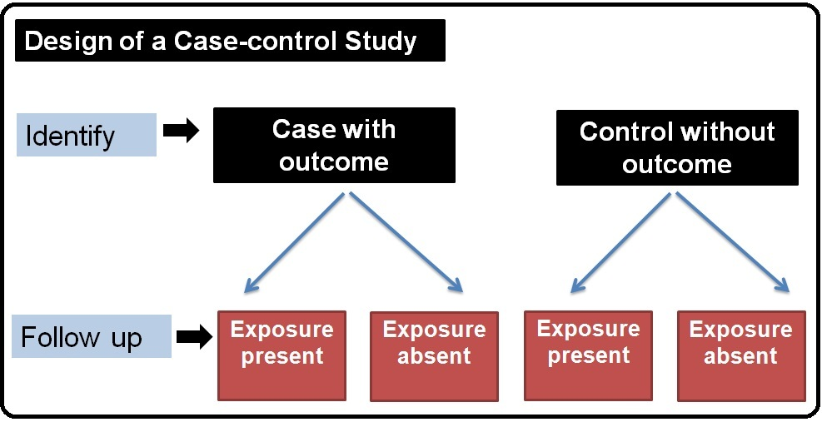

Slide 9
3 distinct features
1. Both exposure and out come has occurred before the start of the study.
2.The study proceeds backwards from effect to cause.
3. It uses a control group or comparison group to support or refute or interference.

Slide 10
What is odds ratio?
In case-control study design to identify the odds ratio at first we need to;
classify persons on the basis of infection status
compare odds of exposed to suspected causal agent between cases and control subjects
An odds ratio is another measure of association which quantifies the relationship between an exposure and health outcome from a comparative study. It is sometimes called the cross-product ratio. The odds ratio is calculated as:
ad
Odds ratio =-------------------------
bc

Slide 11
Such two-by-two table is often useful to find out the odds:
Groups | Case | Non-case | Total
Exposed | a | b | a+b
Unexposed | c | d | c+d
Here,
a = number of persons with disease and with exposure
b = number of persons without disease, but with exposure
c = number of persons with disease, but without exposure
d = number of persons without disease and without exposure
a + c = total number of persons with disease (“cases”)
b + d = total number of persons without disease (“controls”)

Slide 12
How to find odds ratio?
Example: Several college students presented with GI related symptoms thought to have been associated with food served in the cafeteria.
Hypothesis: contaminated salad was the source of infection
Exposure status | Cases | Controls
Ate salad | 12 (a) | 4 (b) | 12×14 OR= 4×6
Did not eat salad | 6 (c) | 14 (d) | OR= 7.0

Slide 13
Advantages
Good for studying rare conditions or diseases
Less time needed to conduct the study because the condition or disease has already occurred.
Lets you simultaneously look at multiple risk factors.
Useful as initial studies to establish an association
Can answer questions that could not be answered through other study designs .

Slide 14
Disadvantages
Retrospective studies have more problems with data quality because they rely on memory and people with a condition will be more motivated to recall risk factors (also called recall bias).
Not good for evaluating diagnostic tests because it’s already clear that the cases have the condition and the controls do not.
It can be difficult to find a suitable control group

Slide 15
Cohort Study
In epidemiology cohort is defined as a group of people who shares a common characteristics or experience within a defined time period. Example, birth cohort, marriage cohort, and exposure cohort.
In a cohort study we records whether each study participant is exposed or not, and then tracks the participants to see if they develop the disease of interest.
After a period of time, the investigator compares the disease rate in the exposed group with the disease rate in the unexposed group.
The unexposed group serves as the comparison group, providing an estimate of the baseline or expected amount of disease occurrence in the community. If the disease rate is substantively different in the exposed group compared to the unexposed group, the exposure is said to be associated with illness.

Slide 16
The length of follow-up varies considerably. In an attempt to respond quickly to a public health concern such as an outbreak, public health departments tend to conduct relatively brief studies.
These studies are sometimes called follow-up or prospective cohort studies, because participants are enrolled as the study begins and are then followed prospectively over time to identify occurrence of the outcomes of interest.
An alternative type of cohort study is a retrospective cohort study. In this type of study both the exposure and the outcomes have already occurred. Just as in a prospective cohort study, the investigator calculates and compares rates of disease in the exposed and unexposed groups.

Slide 17
Cohort study

Slide 18
Distinguished features of cohort study
The cohort are identified prior to the appearance of the disease under investigation.
The study group so identified are observed over a period of time to determine the frequency of disease among them.
The study proceed forward from cause to effect.

Slide 20
How to find relative risk?
Example of retrospective cohort study design:
Of 72 persons who attended in a birthday party, 43 became ill within several hours.
Hypothesis: contaminated vanilla ice cream was the source of infection.

Slide 21
Exposure status | N | Became ill | Not became ill
Ate ice cream | 54 | 43 | 11
Did not eat ice cream | 18 | 3 | 15
Exposure status | N | Became ill | Attack rate | Relative Risk
Ate ice cream | 54 | 43 | 79.6% | 4.9
Did not eat ice cream | 18 | 3 | 16.67%

Slide 22
Advantages of cohort study
Incidence can be calculated.
Several possible outcome related to exposure can be studied.
It provide a direct estimate of relative risk.
Since comparison group are formed before disease develops, certain forms of bias can be minimized like misclassification of individuals into exposed and non- exposed groups.

Slide 23
Disadvantages of cohort study
It involves a large number of people.
Unsuitable for investigation uncommon disease or diseases with low incidence in the population.
It takes long time to complete study.
Some administrative problems such as loss of experiment staffs , loss of funding and extensive record keeping are inevitable.
Study is expensive.
Study itself may alter peoples behavior.
The study has drop out or attrition problem.

Slide 24
Case Control Vs Cohort
Case control study | Cohort study
1. Test whether the suspected cause occurs more frequently among the cases than control. | 1. Test whether the disease occurs more frequently in those exposed than in those not similarly exposed.
2. Exposure measured after development of disease. | 2. Exposure measured before development of disease.
3. Risk or incidence can not be measured directly. | 3. Risk or incidence of disease measured directly.
4. Start with disease. | 4. Start with people exposed to suspected cause.
5. Involves fewer number of subjects. | 5. Involves larger number of subjects.
7. Suitable for study of rare disease. | 7.Inappropriate when disease or exposure under investigation is rare.
8. Yield relatively quick result. | 8. Long follow up required often need , delayed results.
9. Relatively inexpensive. | 9. Expensive.

Slide 25
Thank You

