Slide 1
Lecture-5: Symmetric(Even) and Anti symmetric(Odd) Signal
Symmetric (Even) Signal: A real-valued signal x(n) is called symmetric (even) if,
x(-n)= x(n)
Examples: x(1)=x(-1), x(2)=x(-2)
Antisymmetric (odd) Signal: A signal x(n) is called antisymmetric (odd) if,
x(n)= -x(-n) x(-n)= -x(n)
Examples: x(-1)= -x(1), x(-2)= -x(2)

Slide 2
Block Diagram Representation of Discrete-Time Systems
An Adder: It performs the addition of two signal sequences to form another sequence.
A constant multiplier:
X₁(n)
Y(n)= X₁(n) + X₂(n)
X₂(n)
X
x(n) a y(n)= ax(n)

Slide 3
A Signal Multiplier: This is the multiplication of two signals sequences to form another sequence which is denoted as y(n) in the figure:
A Unit Delay Element: It simply delays the signal passing through the system by one sample.
X(n) y(n)=X(n-1)
If the input signal is x(n), then the output is x(n-1)
X₁(n) Y(n)= X₁(n) X₂(n)
X
X₂(n)
Z⁻¹

Slide 4
A Unit Advance Element: Moves the input x(n) ahead by one sample in time to yield x(n+1).
X(n) y(n)=X(n+1)
Z

Slide 5
Problems
Example-2.2.3: Using the basic building blocks sketch the block diagram representation of the discrete-time system described by the input-output relation.
$y\left(n\right)=\frac{1}{4} y\left(n−1\right)+\frac{1}{2} x\left(n\right)+\frac{1}{2}x(n−1)$
Where, x(n) is the input and y(n) is the output of the system.

Slide 6
Classification of Discrete-Time System
Static versus Dynamic system: A discrete-time system is called static or memory less if its output at any instant n depends at most on the input sample at the same time, but not on past or future samples of the input. In any other case, the system is said to be dynamic or to have memory.
Examples: y(n)= x(n)
y(0)= x(0) Static System
y(-1)= x(-1)
Examples: y(n)= x(n-1) Dynamic System
y(0)= x(-1)

Slide 7
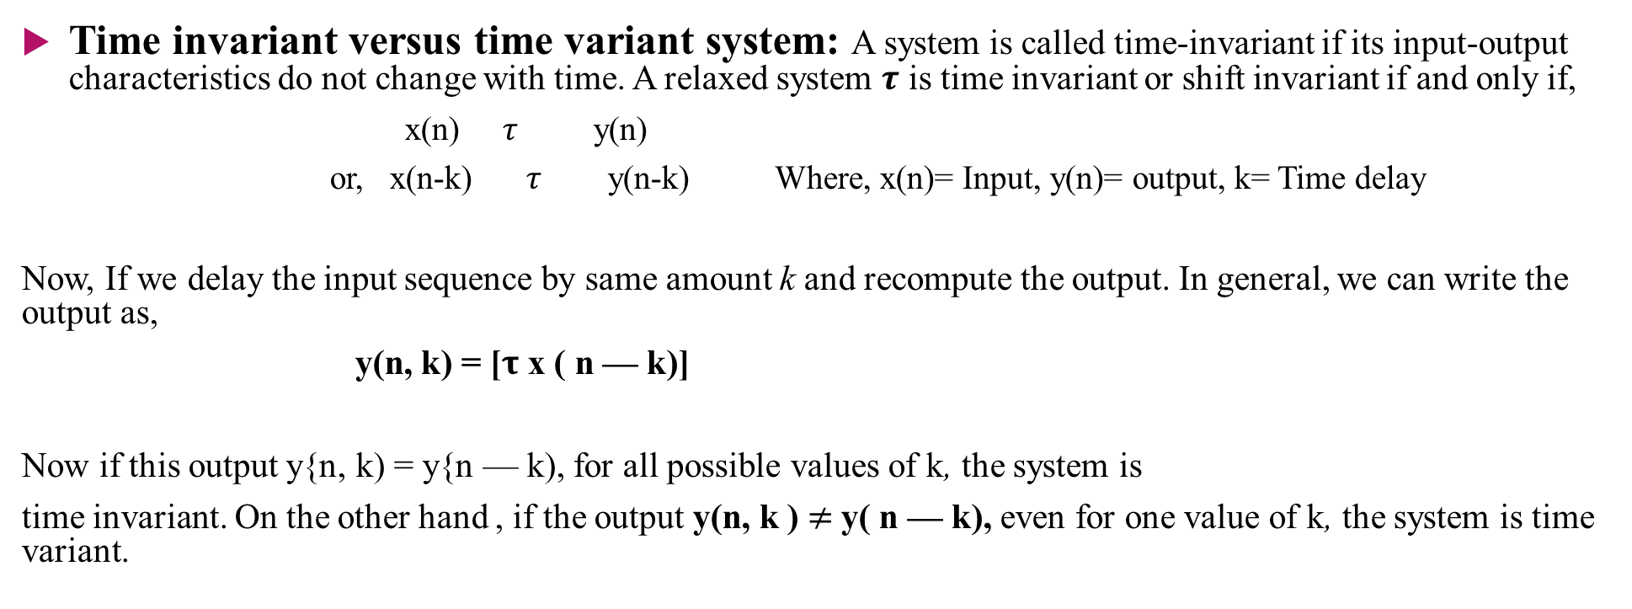
Time invariant versus time variant system: A system is called time-invariant if its input-output characteristics do not change with time. A relaxed system $τ$ is time invariant or shift invariant if and only if,
x(n) $τ$ y(n)
or, x(n-k) $τ$ y(n-k) Where, x(n)= Input, y(n)= output, k= Time delay
Now, If we delay the input sequence by same amount k and recompute the output. In general, we can write the output as,
y(n, k) = [$τ$ x ( n — k)]
Now if this output y{n, k) = y{n — k), for all possible values of k, the system is
time invariant. On the other hand , if the output y(n, k ) $≠$y( n — k), even for one value of k, the system is time variant.

Slide 8
Problems
Examples: Determine if the following systems are time-invariant or time-variant,
(a) y(n)= x(n)-x(n-1)
(b) y(n)= n x(n)
(c) y(n)= x(-n)

Slide 9

Linear Versus Non-linear System: A relaxed $τ$ system is linear if and only if
$τ$ [a₁x₁(n) + a₂x₂(n)] = a₁$τ$[x₁(n) ] + a₂ $τ$ [x₂(n)]
for any arbitrary input sequences x₁(n) and x₂(n), and any arbitrary constants a₁ and a₂ . Otherwise it is non-linear system.

Slide 10
Problems
Example-2.2.5: Determine if the systems described by the following input-output equations are linear or nonlinear.
(a) y(n)= nx(n)
(b) y(n)= x(n²)
(c) y(n)= x²(n)
(d) y(n)= Ax(n)+B
(e) y(n)= $e^{x(n)}$

Slide 11
Causal Versus Non-causal systems: A system is said to be causal if the output of the system at any time n depends on present and past inputs, but does not depend on future inputs. On the other hand, the system whose output depends on its future input, then it is called non-causal system.
y(n)= x(n) y(n)= x(n+1)
y(0)= x(0) y(0)= x(1)
y(-1)= x(-1) Causal System y(n)= x(-n) Non-causal System
y(n)= x(n-1) y(-1)= x(1)
y(0)= x(-1)

Slide 12
Stable Versus Unstable System: An arbitrary relaxed system is said to be bounded input-bounded output stable if and only if every bounded input produces a bounded output. If for some bounded input sequence x(n), the output is bounded (finite), then the system is called stable system and if the output is unbounded (infinite), the system is unstable system.

Slide 13
Problems
Example-2.2.7: Consider the non-linear system described by the input-output equation,
y(n)= y²(n-1)+ x(n)
As an input sequence we select the bounded signal,
x(n)= C$δ\left(n\right)$, where C is a constant.
Determine the system is stable or unstable.

