Slide 1
Internet Protocols
and Formats
CSE334
Md. Ferdouse Ahmed Foysal
Daffodil International University

Slide 2
Hypertext Transfer Protocol (HTTP)
The Hypertext Transfer Protocol (HTTP) was one of the first World Wide Web technologies. It is used by the global information initiative since 1990.
It is an application-level protocol for distributed systems. The HTTP protocol follows the request/response paradigm, like many other protocols in the networking area, but it allows more than just simple data retrieval. A client sends a request to the server, followed by a message containing request modifiers, client information, and possible body content. The server responds with a status line containing the protocol version and an status code, followed by the server information, meta information, and possible entity-body content.

Slide 3
HTTP methods
An HTTP request consists of the HTTP method (GET, HEAD, HTTP methods POST, etc.) , the Uniform Resource Identifier (URI), the protocol version and an optional supplemental information. The method is executed on the object named by the URI. In the simplest ease, a single connection is enough to establish the communication. The connection is established by the client prior to the request and terminated by the server after the response is transmitted.
An HTTP response consists of a status line, which indicates success or failure of the request, a description of the information in the response (called meta information) and the actual information request.

Slide 4
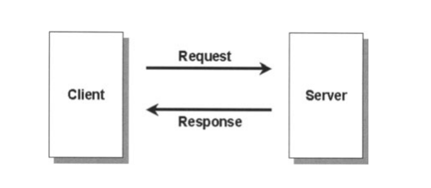
HTTP Connection
In the client -server communication chain intermediaries can be present. Usual intermediaries are gateways, tunnels, or proxies.
A proxy is an agent for forwarding a client's request. The proxy rewrites parts of the received message and forwards it to the server.
A gateway acts as a receiving part in the request chain. If necessary, the gateway translates the request to a protocol, the receiving server can understand.
Tunnels are usually used when the communication takes place across a firewall. The tunnel acts like a relay between connections and doesn't change the message.

Slide 5
Client-Server Communication Chain
In order to identify a network resource, HTTP uses a Uniform Resource Identifier (URI). The resource is identified by its name, location, or other characteristics.

Slide 6
Hypertext Markup Language (HTML)
To publish documents over the Web, which have to be processed by different browsers, a standardized language is needed. HTML is an universal representation which can be used by any Web browser.
Such a language is the Hypertext Markup Language (HTML). HTML first became popular during the 1990s with the explosive growth of the Web. The first definitive version however was HTML 2.0 in 1995. HTML 3.0 proposed many upgrades of several features but was never implemented because of the missing consensus in standards discussions. HTML 4 includes the support of style sheets, scripting, frames, embedding objects, and some of the browser proprietary extensions. HTML not only provides the means to build documents with elements known from other word processors. It also enables authors to retrieve online information via hypertext links, to design forms for conducting transactions with remote services, and to include different kinds of multi media information into documents.

Slide 7
Tags
Thus, HTML can specify the logical organization in a document. It is not intended to act like a WYSIWIG word processor because HTML has to be processed by many different Web browsers.
HTML instructions are called tags. Tags are surrounded by angle Tags brackets (e.g. <BODY>). Tags can be differentiated in "Empty Tags", "Opening Tags" and "Closing Tags".
"Closing Tags" contain a leading slash character. Most tags mark blocks of a document for a special purpose. The above <BODY> tag for example marks the beginning of the body section of a HTML document. The tag </BODY> marks the end of the body section of that document. Elements (like <HR» do not affect a block of a HTML document and have no "Closing Tag". <HR> for example would draw a line across the page.

Slide 8
Tag attributes
Tags can contain attributes within their brackets. Attributes are Tag attributes used to influence the tag behavior by passing parameters to the interpreter handling the tag. Attributes are placed between the tag name and the right angle bracket of the tag. Tag name and attribute name are separated by a blank. The attribute name and its value are separated by a "=" character.

Slide 9
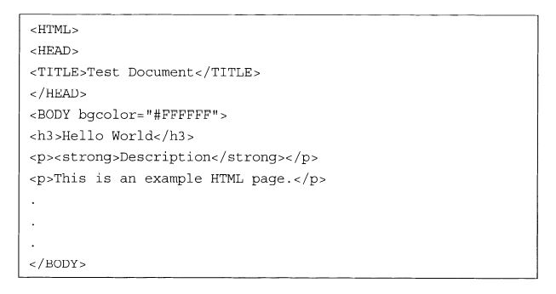
HTML Document Tags
The HTML document is structured into two parts, the HTML HEAD and the HTML BODY. Both parts are contained within HTML tags. The HEAD contains general information about the document, like its title. The BODY contains information, which will be displayed in the browser. A typical HTML document may look like this:

Slide 10
HTML BODY
The BODY contains the content of the document. This can be ASCII text or so me tags for structuring the document. Some examples for structure elements are the headline tags <Hl> to <H6>, which provide different levels of headlines, the <p> tag to start a new paragraph, the <HR> tag to draw a horizontal line, etc.

Slide 11
HTML HEAD
The HTML HEAD contains meta information about the document, like the author name, the document name etc. One element in the document header is the title of the document. Another important element is <LINK>, which can be used for interconnecting documents.

Slide 12
Extensible Markup Language (XML)
The Extensible Markup Language (XML) is a standard format for interchanging structured documents. It is a subset of the Standard Generalized Markup Language (SGML), which is defined in ISO 8879.

Slide 13
User Defined Tags
Unlike HTML, XML enables the creation of user defined tags. Traditional HTML tags are extended by user defined elements. Like in HTML, the start and end of each logical block is marked by the appropriate tags. XML was published as an open specification by the World Wide Web Consortium (W3C).

Slide 14
Document Type Definitions (DTD)
Document Type Definitions (DTDs) are an important element of XML. They define the role of text elements in a formal model. The DTD can be used to check, if a XML document contains valid tags and if the tags occur in the right place within the document. It also specifies the attributes that belong to an element and the valid values of these attributes.

Slide 15
Properties of "valid“ XML documents
There are some basic rules to determine if a XML document can be called "valid":
The XML document contains a header information, which consists of the XML version, the encoding information, and an information whether other files are referenced.
The document contains a DTD with the markup declarations in the document itself or as a link to an external DTD document.
The XML document contains a root element with the same name as the DTD name.
If only the last point is present, the document still can be called "well formed", which means that the structure of the document still behaves according the XML rules.

Slide 16
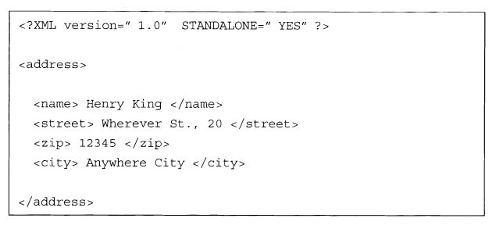
XML Example
A "valid" XML document may look like this:

Slide 17
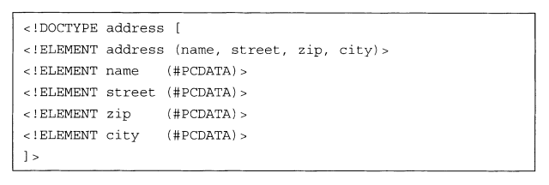
DTD Example
The corresponding DTD looks like this:

Slide 18
Acknowledgements
These slides contain material developed and copyright by:
Pervasive Computing Handbook - Uwe Hansmann

