Slide 1
Chapter 6
The Political Environment:
A Critical Concern
Farhana Noor
Assistant Professor
Daffodil International University

Slide 2
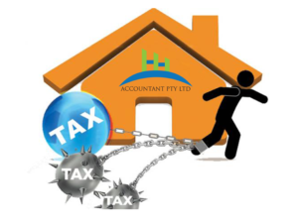
Political Risks of Global Business
A.Confiscation– the seizing of a company’s assets without payment
B.Expropriation– where the government seizes an investment but makes some reimbursement for the assets.
C.Domestication– when host countries gradually cause the transfer of foreign investments to national control and ownership through a series of government decrees
Mandating local ownership
Greater national involvement in a company’s management

Slide 3
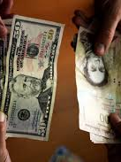
D.Economic Risks
1.Exchange controls:Exchange controls are government-imposed controls and restrictions on private transactions conducted in foreign currency. The government's major aim of exchange control is to manage or prevent an adverse balance of payments position on national accounts.
Example: Banning the use of foreign currency within the country; banning locals from possessing foreign currency; restricting currency exchange to government-approved exchangers; fixed exchange rates.

Slide 4
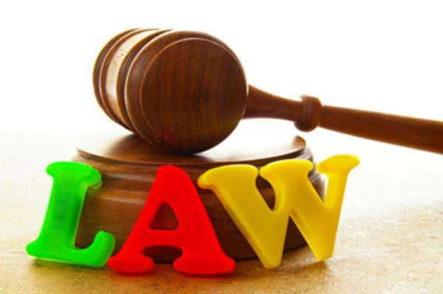
Economic Risks
2.Local-Content Laws:- In addition to restricting imports of essential supplies to force local purchase, countries often require a portion of any product sold within the country to have local content, that is, to contain locally made parts.

Slide 5
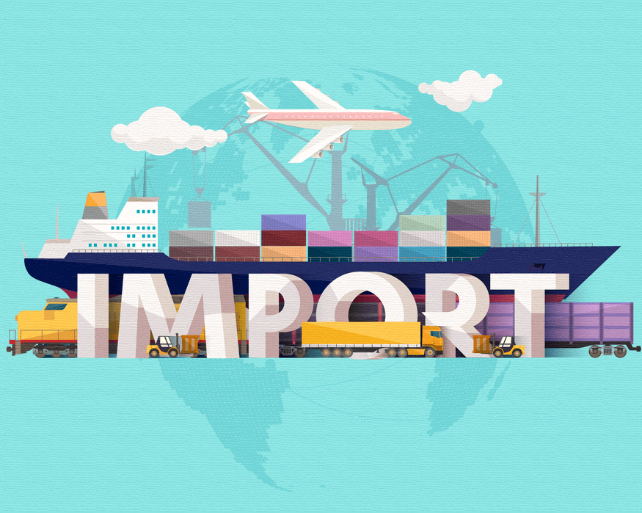
Economic Risks
3.Import Restrictions:- Selective restrictions on the import of consumer products, raw materials, machines, and spare parts are fairly common strategies to force foreign industry to purchase more supplies within the host country and thereby create markets for local industry.

Slide 6
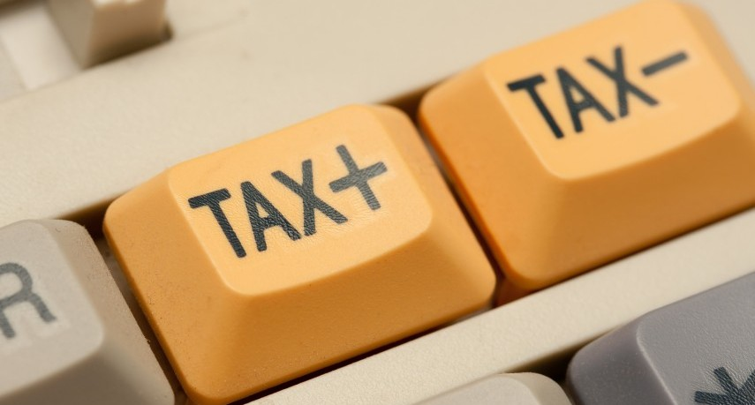
Economic Risks
4.Tax Controls :- Taxes must be classified as a political risk when used as a means of controlling foreign investments.

Slide 7
Economic Risks
5.Price Controls:- Essential products that command considerable public interest, such as pharmacy food, gasoline, and cars, are often subjected to price controls. Such controls applied during inflationary periods can be used to control the cost of living. They may also be used to force foreign companies to sell equity to local interests.

Slide 8
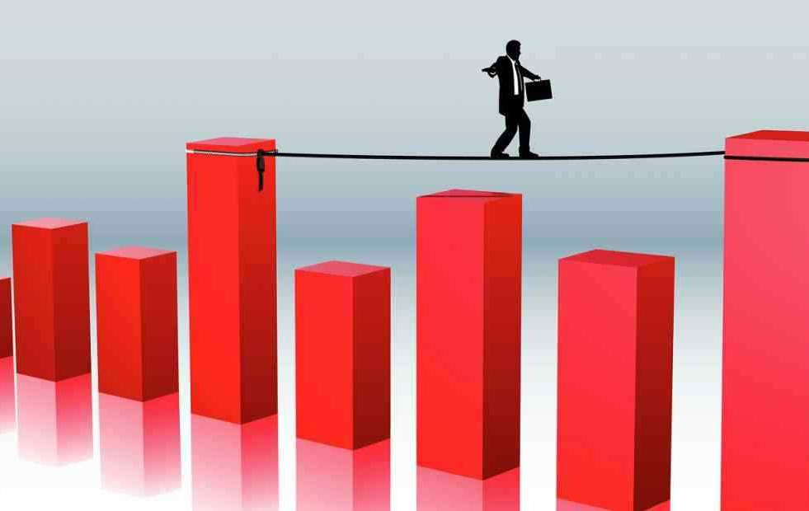
Economic Risks
6.Labor Problems:- Labor unions with strong government support may use it effectively to obtain special concessions from businesses. Layoffs may be forbidden, profits may have to be shared, and an extraordinary number of services may have to be provided.

Slide 9
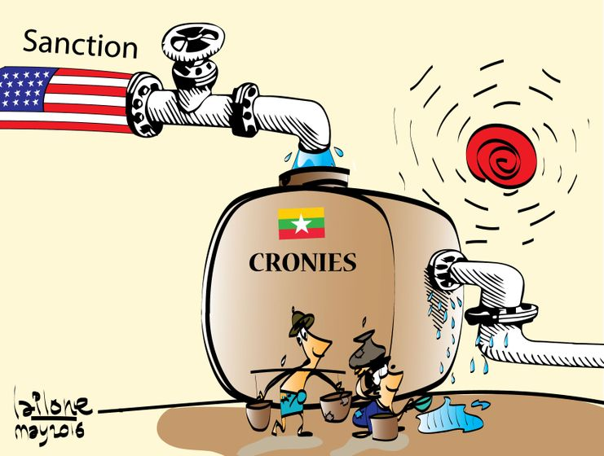
E.Political Sanctions
Sanctions, in law and legal definition, are penalties or other means of enforcement used to provide incentives for obedience with the law, or with rules and regulations. The sanctions can be either comprehensive or selective, using the blocking of assets and trade restrictions to accomplish foreign policy and national security goals.
United States’ long-term boycott of trade with Cuba and Iran.
Chinese recently signed and agreement with Iran.

Slide 10
F.Political and Social Activists (PSAs) and Nongovernmental Organizations
Those who seek to bring about peaceful change .
Those who resort to violence and terrorism to effect change.
Some of the most effective and best-known PSAs.
Worldwide boycott of Nestlé.
Free Burma Campaign (FBC) .
College campuses boycott of Pepsi drinks and PepsiCo-owned Pizza Hut and Taco Bell stores.

Slide 11
G.Violence Terrorism and War
Terrorist attacks victimized thousands of people around the world.
These attacks affect business Multinationals are targeted to embarrass government and its relationship with firms generate funds by kidnapping executives inflict terror \ within a country

Slide 12
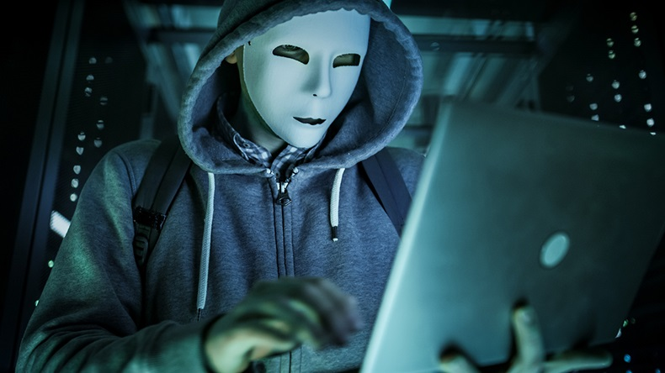
H.Cyberterrorism and Cybercrime
Cyberterrorism is the merging of cyberspace and terrorism. It refers to unlawful attacks and threats of attacks against computers, networks and the information stored therein when done to intimidate or coerce a government or its people in furtherance of political or social objectives.
Examples are hacking into computer systems, introducing viruses to vulnerable networks, web site defacing, Denial-of-service attacks, or terroristic threats made via electronic communication.
The main difference between cybercrime and cyber terrorism lies in the objective of the attack. Cybercriminals are predominantly out to make money, while cyber terrorists may have a range of motives and will often seek to have a destructive impact, particularly on critical infrastructure.

Slide 13
Assessing Political Vulnerability
-A marketer has no absolute guidelines to determine whether a company and its products will be subject to political attention.
-Countries seeking investments in high-priority industries may well excuse companies from- • taxes • customs duties • quotas • exchange controls • other weaknesses to investment.

Slide 14
A. Politically Sensitive Products and Issues
Products that have or are perceived to have an effect on the
environment
exchange rates
national and economic security
welfare of people
particularly children health

Slide 15
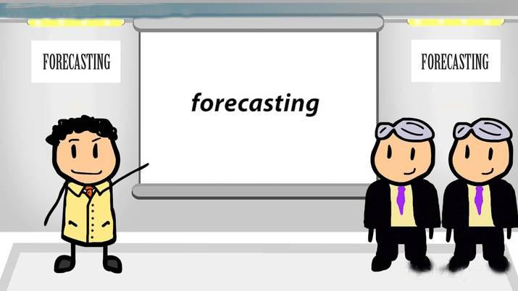
B.Forecasting Political Risk
The task of political risk forecasting at the country level are "to establish basic measures of reference, identify current trends and any potential break in the trends, and delimit the areas of concern that may harbor the seeds of potential threats to the investment.
Political risk may also result from events outside of government controls such as war, revolution, terrorism, labor strikes, and extortion. Political risk can adversely affect all aspects of the international business from the right to export or import goods to the right to own or operate a business.

Slide 16
Lessening Political Vulnerability
The simplest way to manage political risks is to avoid investing in a country ranked high on such risks. Where investment has already been made, plants may be wound up or transferred to some other country which is considered to be relatively safe.
Joint ventures
Expanding the investment base
Licensing
Planned domestication
Political payoffs

Slide 17
Joint ventures
Typically less susceptible to political harassment, joint ventures can be with locals or other third-country multinational companies; in both cases, a company’s financial exposure is limited.
A joint venture with locals helps minimize anti-MNC feelings, and a joint venture with another MNC adds the additional bargaining power of a third country.

Slide 18
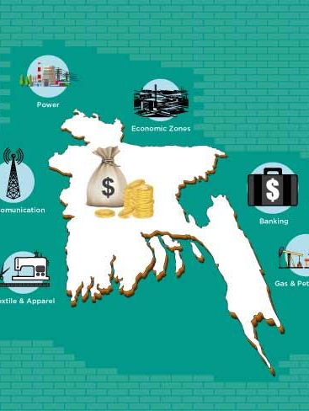
Expanding the investment base
Including several investors and banks in financing an investment in the host country is another strategy. This approach has the advantage of engaging the power of the banks whenever any kind of government takeover or harassment is threatened.

Slide 19
Licensing
Including several investors and banks in financing an investment in the host country is another strategy. This approach has the advantage of engaging the power of the banks whenever any kind of government takeover or harassment is threatened.

Slide 20
Planned domestication
The strategies just discussed can be effective in forestalling or minimizing the effect of a total takeover. However, in those cases where a host country in demanding Local participation, the most effective long-range solution is planned phasing out, that is planned domestication. Planned domestication essence, a gradual process of participating with nationals in all phases of company operation.

Slide 21
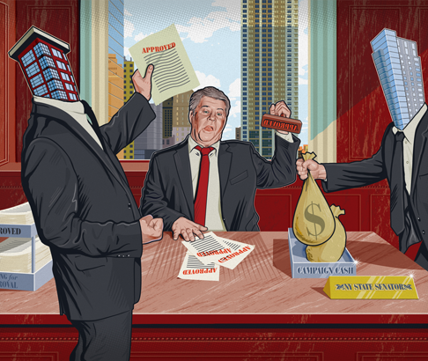
Political Payoffs
An attempt to lessen political risks by paying those in power to intervene on behalf of the multinational company.
Not allowing an international student (non-citizen) to work in a government or military position.

Slide 22
The different ways in which Political Risk can be managed are as follows:
1) Avoiding Investment:
The simplest way to manage political risks is to avoid investing in a country ranked high on such risks. Where investment has already been made, plants may be wound up or transferred to some other country which is considered to be relatively safe.
2) Adaptation:
Another way of managing political risk is adaptation. Adaptation means incorporating risk into business strategies. MNCs incorporate risk by means of the following three strategies: local equity and debt, development assistance, and insurance.
i) Local Equity and Debt:
This involves financing subsidiaries with the help of local firms, trade unions, financial institutions, and government.

Slide 23
ii) Developmental Assistance:
Offering development assistance allows an international business to assist the host country in improving its quality of life.
iii) Insurance:
This is the last means of adaptation. Companies buy insurance against the potential effects of political risk.
3) Threat:
Political risk can also be managed by trying to prove to the host country that it cannot do without the activities of the firm. This may be done by trying to control raw materials, technology, and distribution channels in the host country.

Slide 24
4) Lobbying:
Influencing local politics through lobbying is another way of managing political risks. Lobbying is the policy of hiring people to represent a firm’s business interests as also its views on local political matters.
5) Terrorism Consultants:
To manage terrorism risk, MNCs hire consultants in counterterrorism to train employees to cope with the threat of terrorism.
6) Invaluable Status: Achieving a status of indispensability is an effective strategy for firms that have exclusive access to high technology or specific products.
7) Local Borrowing:
Financing local operations from indigenous banks and maintaining a high level of local accounts payable maximize the negative effect on the local economy if adverse political actions were taken.
8) Minimizing Fixed Investments:
Political risk, of course, is always related to the amount of capital at risk. Given equal political risk, an alternative with comparably lower exposed capital amounts is preferable.

