Slide 1
Lecture-9: Frequency Analysis of Signals and Systems
Fourier Transform can convert time domain signal into frequency domain signal.
Mathematical Expression of coefficient of Fourier transform:
The periodic signal which is a combination of harmonically related complex exponentials,
$x\left(t\right)= \sum_{k=−∞}^{∞}{\text{C}\text{k} e^{j2πk\text{F}\text{o}\text{t}}}$ where, $\text{C}\text{k}$= Fourier Coefficient
Now, $\int_{\text{t}\text{o}}^{\text{t}\text{o}\text{ +}\text{Tp} }{x\left(t\right) }e^{−j2π\text{l}\text{F}\text{o}\text{t}}$dt = $\int_{\text{t}\text{o}}^{\text{t}\text{o}\text{ +}\text{Tp} }{x\left(t\right) }e^{−j2π\text{l}\text{F}\text{o}\text{t}}$ ($\sum_{k=−∞}^{∞}{\text{C}\text{k} e^{j2πk\text{F}\text{o}\text{t}}}$)dt
$\sum_{k=−∞}^{∞}{\text{C}\text{k}\int_{\text{t}\text{o}}^{\text{t}\text{o}\text{ +}\text{Tp} }{ }e^{j2π\text{F}\text{o}\text{(}\text{k}\text{−}\text{l}\text{)}\text{t}}}$dt = $\sum_{k=−∞}^{∞}{\text{C}\text{k} [}$ $\frac{e^{j2π\text{F}\text{o}\text{(}\text{k}\text{−}\text{l}\text{)}\text{t}}}{j2π\text{F}\text{o}\text{(}\text{k}\text{−}\text{l}\text{)}}$ $]_{\text{t}\text{o}}^{\text{t}\text{o}\text{ +}\text{Tp}}$
So, finally $\text{C}\text{k}$= $\frac{1}{\text{Tp}}$ $\int_{\text{t}\text{o}}^{\text{t}\text{o}\text{ +}\text{Tp} }{x\left(t\right) }e^{−j2π\text{k}\text{F}\text{o}\text{t}}$ where, $\text{T}\text{p}$= $\frac{1}{\text{F}\text{o}}$

Slide 2
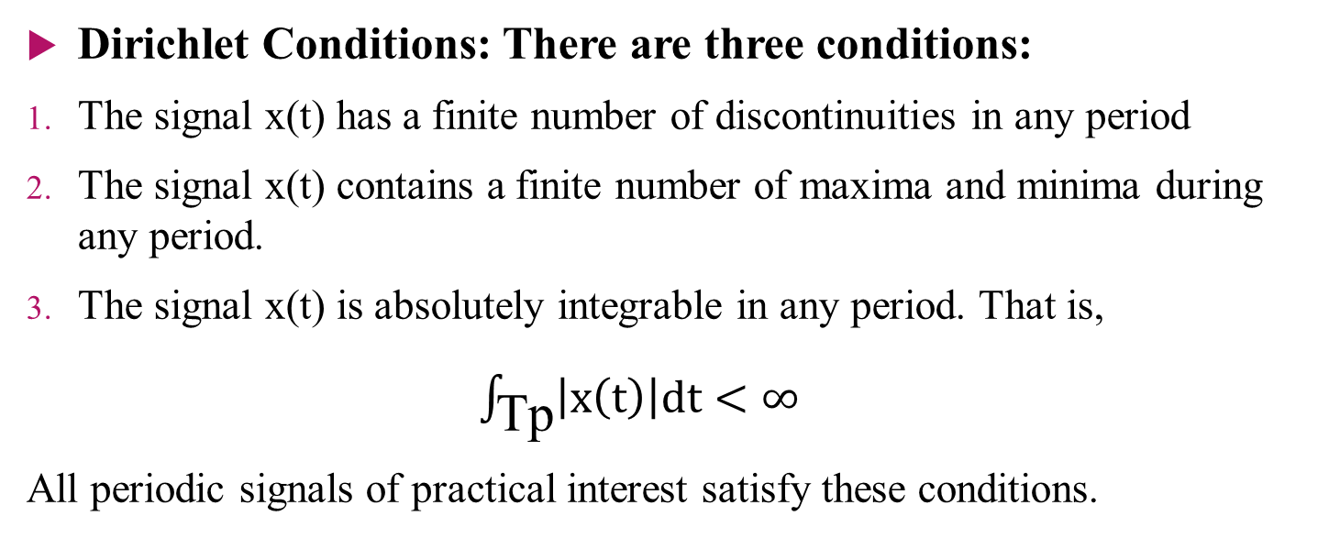
Dirichlet Conditions
Dirichlet Conditions: There are three conditions:
The signal x(t) has a finite number of discontinuities in any period
The signal x(t) contains a finite number of maxima and minima during any period.
The signal x(t) is absolutely integrable in any period. That is,
$\int_{\text{Tp}}{\left|x\left(t\right)\right|dt<∞}$
All periodic signals of practical interest satisfy these conditions.

Slide 3
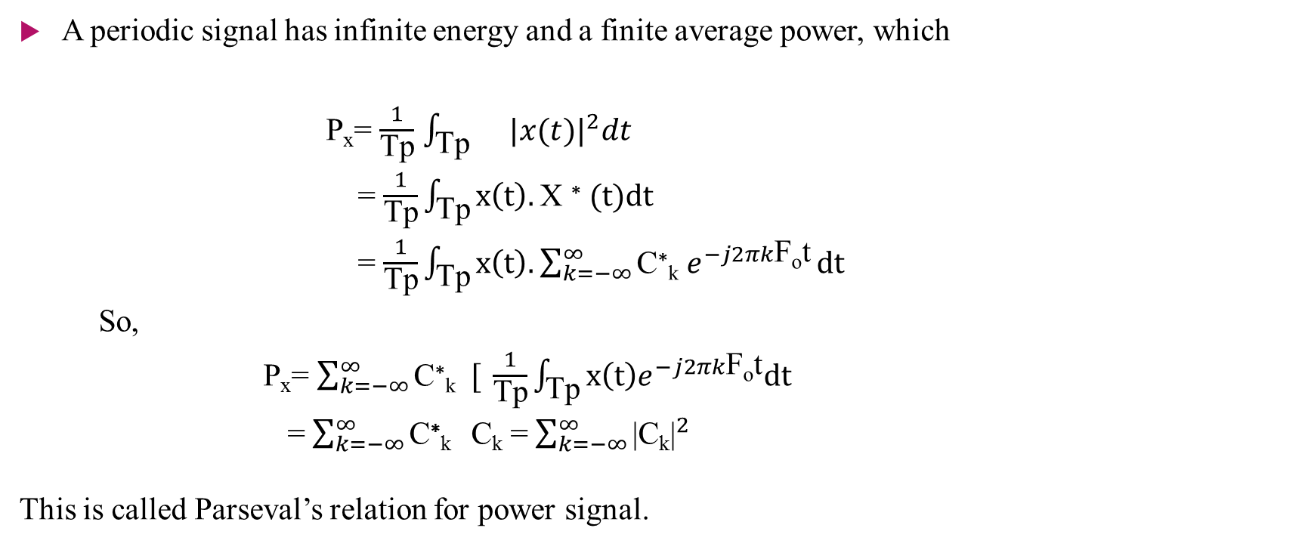
Power Density Spectrum of Periodic Signals
A periodic signal has infinite energy and a finite average power, which
P_{x}= $\frac{1}{\text{Tp}}$ $\int_{\text{Tp}}{}{|x(t)|}^{2}dt$
= $\frac{1}{\text{Tp}}\int_{\text{Tp}}{x\left(t\right).\text{X} \text{∗} (t)dt}$
= $\frac{1}{\text{Tp}}\int_{\text{Tp}}{x\left(t\right).\sum_{k=−∞}^{∞}{\text{C}\text{∗}\text{k} e^{−j2πk\text{F}\text{o}\text{t}}}dt}$
So,
P_{x}= $\sum_{k=−∞}^{∞}{\text{C}\text{∗}\text{k} [ }\frac{1}{\text{Tp}}\int_{\text{Tp}}{x\left(t\right)e^{−j2πk\text{F}\text{o}\text{t}}dt}$
= $\sum_{k=−∞}^{∞}{\text{C}\text{∗}\text{k} }\text{C}\text{k}$ = $\sum_{k=−∞}^{∞}{{\text{|}\text{C}\text{k}\text{|}}^{2}}$
This is called Parseval’s relation for power signal.

Slide 4
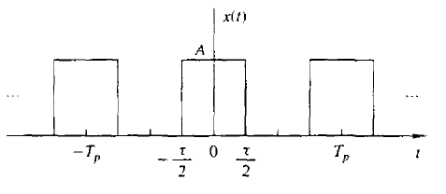
Problems
Example-4.1.1: Determine the Fourier series and the power density spectrum of the rectangular pulse train signal illustrated in the following figure:
Figure: Continuous-time period train of rectangular pulses

