Slide 1
Version Control with Git
Fahim Faisal
Lecturer, Dept. of CSE
Daffodil International University

Slide 2
Problems Working Alone
Ever done one of the following?
Had code that worked, made a bunch of changes and saved it, which broke the code, and now you just want the working version back…
Accidentally deleted a critical file, hundreds of lines of code gone…
Somehow messed up the structure/contents of your code base, and want to just “undo” the crazy action you just did
Hard drive crash!!!! Everything’s gone, the day before deadline.
Possible options:
Save as (MyClass-v1.java)
Ugh. Just ugh. And now a single line change results in duplicating the entire file…

Slide 3
Problems Working in Teams
Whose computer stores the "official" copy of the project?
Can we store the project files in a neutral "official" location?
Will we be able to read/write each other's changes?
Do we have the right file permissions?
Lets just email changed files back and forth! Yay!
What happens if we both try to edit the same file?
Bill just overwrote a file I worked on for 6 hours!
What happens if we make a mistake and corrupt an important file?
Is there a way to keep backups of our project files?
How do I know what code each teammate is working on?

Slide 4
Solution: Version Control System
Version Control System: Software that tracks and manages changes to a set of files and resources.
You use version control all the time
Built into word processors/spreadsheets/presentation software
The magical “undo” button takes you back to “the version before my last action”
Wiki’s
Wiki’s are all about version control, managing updates, and allowing rollbacks to previous versions

Slide 5
Software Version Control
Many version control systems are designed and used especially for software engineering projects
Examples: CVS, Subversion (SVN), Git, Monotone, BitKeeper, Perforce
helps teams to work together on code projects
a shared copy of all code files that all users can access
keeps current versions of all files, and backups of past versions
can see what files others have modified and view the changes
manages conflicts when multiple users modify the same file
not particular to source code; can be used for papers, photos, etc.
but often works best with plain text/code files

Slide 6
Repositories
Repository (aka “repo”): a location storing a copy of all files.
you don't edit files directly in the repo;
you edit a local working copy or “working tree”
then you commit your edited files into the repo
There may be only one repository that all users share (CVS, Subversion)
Or each user could also have their own copy of the repository (Git, Mercurial)
Files in your working directory must be added to the repo in order to be tracked.

Slide 7
What to put in a Repo?
Everything needed to create your project:
Source code (Examples: .java, .c, .h, .cpp )
Build files (Makefile, build.xml)
Other resources needed to build your project: icons, text etc.
Things generally NOT put in a repo (these can be easily re-created and just take up space):
Object files (.o)
Executables (.exe)

Slide 8
Repository Location
Can create the repository anywhere
Can be on the same computer that you’re going to work on, which might be ok for a personal project where you just want rollback protection
But, usually you want the repository to be robust:
On a computer that’s up and running 24/7
Everyone always has access to the project
On a computer that has a redundant file system (i.e., RAID)
No more worries about that hard disk crash wiping away your project!
Options:
attu, GitLab, GitHub

Slide 9
Aside: So what is GitHub?
GitHub.com is a site for online storage of Git repositories.
Many open source projects use it, such as the Linux kernel.
You can get free space for open source projects or you can pay for private projects.
Question: Do I have to use GitHub to use Git?
Answer: No!
you can use Git completely locally for your own purposes, or
you could share a repo with users on the same file system (e.g. attu) as long everyone has the needed file permissions.

Slide 10
Git Resources
At the command line: (where <verb> = config, add, commit, etc.)
$ git help <verb>
$ git <verb> --help
$ man git-<verb>
Free on-line book: https://git-scm.com/book/en/v2
Git tutorial: http://schacon.github.com/git/gittutorial.html
Reference page for Git: http://gitref.org/index.html
Git website: http://git-scm.com/
Git for Computer Scientists: http://eagain.net/articles/git-for-computer-scientists/

Slide 11
History of Git
Came out of Linux development community
Linus Torvalds, 2005
Initial goals:
Speed
Support for non-linear development (thousands of parallel branches)
Fully distributed
Able to handle large projects like Linux efficiently
Notes:
Initial goals were to support development of Linux

Slide 12
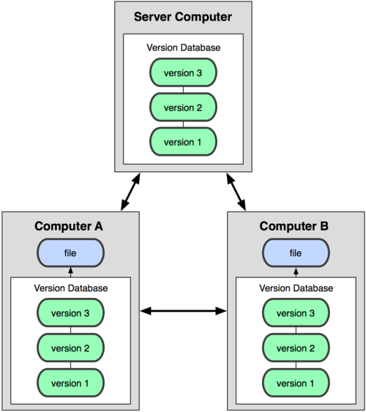
Git uses a distributed model
Distributed Model
Centralized Model
(CVS, Subversion, Perforce)
(Git, Mercurial)
Result: Many operations are local
Notes:
http://git-scm.com/book/en/Getting-Started-About-Version-Control

Slide 13
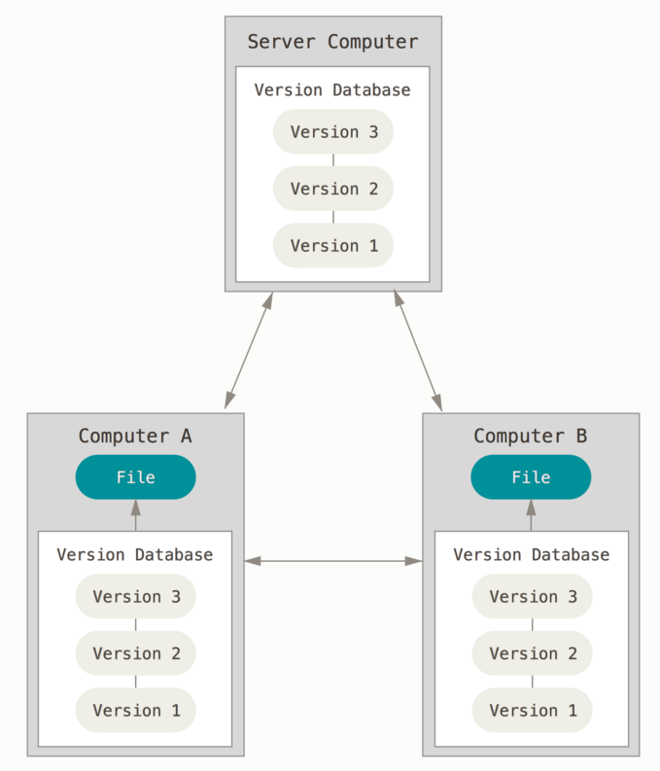
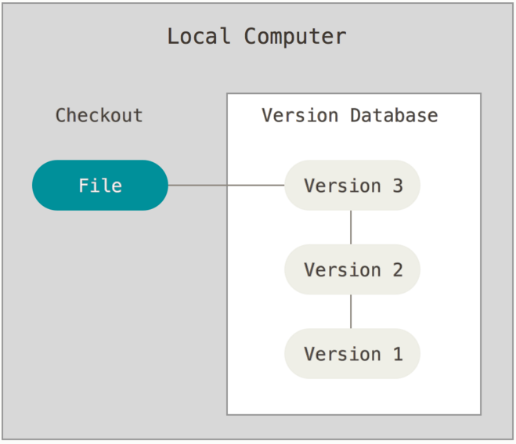
Ways to use Git
Possible Servers:
GitLab
attu
GitHub
Using Git on your own computer, one user
Using Git on multiple computers, multiple users or one user on multiple computers

Slide 14
A Local Git project has three areas
Unmodified/modified Files
Staged Files
Committed Files
Note: working directory sometimes called the “working tree”, staging area sometimes called the “index”.

Slide 15
Git file lifecycle

Slide 16
Basic Workflow
Basic Git workflow:
Modify files in your working directory.
Stage files, adding snapshots of them to your staging area.
Do a commit, which takes the files as they are in the staging area and stores that snapshot permanently to your local Git directory (your local copy of the repo).
Notes:
If a particular version of a file is in your local git directory, it’s considered committed.
If it’s modified but has been added to the staging area, it is staged.
If it was changed since it was checked out but has not been staged, it is modified.

Slide 17
Get ready to use Git!
Set the name and email for Git to use when you commit:
$ git config --global user.name “Bugs Bunny”
$ git config --global user.email bugs@gmail.com
You can call git config –-list to verify these are set.
These will be set globally for all Git projects you work with.
You can set variables on a project-only basis by not using the --global flag.
The latest version of git will also prompt you that push.default is not set, you can make this warning go away with:
$ git config --global push.default simple
You can also set the editor used for writing commit messages: $ git config --global core.editor emacs (it is vim by default)
vim tips: “a” add, “esc” when done adding, “wq:” to save and quit
vim editor: http://www.gentoo.org/doc/en/vi-guide.xml
vim ref card: http://tnerual.eriogerg.free.fr/vimqrc.pdf

Slide 18
Create a local copy of a repo
Two common scenarios: (only do one of these)
To clone an already existing repo to your current directory:
$ git clone <url> [local dir name]
This will create a directory named local dir name, containing a working copy of the files from the repo, and a .git directory which you can ignore (used to hold the staging area and your local repo)
Example: git clone git@gitlab.cs.washington.edu:rea/superTest.git
To create a Git repo in your current directory:
$ git init
This will create a .git directory in your current directory which you can ignore (used to hold the staging area and your local repo).
Then you can commit files in your current directory into the local repo:
$ git add file1.java
$ git commit –m “initial project version”

Slide 19
Git commands
command | description
git clone url [dir] | copy a git repository so you can add to it
git add files | adds file contents to the staging area
git commit | records a snapshot of the staging area
git status | view the status of your files in the working directory and staging area
git diff | shows diff of what is staged and what is modified but unstaged
git help [command] | get help info about a particular command
git pull | fetch from a remote repo and try to merge into the current branch
git push | push your new branches and data to a remote repository
others: init, reset, branch, checkout, merge, log, tag

Slide 20
Adding & Committing files
The first time we ask a file to be tracked, and every time before we commit a file we must add it to the staging area:
$ git add README.txt hello.java
This takes a snapshot of these files at this point in time and adds it to the staging area.
Note: To unstage a change on a file before you have committed it:
$ git reset HEAD filename
To move staged changes into the local repo we commit:
$ git commit –m “Fixing bug #22”
Note: You can edit your most recent commit message (if you have not pushed your commit yet) using: git commit –-amend
Note: These commands are just acting on your local version of repo.
Notes:
Note: To unstage a change on a file before you have committed it:
$ git reset HEAD filename
Note: To unmodify a modified file:
$ git checkout -- filename

Slide 21
Status and Diff
To view the status of your files in the working directory and staging area:
$ git status or
$ git status –s
(-s shows a short one line version)
To see difference between your working directory and the staging area (This shows what is modified but unstaged):
$ git diff
To see difference between the staging area and your local copy of the repo (This shows staged changes): (--staged is synonymous)
$ git diff --cached
Notes:
Git diff HEAD will show diff between working tree and staging area vs. the repo

Slide 22
After editing a file…
$emacs rea.txt
$ git status
# On branch master
# Changes not staged for commit:
# (use "git add <file>..." to update what will be committed)
# (use "git checkout -- <file>..." to discard changes in working directory)
#
# modified: rea.txt
#
no changes added to commit (use "git add" and/or "git commit -a")
$ git status -s
M rea.txt ← Note: M is in second column = “working tree”
$ git diff ← Shows modifications that have not been staged.
diff --git a/rea.txt b/rea.txt
index 66b293d..90b65fd 100644
--- a/rea.txt
+++ b/rea.txt
@@ -1,2 +1,4 @@
Here is rea's file.
+
+One new line added.
$ git diff --cached ← Shows nothing, no modifications have been staged yet.
$

Slide 23
After adding file to staging area…
$ git add rea.txt
$ git status
# On branch master
# Changes to be committed:
# (use "git reset HEAD <file>..." to unstage)
#
# modified: rea.txt
#
$ git status -s
M rea.txt ← Note: M is in first column = “staging area”
$ git diff ← Note: Shows nothing, no modifications that have not been staged.
$ git diff --cached ← Note: Shows staged modifications.
diff --git a/rea.txt b/rea.txt
index 66b293d..90b65fd 100644
--- a/rea.txt
+++ b/rea.txt
@@ -1,2 +1,4 @@
Here is rea's file.
+
+One new line added.

Slide 24
Viewing logs
To see a log of all changes in your local repo:
$ git log or
$ git log --oneline (to show a shorter version)
1677b2d Edited first line of readme
258efa7 Added line to readme
0e52da7 Initial commit
git log -5 (to show only the 5 most recent updates, etc.)
Note: changes will be listed by commitID #, (SHA-1 hash)
Note: changes made to the remote repo before the last time you cloned/pulled from it will also be included here

Slide 25
Pulling and Pushing
Good practice:
Add and Commit your changes to your local repo
Pull from remote repo to get most recent changes (fix conflicts if necessary, then add and commit those changes to your local repo)
Push your changes to the remote repo
To fetch the most recent updates from the remote repo into your local repo, and put them into your working directory:
$ git pull origin master
To push your changes from your local repo to the remote repo:
$ git push origin master
Notes: origin = an alias for the URL you cloned from
master = the remote branch you are pulling from/pushing to, (the local branch you are pulling to/pushing from is your current branch)
Notes:
$ git remote -v
origin https://github.com/rea2000/santalist.git (fetch)
origin https://github.com/rea2000/santalist.git (push)

Slide 26
Avoiding Common Problems
Do not edit the repository (the .git directory) manually. It wasn't designed for modifications by humans.
Try not to make many drastic changes at once. Instead, make multiple commits, each of which has a single logical purpose. This will minimize merge conflicts. This is good coding practice in general.
Always git pull before editing a file. It's easy to forget this. If you forget, you may end up editing an outdated version, which can cause nasty merge conflicts.
Don't forget git push after you have made and committed changes. They are not copied to the remote repository until you do a push.

Slide 27
Branching
To create a branch called experimental:
$ git branch experimental
To list all branches: (* shows which one you are currently on)
$ git branch
To switch to the experimental branch:
$ git checkout experimental
Later on, changes between the two branches differ, to merge changes from experimental into the master:
$ git checkout master
$ git merge experimental
Note: git log --graph can be useful for showing branches.
Note: These branches are in your local repo!

Slide 28
SVN vs. Git
SVN:
central repository approach – the main repository is the only “true” source, only the main repository has the complete file history
Users check out local copies of the current version
Git:
Distributed repository approach – every checkout of the repository is a full fledged repository, complete with history
Greater redundancy and speed
Branching and merging repositories is more heavily used as a result

Slide 29
Conclusion
You *will* use version control software when working on projects, both here and in industry
Rather foolish not to
Advice: just set up a repository, even for small projects, it will save you time and hassle
HW9 (Git) has more details and walks you through creating a Git repo and adding to a shared repo.

Slide 30
Questions?

Slide 31
Thank You

