Slide 1
Situation Analysis
Chapter 2

Slide 2
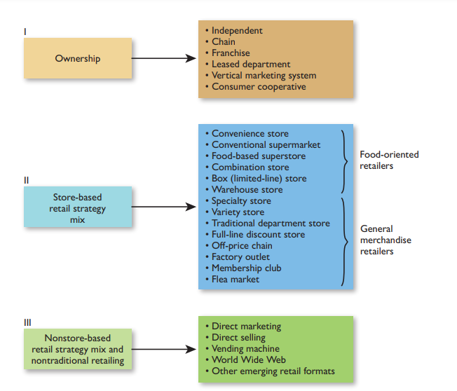
Retail Institution By Ownership
Retail firms may be independently owned, chain-owned, franchisee-operated, leased departments, owned by manufacturers or wholesalers, or consumer-owned.

Slide 3
Independent
An independent retailer owns only one outlet
2.2 million independent U.S. retailers
Account for one-third of total store sales
70% of independents operated by owners and their families
Why so many? Ease of entry
SBDC
COMPETITIVE ADVANTAGES AND DISADVANTAGES OF INDEPENDENTS
There is flexibility in choosing retail formats and locations and in devising strategy.
Investment costs for leases, fixtures, workers, and merchandise can be held down; and there is no duplication of stock or personnel.
Independents have “independence.”
Owner-operators typically have a strong entrepreneurial drive

Slide 4
Independent
These are some of the disadvantages of independent retailing:
In bargaining with suppliers, independents may not have much power because they often buy in small quantities
Independents generally cannot gain economies of scale in buying and maintaining inventory.
Operations are labor intensive, sometimes with little computerization.
Due to the relatively high costs of TV ads and the broad geographic coverage of magazines and some newspapers (too large for firms with one outlet), independents are limited in their access to certain media.
A crucial problem for independents is overdependence on the owner. All decisions may be made by that person, and there may be no management continuity when the owner-boss is ill, on vacation, or retires.

Slide 5
Chain Retailers
Operate multiple outlets under common ownership
Engage in some level of centralized or coordinated purchasing and decision making
In the U.S., there are roughly 110,000 retail chains operating about 900,000 establishments
Advantages and Disadvantages
COMPETITIVE ADVANTAGES AND DISADVANTAGES OF CHAINS
Many chains have bargaining power due to their purchase volume
Chains achieve cost efficiencies when they buy directly from manufacturers and in large volume, ship and store goods, and attend trade shows sponsored by suppliers to learn about new offerings.
Efficiency is gained by sharing warehouse facilities, purchasing standardized store fixtures, and so on
Chains, particularly national or regional ones, can take advantage of a variety of media, from TV to magazines to newspapers to online blogs.

Slide 6
Chain Retailers
Chain retailers also have a number of disadvantages:
After chains are established, flexibility may be limited. New no overlapping store sites may be hard to find. Consistent strategies must be maintained throughout all units, including prices, promotions, and product assortments. It may be difficult to adapt to local diverse markets
Investments are higher due to multiple leases and fixtures. There is higher investment in inventory due to the number of store branches that must be stocked.
Managerial control is complex, especially for chains with geographically dispersed branches. Top management cannot maintain the control over each branch that independents have over

Slide 7
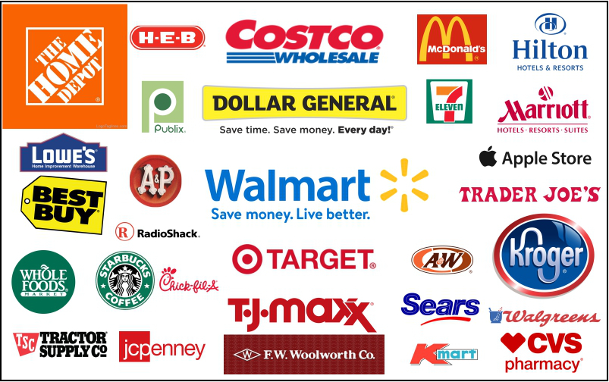
Typical information stored on a database includes the following:

Slide 8
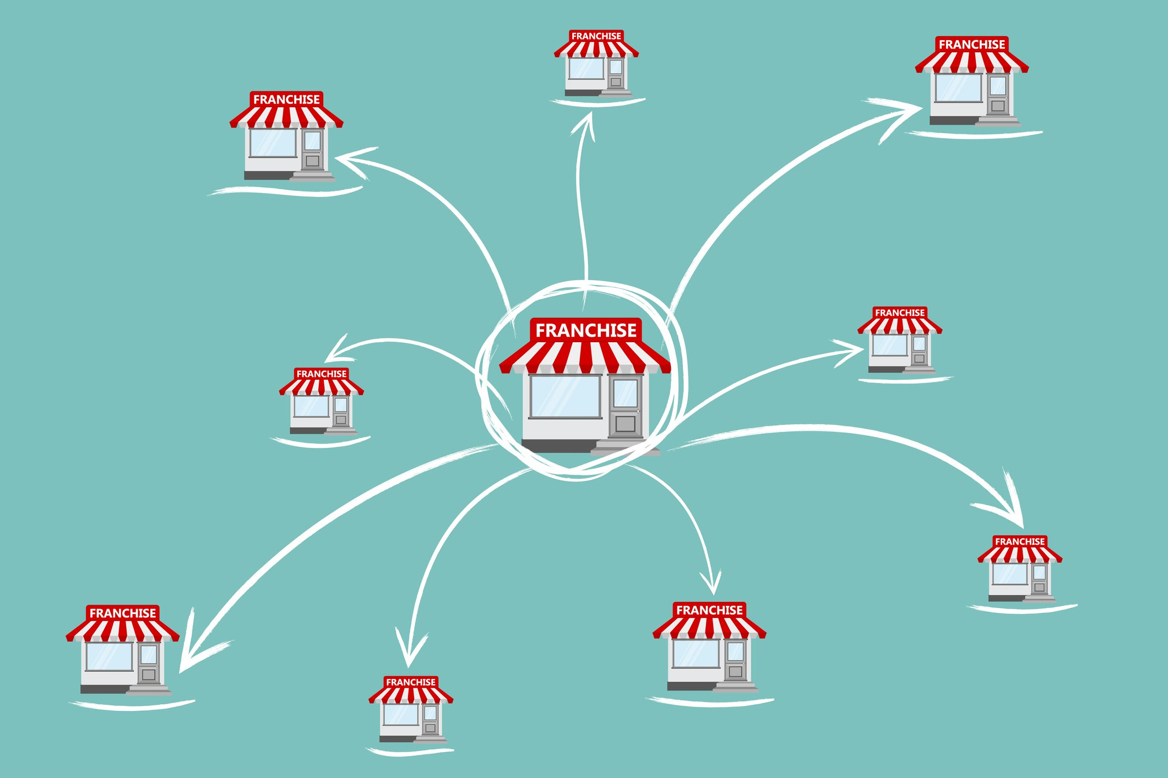
Franchising
A contractual agreement between a franchisor and a retail franchisee that allows the franchisee to conduct business under an established name and according to a given pattern of business
Franchisee pays an initial fee and a monthly percentage of gross sales in exchange for the exclusive rights to sell goods and services in an area
Wholesaler-Retailer Structural Franchising Arrangements
Competitive State of Franchising

Slide 9
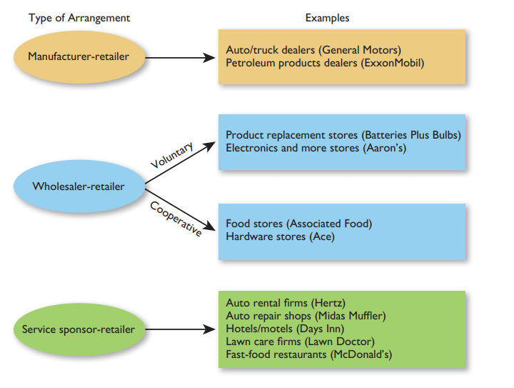
Three structural arrangements dominate retail franchising

Slide 10
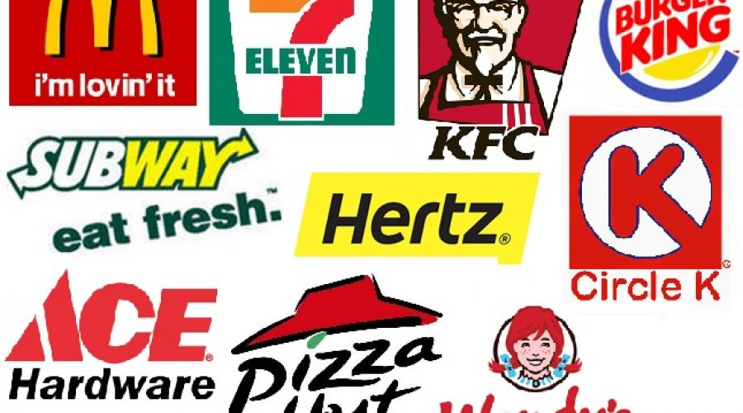
The Top 10 Biggest Franchises in the World

Slide 11
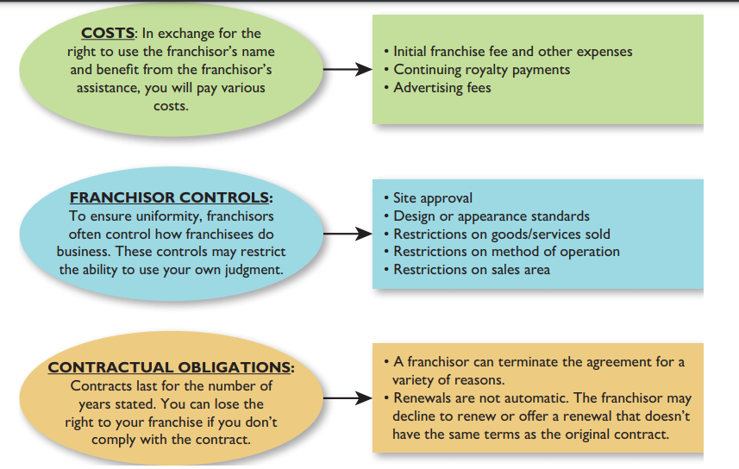
Selected Factors for Prospective Franchisees to Consider

Slide 12
COMPETITIVE ADVANTAGES AND DISADVANTAGES OF FRANCHISING
▶ They own a retail enterprise with a relatively small capital investment.
▶▶ They acquire well-known names and goods/service lines.
▶▶ Standard operating procedures and management skills may be taught to them. ▶▶ Cooperative marketing efforts (such as regional or national advertising) are facilitated.
▶▶ They obtain exclusive selling rights for specified geographical territories.
▶▶ Their purchases may be less costly per unit due to the volume of the overall franchise.
Some potential problems do exist for franchisees:
▶▶ Oversaturation could occur if too many franchisees are in one geographic area.
▶▶ Due to overzealous selling by some franchisors, franchisees’ income potential, required managerial ability, and investment may be incorrectly stated.
▶▶ They may be locked into contracts requiring purchases from franchisors or certain vendors.
▶▶ Cancellation clauses may give franchisors the right to void agreements if provisions are not satisfied.
▶▶ In some industries, franchise agreements are of short duration.
▶▶ Royalties are often a percentage of gross sales, regardless of franchisee profits.

Slide 13
Leased Departments
A leased department is a department in a retail store that is rented to an outside party. The proprietor is responsible for all aspects of its business and pays a percentage of sales as rent
The department store sets operating restrictions to ensure consistency and coordination
Competitive State of Leased Departments
COMPETITIVE ADVANTAGES AND DISADVANTAGES OF LEASED DEPARTMENTS
A leased department is a department in a retail store that is rented to an outside party. The proprietor is responsible for all aspects of its business and pays a percentage of sales as rent
The department store sets operating restrictions to ensure consistency and coordination
Competitive State of Leased Departments

Slide 14
Leased Departments
Lessees face these possible problems:
▶▶ There may be inflexibility as to the hours they must be open and the operating style.
▶▶ The goods/service lines are usually restricted.
▶▶ If they are successful, stores may raise rent or not renew leases when they expire.
▶▶ In-store locations may not generate the sales expected.
Vertical system
A vertical marketing system consists of all the levels of independently owned businesses along a channel of distribution. Goods and services are normally distributed through one of these systems: independent, partially integrated, and fully integrated.

Slide 15
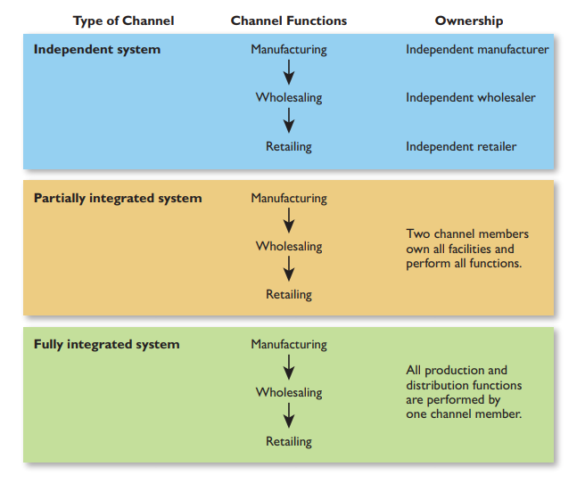
Vertical Marketing Systems: Functions and Ownership

Slide 16
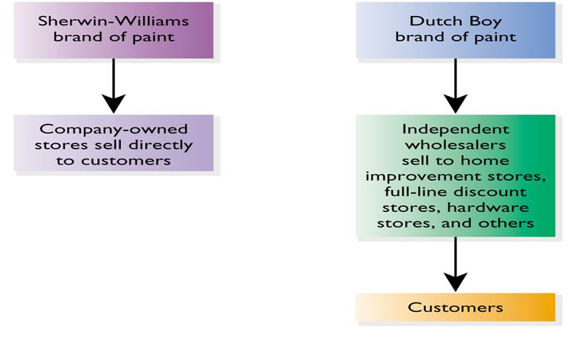
Sherwin-Williams’ Dual Vertical Marketing System

Slide 17
Consumer cooperative
A consumer cooperative is a retail firm owned by its customer members. A group of consumers invests, elects officers, manages operations, and shares the profits or savings that accrue.13 In the United States, there are several thousand such cooperatives, from small buying clubs to Recreational Equipment Inc. (REI), with $2.5 billion in annual sales. Consumer cooperatives have been most popular in food retailing. Yet, the 500 or so U.S. food cooperatives account for less than 1 percent of total grocery sales.

Slide 18
Retail Institutions by Store-Based Strategy Mix.

Slide 19
CONSIDERATIONS IN PLANNING A RETAIL STRATEGY MIX
▶ Be price-oriented and cost-efficient to attract price-sensitive shoppers.
▶▶ Be upscale to attract full-service, status-conscious consumers.
▶▶ Be convenient to attract those consumers who want shopping ease, nearby locations, or extended hours.
▶▶ Offer a dominant assortment in the product lines carried to appeal to customers interested in variety and in-store shopping comparisons.
▶▶ Offer superior customer service to attract those frustrated by the decline in retail service.
▶▶ Be innovative or exclusive and provide a unique way of operating (such as kiosks at airports) or carry products/brands not stocked by others to reach people who are innovators or bored.

Slide 20
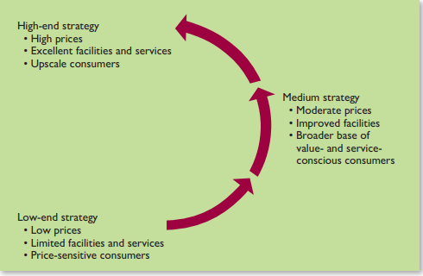
The Wheel of Retailing
As a low-end retailer upgrades its strategy to increase sales and profit margins, a new form of discounter takes its place.

Slide 21
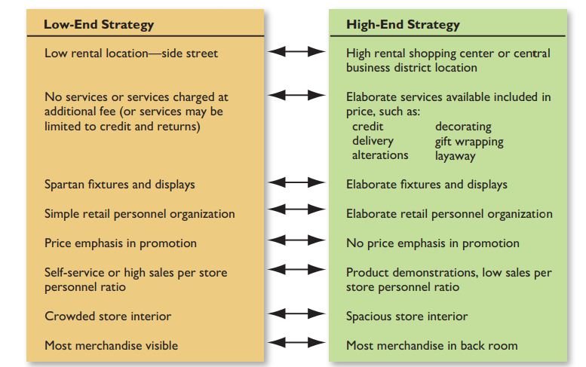
Retail Strategy Alternatives

Slide 22
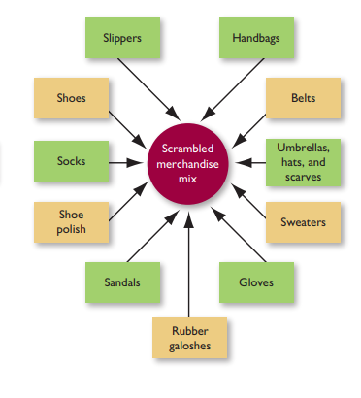
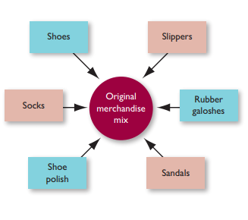
Scrambled merchandising
Whereas the wheel of retailing focuses on product quality, prices, and customer service, scrambled merchandising involves a retailer increasing its width of assortment (the number of different product lines carried). Scrambled merchandising occurs when a retailer adds goods and services that may be unrelated to each other and to the firm’s original business

Slide 23
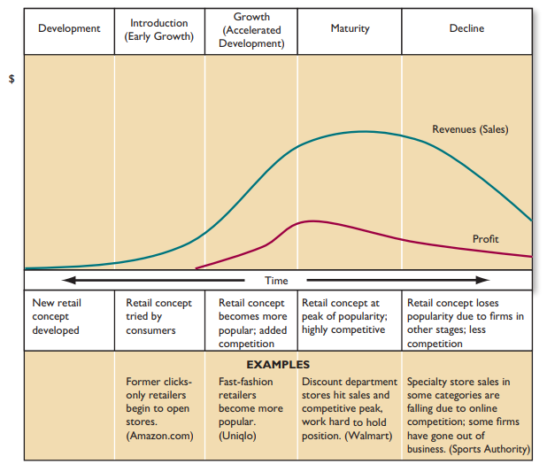
The Retail Life Cycle

Slide 24
How Retail Institutions Are Evolving
Mergers, Diversification, Downsizing
Cost-Containment and Value-Driven Retailing through:
- holding down initial investment
Operating costs
Cost commitment could achieved through:
Standardized operating procedures ,layout and size of store
Using secondary location
Buying refurbished equipment's
Using inexpensive construction materials
Placing stores in smaller communities

Slide 25
Mergers, Diversification, and Downsizing
Mergers: combination of separately owned firms (e.g., Movie Gallery and Hollywood Entertainment)
Diversification: retailers become active in businesses outside their normal operations (e.g., Limited Brands)
Downsizing: unprofitable stores are closed or divisions are sold off (e.g., Kmart)

Slide 26
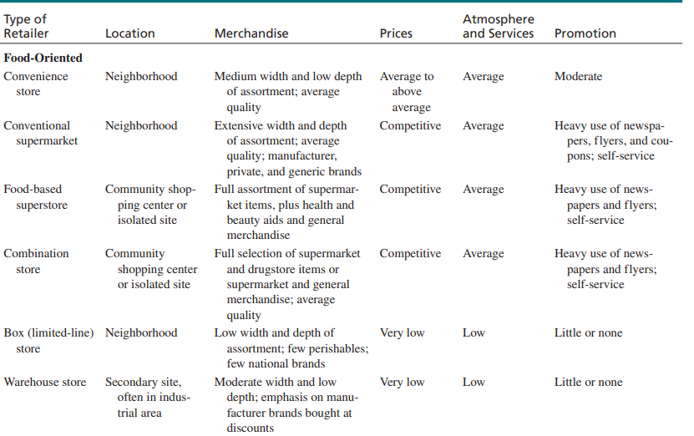
Store-Based Retail Strategy Mixes

Slide 27
Store-Based Retail Strategy Mixes
Food-Oriented
Convenience store
Conventional supermarket
Food-based superstore
Combination store
Box (limited-line) store
Warehouse store
General Merchandise
Specialty store
Traditional department
Full-line discount store
Variety store
Off-price chain
Factory outlet
Membership club
Flea market

Slide 28
Convenience Store Strategy Mix Mini market
Location:
Neighborhood
Prices:
Average to
Above average
Merchandise:
Medium width
and low depth
of assortment;
average quality
Atmosphere and
Services:
Average
Promotion:
Moderate

Slide 29
Conventional Supermarket Strategy Mix Self service supermarket
Location:
Neighborhood
Prices:
Competitive
Merchandise:
Extensive width and
depth of assortment;
average quality;
manufacturer, private,
and generic brands
Atmosphere and
Services:
Average
Promotion:
Heavy use of
newspapers, flyers,
and coupons

Slide 30
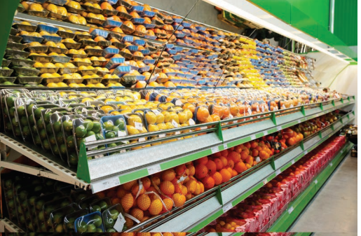
FIGURE :Supermarkets

Slide 31
Food-Based Superstore Strategy Mix Superstore
Location:
Community shopping
center or isolated site
Prices:
Competitive
Merchandise:
Full assortment plus
health and beauty aids
and general merchandise
Atmosphere and
Services:
Average
Promotion:
Heavy use of
newspapers, flyers

Slide 32
Combination Store Strategy Mix Hypermarket (Carrefour)
Location:
Community shopping
center or isolated site
Prices:
Competitive
Merchandise:
Full assortment plus
health and beauty aids
and general merchandise
Atmosphere and
Services:
Average
Promotion:
Heavy use of
newspapers, flyers

Slide 33
Warehouse Store Strategy Mix/groceries
Location:
Secondary site, often in
industrial area
Prices:
Very low
Merchandise:
Moderate width and
low depth of
assortment; emphasis on
manufacturer brands
bought at discount
Atmosphere and
Services:
Low
Promotion:
Little or none

Slide 34
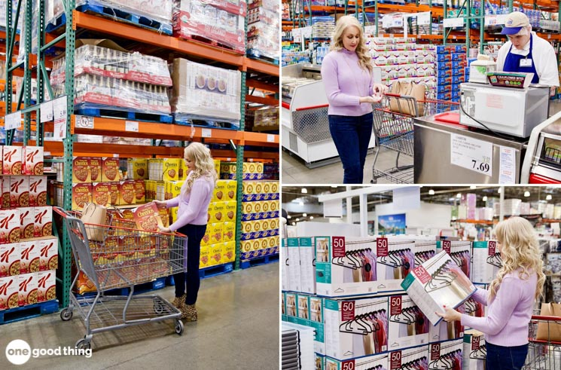
Figure: Warehouse Store

Slide 35
Specialty Store Strategy Mix
Location:
Business district or
shopping center
Prices:
Competitive to
Above average
Merchandise:
Very narrow width and
extensive depth of
assortment; average to
good quality
Atmosphere and
Services:
Average to excellent
Promotion:
Heavy use of displays
Extensive sales force

Slide 36
Full-Line Discount Store Strategy Mix
Location:
Business district, shopping
center or isolated store
Prices:
Competitive
Merchandise:
Extensive width and
depth of
assortment; average to
good quality
Atmosphere/Services:
Slightly below
average to average
Promotion:
Heavy on newspapers;
price-oriented; selling

Slide 37
Variety Store Strategy Mix/Apparel and accessories
Location:
Business district, shopping
center or isolated store
Prices:
Average
Merchandise:
Good width and
some depth of
assortment;
below-average
to average quality
Atmosphere/Services:
Below average
Promotion:
Use of newspapers

Slide 38
Factory Outlet Strategy Mix
Location:
Out of the way site
or discount mall
Prices:
Very Low
Merchandise:
Moderate width and
poor depth of
assortment;
low continuity
Atmosphere/Services:
Very low
Promotion:
Little

Slide 39
Membership Club Strategy Mix Customers membership
Location:
Isolated store or
secondary site
Prices:
Very Low
Merchandise:
Moderate width and
poor depth of
assortment;
low continuity
Atmosphere/Services:
Very low
Promotion:
Little;
some direct mail

Slide 40
Web, Nonstore-Based, and Other Forms of Nontraditional Retailing

Slide 41
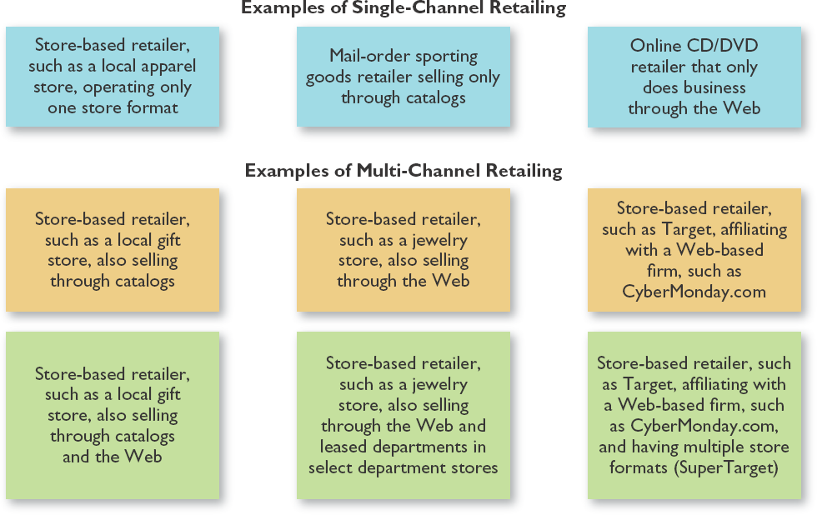
Approaches to Retailing Channels

Slide 42
Non-store Retailing
Retailing strategy that is not store- based
Exceeds $410 billion annually
80% comes from direct marketing
Web-based retailing is the fastest- growing area
Web retailing expected to reach $180 annually as of 2012
Nontraditional Retailing
Nontraditional retailing also includes formats that do not fit into store and nonstore-based categories:
Video kiosks
Airport retailing

Slide 43
Direct Marketing
Customer is initially exposed to a good or service through a non- personal medium and then orders by mail, phone, fax, or computer
Annual U.S. sales exceed $425 billion (including the Web)
Other leading countries include
Japan
Germany
Great Britain
France
Italy

Slide 44
Characteristics of Direct Marketing Customers
Married
Upper middle class
35-50 years old
Desire convenience, unique items, good prices

Slide 45
Strategic Business Advantages of Direct Marketing
Reduced costs
Lower prices
Large geographic coverage
Convenient to customers
Ability to pinpoint customer segments
Ability to eliminate sales tax for some
Ability to supplement regular business without additional outlets

Slide 46
Strategic Business Limitations of Direct Marketing
Products often cannot be examined prior to purchase
Costs may be underestimated
Response rates to catalogs under 10%
Clutter exists
Long lead time required
Industry reputation sometimes negative
Data-Base Retailing
Collection, storage, and usage of relevant customer information
name
address
background
shopping interests
purchase behavior
Observation of 80-20 rule

Slide 47
Emerging Trends
Evolving activities
Changing customer lifestyles
Increasing competition
Increasing usage of dual distribution channels
Changing media roles, technological advances, and global penetration
Selection Factors by Customers
Company reputation and image
Ability to shop whenever consumer wants
Types of goods and services
Availability of toll-free phone number or Web site for ordering
Credit card acceptance
Speed of promised delivery time
Competitive prices
Satisfaction with past purchases and good return policy

Slide 48
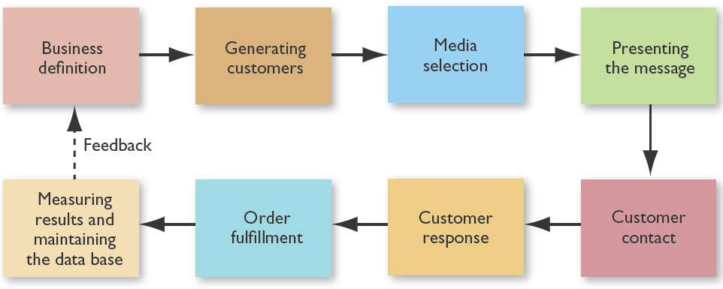
Executing a Direct Marketing Strategy

Slide 49
Media Selection
Printed catalogs
Direct-mail ads and brochures
Inserts with monthly credit card and other bills (statement stuffers)
Freestanding displays
Ads or programs in mass media
Banner ads or hot links on the Web
Video kiosks
Outcome Measures
Overall response rate
Average purchase amount
Sales volume by product category
Value of list brokers

Slide 50
Direct Selling
Direct selling includes personal contact with consumers in their homes (and other nonstore locations such as offices) and phone solicitations initiated by retailer.
Annual sales of $29 billion in the U.S., where 16 million people are employed (more than 90 percent part-time).
Annual foreign revenues of $105 billion, generated by 72 million salespeople.

Slide 51
A Snapshot of the U.S. Direct Selling Industry
Major Product Groups (as a percent of sales)
Home and family care products/home durables | 24.4
Wellness (weight loss products, vitamins, etc.) | 23.0
Personal care | 19.4
Services | 19.2
Clothing | 11.0
Leisure/educational (books, encyclopedias, toys/games, etc. | 3.0

Slide 52
Vending Machines
Vending machines are a cash- or card-operated retailing format that sells goods and services.
Eliminates the use of sales personnel and allows 24-hour sales.
Machines placed wherever convenient for consumers.
95 percent of the $50 billion in annual
U.S. vending machine sales involve hot/cold beverages and food items.
Emergence of World Wide Web
The World Wide Web (Web) is a way to access information on the Internet.
People work with easy-to-use Web addresses (sites) and pages.
Web users see words, charts, pictures, and video while hearing audio.
Both “Internet” and “World Wide” Web convey the same central theme: online interactive retailing.

Slide 53
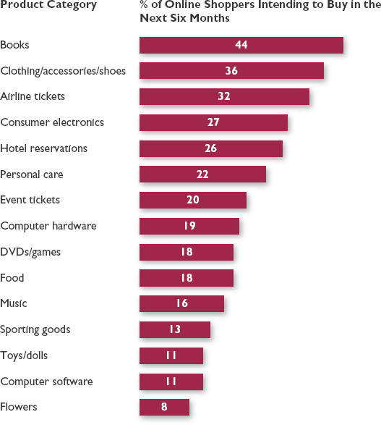
Global Consumers’ Online Retail Purchase Intent (Selected Product Categories)

Slide 54
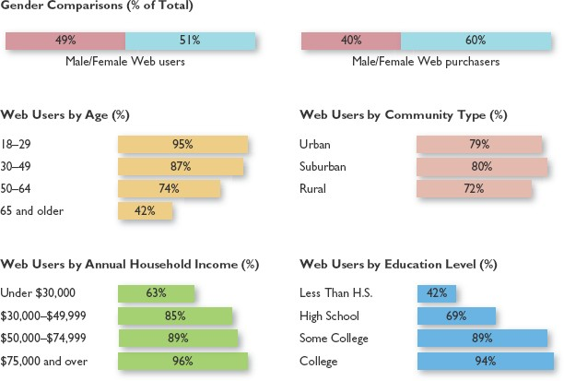
Five Stages of Developing a Retail Web Presence

Slide 55
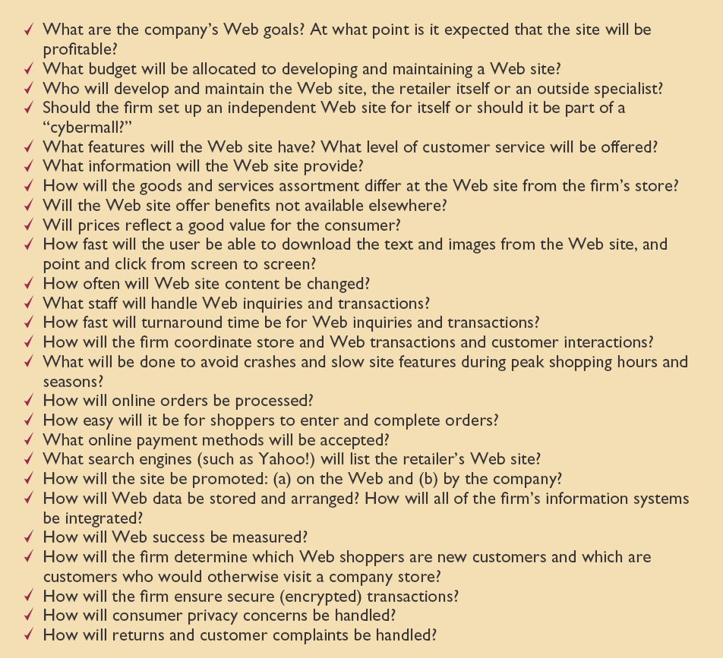
Checklist of Retailer Decisions for the Web

Slide 56
Web Strengths
Using the Web •Shopping
Online
selection
prices
convenience
fun
information
entertainment
interactive communications

Slide 57
Reasons NOT to Shop Online
Lack of trust
Fear
Lack of security (credit card access)
Lack of personal communication
High shipping costs
Recommendations for Web Retailers I
Develop or exploit a well-known, trustworthy retailer name
Tailor the product assortment for Web shoppers
Enable the shopper to “click” as little as possible-Amazon.com one-click option
Provide a solid search engine
Use customer information

Slide 58
Recommendations for Web Retailers II
Include unedited ratings and reviews for customers to increase consumer information and to reduce risk
Personalize the shopping experience for each shopper based on past purchases and previous Web searches
Include free shipping or one time shipping fee for unlimited shipping

Slide 59
Multichannel Retailing
Seeks synergies among formats (get product information on Web, order through catalog, pick-up in store, use kiosks for out-of-stock merchandise)
Retailer views each channel as creating value (immediacy of store, 24/7 of Web, long lasting impression of catalog)
Channels are viewed as complementary, not competitive (Costco Web site vs. store)
Principles of Multi-Channel Retailing
Use same product identification in all channels
Price goods the same in all channels
Assess infrastructure economies. Direct marketer data base and delivery system.
Cross promote goods across channels.
Use suitable partners (Amazon to sell, Fed Ex to deliver)

