Slide 1
Writs
Constitutional Law of Bangladesh-II
LAW 215

Slide 3
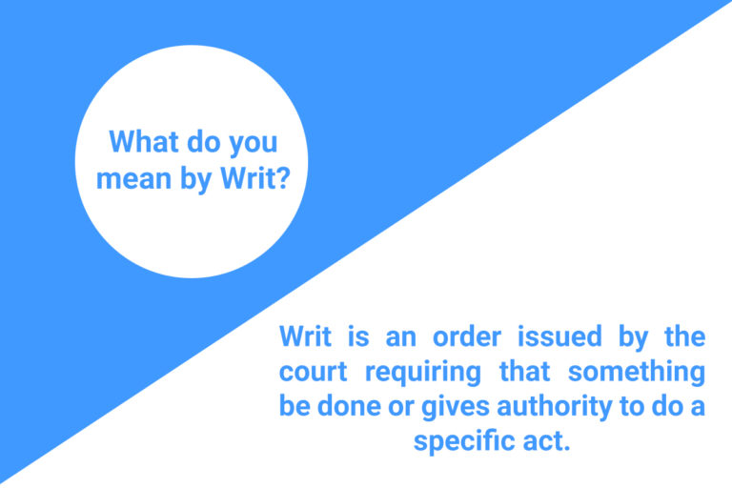

Slide 4
Writs in its Early Days
Two institutions were strong before the conquest of William I in 1066 CE:
The Crown
Local Tribunals (Village Courts & Shire Courts)
William I built a feudal structure which differed in many ways from Anglo-Saxon.
The feudal lord’s authority and responsibility included the power and duty to hold his feudal court to render justice for his tenants.
If the tenants were convinced that he could get no remedy in his lord’s court, he would take his troubles to the king. If the case sounded serious enough, the king might direct the landlord to rectify the situation.
The instrument of intervention was the writ. The writ was nothing more than a written directive from the king, witnessed and bearing his seal, directed to a royal official or to an individual or group of individual or group of individuals ordering the addressees to do or refrain from doing a designated act.

Slide 5
Reasons behind the origin of writs
Though the development of the common law courts in various forms had also been constant, but the origin of writ court had a specific reason. The jurisdiction of common law was more or less static. It did not recognize rights except those already prevalent and admitted by it.
Similarly, common law courts worked under a prescribed procedure with many limitations on it. Its forms, under which rights were to be enforced, were fixed and limited. Thus, there had been number of cases, which did not fall under any of the fixed remedies and so these cases remained beyond the jurisdiction of the common law courts. In such cases, these courts were powerless to grant relief.

Slide 6
Reasons behind the origin of writs
Thus, the deficiency of remedy or failure of the common law courts to grant relief in time, became the cause/ground of petition to the king in council to exercise their extra-ordinary judicial powers. These petitions were heard and disposed of by or on behalf of the King’s Bench. A written order was issued in the name of the king called — a writ, which was to act as a foundation to the subsequent proceedings. Originally, writs were intended to be issued only by the crown and in the interest of the crown.
However, in due course of time, the writs became available to the ordinary citizens also. A prescribed fee was charged for these writs and that is why the filing of writ used to be called as ‘Purchase’ of a writ. These writs were used to establish royal supremacy also. This form of adjudication was called-prerogative writs also.

Slide 7
Reasons behind the origin of writs
Rigidity of common law courts fostered the writs.

Slide 8
Writs in South Asia
In the 17th and 18th centuries, the writs of habeas corpus, mandamus, certiorari and quo warranto were given the names of prerogative writs as they were connected closely with the rights of the people. The Judicature Act 1873 abolished the Court of Chancery and other courts and consolidated superior courts which exercised jurisdiction on the issuance of writs. In 1753 the East India Company set up Mayor’s Court at Madras, Bombay and Calcutta that ran side-by-side with native courts which administered justice under civil and criminal branches of law.
In South Asia, the Presidency Courts at Calcutta, Madras and Bombay were established by the Indian High Court Act 1862. The local Supreme Court, as well as Saddar Diwani Adalat and Saddar Nizamat Adalat, were merged together.

Slide 9
Writs in South Asia
The High Courts continued to exercise the power to issue prerogative writs within the limits of their respective original jurisdiction. They did not have the power to issue such writs upon Mofussil Courts or Tribunals or to persons outside the limits of the Presidency towns.
No other High Court except these High Courts were vested with the power to issue prerogative writs (Section 45 of the Specific Relief Act 1877) but this was not made applicable to Lahore High Court, Sindh Chief Court and Courts of Judicial Commissioner at Peshawar and Quetta (AIR 1927 Lah 513).
Section 491 of the Code of Civil Procedure was amended in 1923 and all High Courts were empowered to make order within their jurisdiction.

Slide 10
Writs in South Asia
The Government of India Act was passed in 1935 which established a Federal Court which, to the exclusion of any other court, had original jurisdiction in disputes between the federation and provinces. It also had appellate jurisdiction over the judgment of High Courts.
The writs were a matter of late introduction into the scheme of law in the subcontinent. Prior to the amendment in 1954, the only provision in the law for the issuance of a writ was that in section 45 of the Specific Relief Act, which by expression was confined to the Presidency towns. But across the rest of the country and in matters not covered by section 45 in presidency towns as well, the position was that no court could issue a writ to the government or any public body, for the enforcement of public duties. The reason may be found in the fact that the subcontinent lay under foreign rule (PLD 1961 SC 237).

Slide 11
Writs in East Bengal
After the creation of Pakistan, the High Court of Dacca was the only court in the country empowered to issue writs under Section 45 of the Specific Relief Act 1877. Under the Independence Act of 1947, the Government of Pakistan adopted Government of India Act which was amended by adding section 223-A wherein every High Court of Pakistan was given authority to issue writs within their territorial jurisdiction including writs of habeas corpus, mandamus, prohibition, qua warranto and certiorari.
The Constitution of Pakistan was first framed in 1956. Writs were issued under the 1962 Constitution.

Slide 12
Writs in Bangladesh
According to Article 102(2): The High Court Division may, if satisfied that no other equally efficacious remedy is provided by law –
(a) on the application of any person aggrieved, make an order- (i) directing a person performing any functions in connection with the affairs of the Republic or of a local authority, to refrain from doing that which he is not permitted by law to do or to do that which he is required by law to do ; or (ii) declaring that any act done or proceeding taken by a person performing functions in connection with the affairs of the Republic or of a local authority, has been done or taken without lawful authority and is of no legal effect ; or
(b) on the application of any person, make an order- (i) directing that a person in custody be brought before it so that it may satisfy itself that he is not being held in custody without lawful authority or in an unlawful manner ; or (ii) requiring a person holding or purporting to hold a public office to show under what authority he claims to hold that office.

Slide 13
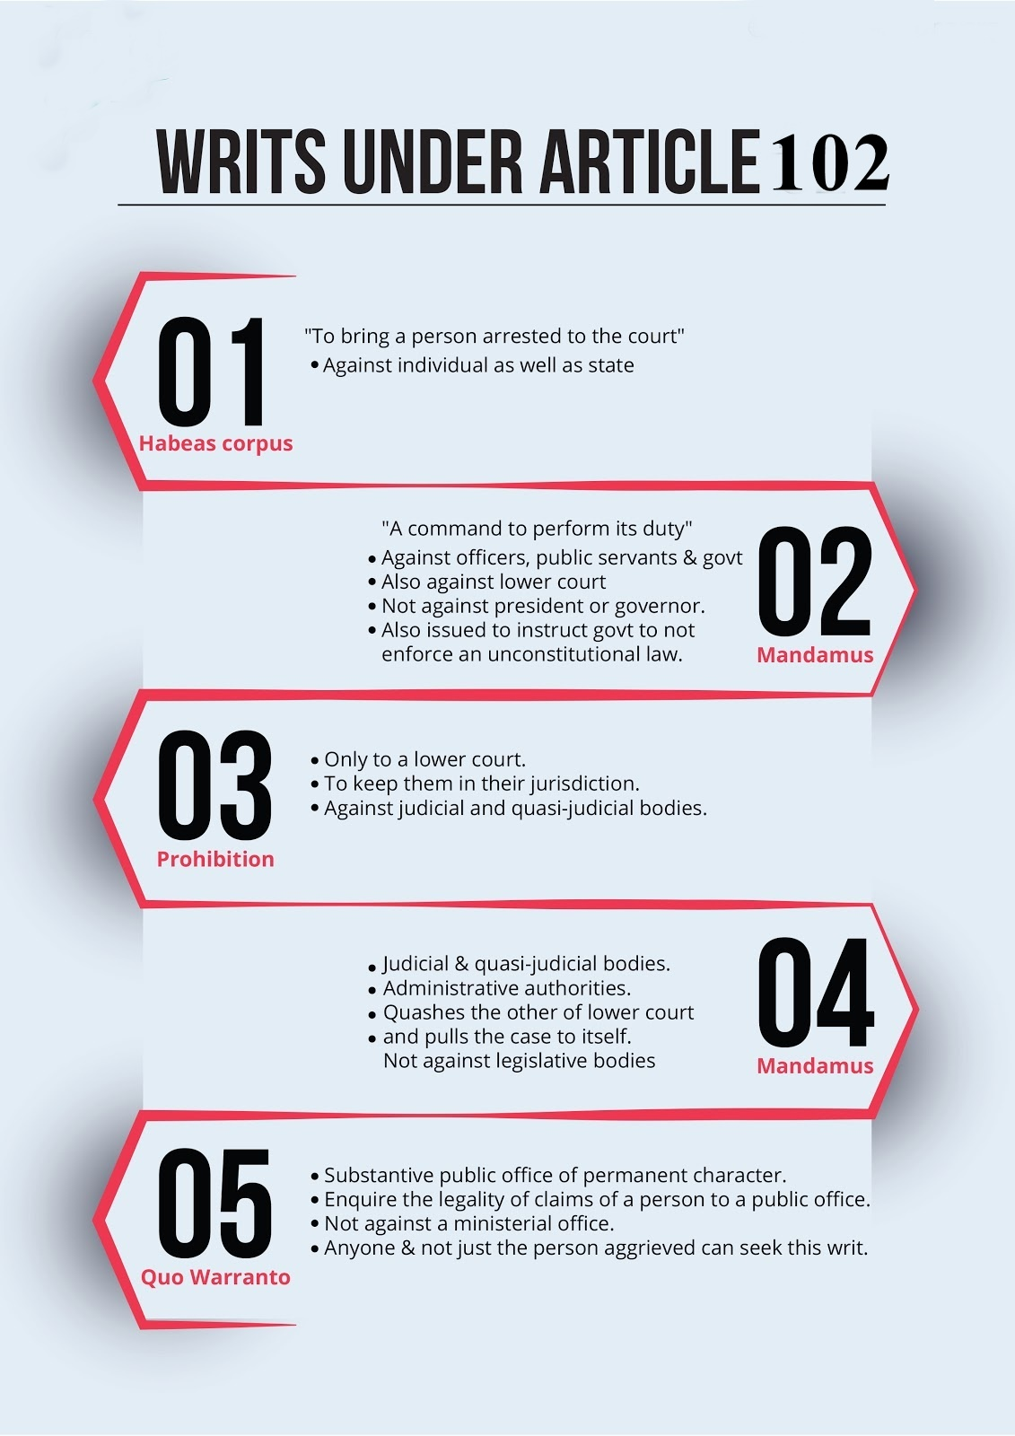

Slide 15
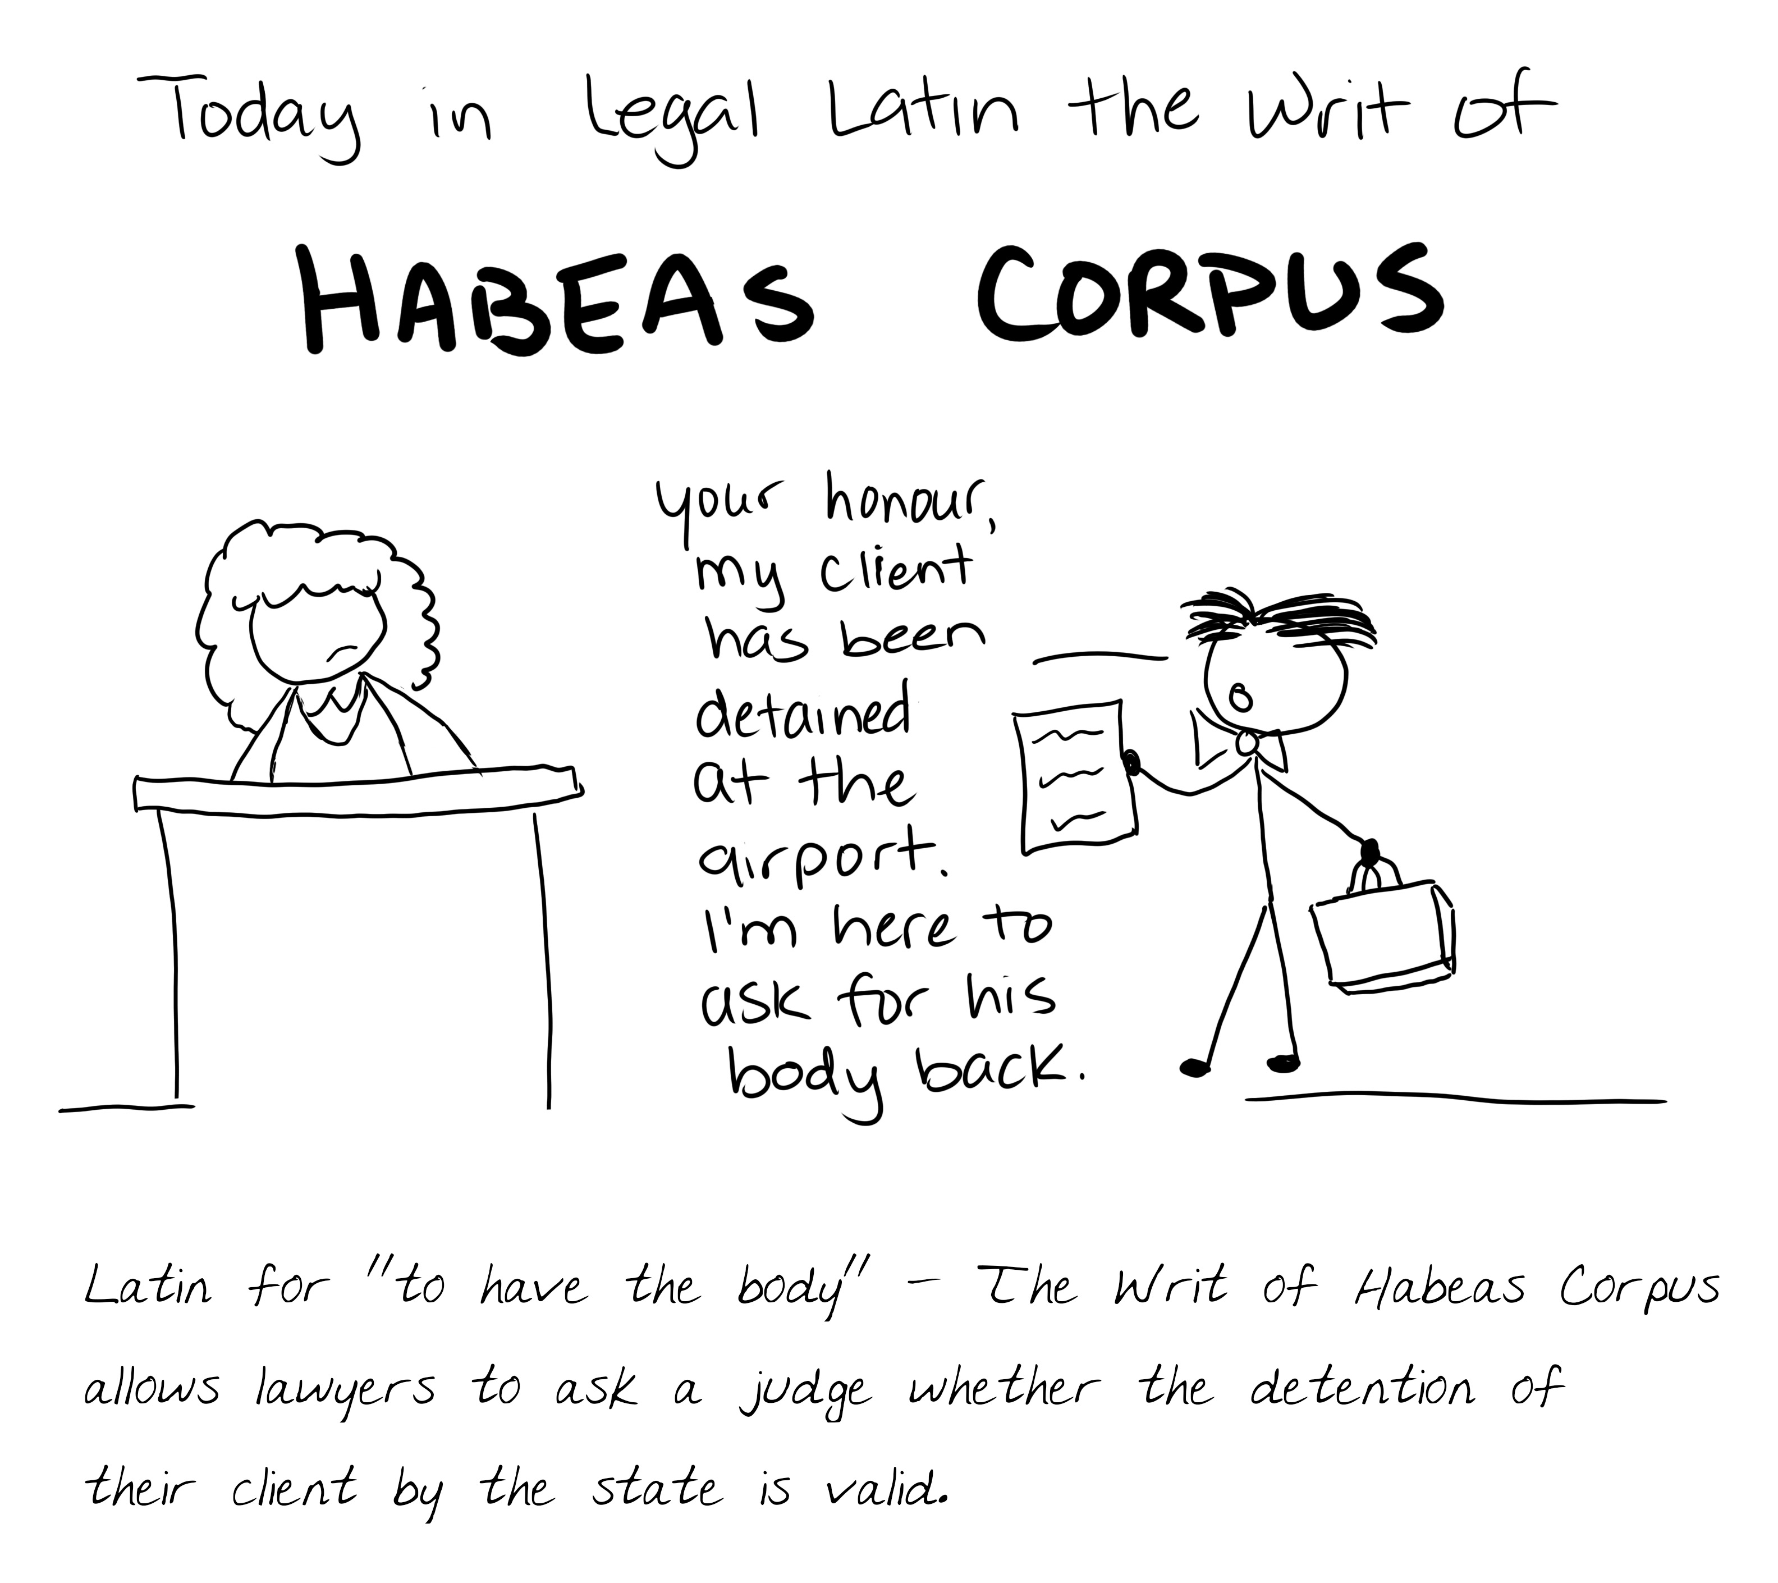

Slide 16
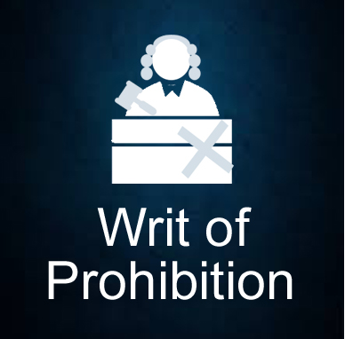

Slide 17
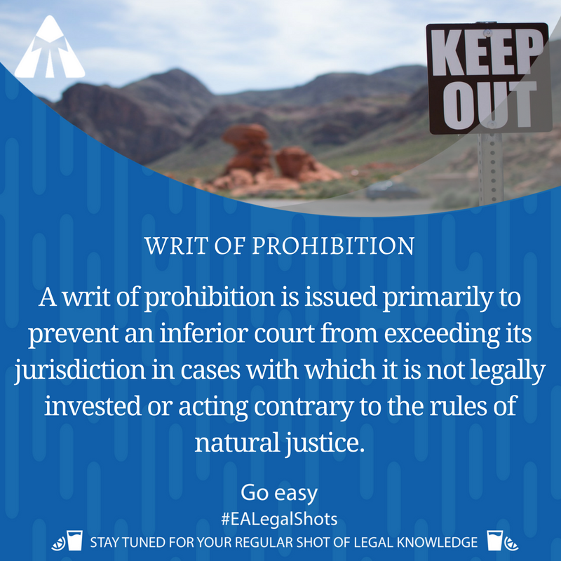

Slide 18
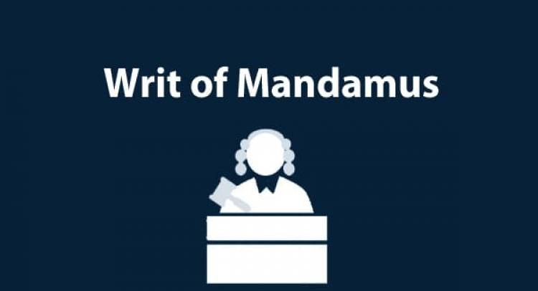

Slide 19
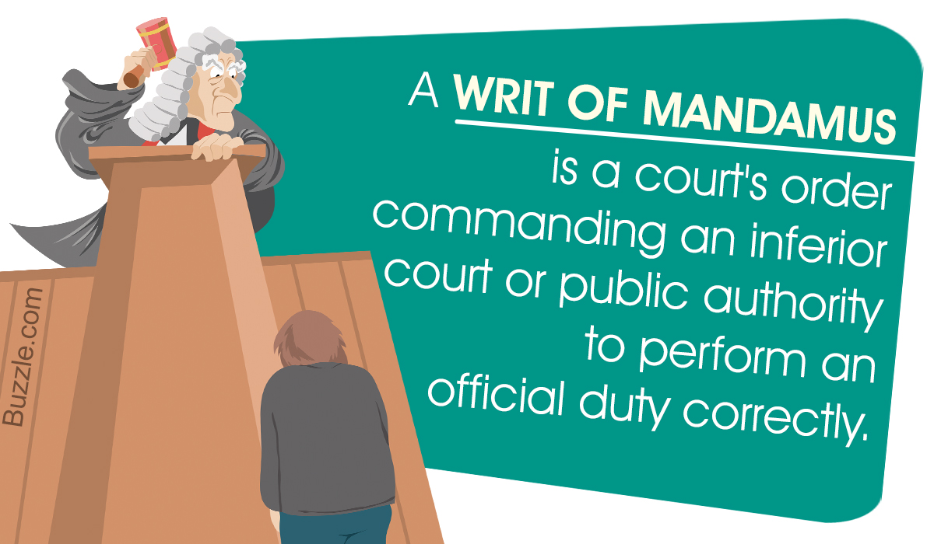

Slide 20
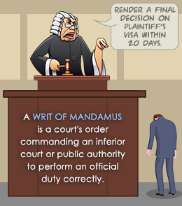

Slide 21
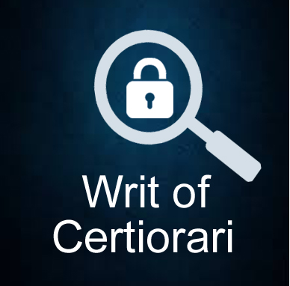

Slide 22
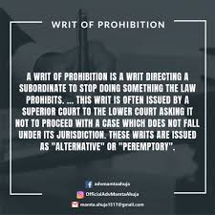

Slide 26
Jurisdictions of the Supreme Court of Bangladesh

Slide 27
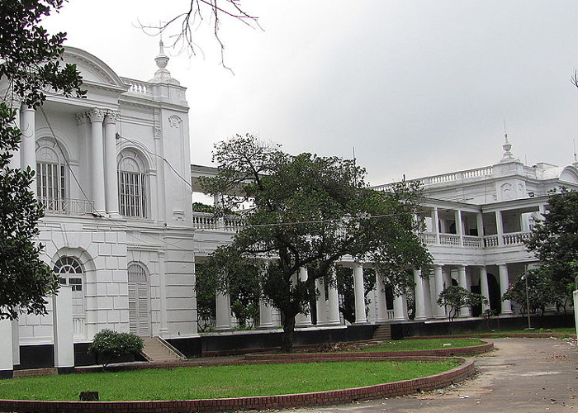
Old High Court Building

Slide 28
Jurisdiction of High Court Division
According to Article 101: The High Court Division shall have such original, appellate and other jurisdictions and powers as are conferred on it by this Constitution or any other law.

Slide 29
Powers of High Court Division to issue certain orders and directions
102. (1) The High Court Division on the application of any person aggrieved, may give such directions or orders to any person or authority, including any person performing any function in connection with the affairs of the Republic, as may be appropriate for the enforcement of any of the fundamental rights conferred by Part III of this Constitution.
(2) Five Types of Writs
(3) Notwithstanding anything contained in the forgoing clauses, the High Court Division shall have no power under this article to pass any interim or other order in relation to any law to which article 47 applies. (4) Whereon an application made under clause (1) or sub-clause (a) of clause (2), an interim order is prayed for and such interim order is likely to have the effect of- (a) prejudicing or interfering with any measure designed to implement any development programme, or any development work ; or (b) being otherwise harmful to the public interest, the High Court Division shall not make an interim order unless the Attorney-General has heen given reasonable notice of the application and he (or an advocate authorised by him in that behalf) has been given an opportunity of being heard, and the High Court Division is satisfied that the interim order would not have the effect referred to in sub-clause (a) or sub-caluse (b). (5) In this article, unless the context otherwise requires, “person” includes a statutory public authority and any court or tribunal, other than a court or tribunal established under a law relating to the defence services of Bangladesh or any disciplined force or a tribunal to which article 117 applies.

Slide 30
Jurisdiction of Appellate Division
Article 103. (1) The Appellate Division shall have jurisdiction to hear and determine appeals from judgments, decrees, orders or sentences of the High Court Division. (2) An appeal to the Appellate Division from a judgment, decree, order or sentence of the High Court Division shall lie as of right where the High Court Division – (a) certifies that the case involves a substantial question of law as to the interpretation of this Constitution ; or (b) has confirmed a sentence of death or sentenced a person to death or to imprisonment for life ; or (c) has imposed punishment on a person for contempt of that division ; and in such other cases as may be provided for by Act of Parliament. (3) An appeal to the Appellate Division from a judgment, decree, order or sentence of the High Court Division in a case to which clause (2) does not apply shall lie only if the Appellate Division grants leave to appeal. (4) Parliament may by law declare that the provisions of this article shall apply in relation to any other court or tribunal as they apply in relation to the High Court Division.

Slide 31
Review of judgments or orders by Appellate Division105. The Appellate Division shall have power, subject to the provisions of any Act of Parliament and of any rules made by that division to review any judgment pronounced or order made by it.

Slide 32
Rule-making power of the Supreme Court
Article 107. (1) Subject to any law made by Parliament the Supreme Court may, with the approval of the President, make rules for regulating the practice and procedure of each division of the Supreme Court and of any court subordinate to it.
(2) The Supreme Court may delegate any of its functions under clause (1) and article 113 and 116 to a division of that Court or to one or more judges.
(3) Subject to any rules made under this article the Chief Justice shall determine which judges are to constitute any Bench of a division of the Supreme Court and which judges are to sit for any purpose.
(4) The Chief Justice may authorise the next most senior judge of either division of the Supreme Court to exercise in that division any of the powers conferred by clause (3) or by rules made under this article.

Slide 33
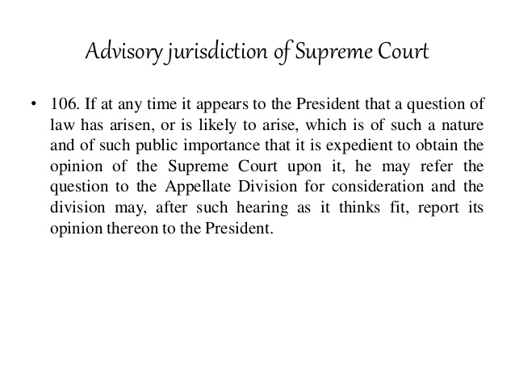
Advisory Jurisdiction of Supreme Court

Slide 34
Supreme Court as court of record
Article 108. The Supreme Court shall be a court of record and shall have all the powers of such a court including the power subject to law to make an order for the investigation of or punishment for any contempt of itself.

Slide 35
Transfer of cases from subordinate courts to High Court Division
Article 110. If the High Court Division is satisfied that a case pending in a court subordinate to it involves a substantial question of law as to the interpretation of this Constitution, or on a point of general public importance, the determination of which is necessary for the disposal of the case, it shall withdraw the case from that court and may –
(a) either dispose of the case itself ; or
(b) determine the question of law and return the case to the court from which it has been so withdrawn (or transfer it to another subordinate court) together with a copy of the judgment of the division on such question, and the court to which the case is so returned or transferred shall, on receipt thereof, proceed to dispose of the case in conformity with such judgment.

Slide 36
Superintendence and control over courts
109. The High Court Division shall have superintendence and control over all courts and tribunals subordinate to it.

