Slide 1
Business Problem Solving Model

Slide 2
DISCOVER
INVESTIGATE
BRAINSTORM
IMPLEMENT
REVIEW
STEP 1: Identify the problem
STEP 2: Gather information to define the problem
STEP 3: Produce as many alternatives as possible
STEP 4: Put one best solution into effect
STEP 5: Assess the effects of the solution

Slide 3
STEP 1: Identify the problem
Managing bias: Unconscious biases that may cause misunderstanding a situation
Creative confidence: Willingness to try and fail
Empathy: Ability to take in the world from another person’s perspective.

Slide 4
STEP 2: Gather information to define the problem
Identify Stakeholders: Either affected by the problem or their involvement is needed to resolve the matter. Ask “WHY”
Define the problem with statements using three words
“How: is solution-oriented”
“Might: encourages optimism”
“We: is collaborative”

Slide 5
STEP 3: Produce as many alternatives as possible
This step requires to have imagination and creativity
Prepare: Be prepared with all the information about the problem
Brainstorm: Think within a group, discuss and get alternatives
Reflection: Debrief, prioritize thoughts, comment on favorite ideas, ask important questions

Slide 6
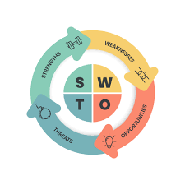
STEP 4: Put one best solution into effect

Slide 7
STEP 5: Assess the effects of the solution
Ask for feedback
Monitor results
Star analysis: Place your main idea at the center of a six-point star diagram. (Who/What/Where/When/Why/How)

Slide 8
STEP 5: Assess the effects of the solution
Who: Who will be benefited?/Who still needs support?
What: What is going well?/What needs to be addressed?
Where: Where you see the biggest impact?/Where are gaps to fill?
When: When will monitoring take place?/When will you know you’re successful?
Why: Why the solution is having an impact?/Why does this solution needs readjustments?
How: How will you know that you’ve solved the problem?

