Slide 1
NGOs: Concepts and Key Issues
0319-714
Development Management: The Third Sector
Mohammad Faisal Akber
Department of Development Studies
Daffodil International University

Slide 2
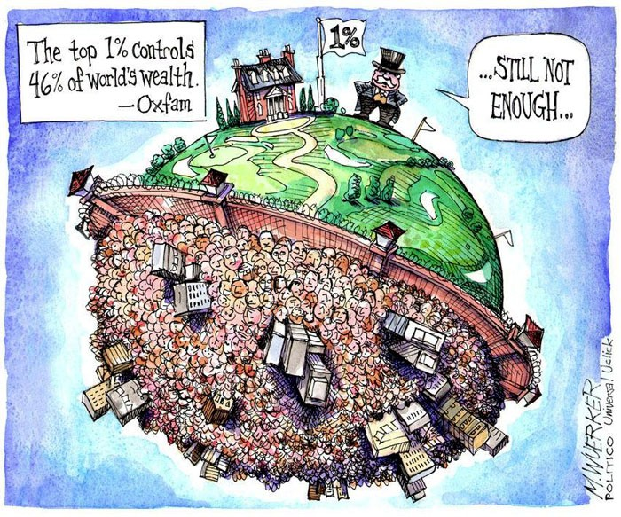

Slide 3
Name of the Course
DEV-604
NGOs and Development

Slide 4
Objectives of the Course
The course is designed to give the students exposure to the experiences of the third sector in promoting development and to help them acquire the professional competencies with proactive knowledge, skills, and attitudes required for social development and justice.
It will equip the student with a sound understanding of the issues being faced by third sectors, e.g. NGOs, civil society, and pressure groups, and opportunities that reflect the impact and implications of the management and organizational challenges in the 21st century.

Slide 5
Contents of the Course
Development Management: Key Issues & Concepts
NGOs: concept and key issues
Alternative Development And Role of Third Sector
The contribution of NGOs in social change
International Development System
Voluntary Associations in Development
NGOs in environment
Women empowerment and NGOs
NGOs provisions on Basic Education
Microfinance and development
NGOs governance
Management and regulation of NGOs in Bangladesh
Civil ociety and Development
GO-NGO collaboration for development

Slide 6
Key Objectives of Today’s Class
Understanding the definitions of NGOs
Identifying the crucial characteristics of NGOs
Conceptualizing the “Generations” of NGOs
Develop an understanding of the classification of NGOs
Understanding why NGOs emerged on the canvas of development
Perceiving the relationship between NGOs and Development

Slide 7
What is an NGO?
“An NGO is an agency that is primarily engaged in work relating to the areas of development or humanitarian work at local, national and international levels.”
- Lewis & Kanji (2009)
Vakil (1997) argues that “NGOs are self-governing, private, not for profit organizations that are geared to improving the quality of life for disadvantaged people.”
Charnovitz (1997) argues that “NGOs are groups of individuals organized for the myriad of reasons that engage human imagination and aspiration”

Slide 8
Key Characteristics of NGOs
As third sector organizations, NGOs have five key characteristics –
Formal: The organization has an institutionalized presence and formal representation.
Private: The Organization is institutionally separate from government.
Non-profit distributing: Owners or directors don’t receive any financial surplus.
Self-governing: The organization is able to control and manage its own affairs.
Voluntary: Some degree of voluntary participation is present.

Slide 9
Categories of NGOs
Operational NGOs: primary purpose is the design and implementation of development related projects (e.g. BRAC, Action Aid).
Advocacy NGOs: primary purpose is to defend or promote a specific cause. These kind of NGOs also try to influence the policies and practices of countries (e.g. Amnesty International, Human Rights Watch).
Humanitarian NGOs: primary purpose is to provide aid in disaster areas and alleviate suffering from poverty and disease (e.g. Care, Action Against Hunger, Islamic Relief)

Slide 10
Types of NGOs: By Orientation
Charitable Orientation: distribution of food, clothing or medicine, provision of housing, transport, schools etc.
Service Orientation: Provision of health, family planning or education services in which programs are designed by the NGO
Participatory Orientation: Self-help projects where local people are involved; particularly in the implementation of a project by contributing cash, tools, lands, materials, labor etc.
Empowering Orientation: The aim is to help poor people develop a clearer understanding of the social, political and economic factors affecting their lives, and to strengthen their awareness of their own potential power to control their lives.

Slide 11
Types of NGOs: By Operation
Community-based Organizations: Sports Clubs, Women’s Organizations, religious or educational organizations etc.
Citywide Organizations: Rotary or Lion’s Club, coalitions of businesses, ethnic or educational groups etc.
National NGOs: BRAC, BAPA, ASA in Bangladesh; Total Care Unit, Theresa Karis Foundation, Lets Talk Humanity in Nigeria; Action-Aid International Somaliland, Adventist Development and Relief Agency ADRA, Islamic Relief Worldwide in Somalia
International NGOs: Save the children, Oxfam, Care, Caritas, JICA etc.

Slide 12
NGOs Action Process

Slide 13
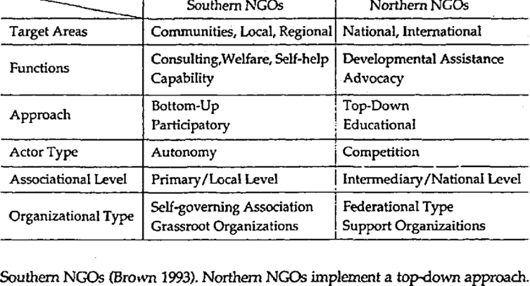
Interesting Terms
Northern NGO
Southern NGO

Slide 14
Generations of NGOs
 | First (Relief and Welfare) | Second (Community Development) | Third (Sustainable Systems Development) | Fourth (People’s Movements)
Problem Definition | Shortage | Local Inertia | Institutional and Policy Constraints | Inadequate mobilizing vision
Timeframe | Immediate | Project life | 10-20 years | Indefinite Future
Scope | Individual or family | Neighborhood or village | Region or nation | National or global
Main Actors | NGO | NGO plus Community | All relevant public and private institutions | Loosely defined networks of people and organizations
NGO role | Doer | Mobilizer | Catalyst | Activist/educator
Source: Korten, D. C. (1990). Getting to the 21st century: Voluntary action and the global agenda. Kumarian Press.

Slide 15
What Do NGOs Do?
Implementers
Catalysts
Partners

Slide 16
NGOs as Implementers and Partners
Implementers
As implementers, NGOs mobilize resources to provide goods and services to people who need them.
Healthcare, microfinance, agricultural extension, emergency relief and human rights – are only a few of the huge activities NGOs carry out.
Within the last two decades, NGOs have been increasingly “contracted” by governments and donors.
Partners
As partners, NGOs are working with governments, donors and the private sector on joint activities.
‘Capacity building work’ is also done by NGOs as partners.
The concept of “partnership” creates a crucial challenge for NGOs to establish mutually beneficial relationships.
Source: Lewis, D., & Kanji, N. Non-governmental organizations and development. Routledge

Slide 17
NGOs as Catalysts
As catalysts, NGOs can inspire, facilitate or contribute to improved thinking and action to promote change.
Individuals or groups in local communities, government, business or donors can be benefitted from an NGO’s role as a catalyst.
As catalysts, NGOs carry out diverse activities like – grassroots organizing and group formation, gender and empowerment work, lobbying and advocacy work, undertaking and disseminating research etc.
Source: Lewis, D., & Kanji, N. (2009). Non-governmental organizations and development. Routledge.

Slide 18
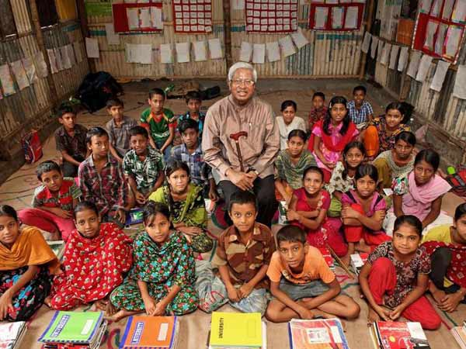
NGOs as Catalyst

Slide 19
Development as a Concept
The concept of “Development” is neither new or old. It is continuously changing and dynamic.
The nature of development as seen in any point of time is different from the other.
Development is a complex phenomenon comprising many dimensions: economic, social, political and administrative etc. It varies context to context, country to country, region to region. To define development, economic indicators are mostly used in the globe.
Different disciplines have viewed development from various perspectives: Economist argue that economic development is the basic indicator measured through the GDP distribution per capita.

Slide 20
Development as a Concept
Development is intended to bring a positive change for human
being and its surroundings. Development could be economic, social (social indicators), environmental (sustainable use of natural resources) or sectoral (Agricultural, Industrial, Service
sectors for example).
According to Gunnar Myrdal, Development means “the process away from underdevelopment of rising out of poverty.”
E. W. Weidener told that “Development is a state of mind, a tendency, a direction rather than a fixed goal, it is a rate of change in a particular direction.”
UN Asian Development Institute defines “Development may be understood as organized growth, i.e. growth which is brought about economically and efficiently and growth which is associated with the desired change in attitude, institutions, conditions of production and the levels of living of people.”

Slide 21
What is Development?
The use of the term development to refer to economic growth. It is a both physical reality and a state of mind in which society has, through some combination of social, economic and institutional processes, secured the means for obtaining a better life.
Tayebwa told that “development is a broad term which should not be limited to mean economic development, economic welfare or material wellbeing as per, development in general includes improvements in economic, social and political aspects of whole society like security, culture, social activities and political institutions.
Rogers told that “development is a long participatory process of social change in the society whose objective is the material and social progress for the majority of population through a better understanding of their environment.”

Slide 22
Dimensions of Development
Development should not be viewed in terms of economic development alone. It encompasses many other aspects as well, such as, political, social, cultural and administrative.
Economic development: raising national income, reducing poverty and more equitable distribution of wealth and income are all essential components of economic development
Political development: is the capacity of a political system to deal with its own fundamental problems more effectively while responding to the changing political demands of the people
Social development: It means bringing about improvement in the social being of the people. It lays stress on provision of health services, education, housing, cultural amenities etc.
Administrative development: It covers both the development of administration and the administration of development. The former refers to strengthening and improving administrative capabilities and the latter is concerned with the organization and management of development.

Slide 23
Core values of Development
Development can be seen… as a process of expanding the real
freedoms that people enjoy (Amarya Sen).
Three basic components that serve as a conceptual basis for understanding the inner meaning of development.
Life sustenance: the ability to provide basic needs that include food, shelter, health and protection. Improvement in the ‘quality of life is called development
Self-esteem: to be a person, it means a sense of worth and self respect that includes identity, dignity, respect, honor or recognition.
Freedom from Servitude: to be able to choose, it means freedom or emancipation from alienating material conditions of life and from social servitude to nature, ignorance, misery, institutions and dogmatic beliefs.

Slide 24
NGOs and Development
In 1980s, NGOs appealed to different sections of the development Community for different reasons.
Some Western donors were frustrated with bureaucratic and ineffective government-to-government, project based aid system.
NGOs were capable of providing an alternative and more flexible funding channel.
Higher chance of local level implementation and grassroots participation were expected
NGOs recognized the centrality of people in development policies.
NGOs were expected to have comparative advantages over government and public sector.
Since NGOs were more locally rooted organizations, they were expected to promote local participation.

Slide 25
NGOs and Development
NGOs were supposed to be closer to marginalized people than government officials.
Government agencies faced resource shortages and their decision making process was manipulated by the elites.
Due to their use of voluntary community input, NGOs were expected to operate at a lower cost.
NGOs possess the scope to experiment and innovate with alternative ideas and approaches to development.
NGOs were bringing a set of new and progressive development agendas of participation, gender, environment and empowerment.
As part of Structural Adjustment Policies (SAPs), NGOs were perceived as a cost-effective and efficient alternative to public sector service delivery.

Slide 26
NGOs and Development
From the late 1970s, World Bank and the IMF provided loans to governments on one condition – Structural Adjustment.
Under Structural Adjustment, govt. had to reduce the role of the state in running of the economy and social sectors.
Governments had to open up the economy to foreign investment and to reduce barriers to trade.
After the ending of the Cold War, international donor community was backing a new policy agenda of “good governance”.
“Good Governance” perceive development outcomes as emerging from a balanced relationship between government, market and third sector.
NGOs became a part of “Good Governance” concept as an emerging civil society.

Slide 27
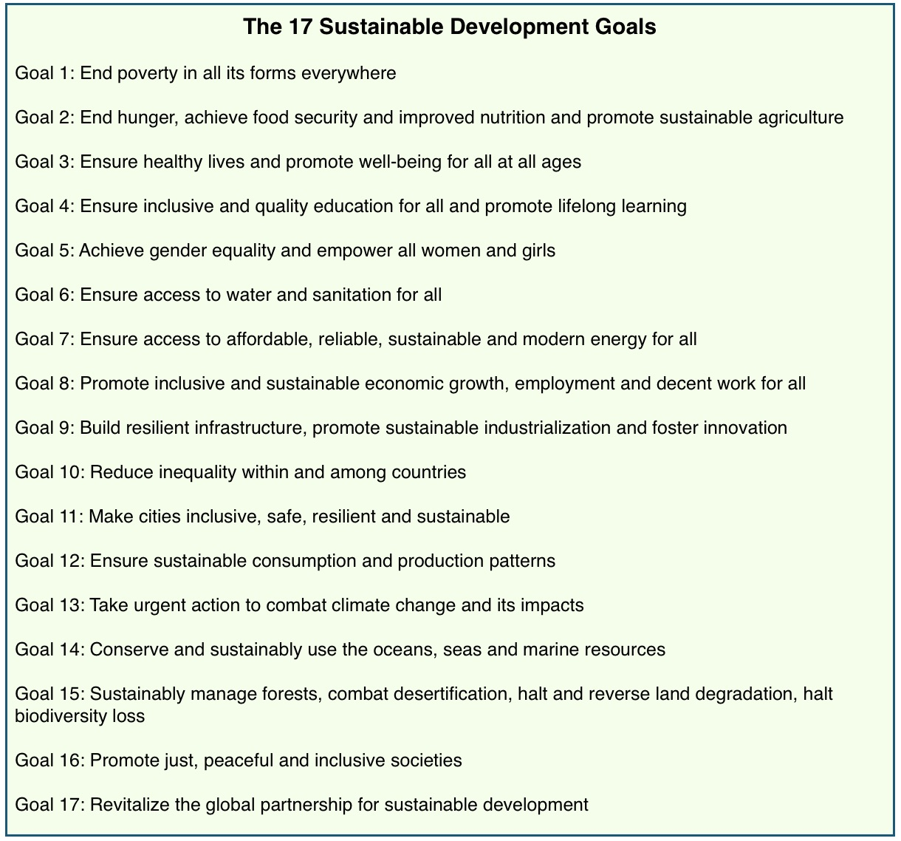
Sustainable Development Goals (SDGs)
In 2015, The UN General Assembly adopted a new development agenda for the period 2016-2030 that includes a set of goals.

Slide 28
References
Lewis, D., & Kanji, N. (2009). Non-governmental organizations and development. Routledge.
Vakil, A. C. (1997). Confronting the classification problem: Toward a taxonomy of NGOs. World development, 25(12), 2057-2070.
Charnovitz, S. (1997). Two centuries of participation: NGOs and international governance. Mich. J. Int'l L., 18, 183.
Begum, A. (2003). Government NGO Interface in Development Management, AHDP.
Fisher, Julie. (1998) Non-Governments-NGOs and the Political Development of the Third World. Kamaria Press.
Fowler, A. (1999) Striking a Balance. Earthscan Publications Ltd.
Lovell, Catherine H. (1992) Breaking the Cycle of Poverty: The BRAC Strategy. University Press Ltd.

