Slide 1
CE 413
Lecture On
Types of Composite Column
Md. Abu Hasan
Senior Lecturer
Department of Civil Engineering
Daffodil International University.

Slide 2
ADVANTAGES OF COMPOSITE COLUMNS
Increased strength for a given cross sectional dimensions.
Increased stiffness, leading to reduced slenderness and increased buckling resistance.
Increased ductility and load retention even after extensive concrete damage.
Good fire resistance
Better Corrosion protection
Significant economic advantages over either structural steel or RCC alternatives.
Simple construction and architectural detailing.
Erection of high rise building in an extremely efficient manner.
Requirement of less formwork for concrete.
Additional toughness which makes it excellent choice for blast loading

Slide 3
Po = 0.85Ac fc′+AsrFyr+AsFy
ADVANTAGES OF COMPOSITE COLUMNS
^{A}sr
A
A
c
s
Steel Section
Steel Concrete Composite Section

Slide 4
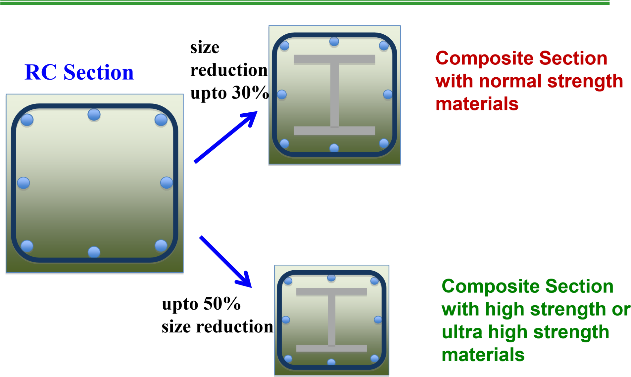
ADVANTAGES OF COMPOSITE COLUMNS

Slide 5
COMPOSITE COLUMNS
Fully encased composite (FEC) Columns
Partially Encased Composite (PEC) Columns
Concrete Filled Tubes / Hollow Structural Sections

