Slide 1
Separation of Powers
Constitutional Law
of Bangladesh
(LAW 315)

Slide 2
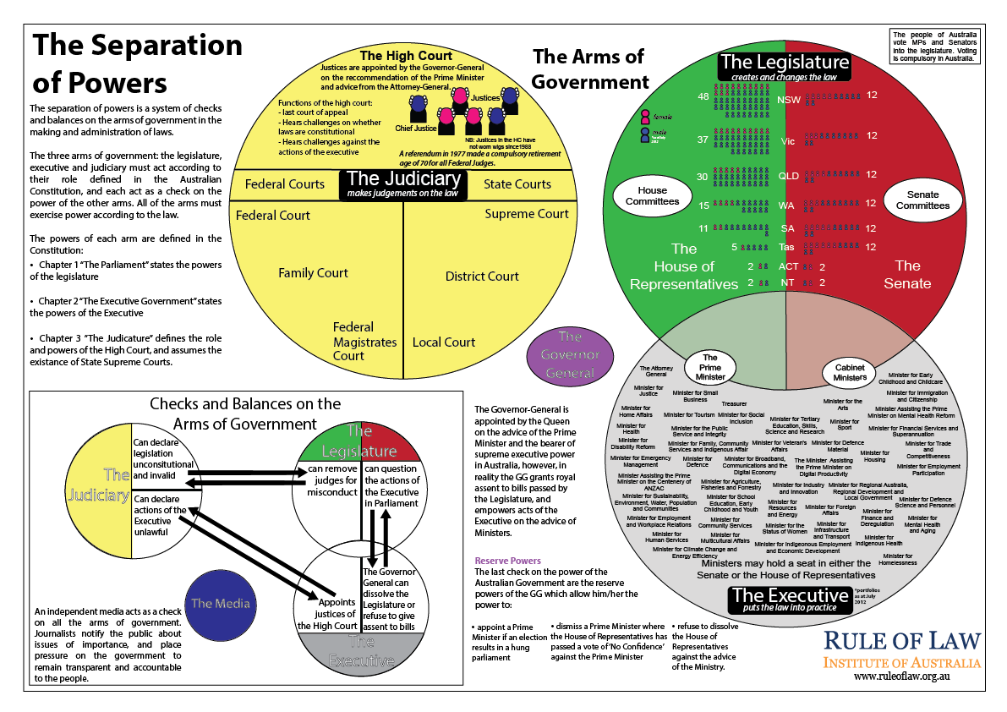

Slide 3
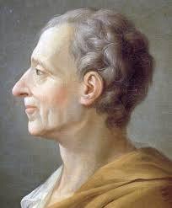
Montesquieu (1689-1755)

Slide 4
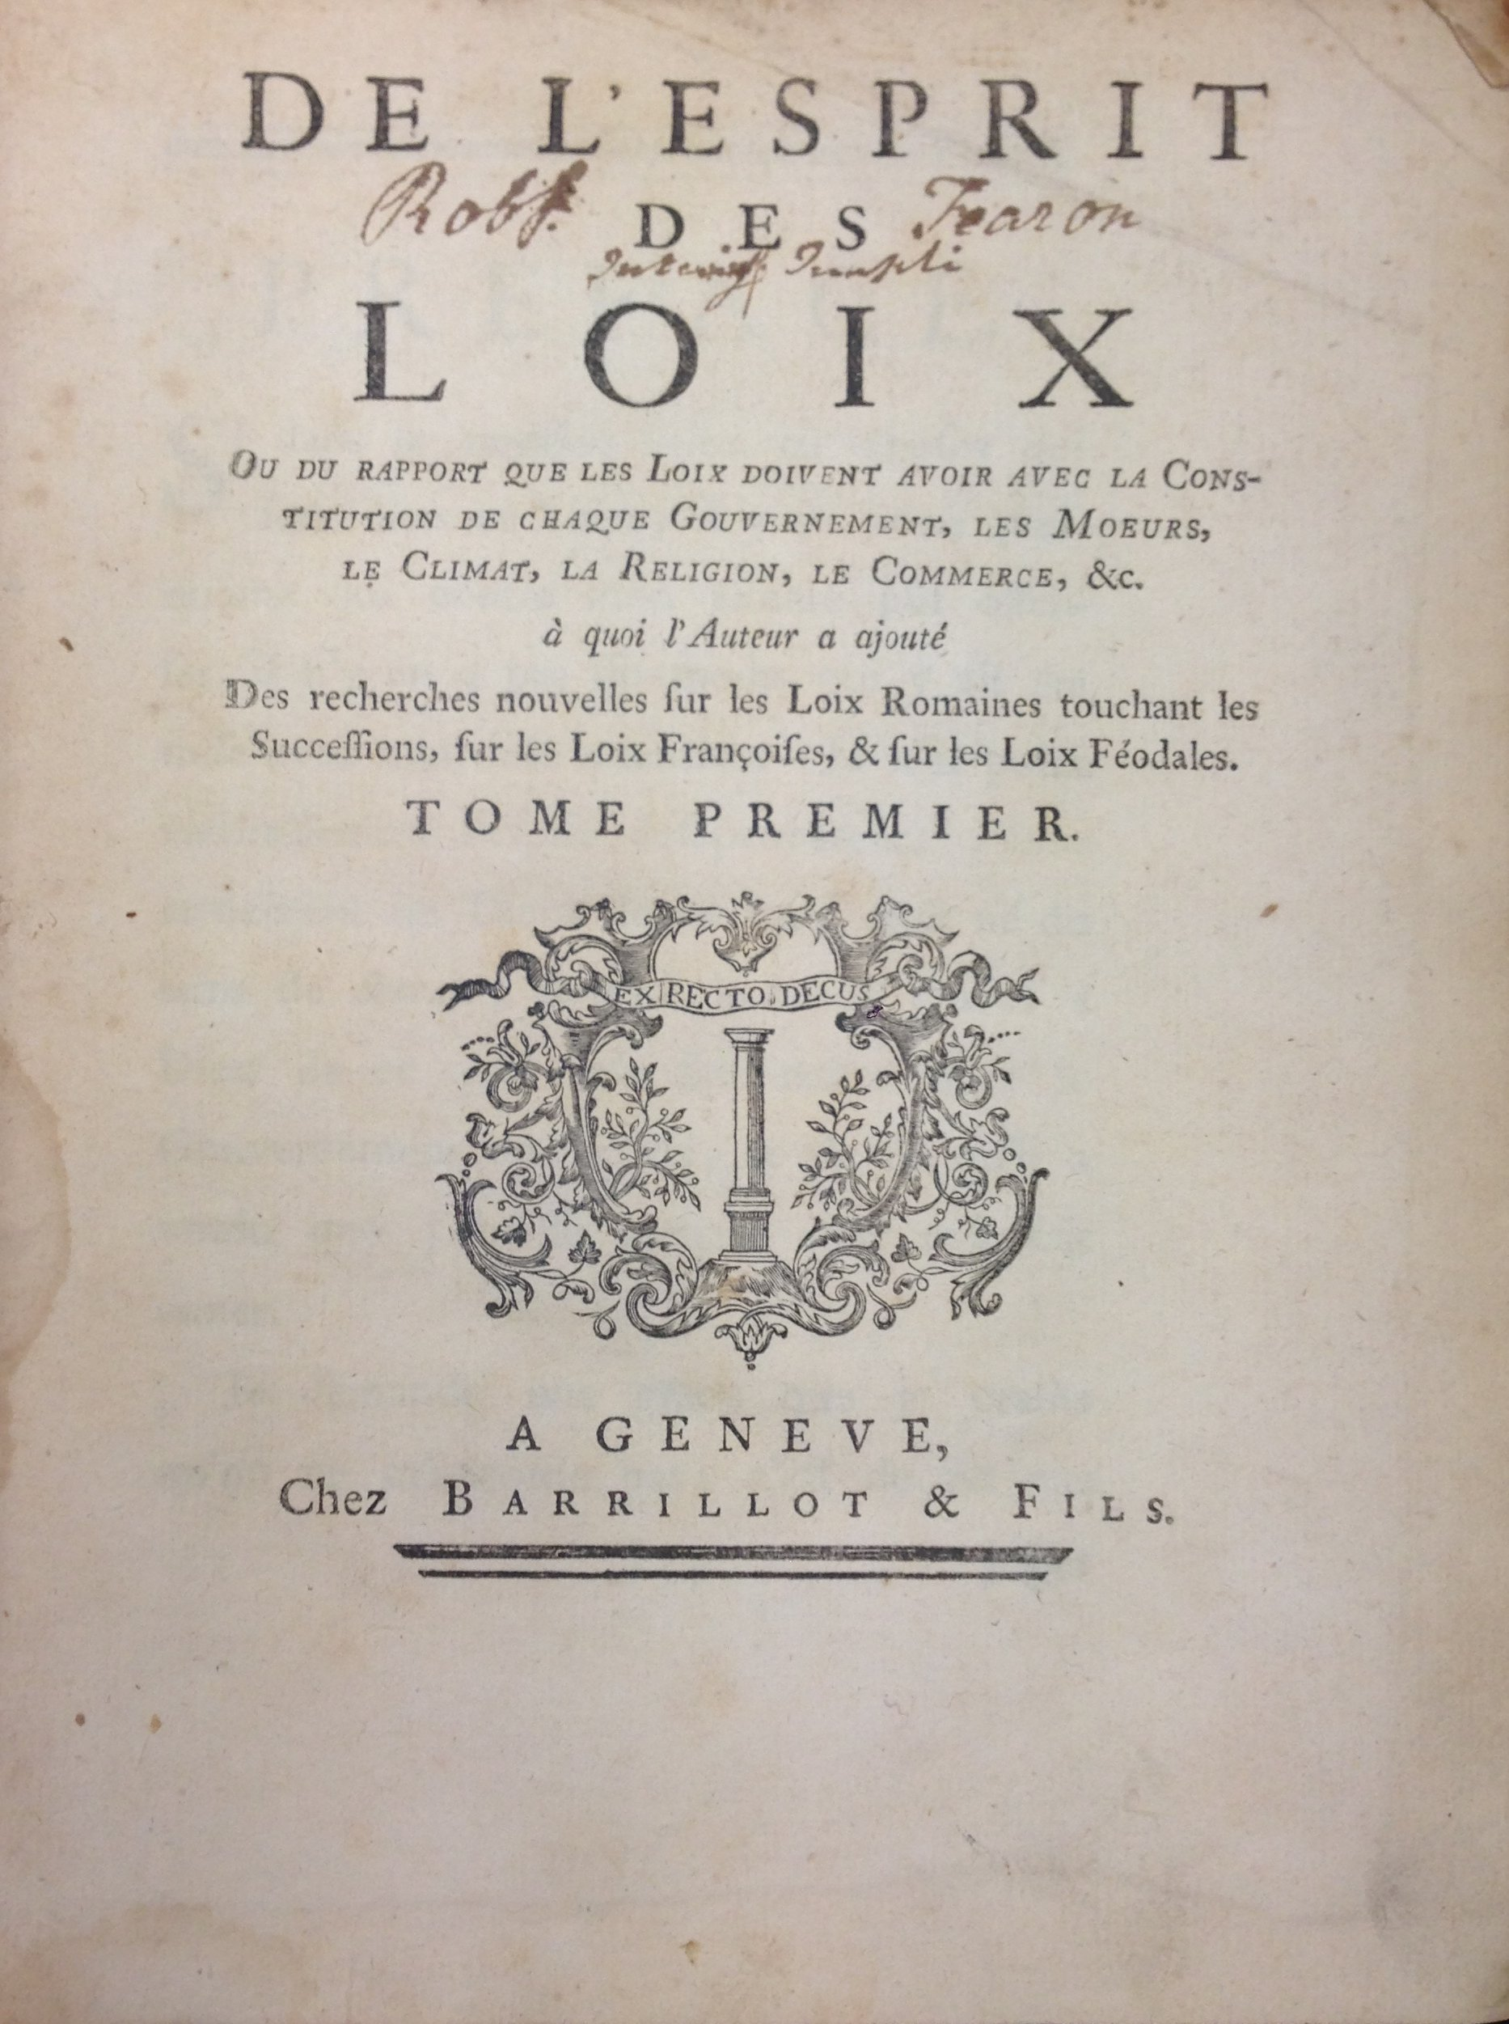
De L’Esprit des Lois: The Spirit of Laws (1748)

Slide 5
Absolutism/Despotism: Unified Powers
In every government there are three sorts of power: the legislative; the executive in respect to things dependent on the law of nations; and the judiciary in regard to matters that depend on the civil law. By virtue of the first, the prince or magistrate enacts temporary or perpetual laws, and amends or abrogates those that have been already enacted. By the second, he makes peace or war, sends or receives embassies, establishes the public security, and provides against invasions. By the third, he punishes criminals, or determines the disputes that arise between individuals. The latter we shall call the judiciary power, and the other, simply, the executive power of the state.
/Baron de Montesquieu, The Spirit of the Laws, Book XI

Slide 6
Montesquieu’s Theory of Separation of Powers
When the legislative and executive powers are united in the same person, or in the same body of magistrates, there can be no liberty; because apprehensions may arise, lest the same monarch or senate should enact tyrannical laws, to execute them in a tyrannical manner.
Again, there is no liberty if the judiciary power be not separated from the legislative and executive. Were it joined with the legislative, the life and liberty of the subject would be exposed to arbitrary control; for the judge would be then the legislator. Were it joined to the executive power, the judge might behave with violence and oppression.
There would be an end of every thing, were the same man, or the same body, whether of the nobles or of the people, to exercise those three powers, that of enacting laws, that of executing the public resolutions, and of trying the causes of individuals.
/Baron de Montesquieu, The Spirit of the Laws, Book XI

Slide 7
Montesquieu Against Parliamentary Form of Government?
The executive power ought to be in the hands of a monarch, because this branch of government, having need of dispatch, is better administered by one than by many: on the other hand, whatever depends on the legislative power, is oftentimes better regulated by many than by a single person. But, if there were no monarch, and the executive power should be committed to a certain number of persons, selected from the legislative body, there would be an end of liberty, by reason the two powers would be united; as the same persons would sometimes possess, and would be always able to possess, a share in both.
/Baron de Montesquieu, The Spirit of the Laws, Book XI

Slide 8
Parliamentary Form versus Presidential Form of Government!
Bangladesh maintains parliamentary form of government. On the other hand, the United States maintains presidential form of government.
What are those two forms of governments?

Slide 9
parliamentary form of government
A parliamentary system is a system of democratic governance of a state where the executive derives its democratic legitimacy from its ability to command the confidence of the legislature (a parliament) and is also held accountable to that parliament.

Slide 10
Bangladesh: Parliamentary Form of Government
According to Article 56 (3) of Bangladesh Constitution, “The President shall appoint as Prime Minister the member of Parliament who appears to him to command the support of the majority of the members of Parliament.”
According to Article 55 (2) of Bangladesh Constitution, “The executive power of the Republic shall, in accordance with this Constitution, be exercised by or on the authority of the Prime Minister.”
According to Article 55 (3) of Bangladesh Constitution, “The Cabinet shall be collectively responsible to Parliament.”

Slide 11
presidential form of government
A presidential system is a democratic system of government where a head of government leads an executive branch that is separate from the legislative branch.

Slide 12
The United States: Parliamentary Form of Government
According to Article II, Section 1 of the US Constitution, “The executive power shall be vested in a President of the United States of America. He shall hold his office during the term of four years, and, together with the Vice President, chosen for the same term, be elected…”.

Slide 13
Judicial Review: Cornerstone of Separation of Powers
The concept of Judicial Review originated in the United States. But there is no mention of this concept in the US Constitution. It originated in an US Supreme Court case Marbury v. Madison (1803).

