Slide 1
Md. Samaun Hasan
Lecturer
Department of Multimedia and Creative Technology
ID: 710001543

Slide 2
Art
Fundamentals

Slide 7
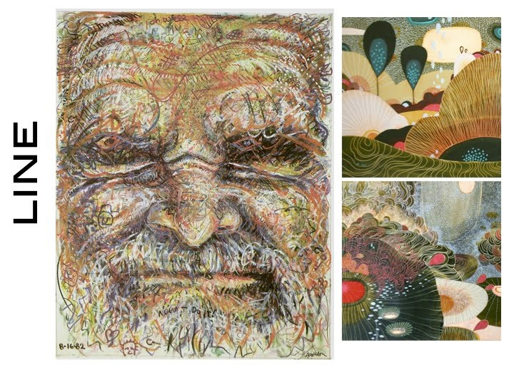

Slide 12
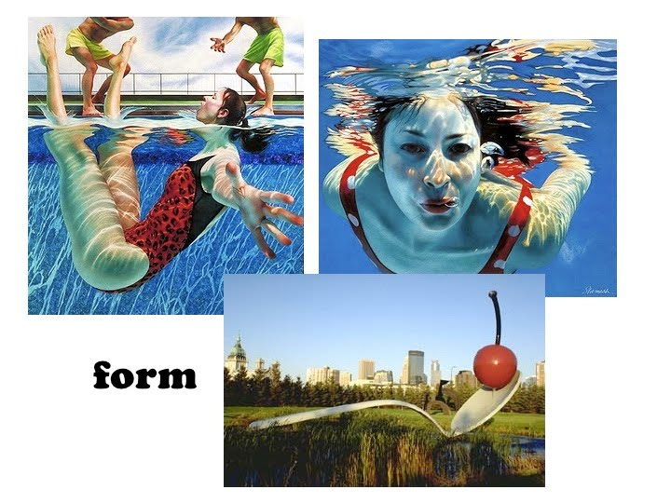

Slide 15
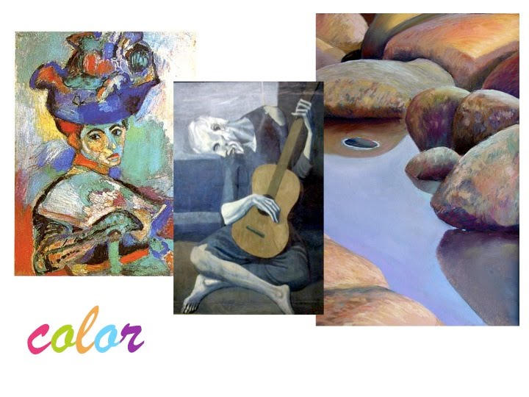

Slide 20
Thank You…

