Slide 1
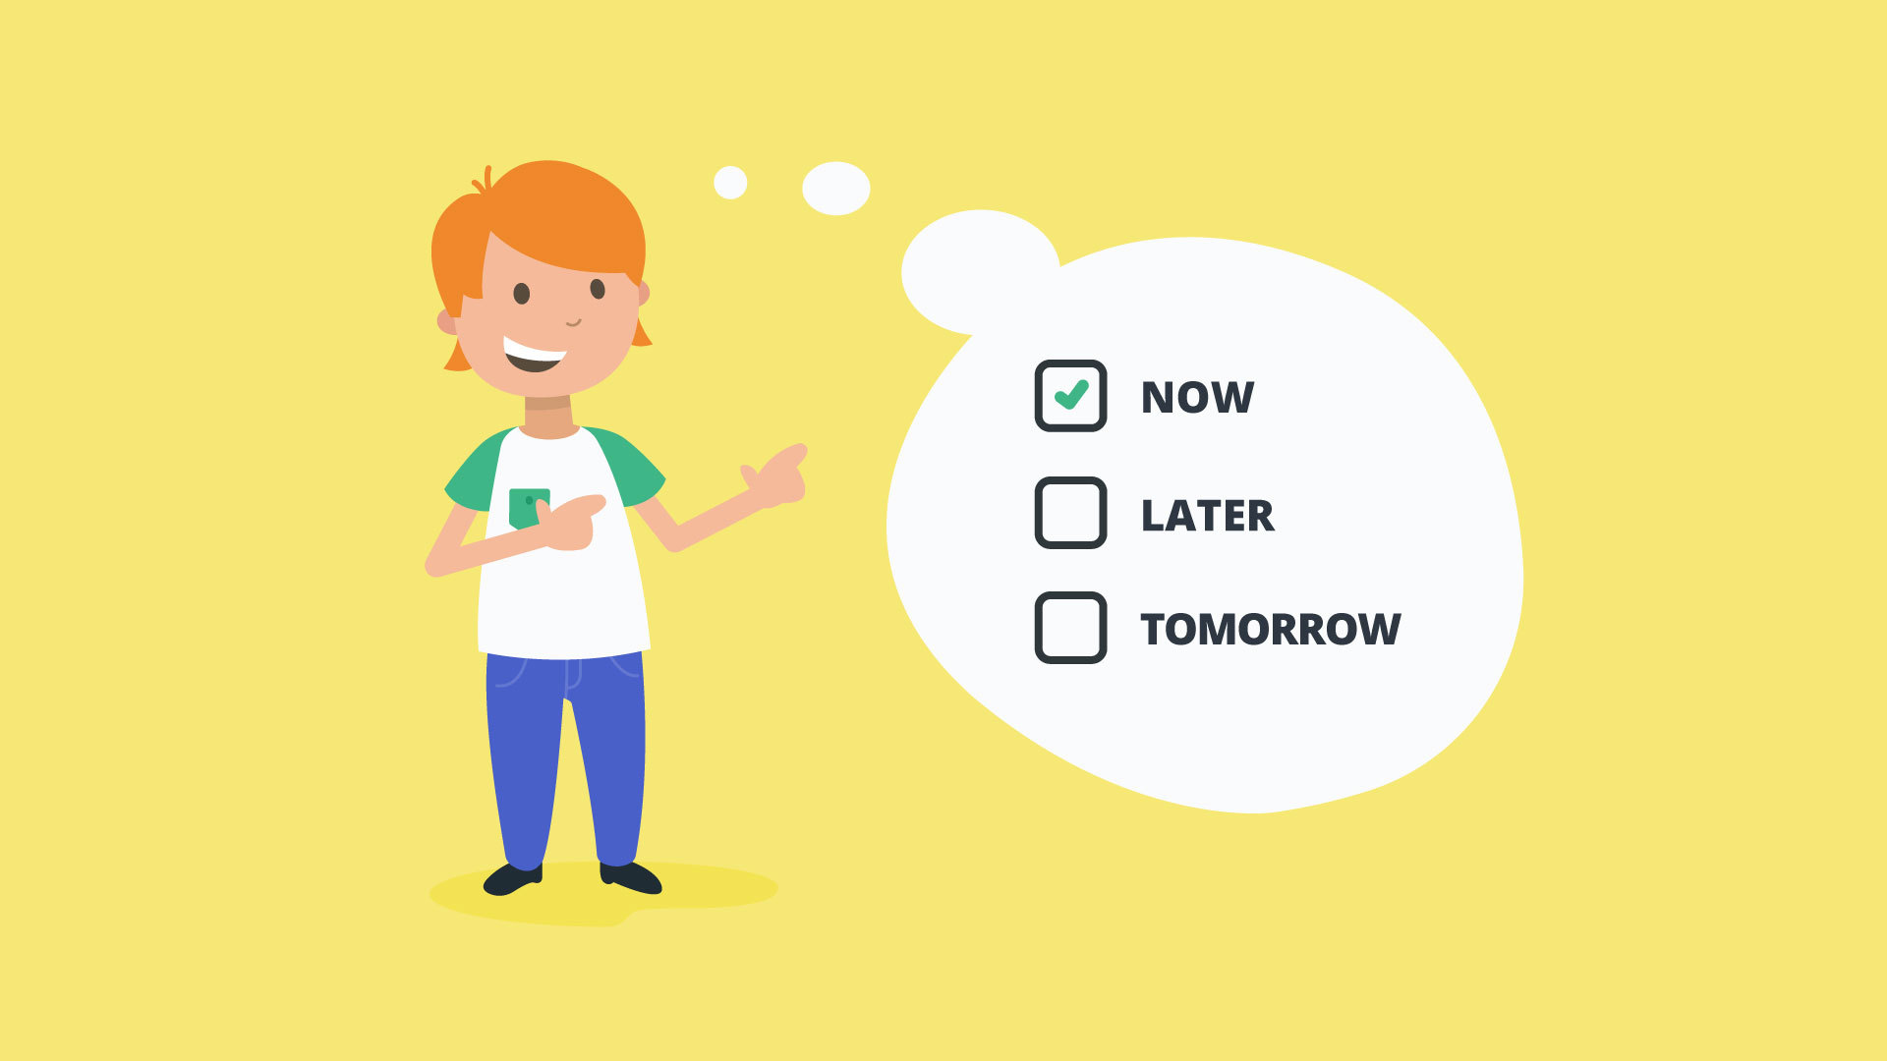
Overcoming Procrastination - Stop Delaying, Start Doing!
Conducted By:
Bilkis Khanam
Psychologist
Daffodil International University

Slide 2
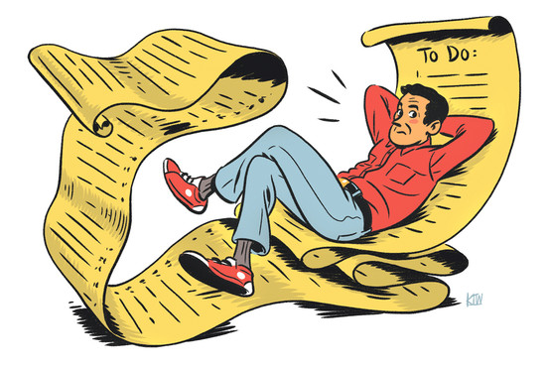
Session 2: Understanding Procrastination (Part 1)
Session Content:
What do you procrastinate about?
How do you procrastinate?
Excuses for Procrastination
Unhelpful rules & assumptions
Consequences of procrastination

Slide 3
What do you procrastinate about?
Work | Household | Study | Health
Meeting deadlines Making phone calls Attending meetings Starting or finishing projects Paperwork Job applications Research or reading | Daily chores (dishes, tidying, cooking, etc.) Bigger chores (washing, ironing, etc.) cleaning the house Household projects Maintenance and fixing things Grocery shopping Gardening | Meeting deadlines Attending classes Homework Assignments Studying for exams Research or reading Asking questions or requesting help | Making medical appointments Attending medical appointments Changing diet Starting an exercise routine Losing weight Quitting smoking/alcohol/drugs
Financial | Social, Family & Relationships | Self-Development | Decision Making
Paying the bills Budgeting | Making phone calls Replying to invitations Spending time with others Arranging or attending get together Discussing problems | Starting a course you always wanted to do Starting a hobby Getting involved in something spiritual Relaxation | Making plans Committing to something new Choosing between options

Slide 4
What do you procrastinate about?
Tasks/Goals I would like to work on
1.
2.

Slide 5
How Do You Procrastinate?
Pleasurable Tasks | Lower Priority Tasks | Distractions
Movies, TV, DVDs Reading Books, Magazines, Newspapers Computer games Surfing the Net Music Shopping Hobbies (art, craft, etc) | Exercising Paperwork Sorting things Tidying Other less important projects Checking emails Researching a topic of interest | Sleeping Eating Smoking Drinking Drugs
Socializing | Daydreaming | Others
Seeing friends, family, partner Phoning friends, family, partner Going out | Thinking about the past or future Imagining the task/goal is already finished Imagining a better life

Slide 6
Do You Excuse Procrastination?
Below are some common Procrastination Excuses.
I’m too tired, I’ll do it tomorrow
I don’t have everything I need, I can’t start it now
I don’t have enough time to do it all, so I will wait until I do
It is too late to start it now
I won’t get much done, so I’ll just leave it for now
It is better to do it when I am in the mood or feeling inspired
I will miss out on the fun happening now, I can do it another time
It is too nice a day to spend on this
I’ve got to organize my desk/kitchen/laundry, etc. first
I’ve got to exercise first
I am too busy to do it now
I have plenty of time, so I can do it later
I work better when I am stressed, so I will leave it to the last minute
It might not be good enough, so why bother doing it
Working on it today won’t make any difference”
I will do it once this other thing is finished

Slide 7
Unhelpful Rules & Assumptions
Need To Be In Charge: “Things should be done my way”, “I shouldn’t have to do things that I don’t want to do”
Pleasure Seeking: Impulsive, seek out pleasure and have difficulty tolerating boredom.
Fear Of Failure Or Disapproval
Fear Of Uncertainty Or Catastrophe
Low Self-Confidence
Depleted Energy

Slide 8
Find out your unhelpful rules & assumptions
Need To Be In Charge | Pleasure Seeking
I must be in charge at all times  Things should be done my way I shouldn’t have to do things that I don’t want to I shouldn’t have to do things because someone else says so If I am not 100% in charge of what I do, then I am weak | Life is too short to be doing things that are boring or hard Fun should always come first Life should be fun at all times Pleasure here & now should be all that matters If I forgo fun, then I will become a boring lifeless drone

Slide 9
Find out your unhelpful rules & assumptions
Fear Of Failure Or Disapproval | Fear Of Uncertainty Or Catastrophe
I must do things perfectly I must not fail  I can’t have others think poorly of me If I try, then I will only fail If I put my work out there, then others will think badly of me | I must be certain of what will happen I should be prepared for the worst I can’t stand not knowing the outcome If I take action, then something bad will happen I am better off not doing anything, than risk it going bad

Slide 10
Find out your unhelpful rules & assumptions
Low Self-Confidence | Depleted Energy
I can’t do things because I am incapable I’m too inadequate so I can’t get things done If I try things, then my inadequacies will show through I shouldn’t try things when I know I’m no good If I know I won’t be able to do something, then I shouldn’t bother | I can’t do things when I am stressed/ fatigued/ unmotivated/ depressed I must rest when my energy is low I must be energized to be able to do things If I do things when I am stressed/ fatigued/ unmotivated/ depressed, I will make things worse If I do things when I am not energized, then it won’t work out

Slide 11
Consequences Of Procrastination
Positive Consequences: make you more likely to procrastinate next time you face the task or goal, because you got something good out of procrastinating and procrastination worked for you in some way.
Relieve Discomfort.
Gain Pleasure

Slide 12
Consequences Of Procrastination
Negative Consequences: often make the situation worse in some way, making the task or goal even harder or more unpleasant in many senses
More Discomfort.
Self-Criticism
Punishment Or Loss.

Slide 13
Find out consequences you have faced
Positive Consequences | Negative Consequences
How Do These Keep Me Procrastinating? | How Do These Keep Me Procrastinating?

