Slide 1
10. Pest management in food industry and storage.

Slide 2
INSECT PESTS OF FOOD AID
About 30 species of insect commonly infest food aid grain and grain products,
Although
there are 200–300 species that may occur from time to time.
Most insect pests are either beetles or moths although there are some other types.
In addition to insects, the only other invertebrates that are commonly found in stored food are mites.

Slide 3
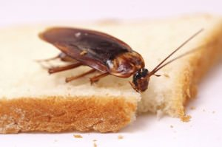
Definition of pest…….
Pests are defined as any harmful, noxious or troublesome organism.
Common pests include insects, mites, rodents, fungi and weeds that wreak havoc on people, plants, animals or the ecology in general.

Slide 4
Common pest in food Storage

Slide 5
Objectives of pest management….
Prevent and control pests.
Know signs of pest infestation and activity.
Know how to store pesticide correctly.
Know how to select a pest control operation.

Slide 6
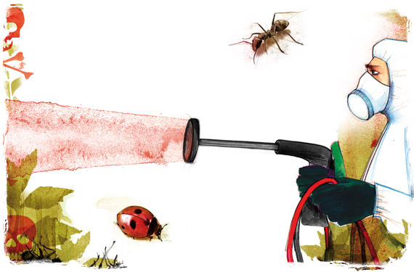
Importance of pest management
Infestation of farms and forests
Obstructions to streams and waterways
Damage to crops
Loss of wildlife habitats
Disease and quality of life impacts in populated areas.

Slide 7
BEETLES VS MOTHS

Slide 8
LIFE STAGES OF INSECTS IN STORED FOOD
During the course of their lives, insects pass through a number of stages.
The adult stage is responsible for reproduction.
After mating, females lay eggs in selected places.
Immature insects hatch from the eggs and then feed and grow to become adults.
For many insects, the immature stage differs in form greatly from the adult, andis
called a larva (Figure 12.3).
When the larva hatches from an egg it is very small, typically 1–2 mm long. It begins to feed and grow immediately, but the larval skin is unable to stretch so the larva must shed its outer skin, a process called moulting, to allow growth.
Moulting occurs several times, and when a larva is fully grown the final moult
produces an immobile stage known as a pupa (Figure 12.3).
Although the pupa is unable to move about, it is physiologically very active with the tissues becoming reorganized in such a manner that the larva changes (or metamorphoses) into the adult.
At the end of the pupation period (typically 5–6 days), the fully formed adult
emerges from the pupal skin (Figure12.3).

Slide 9
DEFINE LARVA
the active immature form of an insect, especially one that differs greatly from the adult and forms the stage between egg and pupa.
Pupa = an insect in its inactive immature form between larva and adult.

Slide 10
MOULTING
LARVA AND PUPA

Slide 11
Advantages of pest management
Minimize the risk of pests developing resistance to pesticides
Reduce the risk to farm workers/operators
Reduce chemical and labour costs
Prevents damage to the environment
Disadvantages of pest management
More time required
Initially complicated decision-making
Crop monitoring results that can be difficult to interpret
Low or nil tolerance to insect contamination for low value crops

Slide 12
Common Pest Signs
Cockroaches
Egg casings (small shells that are black, brown, or dark red)
Small droppings that look like black pepper grains
Flies
Seeing flies regularly in your establishment
Observing a large number of flies around garbage cans or waste containers
Rodents
Small black droppings
Strong smell of ammonia (rodent urine)

Slide 13
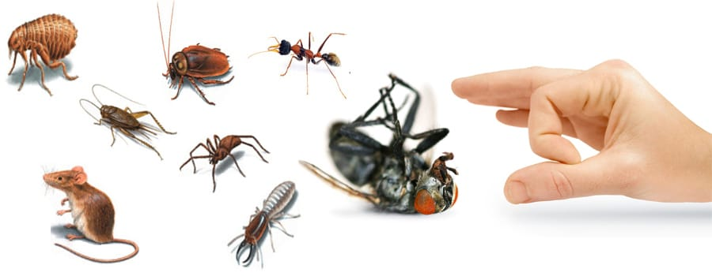
Methods for Preventing Pest Infestations
Block entry points (exclusion) Eliminating entry points for pests will help keep them out of your establishment. This could include patching holes in walls and keeping doors closed as often as possible.
Eliminate sources of food, water, and shelter. Pests are always on the hunt for food, water, and shelter.

