Slide 1
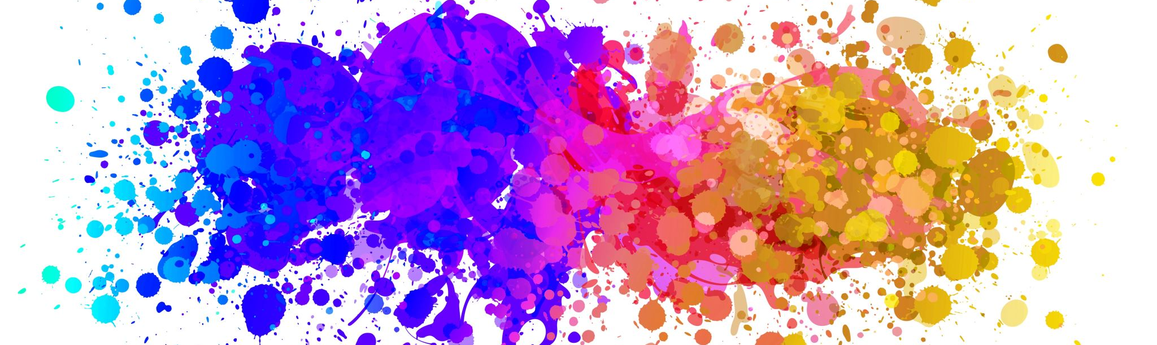
Gender and Population
Reproductive and Child Health
Dr. S. M. Rezoun Shafiullah, MBBS, MPH
Lecturer,
Department of Public Health
Daffodil International University

Slide 2
Concept of Sex and Gender
What do we mean by Sex and Gender?
What is SDG’s?
How is Sex and Gender related to SDG? Or Importance of gender in SDG?

Slide 3
Sex and gender are terms that are often used interchangeably.
However, they are in fact two different concepts, even though for many people their sex and gender are the same.
How and why sex and gender is important for SDGs and the principle of “leave no one behind” is used in this case.

Slide 4
Sustainable Development Goals

Slide 5
Definition of Sex
Sex refers to the biological aspects of an individual as determined by their anatomy, which is produced by their chromosomes, hormones and their interactions.
Generally male or female.
Assigned at birth.

Slide 6
Definition of Gender
Gender is a social construction relating to behaviors and attributes based on labels of masculinity and femininity;
Gender identity is a personal, internal perception of oneself and so the gender category someone identifies with may not match the sex they were assigned at birth
An individual may see themselves as a man, a woman, as having no gender, or as having a non-binary gender – where people identify as somewhere on a spectrum between man and woman.

Slide 7
WHO on Gender
The World Health Organization describes sex as characteristics that are biologically defined, whereas gender is based on socially constructed features.
They recognize that there are variations in how people experience gender based upon self-perception and expression, and how they behave.

Slide 8
Gender- Background
Essentially, nearly all people are born with physical characteristics that are labelled male or female.
In 1964, Robert Stoller coined the term gender identity, which refers to an individual’s personal concept about their gender and how they feel inside. It is a deeply held internal sense of self and is typically self-identified.
Gender identity differs from sexual identity and is not related to an individual’s sexual orientation. As such, the gender category with which a person identifies may not match the sex they were assigned at birth.
Notes:
Stoller, R. J. (1964). A contribution to the study of gender identity. The International Journal of
Psychoanalysis, volume 45 issues 2 to 3, pages 220 to 226.

Slide 9
Variations in sex characteristics
Sex and gender are both generally referred to in two distinct categories: male and female or man and woman.
However, naturally occurring instances of variations in sex characteristics (sometimes known as intersex) also exists where people are born with hormones, chromosomes, anatomy or other characteristics that are neither exclusively male nor female.
They are usually assigned a sex (male or female) by their family or doctor at birth as birth certificates require the sex of the child – either male or female.
Individuals with variations in sex characteristics might identify as male, female, or intersex, and they may consider themselves to be a man, a woman, or to have a non-binary identity.

Slide 10
Transgender
Transgender or trans is an umbrella term for people whose gender identity is different from the sex assigned at birth. The Equality Act 2010 contains the protected characteristic of gender reassignment, which is defined as follows:
“A person has the protected characteristic of gender reassignment if the person is proposing to undergo, is undergoing or has undergone a process (or part of a process) for the purpose of reassigning the person's sex by changing physiological or other attributes of sex.”
This definition covers a wide range of people at varying stages of transition. A person does not need to have legally changed their gender to be included within the definition of the protected characteristic, nor do they need to have had any kind of surgery. The protection extends to anyone who has been treated less favourably because of gender reassignment, regardless of whether they have that characteristic or not.
Many trans people go through a process called transitioning: changing how people see them and the way they look to align with their gender identity. It can involve changing characteristics, appearance, names and pronouns, and may include medical treatment, such as hormone therapy or surgery. Some people may not go on to have surgical procedures, but just have the “lived experience” in the gender they identify as

Slide 11
Sustainable Development Goals (SDGs): gender and sex
The Sustainable Development Goals (SDGs) are a universal set of goals, underpinned by targets and indicators. They seek to eradicate inequalities, ensuring that no one is left behind.
In the SDGs, the goals and targets tend to refer to gender, for example, “Goal 5: Gender equality” and “Target 4.a: Build and upgrade education facilities that are child, disability and gender sensitive and provide safe, non-violent, inclusive and effective learning environments for all”.
To meet the main principle of the SDGs is to “leave no one behind”. Each of these indicators are to be broken down, where relevant, by eight characteristics required by the United Nations (UN).

Slide 12
Gender stereotype
A stereotype is a widely accepted judgment or bias about a person or group — even though it’s overly simplified and not always accurate. Stereotypes about gender can cause unequal and unfair treatment because of a person’s gender. This is called sexism.
There are four basic kinds of gender stereotypes:
Personality traits — For example, women are often expected to be accommodating and emotional, while men are usually expected to be self-confident and aggressive.
Domestic behaviors — For example, some people expect that women will take care of the children, cook, and clean the home, while men take care of finances, work on the car, and do the home repairs.
Occupations — Some people are quick to assume that teachers and nurses are women, and that pilots, doctors, and engineers are men.
Physical appearance — For example, women are expected to be thin and graceful, while men are expected to be tall and muscular. Men and women are also expected to dress and groom in ways that are stereotypical to their gender (men wearing pants and short hairstyles, women wearing dresses and make-up.

Slide 13
Continues….
Hyperfemininity is the exaggeration of stereotyped behavior that’s believed to be feminine. Hyperfeminine folks exaggerate the qualities they believe to be feminine. This may include being passive, naive, sexually inexperienced, soft, flirtatious, graceful, nurturing, and accepting.
Hypermasculinity is the exaggeration of stereotyped behavior that’s believed to be masculine. Hypermasculine folks exaggerate the qualities they believe to be masculine. They believe they’re supposed to compete with other men and dominate feminine folks by being aggressive, worldly, sexually experienced, insensitive, physically imposing, ambitious, and demanding.
These exaggerated gender stereotypes can make relationships between people difficult. Hyperfeminine folks are more likely to endure physical and emotional abuse from their partners. Hypermasculine folks are more likely to be physically and emotionally abusive to their partners.
Extreme gender stereotypes are harmful because they don’t allow people to fully express themselves and their emotions. For example, it’s harmful to masculine folks to feel that they’re not allowed to cry or express sensitive emotions. And it’s harmful to feminine folks to feel that they’re not allowed to be independent, smart or assertive. Breaking down gender stereotypes allows everyone to be their best selves.

Slide 14
Getting rid off sterotype
There are ways to challenge these stereotypes to help everyone — no matter their gender or gender identity — feel equal and valued as people.
Point it out — Magazines, TV, film, and the Internet are full of negative gender stereotypes. Sometimes these stereotypes are hard for people to see unless they’re pointed out. Talk with friends and family members about the stereotypes you see and help others understand how sexism and gender stereotypes can be hurtful.
Be a living example — Be a role model for your friends and family. Respect people regardless of their gender identity. Create a safe space for people to express themselves and their true qualities regardless of what society’s gender stereotypes and expectations are.
Speak up — If someone is making sexist jokes and comments, whether online or in person, challenge them.
Give it a try — If you want to do something that’s not normally associated with your gender, think about whether you’ll be safe doing it. If you think you will, give it a try. People will learn from your example.
If someone has been struggling with gender or gender identity and expectations, It may help him/her to talk to a trusted parent, friend, family member, teacher, or counselor.

Slide 15
Any questions?
Thank you

