Slide 2
✔
✔
✔
✔

Slide 3
✔
✔
✔
✔

Slide 4
•
•
•
•
•
•
•

Slide 5
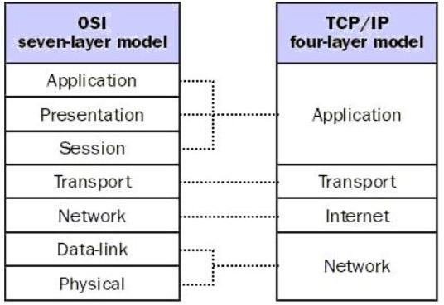
•
•
•

Slide 6
•
•
•
•
•
•
•
•
•

Slide 7
HTTP1.0 A non persistent connection is the one that is closed after the server sends the requested object to the client.
HTTP1.1 With persistent connections, the server leaves the TCP connection open after sending responses and hence the subsequent requests and responses between the same client and server can be sent.

Slide 8
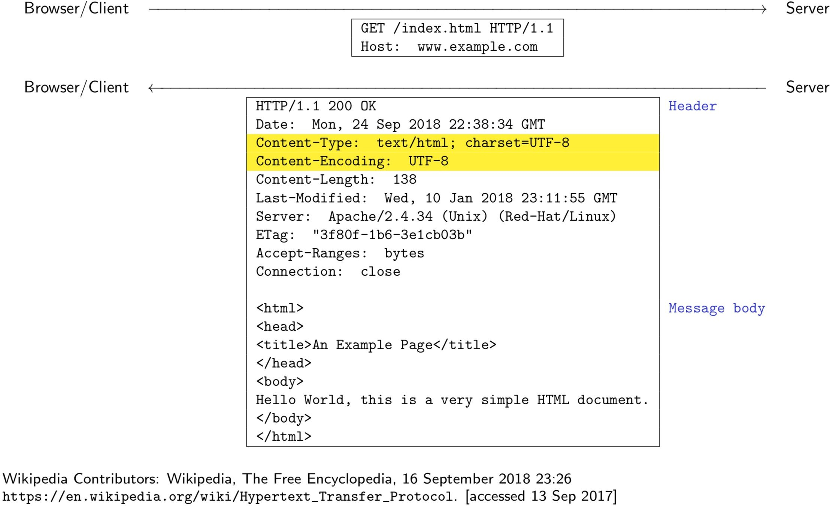

Slide 9
•
•
•

Slide 10
…
•
•
•
•
•
•
•
•
•
•
•

Slide 11
…

Slide 12
•
…
…
•
▪
▪
▪
▪
▪

Slide 13
•
•
•
•
•
•
•

Slide 14
•
•
•
•

Slide 15
•
•
•
•
•

Slide 16
•
•
•
•

Slide 17
•
•
•
•
•
•

Slide 18
•
•
•
•
•
•

Slide 19
•
•
•
•
•
•
•
•
•
•

Slide 20
•
•
•
•
•
•
̈ α

Slide 21
•
•
•
•
•
•

Slide 22
•
•
•
•
•
•
•

Slide 23
•
•
•

