Slide 1
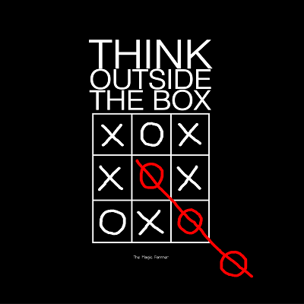
Creative thinking - how to get out of the box and generate ideas: Giovanni Corazza at TEDxRoma

Slide 2
Inside our BOX
we feel SAFE

Slide 3
What can happen if we try to step out ?

Slide 4
It can risk my REPUTATION

Slide 5
WHY
SO,
TO THINK OUT OF BOX

Slide 6
WE ARE NODES IN A NETWORK
WE SHARE INFORMATION
AND IN THE END, ALL POSSESS SAME INFORMATION.

Slide 7
IF WE ALL POSSESS SAME INFORMATION
THEN,
WHAT MAKES US DIFFERENT

Slide 8
THE DIFFERENCE LIES IN--
WHAT WE GENERATE FROM THAT COMMON SHARED INFORMATION

Slide 9
WHICH
BOX ARE WE TALKING ABOUT

Slide 10
SUPPOSE THIS PAGE IS OUR MIND..
THIS IS THE BOX
AND CONTAINS WHAT WE KNOW
THE REST IS WHAT STILL
WE HAVEN’T THOUGHT ABOUT

Slide 11
CONTENTS OF THIS BOX:
GENETIC HERITAGE
2. BOUNDARY CONDITIONS OR ENVIRONMENT
3. INDIRECT EXPERIENCES
4. DIRECT EXPERIENCES

Slide 12
HOW
DO WE GO OUT OF THIS BOX

Slide 13
WE NEED TO THINK BEYOND OUR CONVERGENT INFORMATION
THINK OF SOMETHING WHICH IS
WRONG
ABSURD
IRRELEVANT
DIVERGENT INFO

Slide 14
WE NEED TO THINK OF SOME LONG THOUGHT WHICH CAN TAKE US FAR

Slide 15
ENTER THE
ZONE

Slide 16
ALLOW THE EXISTENCE OF DIVERGENT INFORMATION

