Slide 1
IoT Data Communication
Course Code: CSE412
Course Title: Bigdata and IOT
Program: B.Sc. in CSE
Semester: Spring 2024
Instructor Name: Dr. Fizar Ahmed
Designation: Associate Professor
Email: fizar.cse@diu.edu.bd
Made By:
Md Aminul Hossain
Ibrahim Rashid Mazumder

Slide 2
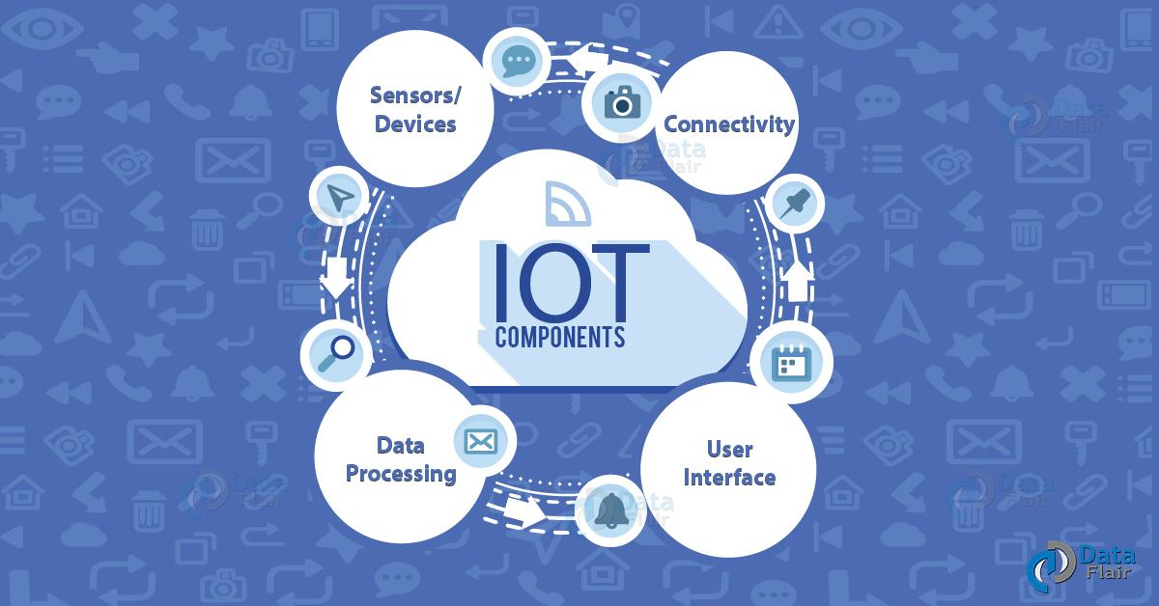
Introduction to IoT Data Communication
IoT data communication refers to the exchange of data between IoT devices.
Data can be transferred using wireless or wired connectivity methods.
Reliable data communication is essential for the successful operation of IoT systems.
Notes:
Image source: https://data-flair.training/blogs/how-iot-works/

Slide 3
Importance of Data Transfer in IoT
Data transfer enables real-time monitoring and control of IoT devices.
Efficient data communication ensures timely decision-making based on IoT data.
Reliable data transfer is crucial for maintaining the integrity and security of IoT systems.
Notes:
Image source: https://www.digi.com/blog/post/how-do-iot-devices-communicate

Slide 4
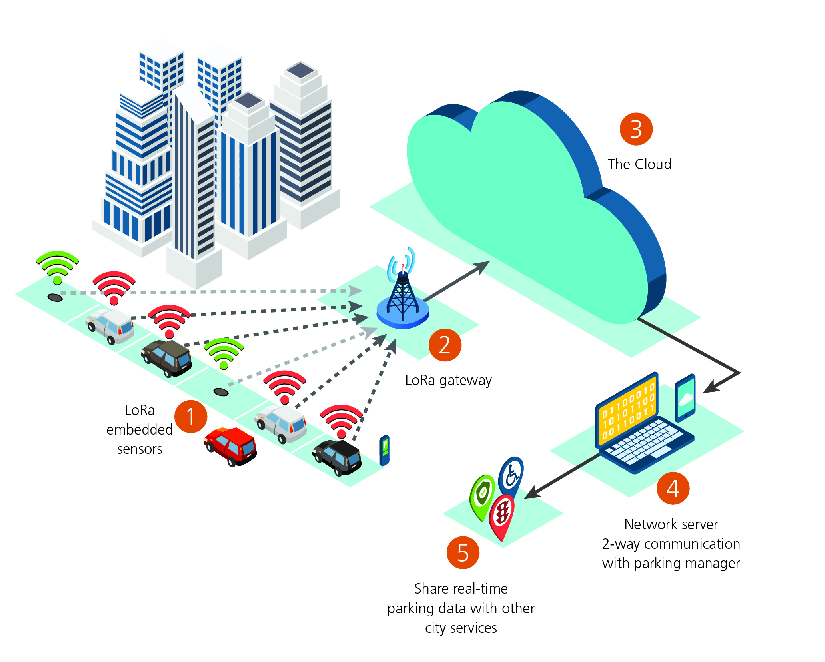
Wireless Connectivity in IoT Data Communication
Wireless connectivity, such as Wi-Fi, Bluetooth, and cellular networks, allows IoT devices to communicate without physical cables.
Wireless communication enables flexibility and scalability in IoT deployments.
IoT devices can transmit data wirelessly to centralized servers or other connected devices.
Notes:
Image source: https://www.electronicsweekly.com/news/iot-smart-cities-the-long-range-forecast-for-wireless-connectivity-2018-08/

Slide 5
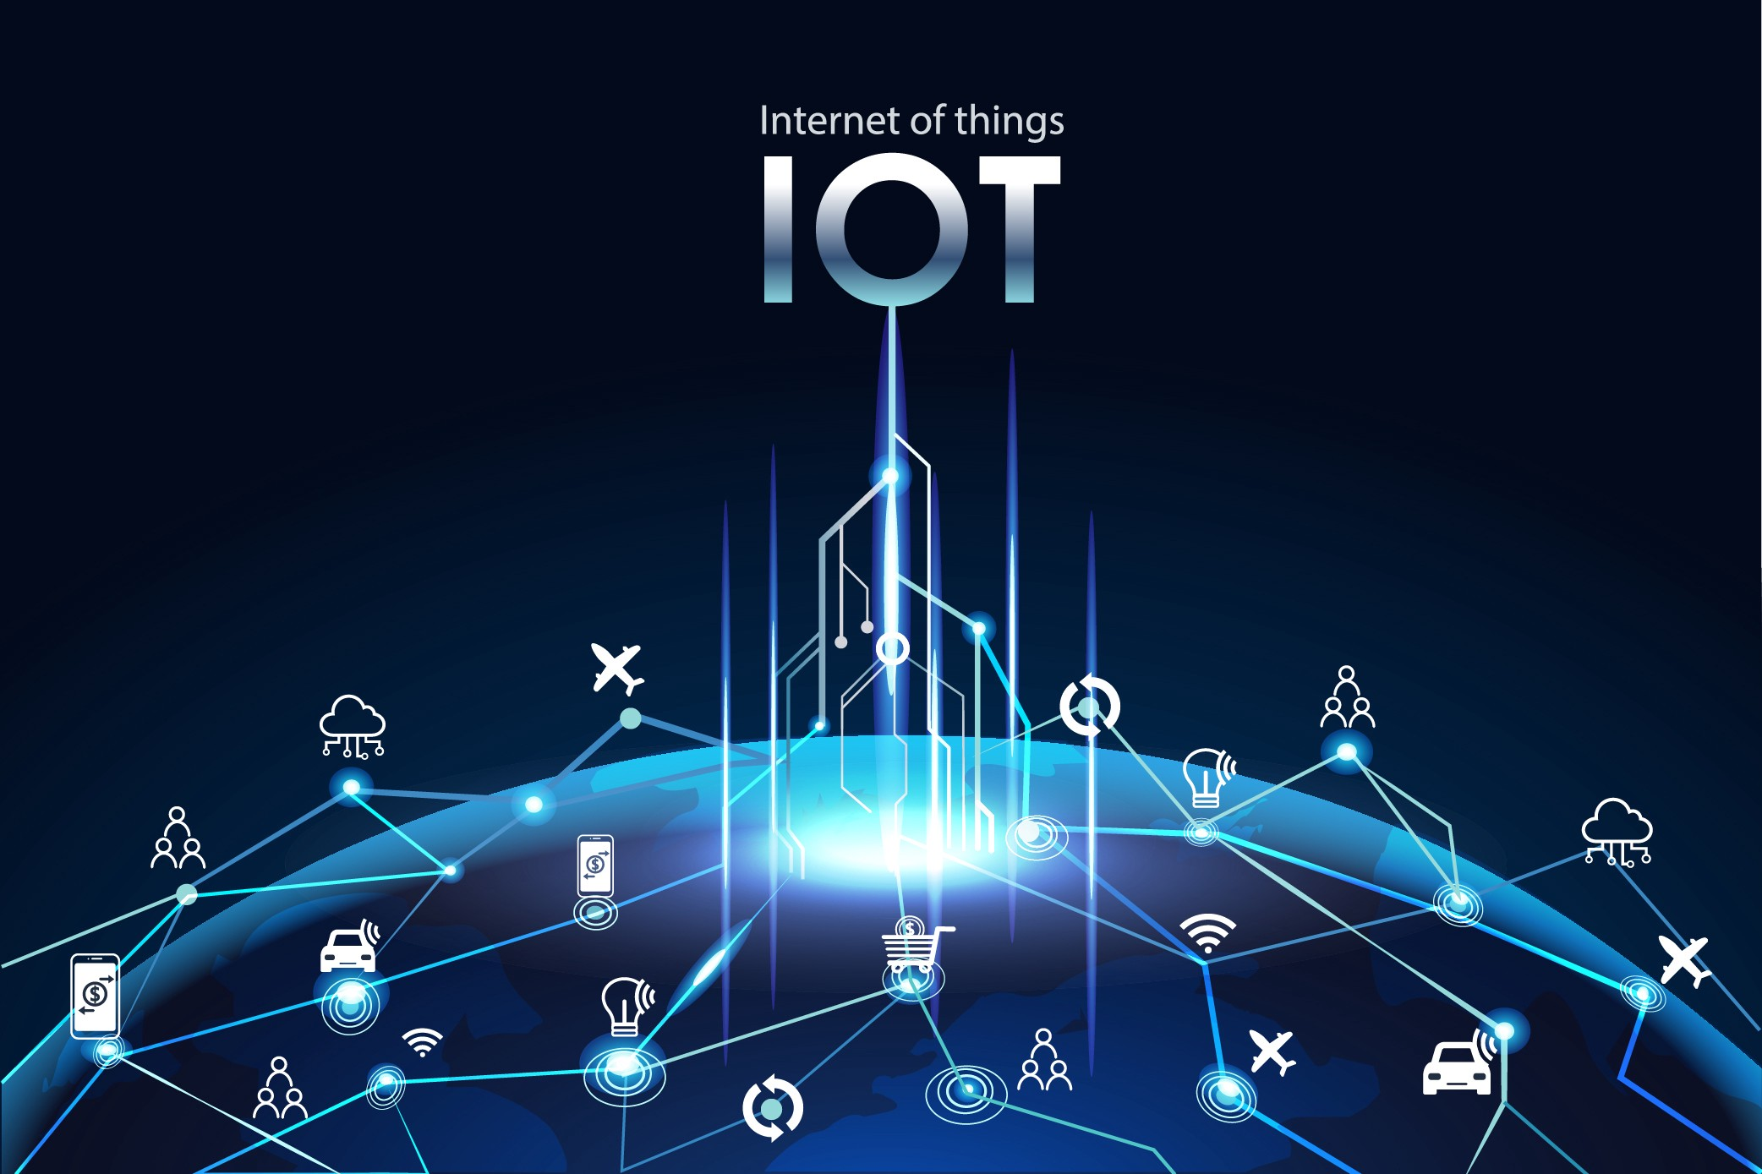
Advantages of Wireless Data Transfer in IoT
Wireless connectivity eliminates the need for physical connections, reducing installation and maintenance costs.
Wireless data transfer enables IoT devices to be deployed in remote or hard-to-reach locations.
Wireless communication provides greater mobility and flexibility for IoT applications.
Notes:
Image source: http://www.checkboxtechnology.com/everything-you-need-to-know-about-iot/

Slide 6
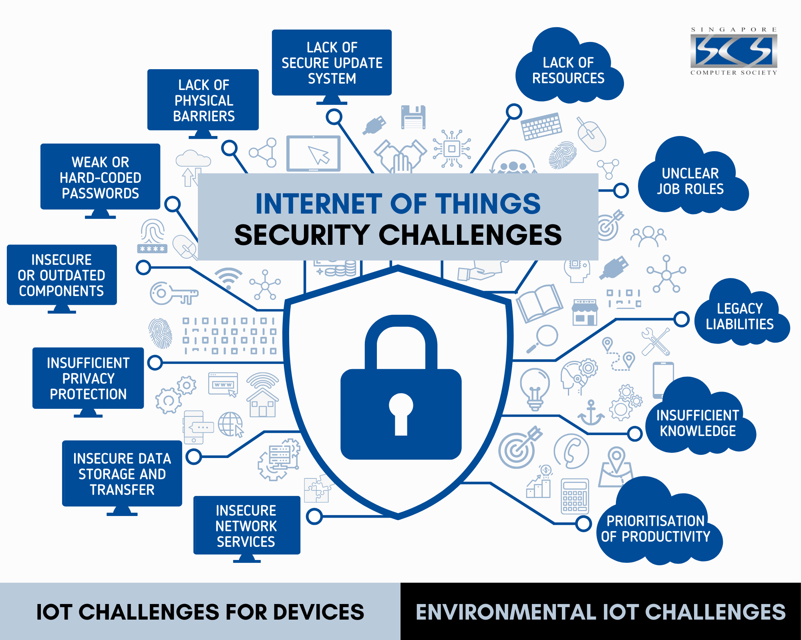
Challenges of Wireless Data Transfer in IoT
Wireless communication may be susceptible to interference, signal loss, or security risks.
Limited bandwidth and range may impact the speed and reliability of data transfer in IoT systems.
Power consumption can be a concern for battery-operated IoT devices using wireless connectivity.
Notes:
Image source: https://www.slidemake.com/presentation/Security-challenges-in-iot-650db0a3c6677bc2a3aa49e8

Slide 7
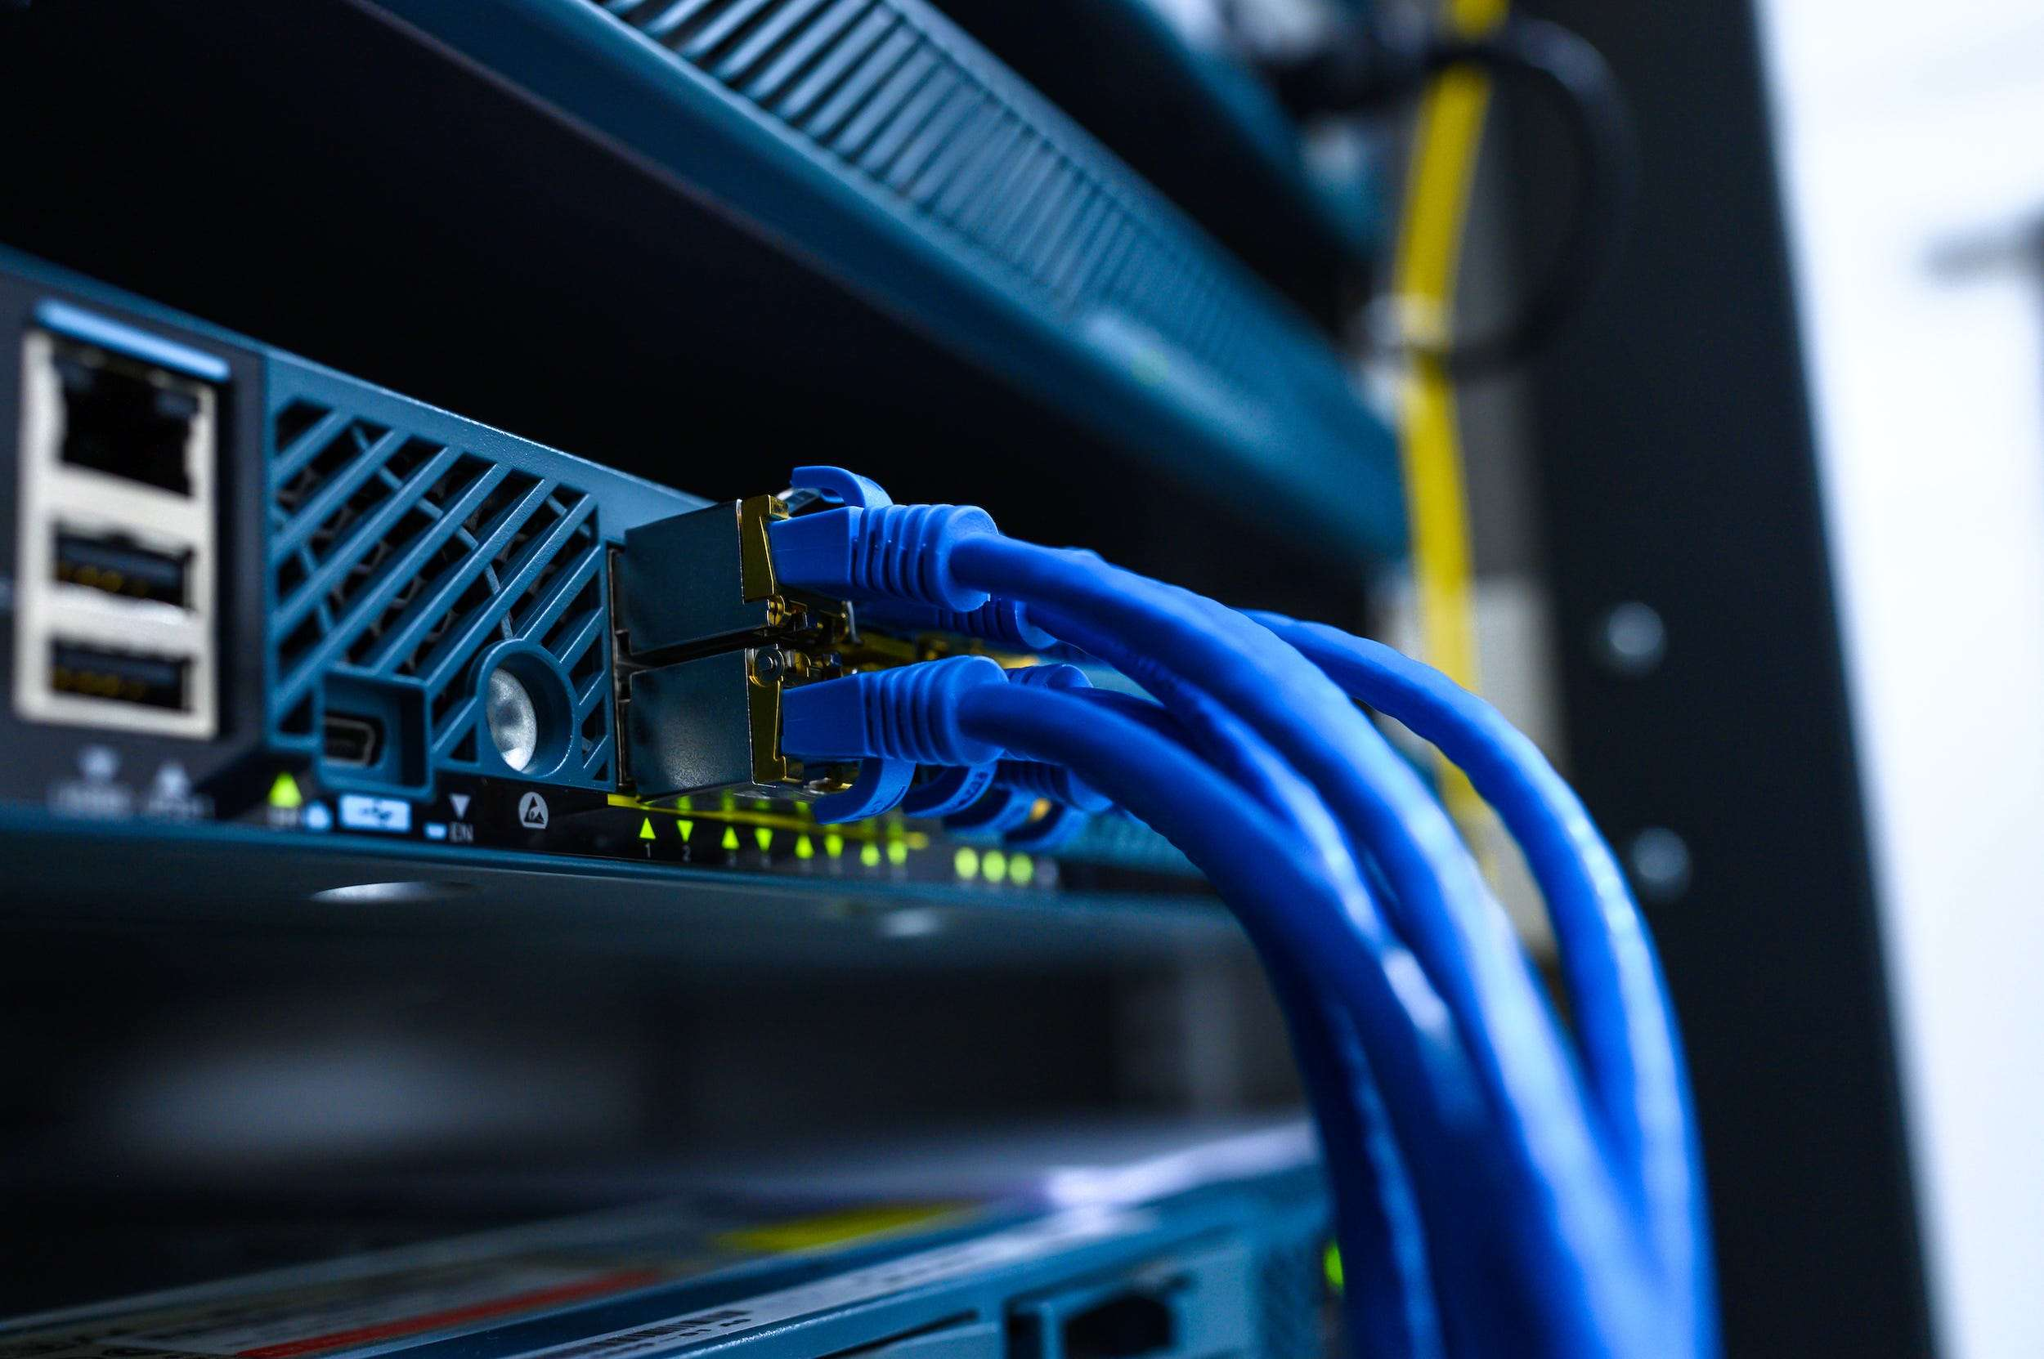
Wired Connectivity in IoT Data Communication
Wired connectivity, such as Ethernet, Powerline, and USB, involves physical cables for data transfer between IoT devices.
Wired communication offers higher reliability, speed, and security compared to wireless connections.
IoT devices connected via wired networks can achieve consistent and stable data transfer.
Notes:
Image source: https://www.businessinsider.in/tech/how-to/what-is-ethernet-the-wired-network-connection-explained/articleshow/84910285.cms

Slide 8
Advantages of Wired Data Transfer in IoT
Wired connectivity provides a secure and stable data transfer environment for IoT devices.
Higher data transfer speeds and lower latency are possible with wired connections, ensuring real-time communication.
Wired networks offer greater resistance to interference and signal degradation compared to wireless communication.
Notes:
Image source: https://www.mindomo.com/hu/mindmap/las-tic-095a2826bb4e47888cb2a5be89c86ac2

Slide 9
Challenges of Wired Data Transfer in IoT
Installation and maintenance of physical cables for wired connectivity can be labor-intensive and costly.
Wired networks may have limitations in terms of flexibility and mobility for IoT devices.
Physical constraints and cable management issues can affect the scalability of IoT deployments using wired connectivity.
Notes:
Image source: https://ded9.com/what-is-the-iot-and-what-are-its-uses/

Slide 10
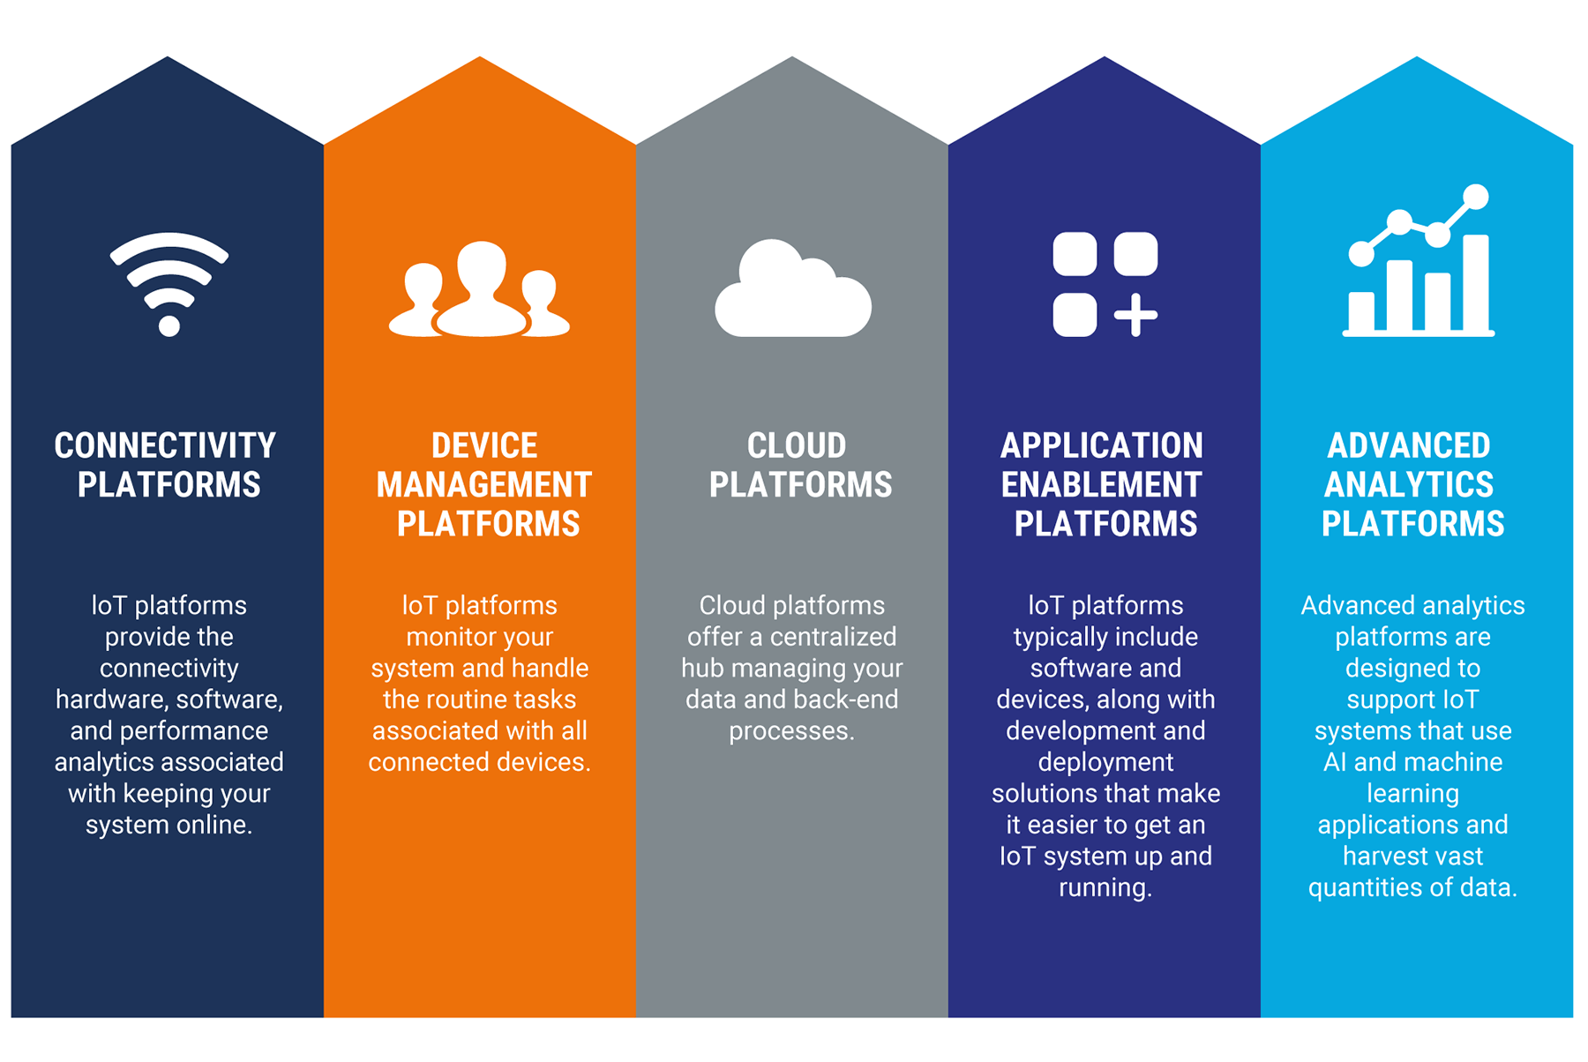
Choosing the Right Data Communication Method for IoT
The selection of data transfer methods in IoT should consider factors such as data volume, speed, distance, security, and cost.
Wireless connectivity is suitable for mobile IoT devices, remote monitoring, and dynamic environments.
Wired connectivity is ideal for high-bandwidth applications, critical data transfer, and fixed installations.
Notes:
Image source: https://www.3pillarglobal.com/insights/things-to-consider-when-selecting-an-iot-platform/

Slide 11
Data Security Considerations in IoT Communication
Secure data transfer protocols, encryption, authentication, and access controls are essential for protecting IoT data during communication.
Both wireless and wired data transfer methods require robust security measures to prevent unauthorized access and data breaches.
IoT devices should be regularly updated and patched to address security vulnerabilities and ensure data integrity.
Notes:
Image source: https://www.slidemake.com/presentation/Security-challenges-in-iot-650db0a3c6677bc2a3aa49e8

Slide 12
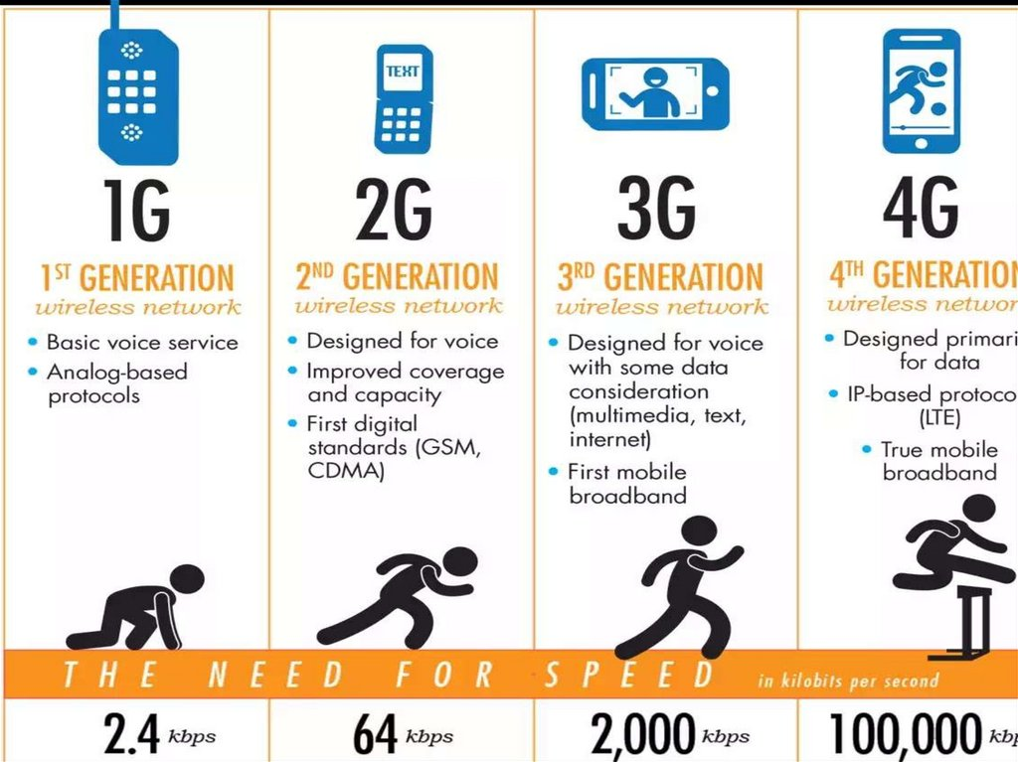
Introduction to Mobile Generations
GSM (Global System for Mobile Communications) was the first widely adopted digital cellular network standard.
2G (Second Generation) introduced digital encryption for voice calls and text messaging.
3G (Third Generation) brought faster data speeds, video calling, and mobile internet capabilities.

Slide 13
Evolution of Mobile Networks
4G (Fourth Generation) enabled high-speed internet access, HD video streaming, and improved call quality.
5G (Fifth Generation) offers even faster speeds, lower latency, and greater capacity for connecting devices.
Each generation builds upon the previous one, improving connectivity and enhancing user experiences.
Impact and Future of Mobile Technology
GSM and 2G laid the foundation for modern mobile communication networks.
3G, 4G, and 5G have transformed the way we connect, work, and communicate.
Future advancements in mobile technology, such as 6G, promise even more innovation and connectivity for users worldwide.

Slide 14
Future Trends in IoT Data Communication
Advancements in 5G networks, LPWAN technologies, and edge computing will revolutionize IoT data communication.
The integration of AI, machine learning, and blockchain in IoT data transfer will enhance security, efficiency, and automation.
IoT data communication will continue to evolve with innovations in connectivity, data processing, and application domains, shaping the future of smart, connected systems.
Notes:
Image source: https://www.premiumtimesng.com/opinion/489188-5g-connectivity-and-the-future-of-the-digital-economy-by-inyene-ibanga.html

Slide 15
Introduction to IPv4 and IPv6
IPv4 is the fourth version of the Internet Protocol and utilizes 32-bit addresses.
IPv6 is the sixth version of the Internet Protocol and uses 128-bit addresses.
IPv4 has a limited address space, leading to the need for IPv6 to accommodate the growing number of devices on the internet.
Notes:
Image source: https://laptopprocessors.ru/regulyarnye-vyrazheniya-python-poisk-ip-adresa/

Slide 16
Understanding Ethernet and GigE
Ethernet is a widely used networking technology that defines wiring and signaling standards for the physical layer and data link layer of the OSI model.
GigE, short for Gigabit Ethernet, offers faster transmission speeds up to 1 gigabit per second.
Ethernet is commonly used for local area networks (LANs) while GigE is often used for high-speed connections between devices.
Notes:
Image source: https://schematicmanualleroy55.z19.web.core.windows.net/lan-wiring-connections.html

Slide 17
Transitioning to IPv6 and GigE
The transition from IPv4 to IPv6 is essential to ensure the continued growth of the internet and support the increasing number of connected devices.
GigE provides higher bandwidth and faster data transfer speeds compared to traditional Ethernet, making it ideal for demanding applications.
As technology advances, the adoption of IPv6 and GigE will become more prevalent to meet the evolving needs of modern networks.
Notes:
Image source: https://www.networxsecurity.org/members-area/glossary/i/ipv6-transition-mechanism.html

Slide 18
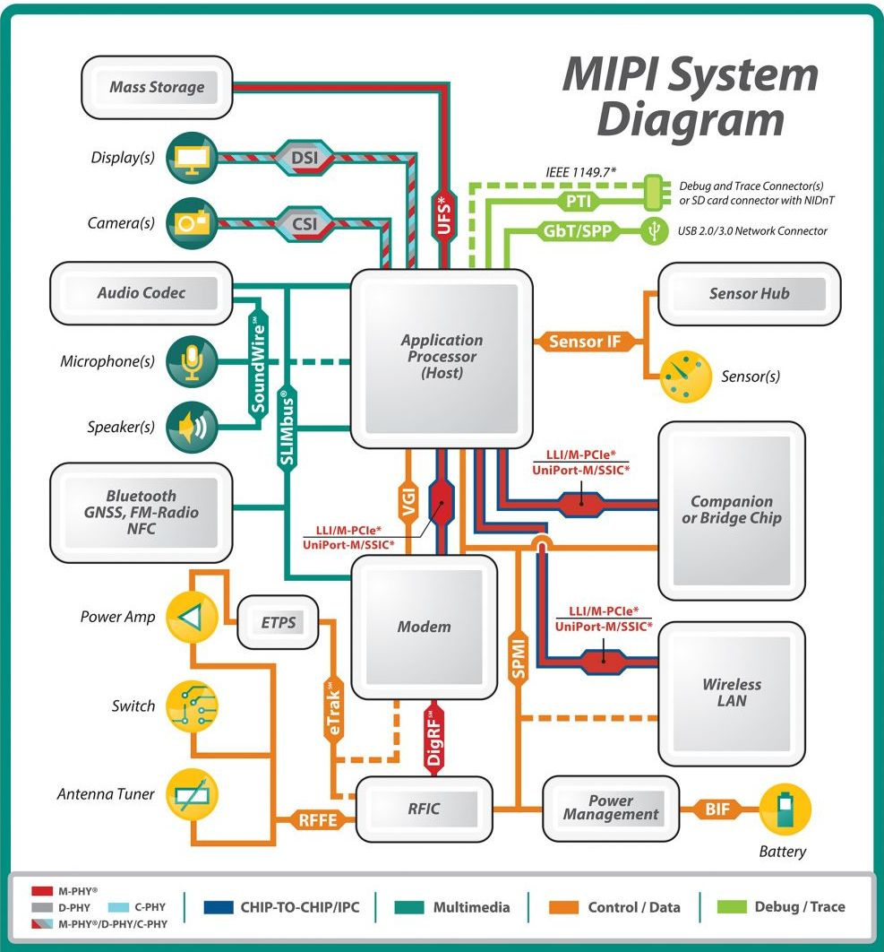
Introduction to MIPI and Inter-Chip Communication
MIPI (Mobile Industry Processor Interface) Alliance standardizes interface specifications for mobile devices.
M-PHY is a physical layer specification within MIPI that enables high-speed data transfer between chips.
UniPro (Unified Protocol) is a versatile protocol layer that works with M-PHY to provide efficient inter-chip communication.
Notes:
Image source: https://www.cnx-software.com/2014/10/30/mipi-introduces-soundwire-audio-interface-for-mobile-devices/

Slide 19
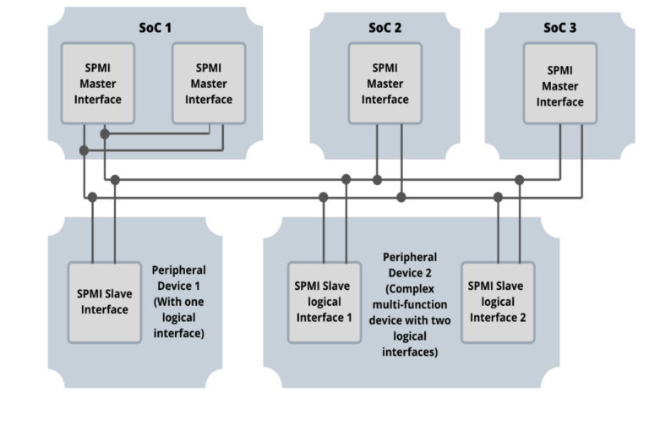
Power Management and Communication Protocols
SPMI (System Power Management Interface) is a standardized communication protocol for managing power in mobile devices.
BIF (Bus Interface) is a specification that defines how components communicate with each other within a device.
These protocols are crucial for efficient data communication and power management in IoT devices.
Notes:
Image source: https://evision-webshop.eu/blog/benefits-of-the-system-power-management-interface-spmi

Slide 20
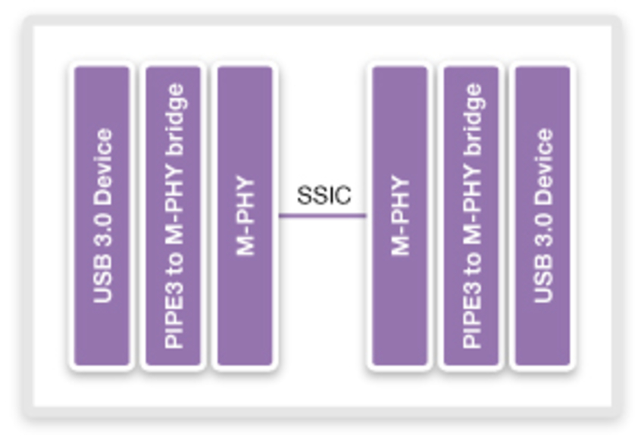
SuperSpeed USB Inter-Chip (SSIC) and IoT Data Communication
SuperSpeed USB Inter-Chip (SSIC) is a USB standard that enables high-speed data transfer between chips in IoT devices.
SSIC leverages the benefits of USB technology for efficient and reliable inter-chip communication.
IoT data communication relies on standards like MIPI, UniPro, SPMI, BIF, and SSIC to enable seamless connectivity and functionality.
Notes:
Image source: https://www.synopsys.com/designware-ip/technical-bulletin/transitioning.html

Slide 21
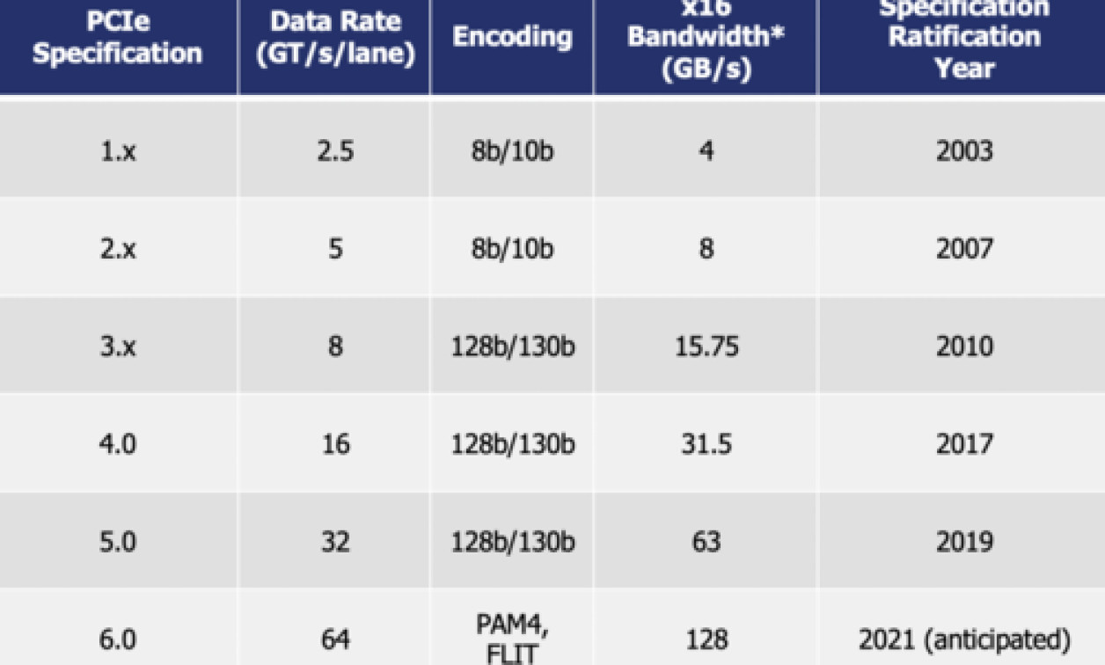
Mobile PCIe (M-PCIe)
Mobile PCIe (M-PCIe) is a high-speed, low-power interface designed for mobile devices to connect peripherals such as storage, wireless modules, and GPUs.
M-PCIe offers faster data transfer rates compared to traditional interfaces, making it ideal for applications that require high bandwidth and low latency.
This technology allows for seamless integration of various components in mobile devices, improving performance and user experience.
Notes:
Image source: https://embeddedcomputing.com/technology/security/iec-iso-other-standards/introduction-to-pcie-60

Slide 22
Overview of SPI
SPI (Serial Peripheral Interface) is a commonly used communication protocol in IoT devices for connecting microcontrollers to peripherals such as sensors, displays, and memory modules.
SPI is known for its simplicity, efficiency, and versatility, making it a popular choice for data transfer in IoT applications.
With its full-duplex communication and multiple slave device support, SPI enables fast and reliable data exchange between connected devices in IoT systems.
Notes:
Image source: https://www.slidemake.com

Slide 23
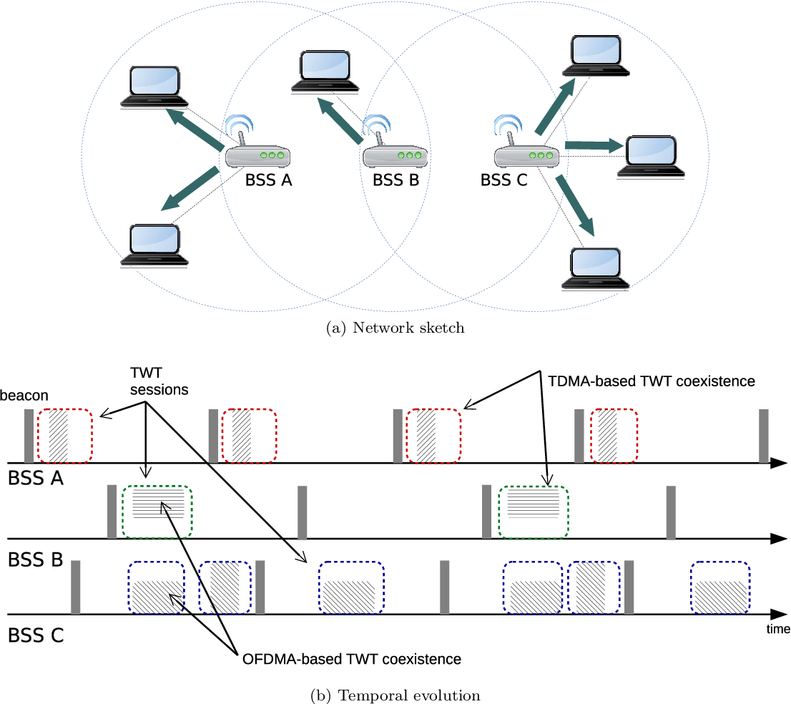
Target Wake Time (TWT) in IoT Data Communication
Target Wake Time (TWT) is a mechanism in IEEE 802.11ax (Wi-Fi 6) that allows devices to schedule when they wake up to communicate, reducing power consumption.
TWT enables IoT devices to synchronize their wake-up times, optimizing network efficiency and prolonging battery life.
By coordinating wake-up times, TWT minimizes contention and interference in crowded IoT environments.
Notes:
Image source: https://www.semanticscholar.org/paper/Target-Wake-Time:-Scheduled-Access-in-IEEE-802.11ax-Nurchis-Bellalta/bc021725fdf50de15fc0a91cfb44bd9e1c28de81

Slide 24
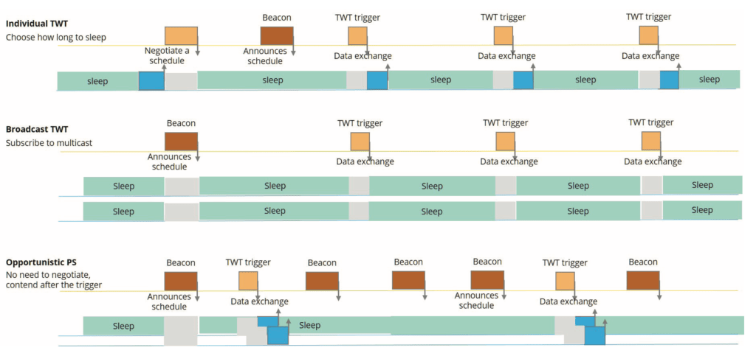
Benefits of Implementing Target Wake Time (TWT) in IoT Networks
TWT improves network performance by reducing latency and jitter, enhancing the overall user experience.
Implementing TWT in IoT networks can significantly increase the scalability of the network, allowing for more devices to connect without sacrificing performance.
With TWT, IoT devices can better manage their power consumption, leading to longer battery life and reduced maintenance costs.
Notes:
Image source: https://www.cleartosend.net/802-11ax-target-wake-time/

Slide 25
Challenges and Considerations for Deploying Target Wake Time (TWT) in IoT Systems
One challenge of TWT implementation is ensuring compatibility with existing devices that do not support the feature, potentially causing network disruptions.
Proper configuration and management of TWT parameters are crucial to maximizing its benefits and avoiding performance degradation.
Security considerations must be taken into account when deploying TWT in IoT systems to prevent potential vulnerabilities and unauthorized access.
Notes:
Image source: https://www.slidemake.com

Slide 26
Grouping of Stations in IoT Data Communication
Grouping of stations in IoT data communication involves organizing multiple IoT devices into clusters for efficient data transmission.
This grouping allows for better management of data traffic and allocation of resources within the IoT network.
By categorizing stations into groups based on proximity or functionality, communication can be optimized for specific tasks or applications.
Notes:
Image source: https://www.digi.com/blog/post/how-do-iot-devices-communicate

Slide 27
Benefits of Grouping Stations in IoT Data Communication
Enhanced network performance: Grouping stations helps reduce network congestion and latency by streamlining data transmission.
Improved security: By segmenting IoT devices into groups, it is easier to implement security protocols and monitor data exchanges within each cluster.
Scalability: Grouping stations allows for easy scalability as the network grows, enabling seamless integration of new devices without compromising performance.
Notes:
Image source: https://www.slidemake.com

Slide 28
Implementation of Grouping Stations in IoT Data Communication
Use of clustering algorithms: Various clustering algorithms such as K-means or hierarchical clustering can be employed to group stations based on specific criteria.
Centralized management: Implementing a centralized management system can facilitate the grouping of stations and enable efficient monitoring and control of data traffic.
Dynamic grouping: Utilizing dynamic grouping techniques allows for the adaptation of station clusters based on changing network conditions or requirements.
Notes:
Image source: https://www.slidemake.com

