Slide 1
Welcome To CE 413
Lecture-01
Md. Abu Hasan
Senior Lecturer
Department of Civil Engineering
Daffodil International University

Slide 2
Syllabus
CE 413: Structural Analysis & Design III
Credit-3.0
Define composite structures
Analysis of composite columns
Design of composite columns
Define of composite floor system
Shear wall and it’s uses
Design of shear wall

Slide 3
Course Plan
Class 2 | Introduction to Composite Structure
Class 3 | Different kinds of composite columns
Class 4 | Fully Encased Composite Column (FEC)
Class 5 | Concrete Filled Tube Column (CFT)
Class 6 | Partially Encased Composite Column (PEC)
Quiz 1 | From Class 1 to Class 6
Assignment 1 | Group wise different topics

Slide 4
Course Plan
Class 7 | Limitation Codes of Fully Encased Composite Column (FEC)
Class 8 | Limitation Codes Concrete Filled Tube Column (CFT)
Class 9 | Limitation Codes Partially Encased Composite Column (PEC)
Class 10 | Design of Fully Encased Composite Column (FEC)
Class 11 | Design Concrete Filled Tube Column (CFT)
Class 12 | Design Partially Encased Composite Column (PEC)
Quiz 2 | From Class 7 to Class 12

Slide 5
Course Plan
Class 13 | Introduction to composite floor system
Class 14 | Design limitations of composite floor system
Class 15 | Introduction to Shear Wall
Class 16 | Different elements and failure category of shear wall
Quiz 3 | From Class 13 to Class 16
Class 17 | Design of shear wall (Part 01)
Class 18 | Design of shear wall (Part 02)
Quiz 4 | From Class 17 to Class 18
Presentation | Group wise different topic
Class 19 | Review Class

Slide 6
Assessment strategies:
Attendance | 07
Class test/Quiz | 15
Presentation | 08
Assignment | 05
Mid-term | 25
Final | 40

Slide 7
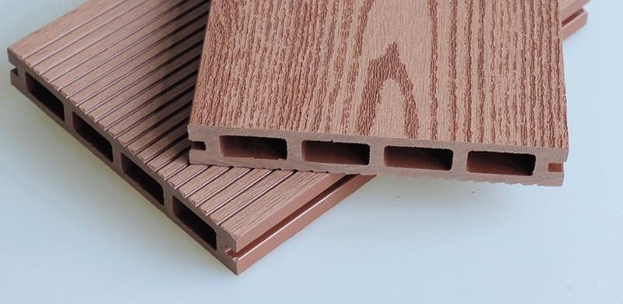
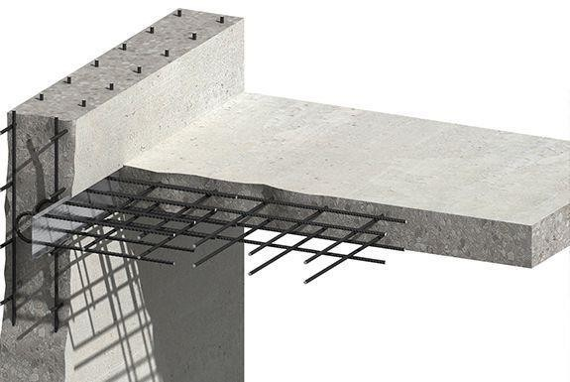
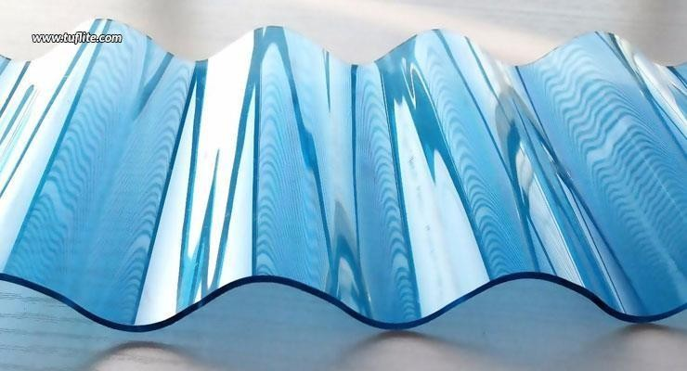
Composite Structure
Two or more materials combined to gain extra strength and benefits.
Examples-
Reinforced concrete
Composite wood or plywood
Reinforced Plastics
Steel Concrete composite

Slide 8
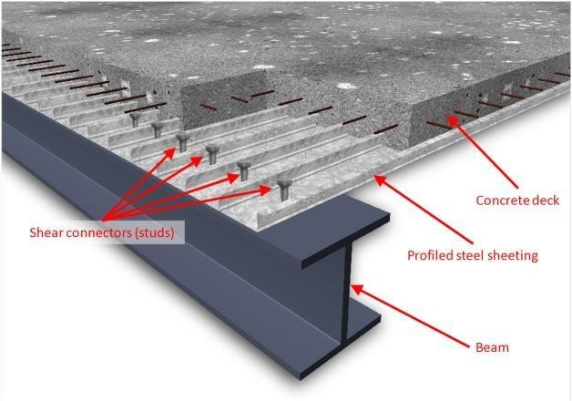
Composite Structure
Steel Concrete composite structure

Slide 9
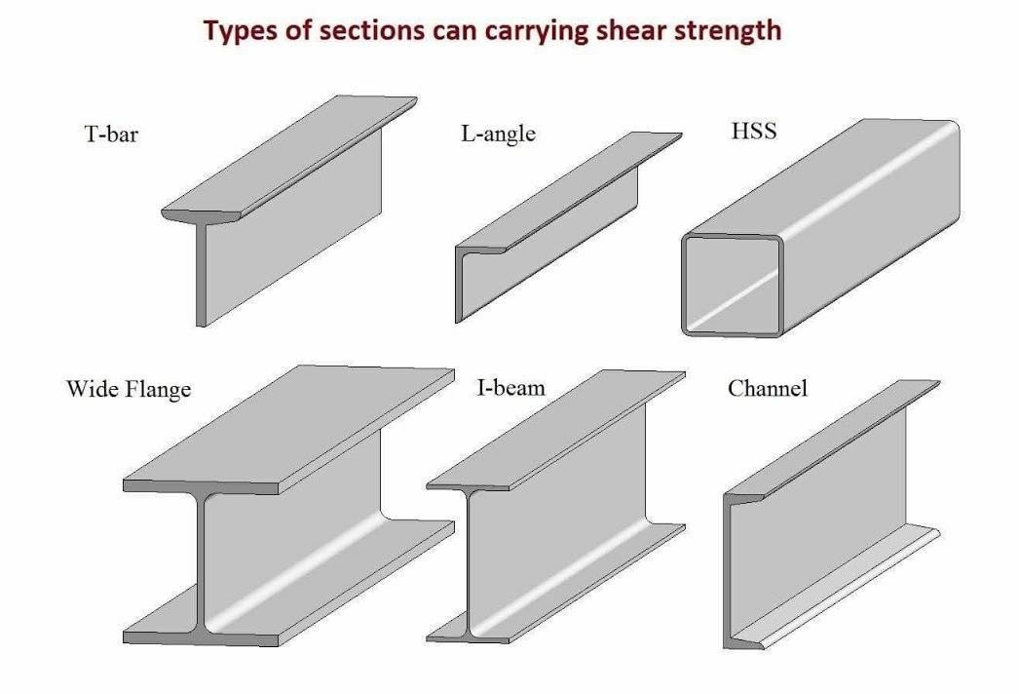
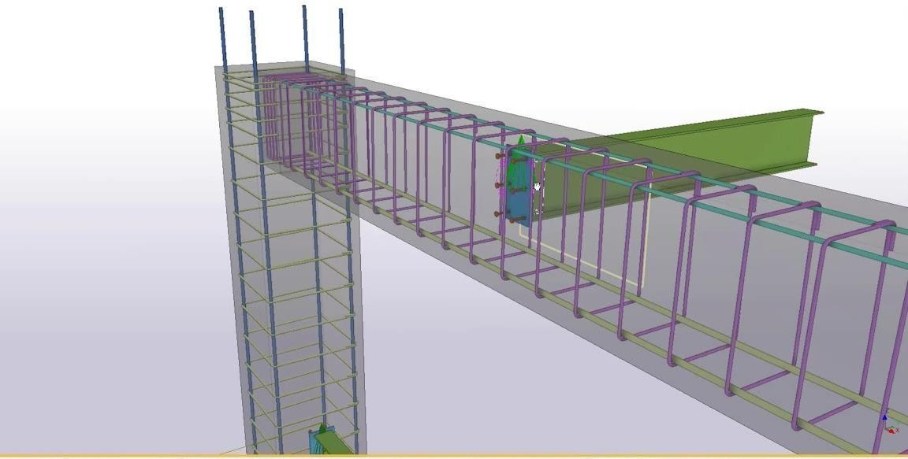
Composite Structure
Steel Concrete composite structure

Slide 10
Composite Structure
Why Steel Concrete composite structure used??
Disadvantage of RCC and Steel structures
Large size
Huge self weight to strength ratio
Huge time consuming
Highly fire susceptible
Construction cost is high for high rise structures
To recover all of this disadvantages Steel Concrete composite structures are used

Slide 11
Composite Structure
Advantage of Steel Concrete composite structures
Small size
Low self weight to strength ratio
Low time consuming
Low fire susceptible
Construction cost is low for high rise structures
More headroom
For these advantages Steel Concrete composite structures are used

Slide 12
Composite Structure
Disadvantage of Steel Concrete composite structures
Corrosion
Highly skilled labour

