Slide 2
Ambivalence
Adapted into colonial discourse theory by Homi K Bhabha, ambivalence describes the complex mix of attraction and repulsion that characterizes the relationship between colonizer and colonized.
The relationship is ambivalent because the colonized subject is never simply and completely opposed to the colonizer. Rather than assuming that some colonized subjects are ‘complicit’ and some ‘resistant’, ambivalence suggests that complicity and resistance exist in a fluctuating relation within the colonial subject.
Ambivalence also characterizes the way in which colonial discourse relates to the colonized subject, for it may be both exploitative and nurturing, or represent itself as nurturing, at the same time.

Slide 3
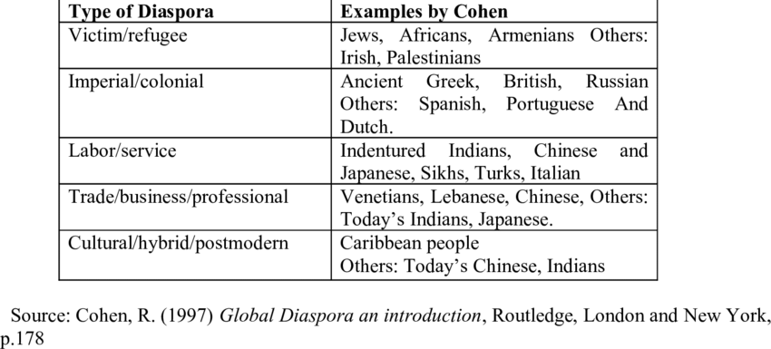
Diaspora
the Jews living outside Palestine or modern Israel
the settling of scattered colonies of Jews outside ancient Palestine after the Babylonian exile
the area outside ancient Palestine settled by Jews
people settled far from their ancestral homelands
the movement, migration, or scattering of a people away from an established or ancestral homeland

Slide 6
Exoticism
The word exotic was first used in 1599 to mean ‘alien, introduced from abroad, not indigenous. By 1651, its meaning has been extended to include ‘an exotic and foreign territory, an exotic habit and demeanor (manner or attitude). As a noun, the term meant ‘a foreigner’ or ‘a foreign plant not acclimatized’ (adapted/adjusted).
The term exoticism describes a cultural phenomenon that projects Western fantasies about profound cultural differences.
It adopts a cultural perspective that is firmly entrenched in the conventions and belief systems of Western civilization and therefore constructs the East as the archetypical location of otherness.
Exoticism demonstrates itself in colorful spectacles of otherness purporting to be an unmediated expression of natural drives and instincts.
Although exoticism is associated with notions of animality, it carefully distances itself from the violence and exploitation that characterize the related concept of barbaris

Slide 9
Mimicry
An increasingly important term in post-colonial theory, because it has come to describe the ambivalent relationship between colonizer and colonized.
When colonial discourse encourages the colonized subject to ‘mimic’ the colonizer, by adopting the colonizer’s cultural habits, assumptions, institutions and values, the result is never a simple reproduction of those traits.
Rather, the result is a ‘blurred copy’ of the colonizer that can be quite threatening. This is because mimicry is never very far from mockery, since it can appear to parody whatever it mimics.
Mimicry therefore locates a crack in the certainty of colonial dominance, an uncertainty in its control of the behaviour of the colonized.

Slide 11
New-Literatures
The label of "New Literatures" includes the literary productions of a geographically and culturally vast and non-contiguous area that includes the former British colonies (for example, from Canada to Australia, from Singapore to Pakistant and India)

Slide 12
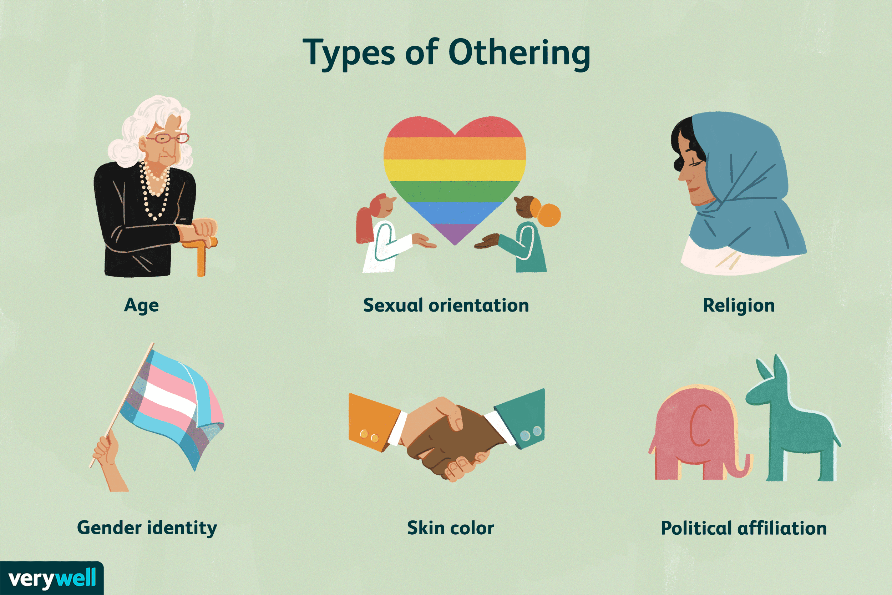
Othering

