Slide 1
The Human Population

Slide 2
Lecture Outcome
Population & Current Growth
Population and Bangladesh
Human Population Issues
Population Growth Rate
Source of Population Statistics
‹#›

Slide 3
Population
A population is a summation of all the organisms of the same group or species, who live in the same geographical area, and have the capability of interbreeding.
‹#›

Slide 4
Current World Population
According to the U.S. Census Bureau, the total population of the World, projected to 6/8/14 at 18:17 GMT (CDT+5) was 7,251,920,265
‹#›

Slide 5
Current Population
301,318 Births today
82,955,403 Births this year
124,327 Deaths today
34,228,394 Deaths this year
176,991 Population growth today
48,727,009 Population growth this year
‹#›

Slide 6
Current Population Trends
In 1963 = 3.2 billion
In 2050 could be 7.2 – 10.6 billion
Largest increase expected in developing countries (approximately 97%)
Decreasing in some developed countries

Slide 7
Most Populous Countries with Density, 2010 & 2050
2010 |  |  |  | 2050
Country | Population (millions) | Population Density/Sq. Km. |  | Country | Population (millions)
China | 1,338 | 140 |  | India | 1,748
India | 1,189 | 362 |  | China | 1,437
USA | 310 | 32 |  | USA | 423
Indonesia | 235 | 124 |  | Pakistan | 335
Brazil | 193 | 23 |  | Nigeria | 326
Pakistan | 185 | 232 |  | Indonesia | 309
Nigeria | 158 | 171 |  | Bangladesh | 226
Bangladesh | 150 | 964 |  | Brazil | 215
Russia | 142 | 8 |  | Ethiopia | 174
Japan | 127 | 337 |  | Congo. Demo. Rep. | 166
Source: PRB, 2010 World Population Data Sheet, BBS 2011, and Mabud 2009

Slide 8
Bangladesh Population Outlook
Bangladesh, one of the largest delta in the world, has a population size of about 150 million in an area of 147,570 sq. km.
Close to 1000 people live in one square kilometer area.
Each year, the population increases by 1.8 to 2.0 million.
The population is likely to grow up to 226 million around 2050.
The population will stabilize at 250 million by 2081
It will happen due to the population momentum inherent in the young age structure.
‹#›

Slide 9
Bangladesh at a Glance
Population: 166,208,7120
Per capita income: $2,100
Life expectancy at birth women/men: 68/72 yrs
Infant mortality rate: 45/1000 live births
Central Intelligence Agency, The World Factbook, 2014

Slide 10
Growth rate 1.6% (2015 est.)
Birth rate 21.14 births/1,000 population (2015 est.)
Death rate 5.61 deaths/1,000
Fertility rate 2.4 children born/woman
Male | Female
72 109 796 | 71 933 901
‹#›

Slide 11
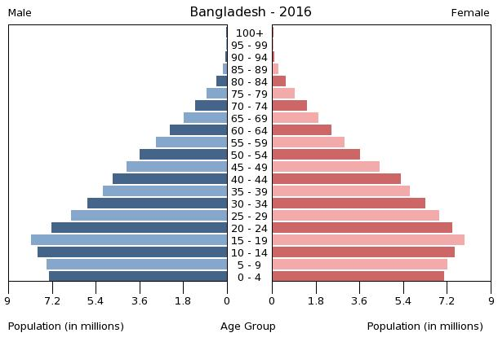
‹#›

Slide 12
Age Structure: Young and Old
Year | Broad Age Groups
 | 0-14 Yrs. (%) | 15-59 Yrs. (%) | 60+ Yrs. (%)
1911 | 42.3 | 53.3 | 4.4
1921 | 42.3 | 53.6 | 4.1
1931 | 41.9 | 54.9 | 3.2
1941 | 41.4 | 55.1 | 3.5
1951 | 42.2 | 53.5 | 4.4
1961 | 46.0 | 48.8 | 5.2
1974 | 48.0 | 46.3 | 5.7
1981 | 46.7 | 47.8 | 5.5
1991 | 45.1 | 49.5 | 5.4
2001 | 39.4 | 54.9 | 5.7
2005 | 37.9 | 55.9 | 6.2
Sources: Bangladesh Bureau of Statistics, 1994 and 1999 and 2006
‹#›

Slide 13
Food Consumption and Nutrition
Malnutrition – a serious public health & socio-economic development problem.
About 35% and 21% women suffer from CED (BMI <18.5) in rural and urban areas respectively.
36 % of children are underweight (low weight-for-age).
12 % are severely underweight.
Percentage of underweight children increases sharply with age and peaks at 47% among children aged 36-47.
Birth weight is very low (30%).
Among U-5 children 36% are stunted.
‹#›
‹#›

Slide 14
Women and Decision Making
Women still lag a lot behind men in educational attainment, literacy, employment, earnings and control over cash, freedom of movement, autonomy and status. They lack full participation and partnership in productive and reproductive lives.
Women in Bangladesh have little say over household decision-making. When it comes to making independent decisions on matters other than daily household purchases, things are even worse.
While only one-third currently women decide independently on daily household purchases, only 9 to 19% make independent decisions on other matters.

Slide 15
Population projections
For the next 20 years

Slide 16
Factors Affecting Human Population Size
Population change equation
Population change = (Births + Immigration) – (Deaths + Emigration)
Crude birth rate = births per 1000 people in population per year
Crude death rate = deaths per 1000 people in population per year

Slide 17
Population Trend Comparisons
Developed Countries
Low infant mortality rate
Life expectancy 77 years
Total fertility rate = 2.0
21% population <15
12% population >65
Per capita GDP = $36,110
Developing Countries
High infant mortality rate
Life expectancy 52 years
Total fertility rate = 5.7
44% population <15
3% population >65
Per capita GDP = $800

Slide 18
Human Population Issue
Several factors determine the impact of a society on natural resources.
Population size
Population density
Degree of technological development
Demography - Study of populations and their characteristics.

Slide 19
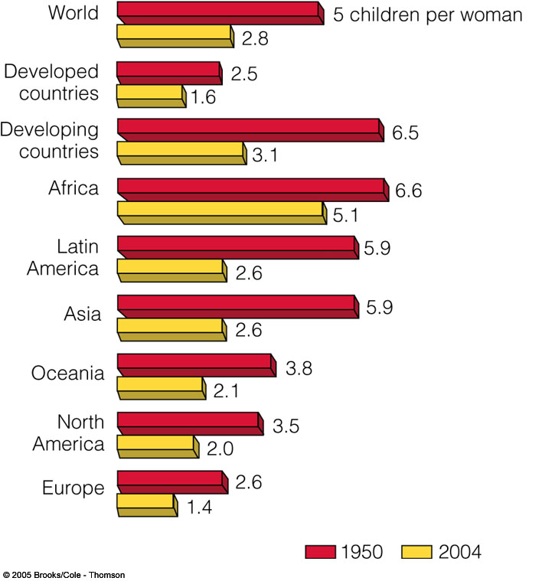
The fertility rates
have significantly
fallen since 1950.

Slide 20
Factors Affecting Birth Rates and Total Fertility Rates
Children in Labor Force
Cost of raising and educating children
Availability of pension systems
Urbanization
Education and employment for women
Infant mortality rate
Average marrying age
Abortion
Availability of birth control

Slide 21
Major social factor determining family size is the role of women in society.
Early marriages foster high fertility rates.
Lack of education opportunities for women reduces their options.
When level of education increases, fertility rates fall.
The most important factor is the ability of women to control the size of their family.
Access to birth control is key.

Slide 22
Cutting Global Population Growth
Family planning
Improve health care
Elevate the status of women
Increase education
Involve men in parenting
Reduce poverty
Sustainability

Slide 23
Population Growth Rate
Country | 2012
United States | 0.90
People’s Republic of China | 0.48
Japan | -0.08
Bangladesh | 1.58
Pakistan | 1.55
India | 1.31
Nepal | 1.77
Notes:
Niger 48
‹#›

Slide 24
__________________________ Divided by N, the number of years
Population Growth Rate
PR = Percent Rate V_{Present} = Present or Future Value V_{Past} = Past or Present Value
Notes:
‹#›

Slide 25
Rate of Population Growth
PR = Percent Rate V_{Present} = Present Value V_{Past} = Past Value
The annual percentage growth rate is simply the percent growth divided by N, the number of years.
Example
In 2000, the population in Chittagong city was 30.00,000. This grew to 50,00,000 in 2010.
What is the annual percentage growth rate for Chittagong city?

Slide 26
Crude Birth Rate
Crude birth rate is the childbirths per 1,000 people per year.
The crude birth rate (CBR) is equal to the number of live births (b) in a year divided by the total midyear population (p)
Therefore, the formula for crude birth rate is: CBR = (b/p) X 1000
Example. In 2012, there were 4,470 births in a city with population of 223,000. Therefore: CBR = (4,470/223,000)X1,000 CBR = 20.04 So, there were 20.04 births for every 1,000 people in the city.
Notes:
Crude birth rate is frequently used in population geography and demography and is a useful indicator in studies of population around the world. The crude birth rate could be of concern for particular countries who may be experiencing population decline, or for national governments who are worried about population growth rates that are higher than their country can sustain
‹#›

Slide 27
Example
In 2012, there were 4,470 births in a city with population of 223,000. Therefore: CBR = (4,470/223,000)X1,000 CBR = 20.04 So, there were 20.04 births for every 1,000 people in the city.
‹#›

Slide 28
Crude Birth Rate (per 1,000 people)
Country | 2010
United States | 14
People’s Republic of China | 11
Japan | 9
Bangladesh | 20
Pakistan | 27
India | 22
Nepal | 24
Notes:
Niger 48
‹#›

Slide 29
CRUDE DEATH RATE (per 1,000 people)
An estimate of the rate at which members of a population die during a specified period.
The numerator is the number of people dying during the period;
The denominator is the size of the population, usually at the middle of the period (mid-year population).
Number of deaths during a specified period x 10^{n}
Number of persons at risk of dying during the period.

Slide 30
Crude Death Rate (per 1,000 people)
Country | 2012
United States | 8
People’s Republic of China | 7
Japan | 10
Bangladesh | 6
Pakistan | 7
India | 8
Nepal | 6
Notes:
Niger 48
‹#›

Slide 31
Sources of Population Statistics:
Census
National Survey
Registration of vital events
Demographic Studies

Slide 32
Census
A census is the procedure of systematically acquiring and recording information about the members of a given population. It is a regularly occurring and official count of a particular population.
Notes:
Census
Bangladesh Bureau of Statistics (BBS) has 8 wings. One of those is Census Wing, which is responsible for conducting three decennial censuses: the Population and Housing Census, the Agriculture Census, and the Economic Census.
After the liberation of Bangladesh the first Population and Housing Census was carried out in 1974, the first Agriculture Census in 1977 and the first Economic Census in 1986.
Since Independence there have been five Population and Housing Censuses with the last one completed in 2011; four rounds of Agriculture Census, with the latest one in 2008 and only just two Economic Censuses in 1986 and 2003. It is anticipated that the next Economic Census will be carried out in 2013.
‹#›

Slide 33
What is the difference between Census and Survey?
• Census involves asking questions from the entire population while survey involves taking out a sample from the population that represent the population best from the point of view of the goal of the survey.
• Survey is quick and gives results quickly too while census is time consuming and takes a long time to generate results.
• Survey is rather inexpensive, whereas census is a mammoth exercise requiring lots of money and a high number of personnel.
• Census is obviously more accurate than survey where accuracy is somewhat less.

Slide 34
Thank you very much for your attention

