Slide 1
Tensile Properties
Chapter 01

Slide 2
Lecture 01

Slide 3
Mechanical Properties of Textile Fibres
Tensile properties
Flexural properties
Torsional properties
Frictional properties

Slide 4
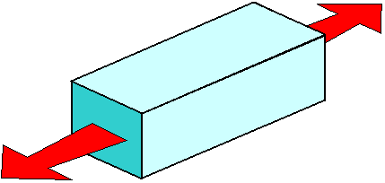
Tensile Properties of Textile Fibres
The behaviors shown by textile materials (fibre, yarn, fabric etc.) when it is subjected to load or tension, are known as tensile properties.

Slide 5
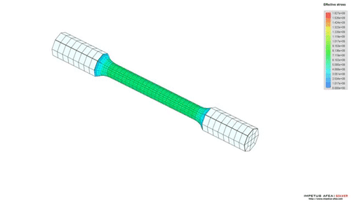
Breaking load
The load required to break a specimen is termed as breaking load. Breaking load depends on fibre type, nature of fibre bonds, crystallinity, orientation etc.
Breaking load is usually expressed by kilogram, gram, pound, Newton etc.

Slide 6
Breaking load

Slide 7
Tensile Strength
The term “Tensile” has been derived from the word “Tension”. Tensile strength is very important property of textile materials which represents the ratio between force required to break a specimen and cross-sectional area of that specimen.
Tensile strength = $\frac{\text{Force} \text{required} \text{to} \text{break} \text{a} \text{specimen} }{\text{Cross}\text{−}\text{sectional} \text{area} }$

Slide 8
Tenacity
Tenacity can be defined as the ratio between breaking load and linear density of specimen. Tenacity of a specimen may be expressed as the units of gram/tex, gram/denier, Newton/tex etc.
Tenacity = $\frac{\text{Breaking} \text{load}}{\text{Linear} \text{density}}$

Slide 9
Breaking extension
The load required to break a specimen is a useful quantity. Breaking extension of a specimen can be defined as the actual, percentage increase in length upto breaking.
So, it can be said that, the length of a specimen which extends for applying load before breaking is known as breaking extension and it is usually expressed as the percentage.
Breaking extension (%) = $\frac{\text{Elongation} \text{at} \text{break} ×\text{ 100 }\%}{\text{Original} \text{length} \text{of} \text{specimen} }$

Slide 10
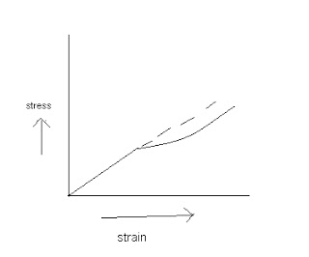
Initial modulus
The tangent of angle between initial curve and horizontal axis is equal to the ratio of stress and strain.
In engineering science, this ratio is termed as initial modulus but in textile science it is known as initial young’s modulus.
Initial modulus of textile materials depends on chemical structure, crystallinity, orientation of fibre etc.
Initial modulus, tanα = $\frac{\text{Stress}}{\text{Strain}}$ ; Tan α ↑↓ → extension ↓↑

Slide 11
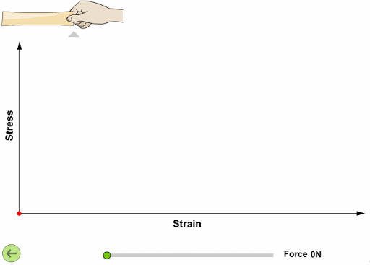
Initial modulus

Slide 12
Thank You

Slide 13
Lecture 02

Slide 14
Work of rupture
The energy required to break a specimen or total work done for breaking a specimen is termed as work of rupture and is expressed by the units of joule, calorie etc.
If applied force ‘F’ increases the length of a specimen in small amount by ‘dl’, then we have-
Work done = Force × Displacement = F × dl

Slide 15
Work factor
Work factor can be defined as the ratio between work of rupture and the product of breaking load and breaking elongation.
So, Work factor = $\frac{\text{Work} \text{of} \text{rupture}}{\text{Breaking} \text{load} \text{x} \text{Breaking} \text{elongation} }$
If the fibre obeys hook’s law, then the load-elongation curve would be a straight line and the work of rupture = ½ x Breaking load x Breaking elongation
So, in an ideal case, the work factor, Wf = 1/2, whereas, Wf >1 for top curve and Wf <1 for bottom curve.

Slide 16
Work recovery
The ratio between work returned during recovery and total work done in total extension is known as work recovery.
Work recovery = $\frac{\text{Work} \text{returned} \text{during} \text{recovery} }{\text{Total} \text{work} \text{done} \text{in} \text{total} \text{extension}}$
Total extension = Elastic extension + Plastic extension
Total work done in total extension = (Work done in elastic extension + Work done in plastic extension)

Slide 17
Elastic recovery
The power of recovery from an immediate extension is called as elastic recovery.
Elastic recovery of fibres depends on type of fibres, fibre structure, type of molecular bonds and crystallinity of fibres.
Elastic recovery can also be defined as the elastic extension against total extension and expressed as the percentage.
So, Elastic recovery (%) = $\frac{\text{Elastic} \text{extension} }{\text{Total} \text{extension} }\text{x}\text{100 }$%

Slide 18
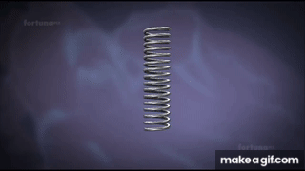
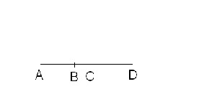
Elastic recovery
Here, AB = initial length of the specimen
AC = final length after recovery
BD = total extension
CD = elastic extension
BC = plastic extension
Total extension = Elastic extension + Plastic extension

Slide 19
Elastic recovery
So,
Elastic recovery (%) = (Elastic extension/total extension) ×100%
= (CD/BD) × 100%
So,
Plastic recovery = (plastic extension/total extension) ×100%
= (BC/BD) ×100%

Slide 20
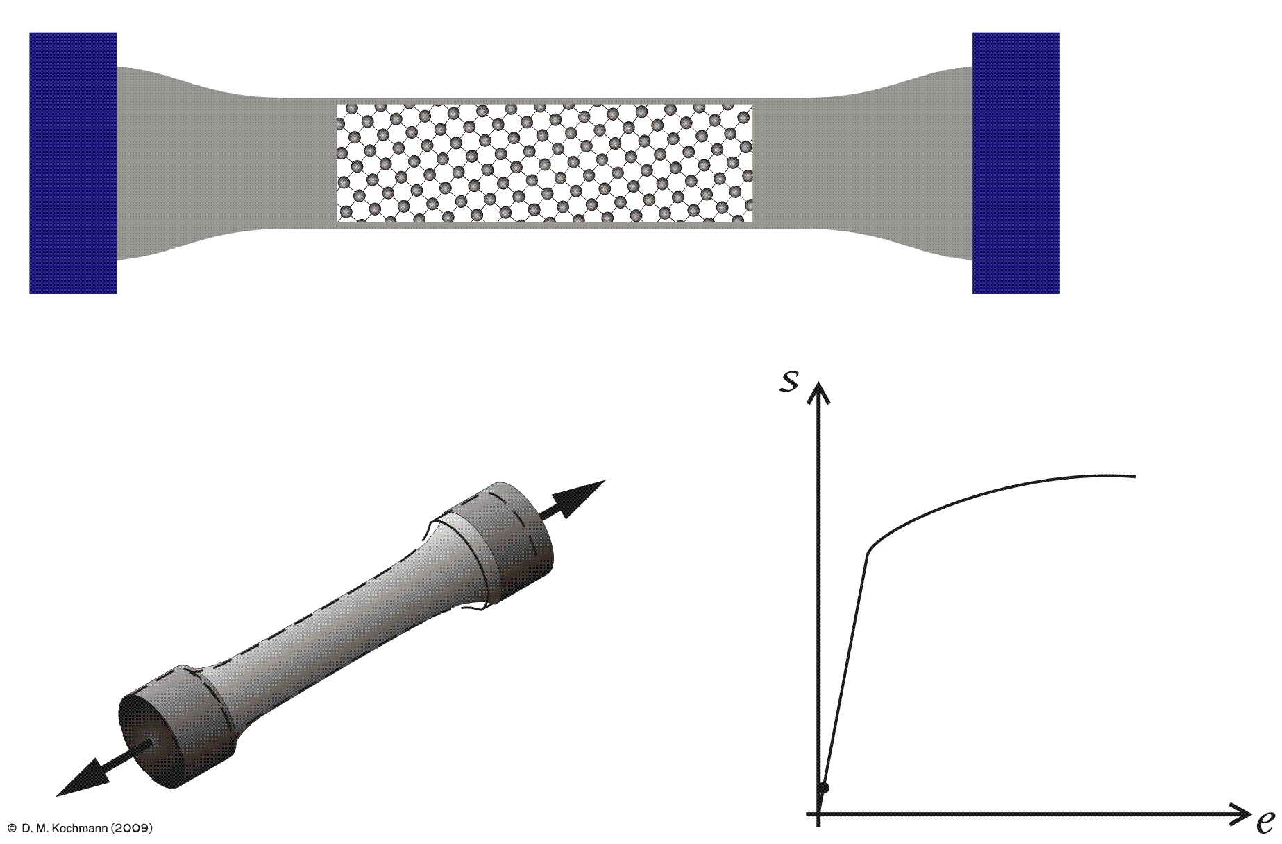
Creep

Slide 21
Creep
When load is applied on a textile fibre, an instaneous strain is occurred in the fibre and after that strain the fibre strain will be lower with passing time that means slow deformation will be occurred.
This type of behavior of textile fibre is known as creep.
The formation of crease marks on cloth depends on creep behaviors of fibres.
Creep is usually classified into two classes-

Slide 22
Creep
i) Temporary creep:
This type of creep is temporarily occurred in fibre. So, after removing load it is possible for textile fibre to recover it’s original shape.
Here, elastic deformation is occurred and fibre does not break, only molecular chains of fibre get stretched.

Slide 23
Creep
ii) Permanent creep:
This type of creep is permanently occurred in fibre. So, after removing load it is not possible for textile fibre to recover it’s original shape.
Here, plastic deformation is occurred and molecular chains of fibre break, hence the whole fibre breaks.

Slide 24
Stress-Strain Curve
A yield strength or yield point is the material property defined as the stress at which a material begins to deform plastically.
Prior to the yield point the material will deform elastically and will return to its original shape when the applied stress is removed.
Stress at yield point is known as yield stress and strain at yield point is known as yield strain.

Slide 25
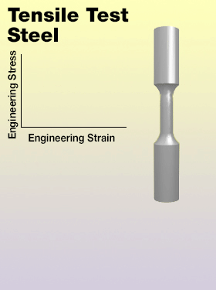
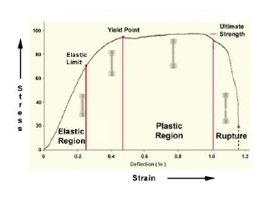
Stress-Strain Curve

Slide 26
Thank You

Slide 27
Lecture 03

Slide 28
Factors affecting the results of Tensile Testing
Materials and it’s conditions:
The chemical treatment to which it has been subjected
The mechanical treatment that it has received
Amount of moisture that it contains
Temperature in the testing atmosphere
Arrangement & Dimension of the specimen
Nature & Timing of the test

Slide 29
Methods or Principles of Tensile Experiment
Constant rate of loading (CRL)
Constant rate of elongation (CRE)

Slide 30
Constant rate of loading (CRL)
A specimen is gripped between two jaws-top jaw which is fixed and bottom jaw which is moveable.
The load on specimen is initially zero, but increase at constant rate.
By adding constant rate of water in a container which is attached to the bottom jaw, may increase the load gradually.

Slide 31
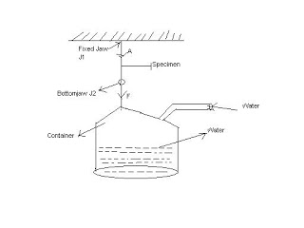
Constant rate of loading (CRL)
Thus, constant rate of flow gives the constant rate of loading.
The function of this applied force is to extend the specimen until it eventually breaks down.
Thus, loading causes the extension.

Slide 32
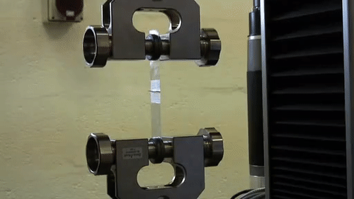
Constant rate of elongation (CRE)
A specimen is gripped between two jaws-top jaw which is fixed and bottom jaw which is moveable to downward direction at a constant velocity by means of a screw mechanism.
Initially the tension on specimen is zero.

Slide 33
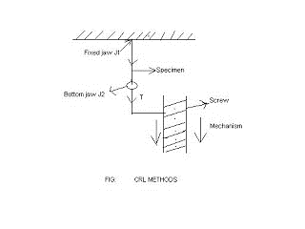
Constant rate of elongation (CRE)
But, when the bottom jaw moves downwards at a constant rate, the specimen is extended and an increasing tension is developed until the specimen finally breaks down.
In this case, the extension causes loading.

Slide 34
Thank You

