Slide 1
Lecture: 1 The Strategic Approach to Human Resource Management
By Dr. AKM Mohsin
September 15, 2021
Add your itle here

Slide 2
Readings
Barney, J. B., & Wright, P. M. (1998). On becoming a strategic partner: The role of human resources in gaining competitive advantage. Human Resource Management, 37(1), 31–46. https://doi.org/3.0.co;2-w">10.1002/(sici)1099-050x(199821)37:1<31::aid-hrm4>3.0.co;2-w
Gomez-Mejia, Balkin & Cardy, Managing Human Resources | Pearson. (2013). Pearson.com. https://www.pearson.com/us/higher-education/product/Gomez-Mejia-Managing-Human-Resources-7th-Edition/9780132729826.html
Performance Management. (n.d.). India.oup.com. Retrieved August 9, 2021, from https://india.oup.com/product/performance-management-9780195693379?
Wright, P. M., & McMahan, G. C. (1992). Theoretical Perspectives for Strategic Human Resource Management. Journal of Management, 18(2), 295–320. https://doi.org/10.1177/014920639201800205
Schuler, R. S., & Jackson, S. E. (1987). Linking Competitive Strategies with Human Resource Management Practices. Academy of Management Executive, 1(3), 207–219. https://doi.org/10.5465/ame.1987.4275740

Slide 3
Learning outcomes
Concept of a Business Strategy
1
2
Strategic Context of HR
3
Strategic HRM-Real life Example
Strategic HRM-Approaches
4

Slide 4
The Concept of a Business Strategy
Strategy defines the company’s distinctive approach to competing and the competitive advantages on which it will be based.

Slide 5
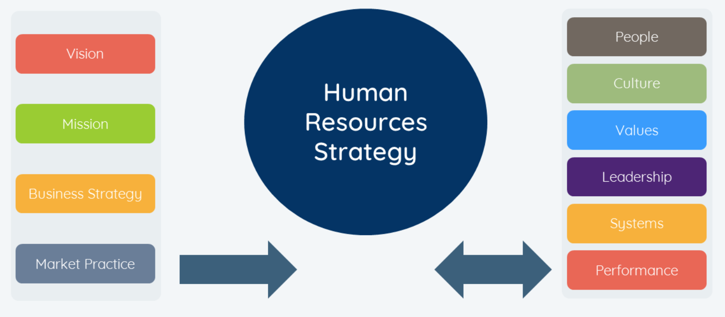
Strategic Context of HR
HR Strategy is the strategy adopted by an organization which aims at integrating core human resource aspects like organization’s culture, its employees, partners, training, incentives and overall system by coordinating a set of actions to get the required business goals.

Slide 6
Strategic Human Resource Management
Strategic human resource management can be defined as the linking of human resources with strategic goals and objectives in order to improve business performance and develop organizational culture that foster innovation, flexibility and competitive advantage.
Strategic Human Resource Management
Strategy
Human Resource Management

Slide 7
Let's start with a question................
How to make an impact using Strategic Human Resources Management? In explaining the 'how', we need to touch upon:
💡Creating a Human Resource strategic plan that follows the business
💡 Aligning HR with Business Strategy
💡Putting more emphasis on data
💡Remembering HR’s other responsibilities
💡Taking an outside-in approach

Slide 8
Strategic HRM-Real life example
Daffodil International Hospital Ltd. entered a foreing country with a high-quality and low-price stretegy (due to low salary cost). This company invested heavily in the-state-of-the-art medical technology and equipment.
The company started comercial operations and failed to provide even minimally acceptable quality service. Hence, Its failed to attract patients. The inquiry into the revealed that the doctors didn't have required skills in critical areas to provide high quality treatment.

Slide 9
Strategic HRM-Real life example
After a year of its painful journey, the company deputed its doctor in foreign country by convincing the department of the immigration authority of the country that local doctors don't possess advance skill in critical areas of treatment and surgery.
The foreign doctors provide their efficiency and treated the patients most successfully. The company after another year of economically and financially dificuly journey could attract customers, but the action increase the cost of operations and ultimately the company incurred loss for 4 consecutive yeras. Consequentely, the company changed its strategy to high-quality and high-price strategy. This shift took five more years to the company to break-even its financial position. Thus, failure to scan human resource environment correctly pushed the company to adverse situation and change the corporate strategy.

Slide 10
Strategic HRM-Real life example
Dafoodil International Hospital Ltd.
The Journey of..........
High-quality and low-price strategy
High-quality and high-price strategy

Slide 11
let's take an example of Starbucks............

Slide 12
Strategic HRM-Best practice approach
The process by which an organization aligns its HR policies with the organization policies and stratigies.
Best practice approach
Employment Security
Selective hiring of new personnel
Self-management teams and decentralized decision making
comparatively high compensation contingent on organizational performance
Extensive Training
Reduce status distinction and barriers
Extensive sharing of financial and performance information.

Slide 13
Strategic HRM-Contengency Approach
Contengency Approach
Best practice are CONTENGENT on
Organizational Strategy
Organizational Culture
Environmental Constraints
Geographic region
labor force avaibility and skill level
Economy
Government regulations

Slide 14
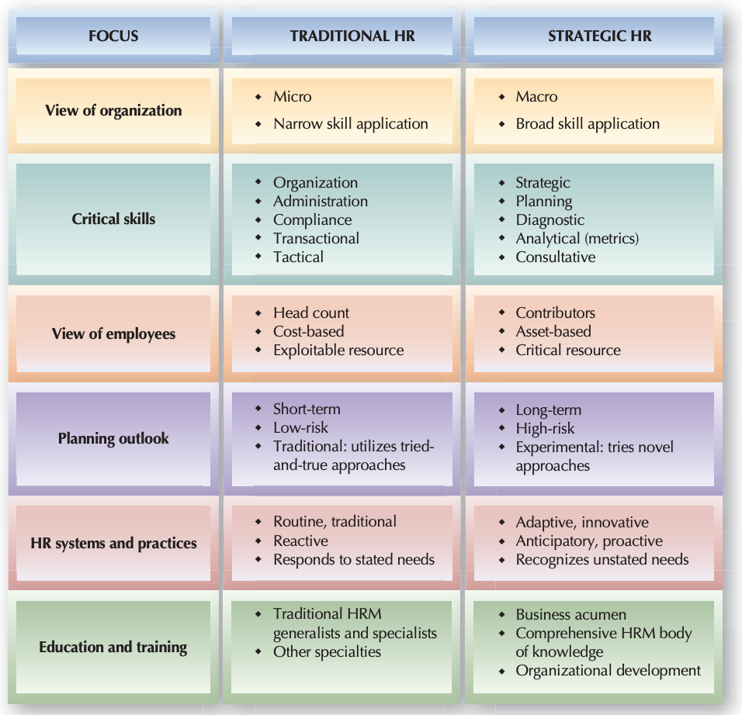
Traditional HR versus Strategic HR
Source: Robert L. Mathis John H. Jackson. Human Resource Management, 13th Edition

Slide 15
The Importance of Strategic HR Planning
Ensure adequate human resources to meet the strategic goals and operational plans of the organization – the right people with the right skills at the right time
Keep up with social, economic, legislative and technological trends that impact on human resources in specific area
Remain flexible so that the organization can manage change if the future is different than anticipated

Slide 16
Align HR with the Business Strategy
Understand the business strategy and current state challenges
Identify how people contribute to organizational growth and success
Design and implement your HR talent strategy
Measure your HR strategy

Slide 17
HR Strategy Differentiation
Firms with more than one business strategy are likely to have more than one approach to their HR strategy.
The challenge is to treat employees across divisions in an equitable fashion while motivating different behaviors that align with the divisions’ strategies or functions.
Equitable treatment of employees is important irrespective of their independent divisional strategies (e.g., General Electric’s R&D division is costly and supports innovation, while the manufacturing division relies on low costs, but all employees receive the same benefits).

Slide 18
Benefits of SHRM
Identifying and analysing external opportunities and threats that may be crucial to the company's success.
Provides a clear business strategy and vision for the future.
To supply competitive intelligence that may be useful in the strategic planning process.
To recruit, retain and motivate people.
To develop and retain of highly competent people.
To ensure that people development issues are addressed systematically.
To supply information regarding the company's internal strengths and weaknesses.
To meet the expectations of the customers effectively.
To ensure high productivity.
To ensure business surplus thorough competency

Slide 19
Strategic Priorities

Slide 20
Thank you!
mohsin@snnu.edu.cn
mohsinakm90@gmail.com
Mobile: 01841156371

