Slide 1
Sales forecasting and budgeting
Chapter 16

Slide 2
Planning
Planning stems from the sales forecast and the purpose of planning is to allocate company resources in such a manner as to achieve these anticipated sales. A company can forecast sales either by forecasting market sales (called market forecasting) and then determining what share of this will accrue to the company, or by forecasting the company’s sales directly.

Slide 3
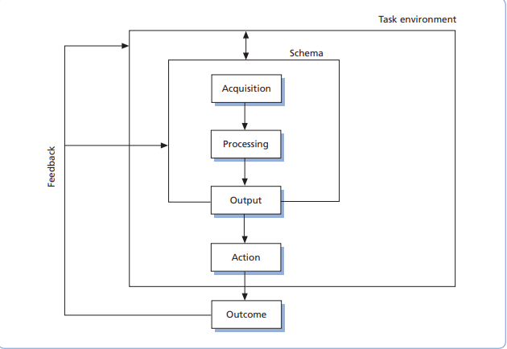
Figure: A conceptually based model of judgmental forecasting

Slide 4
Levels of forecasting
Time period
Short-term forecasts. These are usually for periods up to three months ahead and are really of use for tactical matters such as production planning.
Medium-term forecasts. These have direct implications for planners. They are of most importance in the area of business budgeting, the starting point for which is the sales forecast.
Long-term forecasts. These are usually for periods of three years and more, depending on the type of industry being considered. They are worked out from macro-environmental factors such as government policy, economic trends, etc.
Geographic Area
World
National (India, Bangladesh, US)
Regional (Dhaka, Chittagong)
Territory (Branch/ District)
Customer

Slide 5
Sales Forecasting Methods
Consumer/user survey method
Panels of executive opinion
Salesforce composite
Delphi method
Bayesian decision theory
Product testing and test marketing
Qualitative Methods
Qualitative forecasting techniques are sometimes referred to as judgmental or subjective techniques because they rely more on opinion and less on mathematics in their formulation.

Slide 6
Consumer survey method
This method involves asking customers about their likely purchases for the forecast period, sometimes referred to as the market research method.
Industrial products, where there are fewer customers, such research is often carried out by the Salesforce on a face-to-face basis.
Consumer products, it is not possible to canvass customers through the salesforce. The best method is to interview customers through a market research survey (probably coupled with other questions or through an omnibus survey where questions on a questionnaire are shared with other companies).
This method is of most value when there are a small number of users who are prepared to state their intentions with a reasonable degree of accuracy. It tends, therefore, to be limited to organizational buying.

Slide 7
Panels of executive opinion
This is sometimes called the jury method. Here, specialists or experts are consulted who have knowledge of the industry being examined. Such people can come from inside the company and include marketing or financial personnel or, indeed, people who have a detailed knowledge of the industry. More often, the experts will come from outside the company and can include management consultants who operate within the particular industry. Sometimes external people can include customers who are in a position to advise from a buying company’s viewpoint. This type of forecasting method is termed a ‘top-down’ method whereby a forecast is produced for the industry.
Salesforce composite
This method involves each salesperson making a product-by-product forecast for their particular sales territory. Thus individual forecasts are built up to produce a company forecast; this is sometimes termed a ‘grass-roots’ approach. Each salesperson’s forecast must be agreed with their manager and divisional manager where appropriate, and eventually the sales manager agrees the final composite forecast. Such a method is a bottom-up approach. Where remuneration is linked to projected sales (through quotas or targets) there can be less cause for complaint because the forecast on which remuneration is based has been produced by the salesforce itself.

Slide 8
Delphi method
This method bears a resemblance to the ‘panel of executive opinion’ method and the forecasting team is chosen using a similar set of criteria. The main difference is that members do not meet in committee.
A project leader administers a questionnaire to each member of the team which asks questions, usually of a behavioral nature, such as, ‘Do you envisage new technology products supplanting our product lines in the next five years? If so, by what percentage market share?’ The questioning then proceeds to a more detailed or pointed second stage which asks questions about the individual company. The process can go on to further stages where appropriate. The ultimate objective is to translate opinion into some form of forecast. After each round of questionnaires the aggregate response from each is circulated to members of the panel before they complete the questionnaire for the next round, so members are not completing their questionnaires in a void and can moderate their responses in the light of aggregate results.

Slide 10
The Bayesian view is that probability is a measure of our belief and we can always express our degree of belief in terms of probability.
Bayesian decision theory
To use the Bayesian approach, the decision-maker must be able to assign a probability to each specified event or state of nature. The sum of these probabilities must add to one. These probabilities represent the strength of the decision-maker’s feeling regarding the likelihood of the occurrence of the various elements of the overall problem. It is because of the subjective nature of the process in generating these probabilities that Bayesian decision making is so useful in solving business problems for which probabilities are often unknown. It is also the reason many practitioners often reject the Bayesian approach; in fact some of the more conservative statisticians have termed it ‘the quantification of error’!

Slide 11
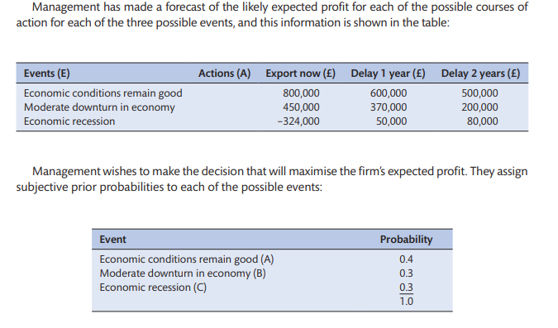

Slide 12
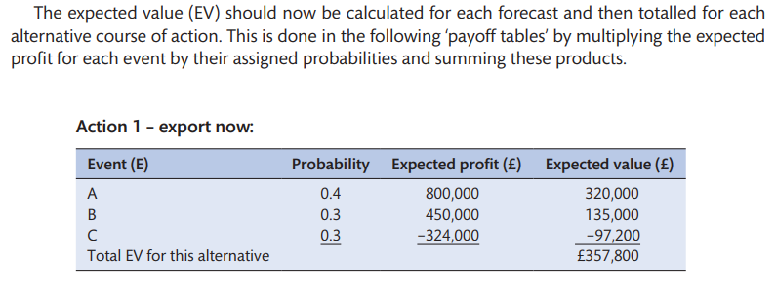

Slide 13
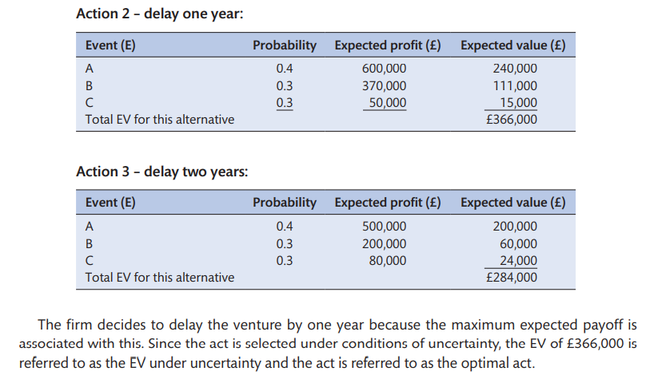

Slide 14
Product testing and test marketing
Product testing involves placing the pre-production model(s) with a sample of potential users beforehand and noting their reactions to the product over a period of time by asking them to fill in a diary noting product deficiencies, how it worked, general reactions, etc. The type of products that can be tested in this manner can range from household durables, for example, vacuum cleaners, to canned foods such as soups. However, there is a limit to the number of pre-production items that can be supplied (particularly for consumer durables) and the technique is really only of value in deciding between a ‘go’ or ‘no go’ decision.

Slide 15
Sales Forecasting Methods
Quantitative forecasting techniques
Moving averages
Exponential smoothing
Time series analysis
Z (or zee) charts
Miscellaneous
Quantitative forecasting techniques are sometimes termed objective or mathematical techniques as they rely more upon mathematics and less upon judgment in their computation. These techniques are now very popular as a result of sophisticated computer packages, some being tailor-made for the company needing the forecast.

Slide 16
Moving averages
This method averages out and smoothes data in a time series. The longer the time series, the greater will be the smoothing. The principle is that one subtracts the earliest sales figure and adds the latest sales figure. The technique is best explained through the simple example given in Table 16.1. It can be seen that using a longer moving average produces a smoother trend line than using a shorter moving average.
These data are reproduced graphically (see Figure 16.2) and it can be seen that averaging smoothes out the annual sales figures. Five-year averaging produces a smoother line than three-year averaging. One can then produce a forecast by extending the trend line, and it is up to the individual forecaster to decide whether three-year or five-year averaging is better. Indeed, it is sometimes unnecessary to smooth the data (in the case of a steady trend) and the technique is then termed trend projection. Generally speaking, the more the data fluctuate, the more expedient it is to have a longer averaging period.

Slide 17
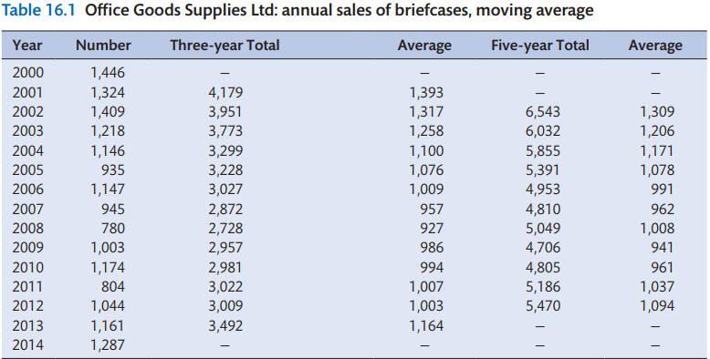

Slide 18
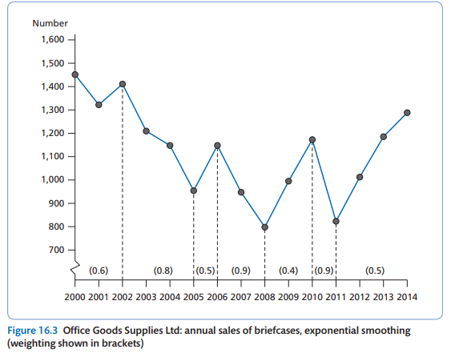

Slide 19
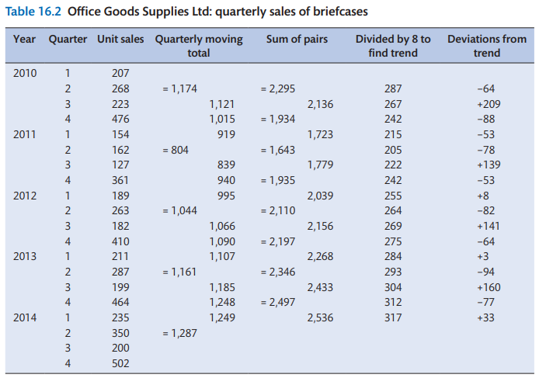

Slide 20
Exponential smoothing
This is a technique that apportions varying weightings to different parts of the data from which the forecast is to be calculated. The problem with moving averages and straightforward trend projection is that it is unable to predict a downturn or upturn in the market (unless the forecaster deliberately places a downturn or upturn in the data). In this technique the forecaster apportions appropriate degrees of ‘typicality’ to different parts of the time series.
In the moving averages technique the forecast will take some time to respond to a downturn or upturn, whereas with the exponential smoothing method the response can be immediate. In the example in Figure 16.3 the forecaster has apportioned greater weightings to downturn periods of trade than to upturn periods, and the forecast will thus reflect another downturn period for 2012. Had a moving averages forecast been used, this would have produced a less steep continuum of the 2009–10 upturn trend.

Slide 21
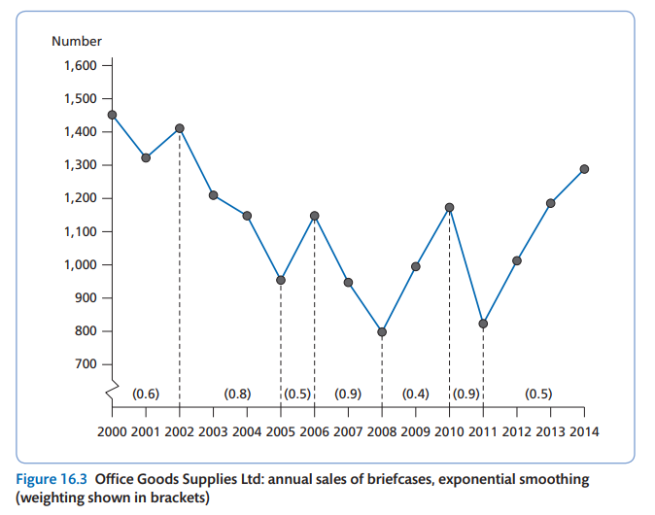

Slide 22
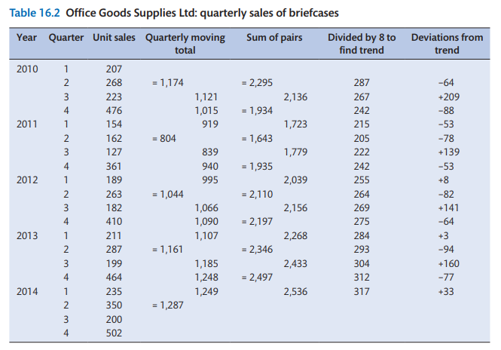

Slide 23
Time series analysis
This technique is useful when seasonality occurs in a data pattern. It is of particular use for fashion products and for products that respond to seasonal changes throughout the year. It can be used for cyclical changes in the longer term (such as patterns of trade) but there are better techniques available for dealing with such longer-term trends. Thus its best application is where the seasonal pattern is repeated on a fairly regular annual basis. These seasonal movements are measured in terms of their deviation from the aggregate trend.
The technique is best explained graphically by using data from the previous example. The quarterly sales of briefcases have been taken for Office Goods Supplies Ltd for the years 2010–14 (see Table 16.2), and it can be seen that sales exhibit a seasonal pattern, with a peak of sales in the final quarter of each year. When the sums of quarterly deviations from the trend are added, the resultant sum is +40 in this particular case (see Table 16.3). The total sum must equal zero, otherwise it would mean that a positive bias would be built into the forecast. However, this correction must come from all figures equally, and is calculated as:
40/45 = +10
Therefore +10 must be subtracted from each quarter’s figures. The corrected figures are then:

Slide 24
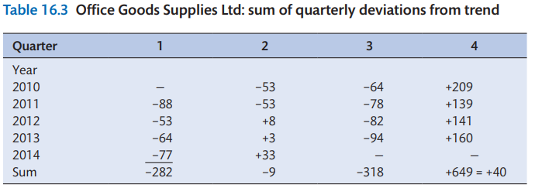

Slide 25
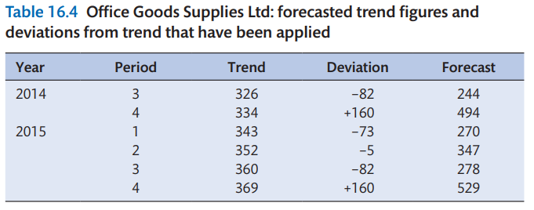
In this particular example these figures must now be divided by four to produce a yearly aggregate (because four years’ data have been used in their compilation) and the figures from which the forecast will be derived are as follows:

Slide 26
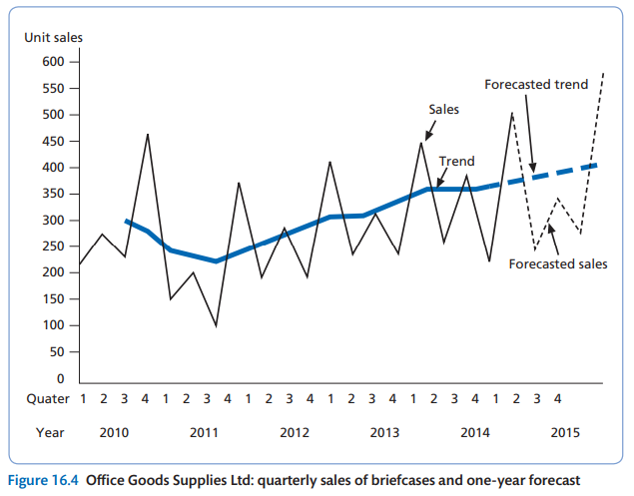

Slide 27
Z (or zee) charts
This technique is merely a furtherance of the moving averages technique. In addition to providing the moving annual total, it shows the monthly sales and cumulative sales. An illustration of the technique shows why it is termed Z chart. Each Z chart represents one year’s data and is best applied using monthly sales data. As a vehicle for forecasting it provides a useful medium where sales for one year can be compared with previous years using three criteria (monthly, cumulative and moving annual).
The sales of briefcases for Office Goods Supplies Ltd have been provided for each month of 2013 and 2014 and this is sufficient to provide data for the Z chart as can be seen in Table 16.5. The figures in Table 16.5 are then transposed graphically in Figure 16.5.

Slide 28
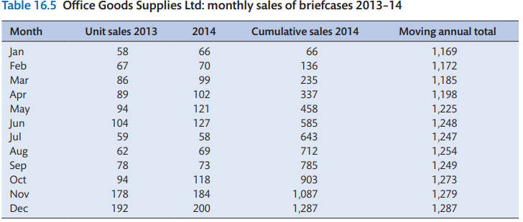

Slide 29
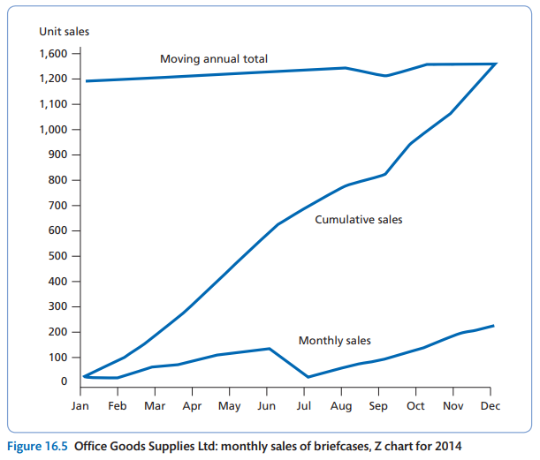

Slide 30
Miscellaneous
This final section briefly outlines two computer-based techniques – to describe their workings in detail would take a disproportionate amount of space together with a detailed knowledge of mathematics
The first of these techniques is Box-Jenkins, which is a sophistication of the exponential smoothing technique that applies different weightings to different parts of the time series. In the case of this technique, the computer package takes earlier parts of the time series and manipulates and weights parts of this against known sales from later parts of the time series. The weighting that provides the best fit is finally deduced and can then be used for the forecast. It is reasonably accurate for short- and medium-term forecasting

Slide 31
Miscellaneous
The other technique is termed X-11 and was developed by an American named Julius Shiskin. It is a decomposition technique and breaks a time series down into trend cycles, seasonal cycles and irregular elements. It is an effective technique for medium-term forecasting and incorporates a number of analytical methods into its computation.

Slide 32
Quantitative techniques (causal)
Leading indicators
This method seeks to define and establish a linear regression relationship between some measurable phenomenon and whatever is to be forecasted. It is not appropriate to enter into a discussion of the technique of linear regression within the confines of this text; should you wish to pursue the technique further, most reasonably advanced statistical texts will adequately describe the method and its applicability.
The best way to explain the technique is to consider the following simple example. The sale of children’s bicycles depends upon the child population, so a sensible leading indicator for a bicycle manufacturer would be birth statistics. The bicycle manufacturer will therefore seek to establish a relationship between the two and, if the manufacturer is considering children’s first two-wheeler bicycles (say, at age three years old, on average) then births will precede first bicycles by three years. In other words first bicycles will lag births by three years.

Slide 33
Simulation
This forecasting methodology has become possible with the widespread use of computers. Leading indicator forecasting establishes relationships between some measurable phenomenon and whatever is to be forecasted, while simulation uses a process of iteration, or trial and error, to arrive at the forecasting relationship. In a reasonably complicated forecasting problem (which most are that utilize this technique) the number of alternative possibilities and outcomes is vast. When probabilities of various outcomes are known, the technique is known as Monte Carlo simulation and depends upon a predetermined chance of a particular event occurring (it is no coincidence that the technique derives from probabilities worked out for gambling games).

Slide 34
Diffusion models
This is essentially a computer technique and its computation is complicated. Basically, diffusion theory assumes that the new product has four basic units:
The innovation;
The communication of the innovation among individuals;
The social system;
Time.
The theory goes on to say that the innovation can be categorized into one of the following groupings:
continuous;
dynamically continuous;
discontinuous.

Slide 35
This is a hierarchical listing, with the innovations being more widely removed from previous technology as one moves further down the list. This means that the further down the hierarchy the innovation is placed, the lower will be the degree of likely acceptance. In the early days of a product innovation, knowledge must be communicated to as many individuals as possible, especially those who are likely to be influential in gaining wider appeal for the innovation. This communication process is broken down into formal and informal communication. These two elements are fed into the forecasting model and as such the model can be applied without large amounts of past sales data. The formal communication is controlled by the company and includes such data as advertising expenditure and sales support for the launch; the informal element relates to such matters as family and reference group influences.

Slide 36
Use of computer software in sales forecasting
The following is a list of more generalized packages that have withstood the test of time.
EXEC*U*STAT from Mercia Software Ltd
FOCA from Timberlake Clark Ltd.
MINITAB from CLE.COM Ltd.
RATS from Timberlake Clark Ltd.
RATS from Timberlake Clark Ltd.
SORITEC from Timberlake Clark Ltd.
SPSS-PC+ from SPSS (UK) Ltd.
STATGRAPHICS from Cocking & Drury Ltd.

Slide 37
Budget determination
The process of determining budget for a project is an activity of aggregating the cost estimates of individual activities, or a work package, to develop the total cost estimate that allows setting a formal cost baseline. This baseline is used to state the budget. However, the budget may differ from the formal cost baseline and constitute the funds authorized to perform the project and its activities. The purpose of the process is to authorize and allocate the monetary resources necessary to complete all project activities and deliver the project on schedule. The main output of the process is a set of monetary resources requirements that serve as a foundation for estimating and controlling the budget and provide valuable data to the project resource management process.

Slide 38
The sales budget
The sales budget may be said to be the total revenue expected from all products that are sold, and as such this affects all other aspects of the business. Thus, the sales budget comes directly after the sales forecast
Budget allocation
For marketers, budget allocation is the maximum amount to spend on a marketing plan. Marketers need to spend their money on efforts needed to reach their audience online and offline to see leads, sales, form fills, and other KPIs, calculated into an ROI.

Slide 39
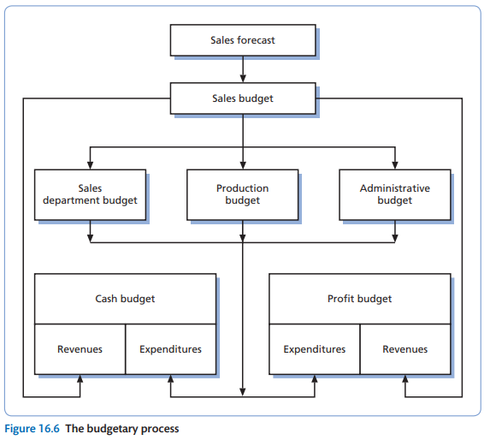
The budgetary process

Slide 40
To produce a good forecast, sales leaders need to pay attention to the following:
Good forecasting requires a good sales strategy.
Good forecasting requires an understanding of your buyer’s behavior.
Good forecasting requires a milestone-driven pipeline process.
Good forecasting requires continual improvement.

