Slide 1
Participatory Rural Appraisal

Slide 2
Objectives of this session
Conceptual understanding of the PRA and its origin
Identify the Key features and benefits of it
Describe the five principles and different tools of it
Know the eight stages in problem solving with PRA

Slide 3
Please think about the question……………..
How do we make friends?

Slide 4
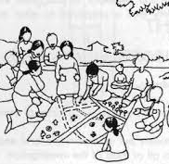
Understanding the Key Concepts
Participatory: Means that people are involved in the process – a “bottom-up” approach that requires good communication skills and attitude of project staff.
Rural: The techniques can be used in any situation, urban or rural, with both literate and illiterate people.
Appraisal: The finding out of information about problems, needs, and potential in a village. It is the first stage in any project.

Slide 5
What is Participatory Rural Appraisal?
Participatory Rural Appraisal (PRA) is considered one of the popular and effective approaches to gather information in rural areas.
PRA is intended to enable local communities to conduct their own analysis and to plan and take action.
PRA involves project staff learning together with villagers about the village.
The aim of PRA is to help strengthen the capacity of villagers to plan, make decisions, and to take action towards improving their own situation.
Collaboration between researchers and local communities; it empowers people, mobilize labor and minimize cost, and giving ownership (win the mind of people)
In fact, it is a shift from extractive survey questionnaires to experience sharing by local people (Data collection to data sharing and empowerment)
PRA is based on village experiences where communities effectively manage their natural resources.

Slide 6
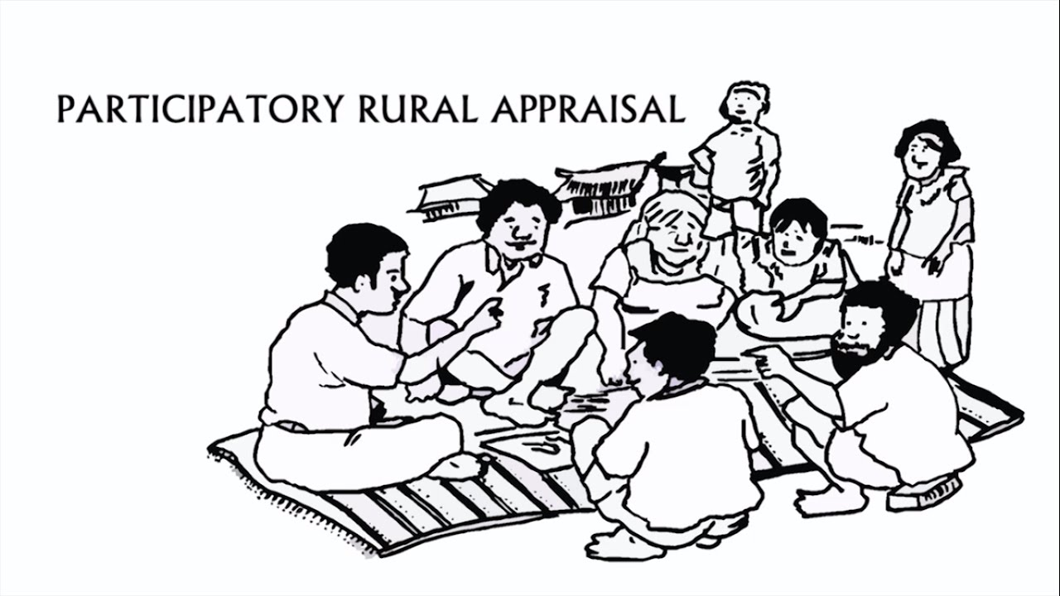
History of PRA
During the 1980s, PRA was firstly developed in Kenya, mainly supported by NGOs operating at grass-roots level. Until today PRA evolved so fast in terms of the methodology, the creation of new tools and specifically in the different ways it is applied.
Compared to RRA (Rapid Rural Appraisal) which aims at extracting information, PRA places emphasis on empowering local people to assume an active role in analyzing their own living conditions, problems and potentials in order to seek for a change of their situation. This changes are supposed to be achieved by collective action and the local communities are invited to assume responsibilities for implementing respective activities. The members of the PRA team act as facilitators. Here it is no longer the external experts but rather the local people themselves who “own” the results of PRA Workshop. Consequently, an important principle of PRA is to share the results of the analysis between PRA team and the community members by visualization, public presentations and discussions during meetings.

Slide 7
The Unique Features of PRA
Reiterative in nature
In the community
Informal
Interactive
Innovative

Slide 8
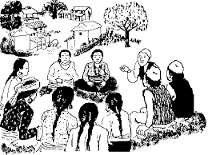
Advantages of PRA
Citizen-centred method of development
“Bottom-UP” approach of development
Use the local knowledge as development solution
Empowerment of local communities
Respect to each other (Both parties)
Enjoyment
Inclusiveness

Slide 9
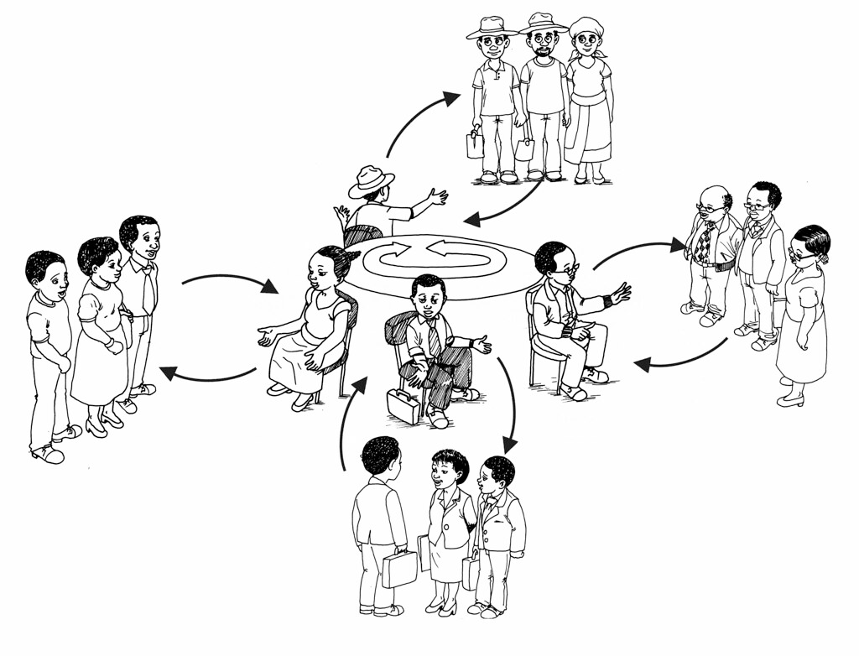
PRA entails Shift From
Etic ---------------Emic
Individual----------Group
Verbal----------Visual
Measuring--------Comparing
Reserve-----------Rapport
Extracting----------Empowering

Slide 10
PRA Principles
Participation
Flexibility
Teamwork
Optimal Ignorance
Systematic

Slide 11
Key Principles of PRA
Participation: PRA relies heavily on participation by the communities, as the method is designed to enable local people to be involved, not only as sources of information, but as partners with the PRA team in gathering and analyzing the information.
Flexibility: The combination of techniques that is appropriate in a particular development context will be determined by such variables as the size and skill mix of the PRA team, the time and resources available, and the topic and location of the work.
Teamwork: Generally, a PRA is best conducted by a local team (speaking the local languages) with a few outsiders present, a significant representation of women, and a mix of sector specialists and social scientists, according to the topic.

Slide 12
Key Principles of PRA
Optimal Ignorance: To be efficient in terms of both time and money, PRA work intends to gather just enough information to make the necessary recommendations and decisions.
Systematic: As PRA-generated data is seldom conducive to statistical analysis (given its largely qualitative nature and relatively small sample size), alternative ways have been developed to ensure the validity and reliability of the findings. These include sampling based on approximate stratification of the community by geographic location or relative wealth, and cross-checking, that is using a number of techniques to investigate views on a single topic (including through a final community meeting to discuss the findings and correct inconsistencies).

Slide 13
Process of PRA

Slide 14
PRA Tools/Methods
Space Related
Time Related
Relationship

Slide 15
Different PRA Tools: Semi-Structured Interview (SSI)
Semi-structured interviews are guided conversations where broad questions are asked, which do not constrain the conversation, and new questions are allowed to arise as a result of the discussion. Semi-Structured Interviews involve the preparation of an interview guide that lists a pre-determined set of questions or issues that are to be explored during an interview. This guide serves as a checklist during the interview and ensures that basically the same information is obtained from a number of people.
The order and the actual working of the questions is not determined in advance. Moreover, within the list of topic or subject areas, the interviewer is free to pursue certain questions in greater depth.
A semi-structured interview is therefore a relatively informal, relaxed discussion based around a predetermined topic.

Slide 16
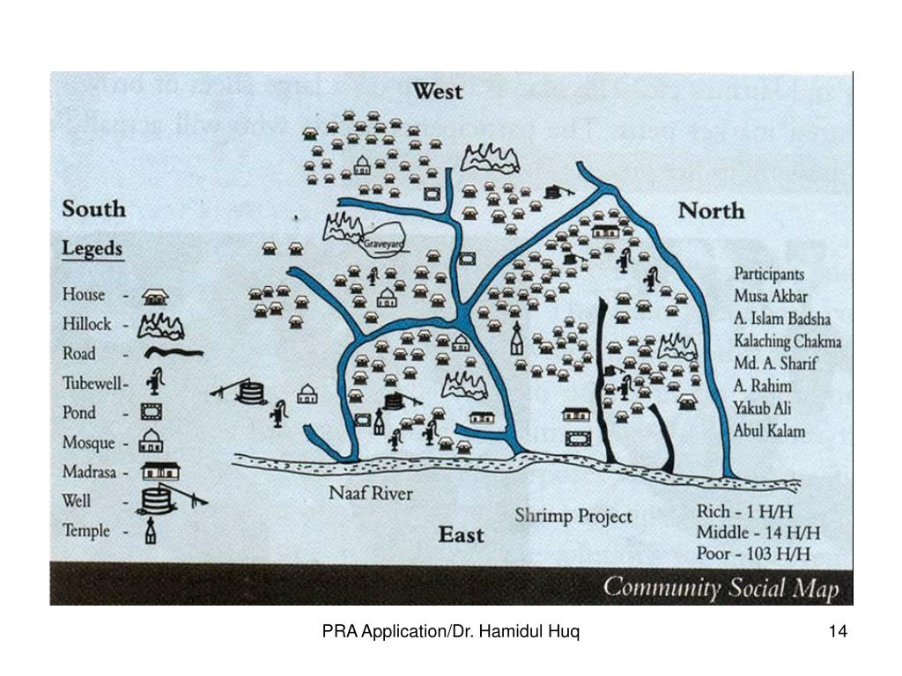
Social Mapping
Social Mapping can be used to:
Identify issues associated with local resources and land types.
Identify appropriate solutions and opportunities to improve land use management.
Develop simple land use management plans
We can compile the results of the Village Resource Mapping and Transect Walk into a Matrix—this highlights the Land/Resource Type, Current Status, Problems, Potential and Activities

Slide 17
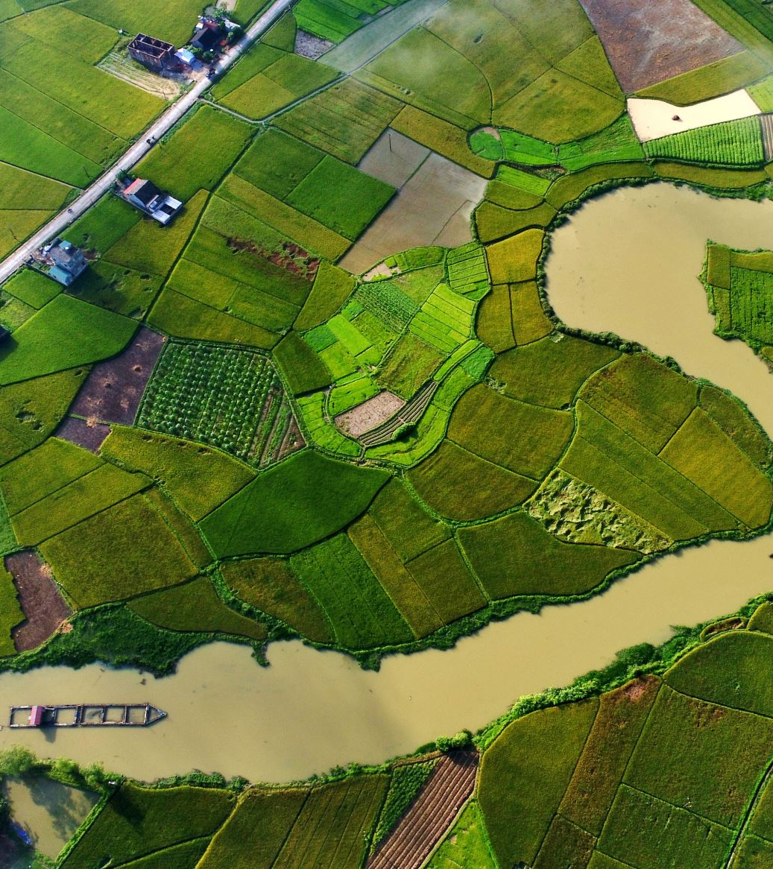
Social Mapping
Social mapping is a PRA method that involves the sketching/drawing of houses and other social facilities and infrastructure (i.e. masjid, temple, stores, rice mills, school, pharmacy, trails and roads, water pumps, irrigation and recreation facilities) in a village.
These features have usually not been well specified in the village vision setting and village land-use maps. It helps to visualize and situate the location of households and other social facilities/infrastructure in a village.
It serves as a baseline for planning, implementation, monitoring, and evaluation of village development activities (including selection of village organizing strategy).
Social Mapping is easier when the size of community is small but it is too tough when the community size is larger.

Slide 18
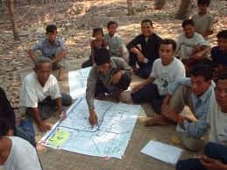
Village Resource Map
The Village Resource Map is a tool that helps us to learn about a community and its resource base.
The primary concern is not to develop an accurate map but to get useful information about local perceptions of resources.
The participants should develop the content of the map according to what is important to them.

Slide 19
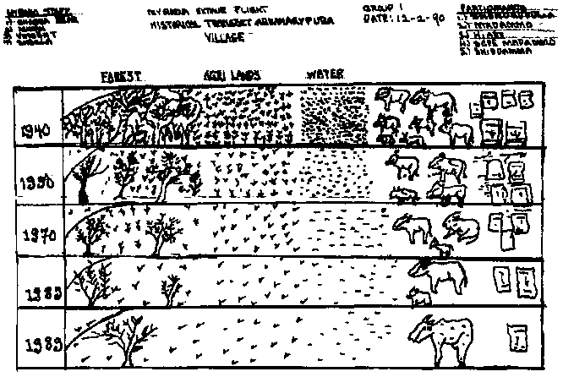
Historical Mapping
The facilitators meet small groups of villagers and discuss with them the most important events in the community’s past and prepare with the information a historical timeline which serves as the base for further work.
It is important to involve different groups of the communities to get their usually different perspectives.
The timeline with basic events can be used for focused discussions on problems, social and technological innovations or on communities history of co-operations and activities which helped them to solve in past problems successfully.

Slide 20
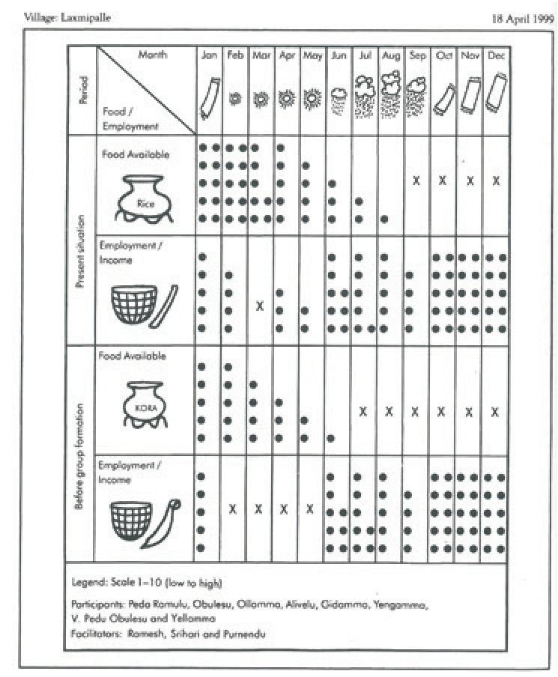
Seasonal Calendar
A seasonal calendar is a PRA method that determines patterns and trends throughout the year in a certain village.
It can be used for purposes such as rainfall distribution, food availability, agricultural production, income and expenditures, health problems, and others.
A time chart or seasonal calendar is prepared by drawing a two-dimensional matrix and writing the time period (i.e. month, year) on an axis and the different village activities on the other axis.
Villagers are encouraged to fill in the matrix of the chart/calendar by marking the grid or by placing stones or other objects on the matrix.

Slide 21
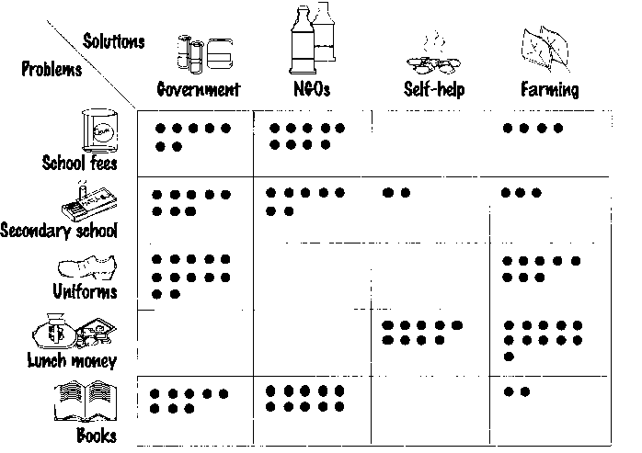
Wealth Ranking
Wealth ranking is a PRA method that determines the economic attributes of households in a village.
It shows information on the relative wealth and well-being of households in a village.
It helps in determining the social and economic status of households in a village.
The information generated by the wealth ranking exercise helps in identifying the poor households in the village.
Ranking is done by villagers themselves.

Slide 22
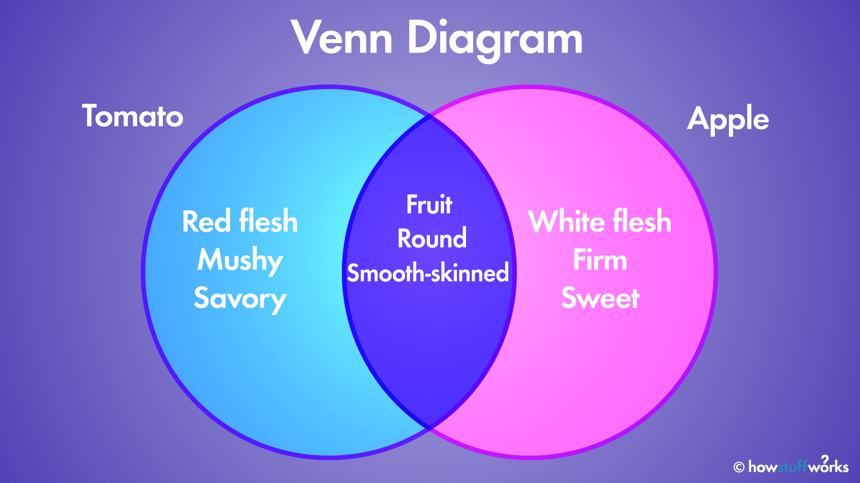
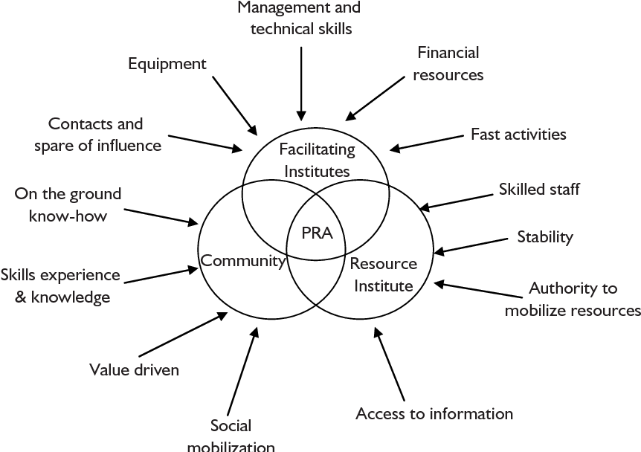
Ven Diagram
The Venn Diagram on Institutions shows institutions, organizations, groups and important individuals found in the village, as well as the villagers view of their importance in the community.
Additionally the Diagram explains who participates in these groups in terms of gender and wealth.
The Institutional Relationship Diagram also indicates how close the contact and cooperation between those organizations and groups is.

Slide 23
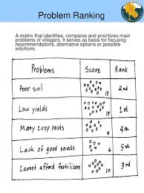
Pair Wise Ranking
Pair-wise ranking is a PRA method that helps villagers to set priorities (i.e. problems, needs, actions, etc.).
Ranking can be undertaken with key informants or group of villagers that represents a good mixture of interests.
It can also be conducted based on gender to determine different preferences between men and women.
For simple issues (i.e. problems), villagers can rank them during the semi-structured interview.
For complicated issues, ranking can be undertaken using pair-wise ranking in order to determine the villagers’ preferences.

Slide 24
Structured Direct Observation
What people say and what they do may be two different things.
Sometimes people idealize a situation and tell things which are more a description of how things should be than how things are.
Other reasons for this difference is that while talking about routine activities a person is only able to give information about some aspects of this activity.
Structured direct observation is better conducted by a team to minimize individual biases.
Always the observation has to be discussed with the people to gain an insider’s perspective.

Slide 25
Key Informant Interview
Depending on the nature and scope of an inquiry, the investigator identifies appropriate groups from which the key informants may be drawn, and then selects a few from each group.
For example, barbers in India know well about the family size of households; shepherds know much about animal structure within the village and development of animal herds over time; old women engaged in agriculture may be specialists regarding seed selection, old men know much about the history of the village and mythological stories related to production activities.

Slide 26
Eight Stages of PRA
1. Rapport Formation
2. Understanding
3. Reframing
4. Solution Searching
5. Solution Planning and Commitment Development
6. Implementation
7. Evaluation and Adjustment
8. Evaluation and Adjustment
9. Ending & Consolidation

Slide 27
Stages of PRA: Problem Solving with PRA
1. Rapport Formation
The objective of this phase is to form a relationship in which the villagers feel comfortable with you and your role as facilitator.
No progress is possible if you fail to establish a good and clear relationship at the beginning.
A sign for this is when the client starts to tell you about the problem with a level of honesty and depth which goes beyond that which you would usually expect from your normal relationship.
2. Understanding
The objective of this phase is to understand the problem from the perspective of your partner, and for the partner to know that you do.
You can find out when you have achieved this objective by asking the partner.
Without such an understanding any attempt to move forward will be resisted by the client.

Slide 28
Stages of PRA: Problem Solving with PRA
3. Reframing
4. Solution Searching
Your objective in reframing is to be critical partner in reflecting the situation and the problem.
You encourage the client to see the problem from a perspective that makes its management possible.
When the partner is in a more manageable perspective they will be ready to move to the next stage.
The objective of this stage is to identify a type of solution.
You will arrive at this point having explored various solution types.
Progress to the next stage depends on the partner being committed to a particular type of solution.

Slide 29
Stages of PRA: Problem Solving with PRA
5. Solution Planning and Commitment Development
6. Implementation
After identifying a type of solution your objective in this stage is to plan a specific solution and to see it through to a successful conclusion.
The actors have to express their commitment to the solution.
The obvious objective is to carry out the plan generated in the previous stage.
Specifically your role here is to help the people with their motivation, focus and persistence.

Slide 30
Stages of PRA: Problem Solving with PRA
7 . Evaluation and Adjustment
8. Ending & Consolidation
Whether you are pushed into this stage through the situation or your partner, the time will come when the implementation as planned has been completed or has reach an impasse.
This is the time when, together, you begin to evaluate and adjust the plan, if necessary.
The objectives in this stage can vary from abandoning a plan the partner has lost faith in, or is creating new problems to fine-tuning a minor aspect of the plan.
Now a particular problem has been overcome, it is wise to help the partner consolidate the problem solving skills they have learned or the solutions they have adopted.
A sensible option is to put the client in a position where they can solve the same or similar problems if they emerge or re-emerge.

Slide 31
Limitations with PRA
Difficult to find the right team and right questions (Women)
Focusing on the wrong target individuals and vested interest on the both sides
Going quickly on the part of the problems
Misled by myths and gossip
Lack of people and social skills that lead to unprofessional
Ignorance realities due to the homogeneous social structure
Local communities are getting opportunities to place themselves as a scholar

Slide 32
Thank you
What is your learning from this class? How do will you apply this knowledge in the coming days specially in your professional life?

