Slide 1
Nutraceuticals, Dietary Supplements and Herbal Products

Slide 2
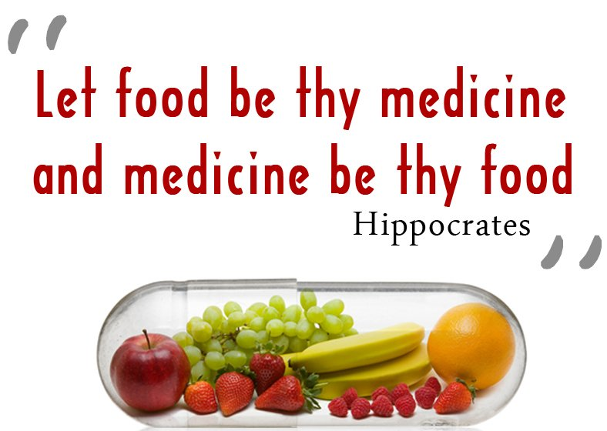
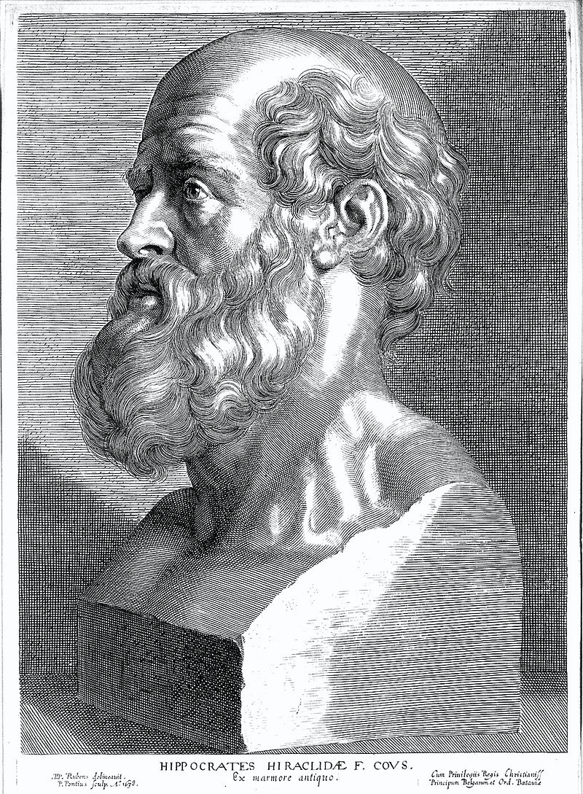

Slide 3
The term “Nutraceutical” was coined from “Nutrition” & “Pharmaceutical” in 1989 by Stephen DeFelice,
Nutraceutical can be defined as –
“ A food or part of food or nutrient, that provides health benefits like improvement of health, delaying of the aging process, increase life expectancy, support the structure or function of the body
or
Can be used in prevention and treatment of chronic diseases.
Other words used in the context:
Dietary supplementation, Functional or Multi-functional Foods,
Medical food, Fortified foods etc.

Slide 5
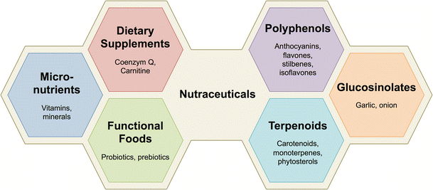

Slide 6
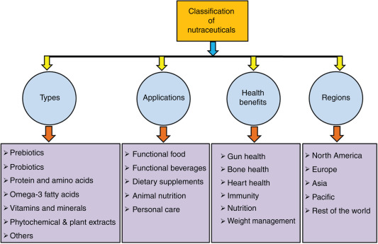

Slide 7
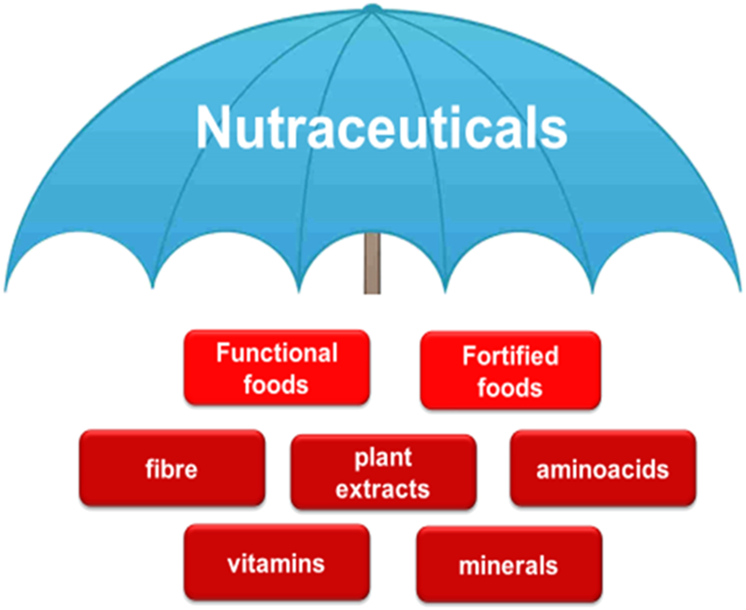

Slide 8
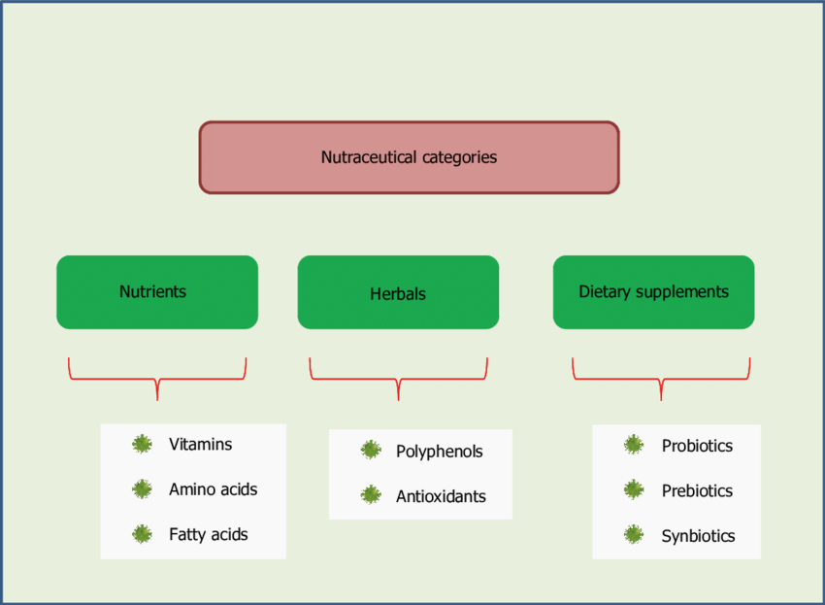

Slide 10
Dietary Supplements
Dietary supplements are defined as any product that is intended to supplement the diet and contains one or more of the following- a vitamin, mineral, herb or other botanical; an amino acid or metabolite; an extract; or any combination of the previously mentioned items.
is intended for ingestion in pill, capsule, tablet, or
liquid form.
EG: Glucosamine

Slide 12
Functional foods
Functional foods, according to their generally accepted definition, are – any food or food ingredient that may provide a health benefit beyond the traditional nutrients it contains. Traditional nutrients refers only to vitamins and minerals.
All foods can be said to be “functional” in the sense that they provide us with essential nutrients, taste and aroma.

Slide 13
Fortified foods
Fortified foods (those that have nutrients added to them that don't naturally occur in the food. These foods are meant to improve nutrition and add health benefits) are enriched with vitamins and minerals usually at arrange up to 100 percent of the Dietary Reference Intake (DRI or Recommended Daily Allowance, RDA) for that nutrient.

Slide 14
Medical foods
Medical foods refer to a food formulated to be consumed or administered internally while under the supervision of a physician.
The food product is intended for the specific dietary management of a disease or condition for which distinctive nutritional requirements are established by medical evaluation.
Medical foods may be used to treat diabetes, obesity or heart disease.

Slide 18
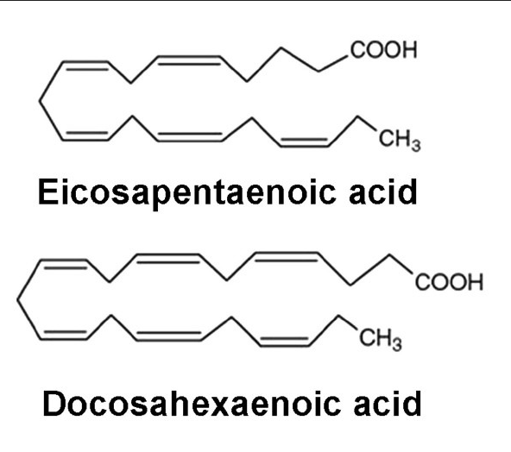
Examples of Functional Components
Class / components | Source |  | Potential benefit
1. Fatty acids
CLA (conjugated linoleic acid) |  | Milk & Meat | Improve body composition, reduce cancers
omega-3 FA DHA-Docosahexaenoic acid EPA-eicosapentaenoic acid |  | Fish oils, & maize mustard, linseed | Reduce CVD & improve mental, visual function

Slide 19
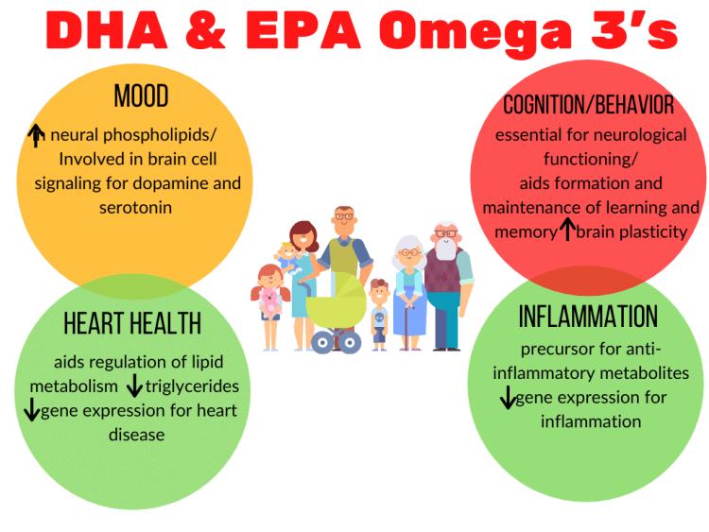

Slide 20
Examples of Functional Components
Class / components | Source | Potential benefit
2. Polyphenols
Anthocyanidine | Fruits | Neutralizes free radicals, reduce risk of cancer
Catechins | Tea
Flavonone | Citrus
Flavones | Fruits, vegetables, soya bean
Proanthocyanidine | Cocoa, chocolate, tea, rapeseed | Reduce CVD

Slide 21
Examples of Functional Components
Class / components | Source | Potential benefit
3. Saponins | Soybeans, chick pea (মটর কলাই) | Lower cholesterol, anti cancer
4.Probiotics / Prebiotics / Synbiotics
Lactobacillus | Card/yogurt | Improve GI health
Fructo - oligosaccharides | Whole grains, onions, combination of Pro & Prebiotics
5.Phytoestrogen
Daidzein , Zenistein | Soybean, flax, lentilseed, maize | Reduce menopause symptoms, ↑ bone health
Lignans | Flax, rye, vegetables | Reduce cancer and heart diseases

Slide 22
Examples of Functional Components
Class / components | Source | Potential benefit
6. Caroteinoids
β- caroteine | oat & maize, Carrots, vegetables, fruits | Neutralizes free radicals
Luteine | vegetables | Healthy vision
Zeoxanthine | Eggs,citrus,corn
Lycopene | Tomatoes | Reduce prostate cancer
7. Dietary fiber
Insoluble fiber | Wheat bran | Reduce breast, colon cancer
β-glucan | Oats | Reduce CVD
Whole grain | Cereal grains

Slide 23
Probiotics
promote the growth of “friendly” bacteria, which help, fight diseases.
Lactobacillus acidophillus: Acidophyllus type support healthy bacteria for small intestine.
Bifidobacterium bifidum: Bifidobacteria support healthy bacteria for large intestine.
Enhance the immune function.

Slide 24
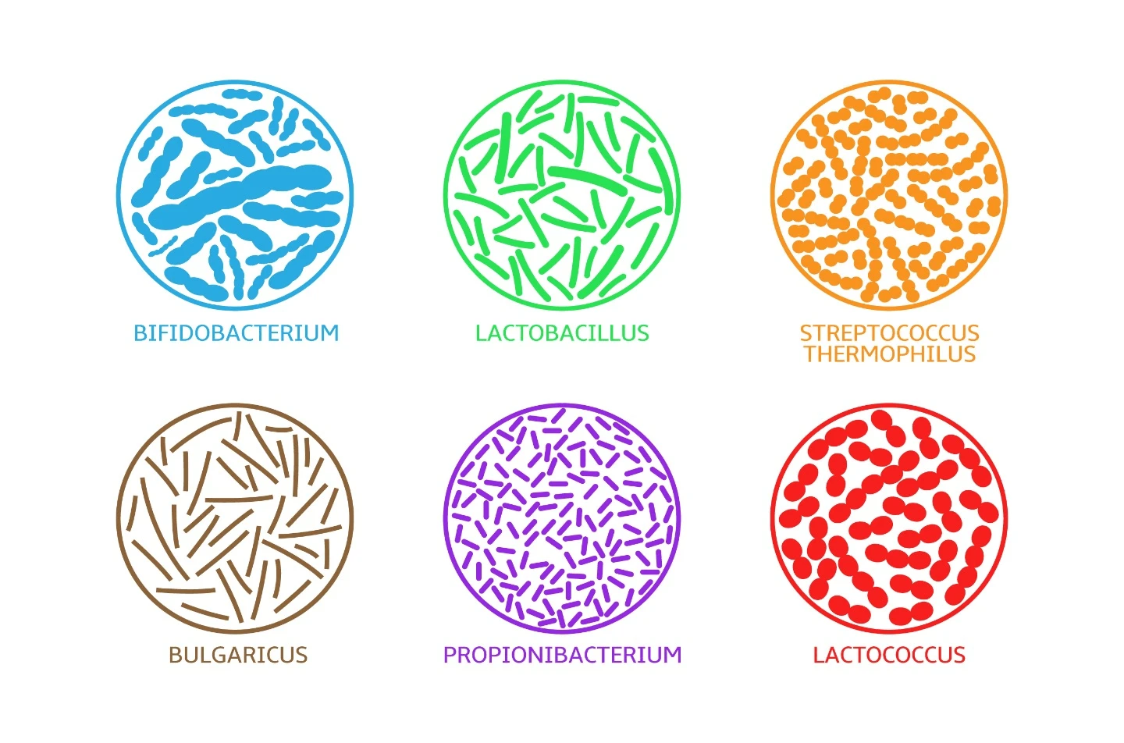

Slide 25
Probiotics cont.
Probiotics given to women around the time of childbirth could protect children from atopic eczema for up to 4 yrs.
Controlling diarrhoea in children
Offset S/E’s of antibiotics
Ease symptoms of lactose intolerance.
Sources: Sour milk, yoghurt, Yeast (Saccharomyces spp)

Slide 26
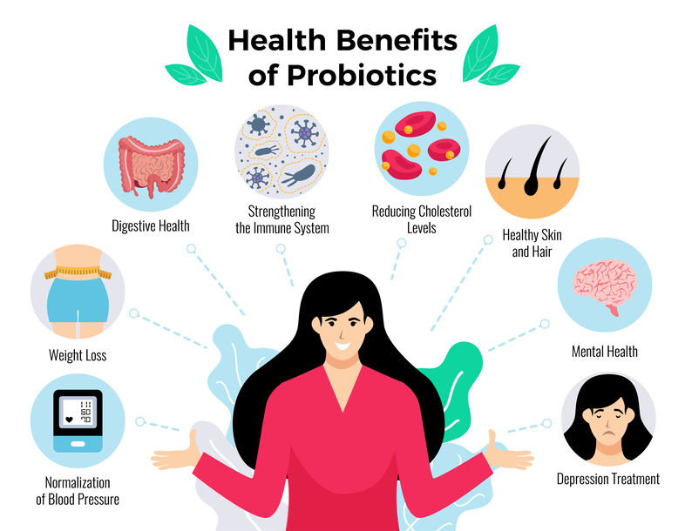

Slide 27
Prebiotics
Prebiotics are a source of food for probiotics to grow, multiply and survive in the gut.
Prebiotics are fibres which cannot be absorbed or broken down by the body and therefore serve as a great food source for probiotics, in particular the Bifidobacteria genus, to increase in numbers. The most common definition of prebiotics is: "non-digestible food ingredients that beneficially affect the host by selectively stimulating the growth and/or activity of one or a limited number of bacteria in the colon, which can improve host health."
Common prebiotics include: inulin, Fructooligosaccharides (FOS), galactooligosaccharides (GOS), lactulose and lafinose

Slide 30
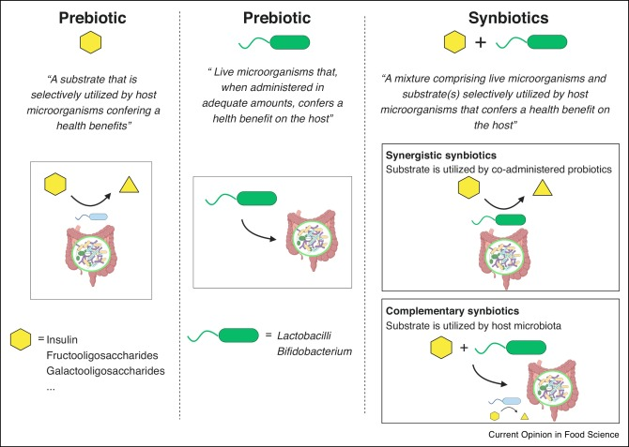

Slide 32
Commonly used Herbs in Nutraceticals Preparation
Herbs | Function
Amlaki | Vitamin C Supplement.
Ginseng | Maintaining the balance of the energy in human body.
Peppermint | Effective in gastrointestinal disorders.
Spirulina | chemoprevention, neuroprotection, antiviral, cardiovascular protection, hepatoprotection, anti-inflammatory, antioxidant.
Ispaghula | effective in gastric irritation and ulceration, useful in chronic dysentery, constipation and piles.
Garlic | Maintains healthy heart
Thyme | Use for asthma, bronchitis, colds, flu, cough, food poisoning, fevers, migraines, nightmares & sore throats.
Fennel (মৌরী) | Use for colic, cramps, flatulence, gout, indigestion and lactation.
Dill (শুলফা) | Use for bad breath, bronchitis, colic, coughs, flatulence, poor appetite and lactation.

Slide 33
Herbals
Aloe vera: Anti-inflammatory, emollient, wound healing,
Evening Primrose oil: Dietary supplement of Gamma linoleic acid, treatment of atopic eczema,
Garlic:Antibacterial, antifungal, antithrombotic, antiinflammatory,
Ginger: carminative, antiemetic, treatment of dizziness.
Ginseng: Adaptogen
Green tea: Antioxidant, reduces risk of CVD, enhances humoral and cell mediated Immunity,
Vegetables, fruits, whole grain, herbs, nuts and various seeds contain an abundance of phenolic compounds, terpenoids, sulphur compounds, pigments etc. that has been associated with protection / treatment of certain disease conditions,

Slide 35
Method to Enhance Active Components in Food
Manipulating the diet to get maximum level of active components
Combination of food ingredients rich in nutraceuticals
Fortifying food with active ingredients
By fermentation of food products
Changing food habits to natural type of diet

