Slide 1
Security Laws of Bangladesh

Slide 2
syllabus
Historical background of Securities laws in Bangladesh.
Historical Background of Securities Law-British India prospective,
Power of Securities Exchange Commission (SEC),
regulation on issuance, prohibitions and restrictions.
Constitution and functions of Securities and Exchange Commission.
Stock Exchange Rules.
Concept of insider trading-Chinese walls,
positions in USA, UK and Bangladesh.

Slide 3
Concept of Securities
Security is an investment in a business. It can take the form of shares of stock, bonds, a package of loans or mortgages offered for sale by a financial institution or a financial instrument representing investment in a company or an international project.
One of the most common examples of a security is a company's stock, which is a type of equity security, bonds, and other claims on a debt that must be paid are debt securities.

Slide 5
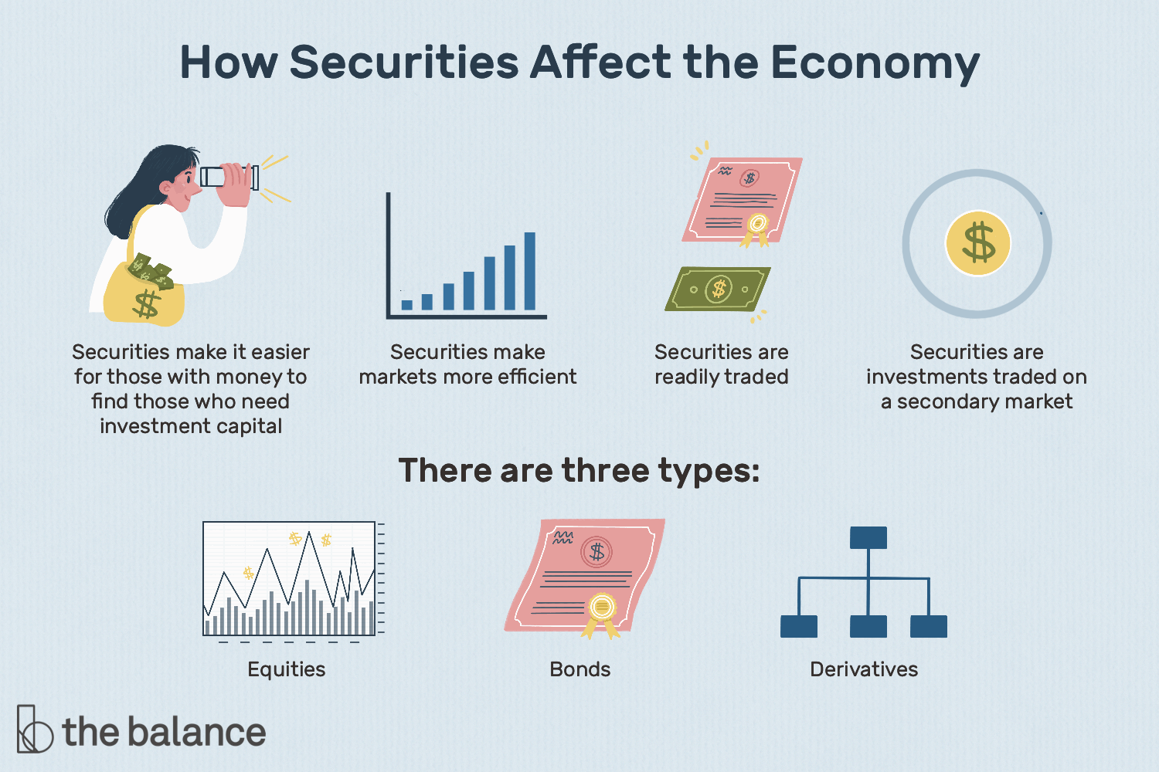

Slide 31
Insider Trading & China Wall Policy

Slide 32
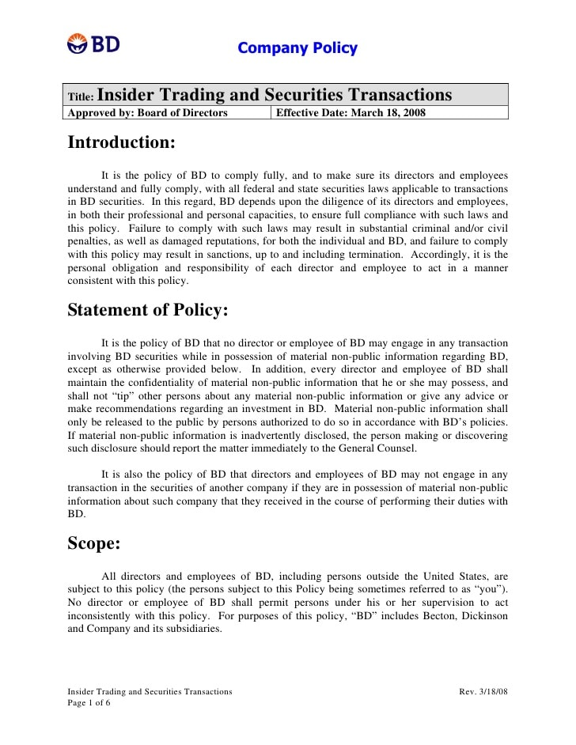

Slide 33
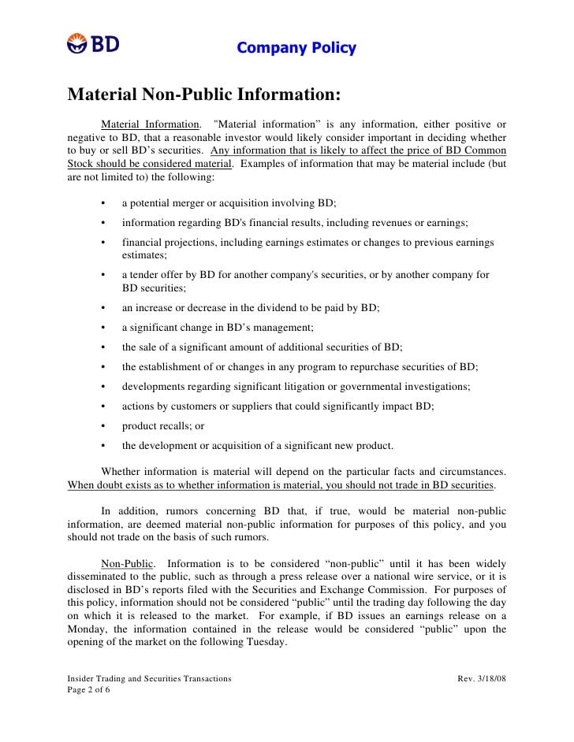

Slide 34
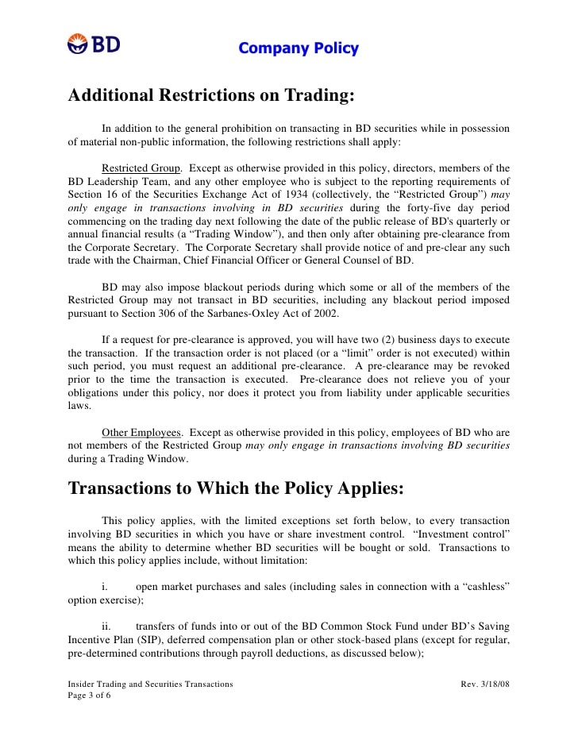

Slide 35
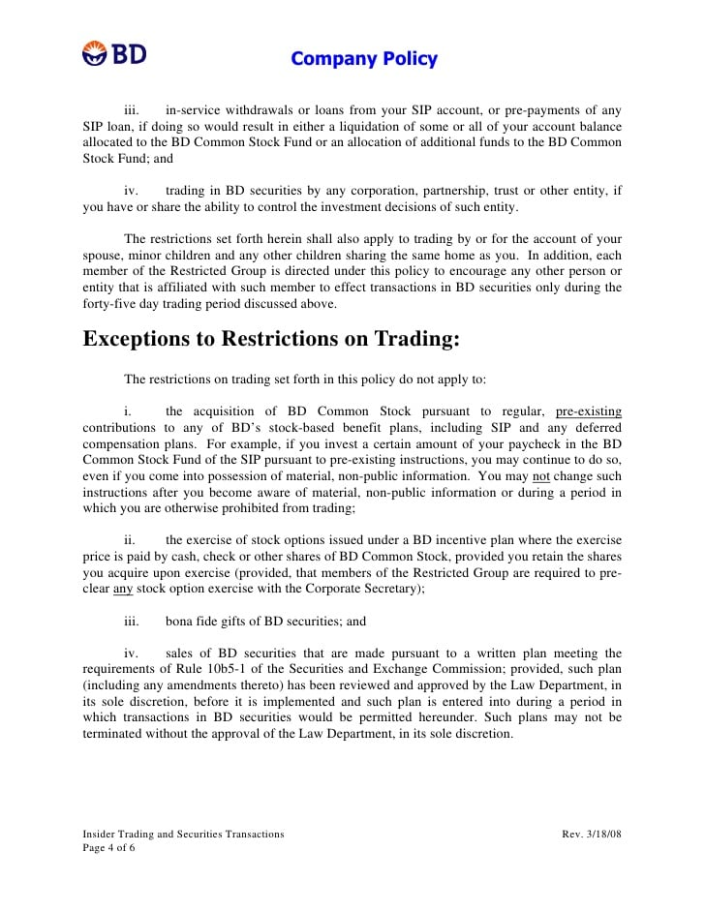

Slide 36
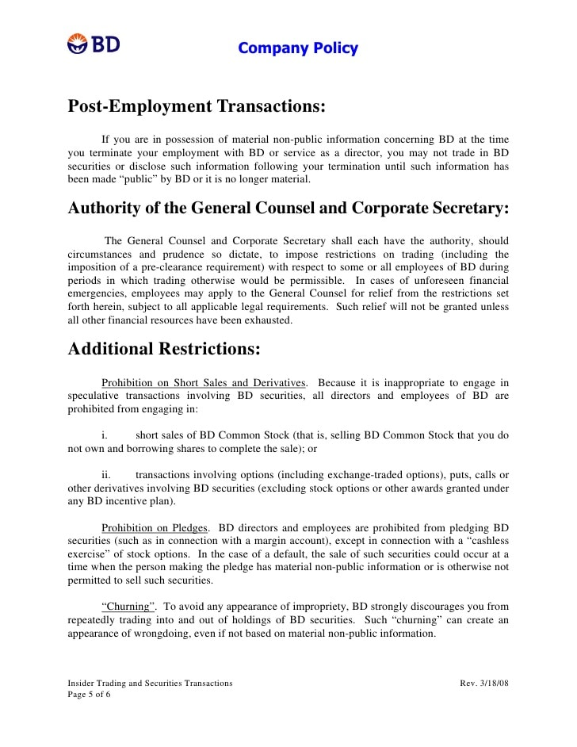

Slide 37
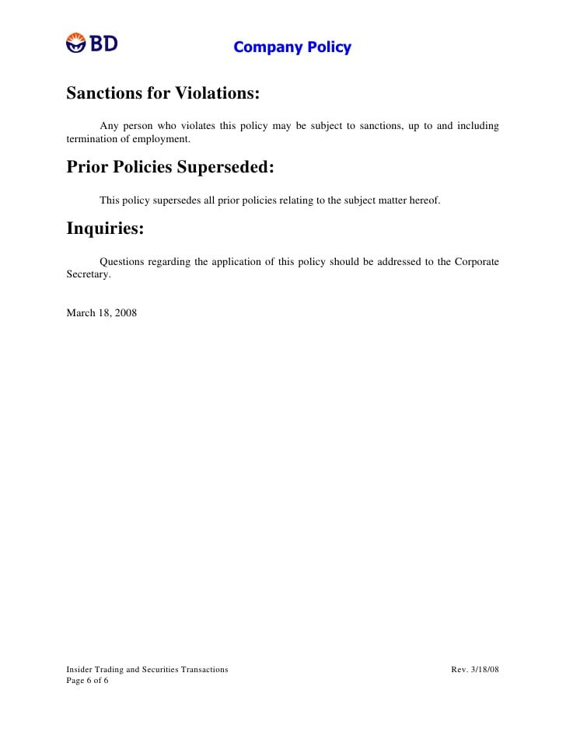

Slide 38
Questions Session

