Slide 1
The Tragedy of Macbeth
William Shakespeare

Slide 2
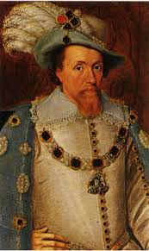
Key Facts
shortest tragedy
set in Scotland
believed to have been written between 1599 and 1606, and is most commonly dated 1606
written during the reign of James I, who had been James VI of Scotland before he succeeded to the English throne in 1603

Slide 3
Source
Holinshed's Chronicles (Macbeth), who based his account of Scotland's history, and Macbeth's in particular, on the Scotorum Historiae, written in 1527 by Hector Boece
associated more closely with the execution of Henry Garnett for complicity in the Gunpowder Plot of 1605

Slide 4
Shakespeare’s Alterations
Shakespeare presents Macbeths’ reign as a dreadful tyranny.
Shakespeare presents Banquo as being noble and good throughout the play

Slide 5
Central Sentiment
Shakespeare’s alterations function to show that there is a divine right of kings, and that to usurp the throne is a nefarious crime against all of humanity.

Slide 6
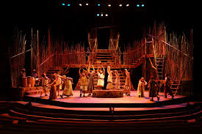
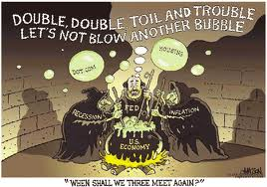
Macbeth in Versions

Slide 7
Interesting Facts
The action of the play takes place over nine days. The historical events chronicled in the play actually took place over the period of about eighteen years.
In the backstage world of theatre, some believe that the play is cursed, and will not mention its title aloud, referring to it instead as "the Scottish play."

Slide 8
Characters
Duncan – King of Scotland
Malcolm – Duncan's elder son
Donalbain – Duncan's younger son
Macbeth – a general in the army of King Duncan; originally Thane of Glamis, then Thane of Cawdor, and later King of Scotland
Lady Macbeth – Macbeth's wife, and later Queen of Scotland
Banquo – Macbeth's friend and a general in the army of King Duncan
Fleance – Banquo's son
Macduff– Thane of Fife
Lady Macduff – Macduff's wife
Macduff's son
Ross, Lennox, Angus, Menteith, Caithness – Scottish Thanes
Siward – General of the English forces
Young Siward – Siward's son
Seyton – Macbeth's servant and attendant
Hecate – Queen of the witches
Three Witches
Three Murderers
Porter – gatekeeper at Macbeth's home
Doctor – Lady Macbeth's doctor
Gentlewoman – Lady Macbeth's caretaker

Slide 9
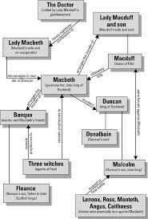
Character Map

Slide 10
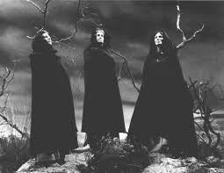
The Three Witches (Act I Scene I)

Slide 11
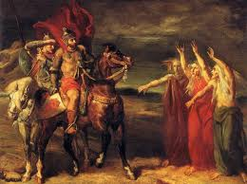
Meeting with Three Witches

Slide 12
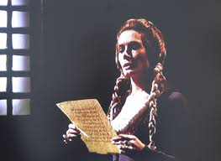
Lady Macbeth Reading the Letter

Slide 13
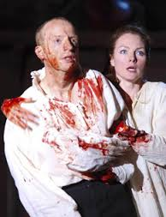
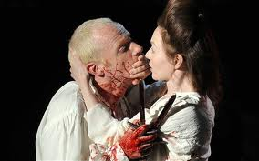
After the Murder

Slide 14
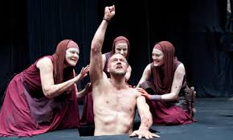
2nd Meeting with the Witches

Slide 15
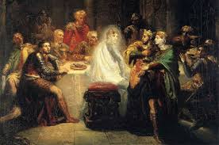
Ghost of Banquo

Slide 16
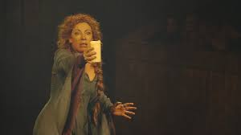
Lady Macbeth’s Sleepwalking

Slide 17
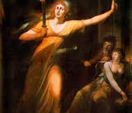
Painting
"The Sleepwalking Lady Macbeth." Painting by Johann Heinrich Füssli

