Slide 1
Keys in Relational Model
Fatema Tuj Johora Lecturer, Department of CSE,DIU

Slide 2
Topic of discussion
What is Key?
Super Key
Candidate Key
Primary Key and
Foreign Key

Slide 3
Key in DBMS
A DBMS key is an attribute or set of an attributes which helps you to identify any two tuples uniquely.
They allow you to find the relation between two tables.

Slide 4
Unique attributes
Let consider some attribute that helps to identify tuples of table uniquely:
Roll No
Registration No
Licence No
Voter ID
Phone No
Address.
Notes:
These collections are called Candidate key.

Slide 5
Candidate Key
A candidate key is a set of attributes (or attribute) which uniquely identify the tuples in relation or table.
candidate key set { StudID, phone,address,email }

Slide 6
Primary Key
Primary key= unique +not null
PRIMARY KEY is a column in a table that uniquely identify every row in that table.
Primary Key { Student ID}

Slide 7
Alternate Key
The candidate key other than the primary key is called an alternate key.
Alternate key { phone no, Address, Email }
Student ID | Name | Phone No | Address | email
1 | Abul | 01833…. | savar | Abul.cse@gmail.com
2 | kalam | o1844 | canada | Kalam.cse@gmail.com

Slide 9
Super Key
The set of attributes which can uniquely identify a tuple is known as Super Key.
Super key= candidate key + Anything
Super key set {StudID, Name},{Student ID, Name} { StudID, phone}, { Email, Name}…….

Slide 10
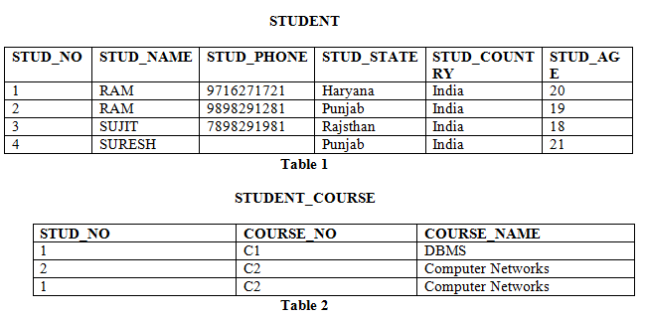
Foreign Key
FOREIGN KEY is a column that creates a relationship between two tables.

Slide 11
Thank you

