Slide 1
Information Access Devices
CSE334
Md. Ferdouse Ahmed Foysal
Daffodil International University

Slide 2
Handheld Computers
A hand-held computer is a portable computer that is small enough to be held in one’s hand. Although extremely convenient to carry, handheld computers have not replaced notebook computers because of their small keyboards and screens.
Traditional hand-held computers were PDAs and devices specifically designed to provide PIM (personal information manager) functions, such as a calendar and address book.
Today PocketPCs, smartphones and tablets are common consumer devices.
Handheld computers comprise the largest group of Internet connectable pervasive devices.
They are small, lightweight, and fit into pockets.
A stylus is used to tap on a touch screen to activate applications or enter data.
Currently two major operating systems are applied on handheld devices: Palm OS and Windows CE.

Slide 3
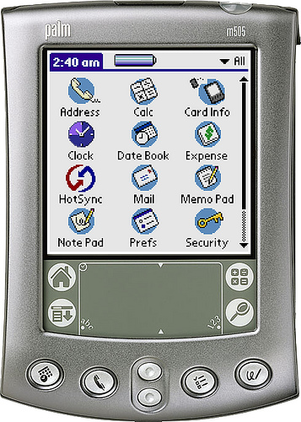
Palm OS-Based Devices
Palm OS also known as Garnet OS is a discontinued mobile operating systems for personal digital assistants (PDAs). It is the best-known and most popular operating system for handheld devices.
Wireless modem, a Bluetooth module, a MP3 player, and a CPS device.
The most important native applications of Palm OS based devices applications are the Address Book, the Date Book, The To Do List, the Memo Pad, and the Mail applications.

Slide 4
Palm Applications
The most important native applications of Palm OS based devices applications are the Address Book, the Date Book, the T0 Do List, the Memo Pad, and the Mail application.
The Address Book displays a master list of addresses sorted by last name and displaying the principal phone numbers.
The Date Book is used to display and edit appointments in a daily, weekly or monthly view.
At the time the Memo Pad application is started, it first shows an index consisting of the first lines of the memos. If you tap on a list element, the complete memo is displayed.
With the Mail application users can read downloaded emails or generate new emails offline.

Slide 5
Palm Applications
Text entry: Text can be entered with taps on a small keyboard and displayed Text entry on the screen. Alternatively, glyphs can be drawn in a dedicated area below the screen.
HotSync: The synchronization mechanism between a Palm OS based device and a desktop PC is HotSync.
Infrared port: The infrared port offers a convenient possibility to exchange data between different devices.
Internet access: The Palm allows to access Internet sites either through an Internet connected PC or directly by going online via modem.

Slide 6
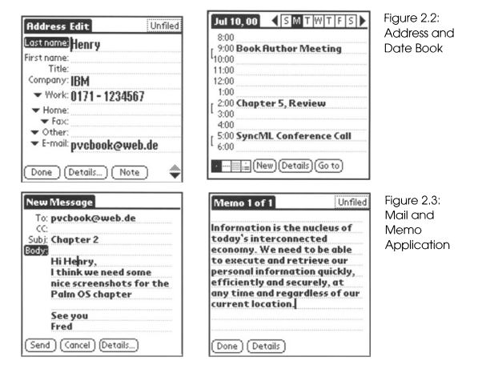
Palm Applications

Slide 7
Palm Applications
Many other applications are available as freeware, shareware or commercial products from various third-party providers. Among them are fax software, calculators, alarm docks, drawing applications, games, travel guides, and many, many more.

Slide 8
Freeware & Shareware
Freeware is copyrighted computer software which is made available for use free of charge, for an unlimited time. Authors of freeware often want to "give something to the community", but also want to retain control of any future development of the software.
The term shareware refers to commercial software that is copyrighted, but which may be copied for others for the purpose of their trying it out with the understanding that they will pay for it if they continue to use it.

Slide 9
Windows CE-Based Handheld Computers
Windows CE is the second major operating system for handheld computers, taking almost the remaining rest of the market share.
Windows CE has been developed by Microsoft and is applied by manufacturers like Casio, HP, and Compaq.
Compared to the competing Palm OS, Windows CE requires plenty of memory and processing power making devices much more expensive.

Slide 10
Windows CE Applications
Personal Information Management: While Palm concentrates on state-of-the-art mobile information management, Windows CE devices are technological wonderboxes, generously equipped with fancy hardware features
They usually have a color display with a good resolution, enabling multimedia applications such as computer games.
There is a built-in microphone for a voice recording facility and a MP3 player. A stereo output is provided to plug in a headset.
USB and infrared support ensure connectivity with peripherals and other devices.
A CompactFlash card slot can be used to attach memory cards for additional storage capacity or one of a wide variety of the other special-purpose cards such as a digital camera card or a modem card.

Slide 11
Windows CE Applications
Active Sync: ActiveSync is the synchronization software, which Windows CE Active Sync applications use for keeping the mobile data consistent and up-to date with databases on the user's corresponding PC. This way, information like address book or calendar entries can be maintained both on the mobile device and on the workplace PC. ActiveSync supports communication through USB, infrared, and serial port, as well as via Ethernet LAN.

Slide 12
Windows CE Applications
PocketPC Office suite: The PIM applications of 2.11 have been updated and renamed to Office suite Packet Outlook. Part of Windows CE are packet versions of Microsoft Word and Excel. Up to now, these tools had only been shipped with larger sub-notebooks versions of CE. Word and Excel will help viewing attachments.
Internet Explorer: The Packet Internet Explorer is definitely one of the highlights of Explorer version 3.0. It supports online and offline browsing.

Slide 13
Windows CE Applications
Multimedia Access: A electronic book application and a media player reflect the aim of Microsoft to emphasize on content delivery complementary to providing just base technology like operating systems.
The Microsoft Media Player can download an individual music library from major record companies onto a handheld device. The Windows Media format compresses two hours of music into 64 MB. That is about half as much as MP3 needs.
Microsoft Reader is an electronic book software delivering books to Windows CE based devices. Well readable fonts, a built-in dictionary, and a large collection of book titles are the benefits for the user. The goody for the publisher is a corresponding copy-protection system preventing illegal reproduction.

Slide 14
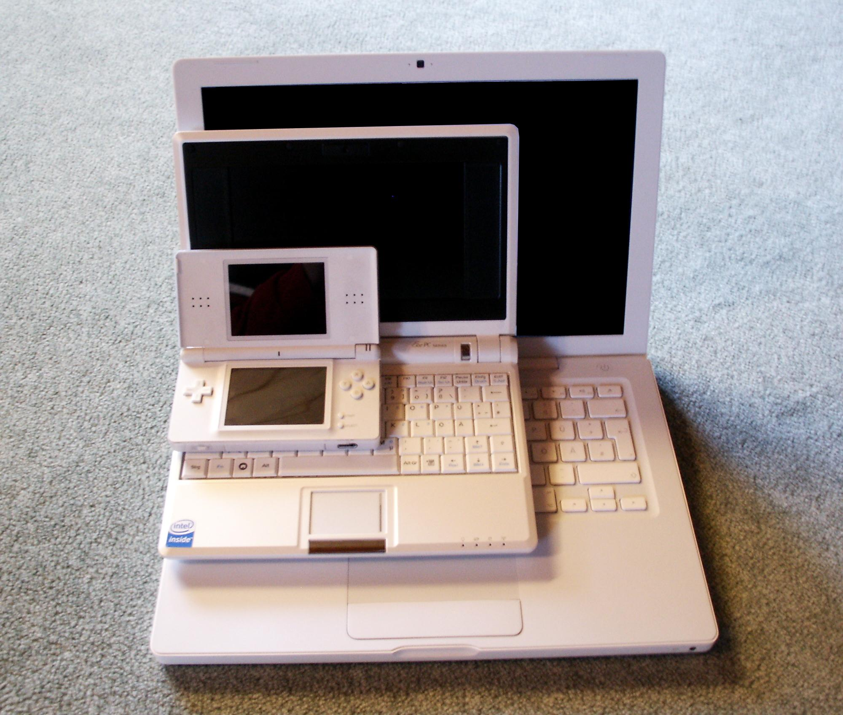
Sub-Notebooks
In terms of size, weight, processing power, and functionality, subnotebooks or clamshells are somewhere in between a handheld device and a regular notebook.
Most of a handheld computer's characteristics are valid for sub-notebooks too. But they have more memory, more CPU power and they provide a reasonable screen as well.
Additionally, they have a small keyboard, making data entry much easier - a significant advantage, in case a lot of text has to be typed in.
Although sub-notebooks won't fit into pockets anymore, they are still highly portable and a bit lighter than full-sized notebooks.

Slide 15
Sub-Notebooks
The main differences to regular notebooks are that the sub-notebooks have much less computing power, cost less and that they are intended for mobile usage.
Like handhelds, they have instant-power on, avoiding to boot an operating system first before usage.
Nevertheless, floppy and CD ROM drives are uncommon for sub-notebooks. And hard disks are rare.
But being less convenient to carry around than a handheld and having less functionality than notebooks, makes the sub-notebook class not very popular for a broad audience.

Slide 16
Windows CE-Based Sub-Notebooks
Major device manufacturers for Windows CE sub-notebooks are HP Jornada 820) and Compaq (Aero 8000) - both are using version 2.11 of that operating system.
Along with handheld PC devices comes a complete set of miniaturized Microsoft office tools and the Internet Explorer.
Windows CE handhelds feature a PC Card slot far various peripherals like wireless communication adapter, modems, and many more.

Slide 17
EPOC-Based Sub-Notebooks
EPOC is a versatile operating system designed far usage in various mobile devices.
Beside sub-notebooks, it is also applied far phones. EPOC has been developed by the Symbian consortium, founded by Ericsson, Motorola, Nokia, and Psion.
Remarkable is, that the EPOC operating system is very stable and users only experience crashes every few years. These devices contain a rich set of applications for mobile workers.
Besides the PIM applications, they feature a word processor, a spreadsheet application, a web browser which supports Java applets, a communication suite with email, fax and SMS, as well as an application to backup and synchronize the device with a PC.
There is plenty of additional third-party software available for EPOC devices. Maps, databases, dictionaries, tools for internet, email, fax and SMS, financial calculators, and accounting applications, just to name a few of them.

Slide 18
Phones
Modern phones create a high demand for new pervasive technologies. They have evolved from a simple person-to-person voice interface to powerful network clients. Today, address books, calendar, memos, and games are state of the art applications, which are no longer restricted to high-end phones.

Slide 19
Cellular Phones
The diversity of cellular phones is incredible; their functionality too: the endless list of features gets longer every day. There are manifold games, fancy form factors, built-in FM radio, and even PIM functionality

Slide 20
Cellular Phones Applicationsa
Entering text: One issue, cellular phones without a reasonable keyboard have to cape with, is how to enter text easily: Voice recognition is one sumptuous way. Instead of picking one of the miniaturized keys, commands and data can be spoken to the device. Stored phone numbers are dialed with one shout.
GSM: Global System for Mobile Communication (GSM) is the accepted de facto standard for mobile wireless communication. A dense net of GSM base stations has been established by numerous telecommunication providers throughout more than 100 countries. Each station feeds the digital signals from cellular phones within its reach into the worldwide telephone network.

Slide 21
Cellular Phones Applications
CDMA and TDMA: In North America and parts of Asia wireless communication providers operate networks based on several other digital standards. Among these, Code Division Multiple Access (CDMA) is today's most common one. It also allows a secure communication using an encoding key, which is sent along with the voice data. Time Division Multiple Access (TDMA) is a competing standard, which works similar to CDMA, but has an improved bandwidth.

Slide 22
Cellular Phones Applications
Accessing the Internet: Besides the pure voice communication, there are several ways for transmitting and accessing data through a wireless network. Data communication is used to transfer information between devices or between a device and an IT network, like the Internet. Especially the connection to the Internet gives mobile users access to a standard resource for information.
Short Message Service (SMS) allows up to 160 characters to be transmitted within one message from and to a GSM phone.
Wireless Application Protocol (WAP) is a cross-industry standard used to deliver specially formatted content from a web server to phones and other wireless devices with a limited screen. A WAP browser within a device enables Internet interaction for retrieving flight schedules, weather forecasts, driving directions, brokerage services, or making hotel reservations

Slide 23
Cellular Phones Applications
Multimedia Messaging: Data transmission using a mobile phone is becoming more and Multimedia more important - the emerging WAP applications make this evident. But WAP is only the very beginning of new data based communication technologies. Beyond SMS, Picture Messaging allows to send text and graphics. Multimedia Message Service adds digital imaging capabilities. Mobile Multimedia supports entire new content types, such as animations or video clips.

Slide 24
Cellular Phones Applications
GPRS and UMTS: The most important obstacle for this evolution is the speed of the GPRS and UMTS data transmission itself: GSM Data currently allows only 9,6 kilo bits per second, which is the bottleneck for wireless information retrieval. From the year 2000 on, a new enhancement to GSM, called General Packet Radio Service (GPRS) is available. This packet-oriented standard will increase the bandwidth of mobile data communication up to 115 kbps. That will already be more than the speed of today's ISDN wired telecommunication nets. But GPRS will only be an intermediate solution. In 2003 the Universal Mobile Telecommunications System (UMTS) will be introduced as a worldwide common standard for wireless communication. UMTS will allow 100 kbps to 2 Mbps for data transmission! Phones based on these enhanced communication standards are often referred as third generation phones (3G).

Slide 25
Cellular Phones Applications
Infrared: Mobile phones usually have an infrared port to exchange data locally with another device. For example in order to "beam" an address book entry to someone else's phone or to interface with a calendar on a PC.
Bluetooth: Bluetooth is a convenient approach to let multiple devices collaborate wireless with each other within a short distance of a few meters. While infrared is a one-to-one communication, Bluetooth establishes a local wireless radio frequency network.

Slide 26
Smart Phones
Smart phones combine a mobile phone with a handheld organizer into an all-in one communication system.
Reasonable resolution.
Dual band GSM, modem, and infrared port ensure connectivity.
Versatile EPOC operating system.
High-speed wireless communication networks like GPRS and UMTS.

Slide 27
Screenphones
Screenphones are the convergence of a phone and an Internet terminal They have a reasonable screen, an option al keyboard and are dedicated to two single tasks: phoning and accessing Internet content and applications.
Simple and convenient usage.
One-dick connection to the net targeting especially non-technical users who would hesitate to install a pc on their own.
The integrated browsers are capable of displaying multi-media web.

Slide 28
Screenphones
Screen-phones can be used for simple information retrieval, for executing e-commerce web applications, emailing, etc.
The device is delivered pre-installed and ready to be plugged into the telephone line.
Mostly screen-phones require an ISDN high-bandwidth connection, some use cable modems or even wireless connections.

Slide 29
Acknowledgements
These slides contain material developed and copyright by:
Pervasive Computing Handbook - Uwe Hansmann

