Slide 1
Pharmaceutical Biotechnology (BPH 421) Galib Muhammad Abrar Ishtiaque Lecturer (Senior Scale) Department of Pharmacy Daffodil International University

Slide 2
Introduction to Biotechnology
CONTENTS
Biotechnology
Sub-fields of Biotechnology
Pharmaceutical Biotechnology
Genetic Engineering
Difference Between:
Biotechnology & Pharmaceutical Biotechnology
Biotechnology & Genetic Engineering
Application of Biotechnology
Role of Pharmacists

Slide 3
TECHNOLOGY?
Things created by humans:
To make our life easier
Or,
To solve problems

Slide 4
TECHNOLOGY?
Application of scientific knowledge for practical purposes

Slide 5
Biotechnology
Biotechnology refers to the use of microorganisms, such as bacteria or yeasts, or biological substances, such as enzymes, to perform specific industrial or manufacturing processes.
The United Nations Convention on Biological Diversity defines biotechnology as:
"Any technological application that uses biological systems, living organisms, or derivatives thereof, to make or modify products or processes for specific use.“

Slide 6
Biotechnology
Biotechnology is the application of scientific and engineering principles to the process of materials by biological agents to provide better goods and service.
In general, Biotechnology implies the use of microorganisms, plants and animals or parts thereof for the production of useful compounds.

Slide 7
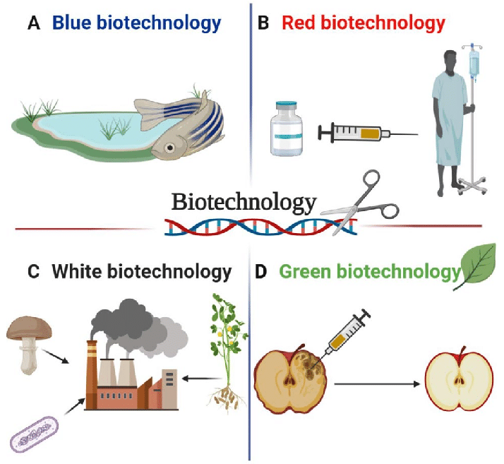
Sub-fields of Biotechnology

Slide 8
Sub-fields of Biotechnology
Blue biotechnology: Marine or aquatic Biotechnology. It is comparatively rare.
Red biotechnology: It is the field of biotechnology which is applied to medical processes. An example would include, an organism designed to produce an antibiotic, or engineering genetic cures to diseases through genomic manipulation.
White (or grey) biotechnology: This sector is focused on industrial processes. Here biotechnology is used to produce product without consuming much resources, obtain better product or to reduce cost. Example includes production of proteases (enzyme) for leather processing.
Green biotechnology: It is the sector of biotechnology focused on agricultural gain. The target here is to improve crops and agricultural method to obtain greater and healthier yield than one obtained from traditional agriculture.

Slide 9
Pharmaceutical Biotechnology
Pharmaceutical biotechnology is the branch of biotechnology that involves exploitation of modern knowledge and technology to produce drug substances from biological systems.
A field that uses micro- and macroorganisms and hybridomas to create pharmaceuticals that are safer and more cost-effective than conventionally produced pharmaceuticals.
Pharmaceutical biotechnology stands for biotechnological manufacturing of pharmaceutical products.

Slide 10
Pharmaceutical Biotechnology
Pharmaceutical biotechnology is the branch of biotechnology which involves the application of different techniques such as recombinant DNA technology, fermentation, mutation, gene splicing, hybridoma technology, etc. to produce therapeutically useful products e.g. recombinant proteins, antibiotics, antibodies, peptide vaccines, hormones, monoclonal antibodies, etc.

Slide 11
Genetic Engineering
Genetic engineering is a branch of biotechnology or biomedical engineering that deals with changing the genetic material of organisms with our knowledge in such a way which doesn’t occur naturally.
Simply we can say that it is the technology of preparing recombinant DNA.

Slide 12
Difference
Between Biotechnology & Pharmaceutical Biotechnology
Biotechnology is the study of cell and other living organisms for the development of novel drugs and therapies where as pharmaceuticals is study of inorganic or organic chemical combinations [do not have life] for the development of drugs or therapies.
Pharmaceutical biotechnology is (might be) the study of micro- and macro-organisms and hybridomas to create pharmaceuticals that are safer and more cost-effective than conventionally produced pharmaceuticals.

Slide 13
Difference
Between Biotechnology & Genetic Engineering
Biotechnology is the study of cell and other living organisms for the development of novel drugs and therapies where as pharmaceuticals is study of inorganic or organic chemical combinations [do not have life] for the development of drugs or therapies.
Genetic engineering is the part of biotechnology. It deals with altering the original function of gene and inserting the desired one. For eg; inserting the human insulin gene in E.coli. for the production of insulin.

Slide 14
Application of Biotechnology
There are three main areas of application of biotechnology.
These are:
Industry
Agriculture
Medicine/pharmaceuticals

Slide 15
Industry
Production of alternative fuel: Ethanol is now considered an alternative fuel. It is now being produced from biomass using genetically modified yeast or bacteria.
Enzyme production: Microbes are genetically modified to produce enzymes which are necessary in laboratories or industries. Such industries include leather, food and laundry etc. For example, the leather is processed with alkaline proteases to make it soft and pliable. Again, lactase is an ingredient of baby food which is now produced by biotechnology.
Biodegradable plastic: Polyhydroxybutyrate (PHB) a polyester along with other polyhydroxyalkanoates (PHAs) are found naturally in some bacteria. Researchers have now produced transgenic plant that will produce the plastic in inclusion bodies.

Slide 16
Agriculture
Both plants and animals have been modified including development of transgenic plant or animal for the purpose of:
Production of drought, insect and resistant crop,
Extend the shelf life of fruits,
Improve nutrient content,
Give pharmaceutical value to food.
The transgenesis is done by introducing an exogenous gene (from another species) into the genome of the target biological system.

Slide 17
Medicine/pharmaceuticals
Foreign protein expression system → e.g. expression of human insulin by bacteria. This insulin has now replaced the traditional porcine or bovine insulin.
Gene therapy and antisense therapy → DNA or RNA can be used directly for treating a disease state in cells. Antisense oligonucleotide can be used as well to inhibit protein synthesis.
Cell therapy → Stem cell research can be used for manipulating undifferentiated cells for replacing damaged or diseased tissues of body.
Embryonic stem cell → The cell present during blastosis phase of fetal development. It is multipotent (all types of cell originate from it).
Hemopoietic stem cell → This is unipotent stem cell. Only blood cells are produced from it.

Slide 18
Medicine/pharmaceuticals
Cancer genetics → Looking for ways to block genes responsible for cancer formation and growth.
Diagnostic kits and tests → In the blood group determination, Anti-A and anti-B agglutinins are used. These are manufactured via biotechnology. Again, glucose oxidase is an enzyme used in blood glucose test. It is also produced with the help of biotechnology.

Slide 19
Role of Pharmacists
Development of therapeutically active drugs:
Genetic engineering
Hybridoma technology
Post-translational modification
Study of pharmaceutically useful microorganisms and other life
Development of therapeutic procedure for a patient
Formulation of the drug into product
Product analysis
Storage and dispensing of the biotech product
Clinical teaching of the product to the patient

Slide 20
The End

