Slide 1
2.14 Energy Rates (Tariffs)
Energy rates are the different methods of charging the consumers for the consumption of electricity. It is desirable to charge the consumer according to his maximum demand (kW) and the energy consumed (kWh). The tariff chosen should recover the fixed cost, operating cost and profit etc. incurred in generating the electrical energy.
Requirements of a Tariff
Tariff should satisfy requirements the following
(i) It should be easier to understand.
(ii) It should provide low rates for high consumption.
(iii) It should encourage the consumers having high load factors.
(iv) It should take into account maximum demand charges and energy charges.
(v) It should provide less charges for power connections than for lighting.
(vi) It should avoid the complication of separate wiring and metering connections.

Slide 2
Types of Tariffs
The various types of tariffs are as follows
(a) Flat demand rate
(b) Straight line meter rate
(c) Step meter rate
(d) Block rate tariff
(e) Two part tariff
(f) Three part tariff
The various types of tariffs can be derived from the following general equation
Y = DX + EZ + C
where Y = Total amount of bill for the period considered.
D = Rate per kW of maximum demand.
X = Maximum demand in kW.
E = Energy rate per kW.
Z = Energy consumed in kWh during the given period.
C = Constant amount to be charged from the consumer during each billing period

Slide 3
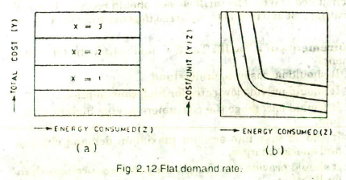
Flat Demand Rate
It is based on the number of lamps installed and a fixed number of hours of use per month or per year.
The rate is expressed as a certain price per lamp or per unit of demand (kW) of the consumer. This energy rate eliminates the use of metering equipment. It is expressed by the expression
Y=DX

Slide 4
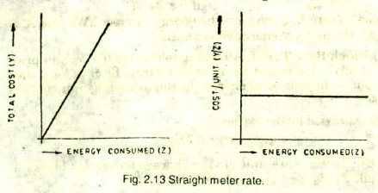
Straight Line Meter Rate
According to this energy rate the amount to be charged from the consumer depends upon the energy consumed in kWh which is recorded by a means of a kilowatt hour meter.
It is expressed in the form
Y=EZ
This rate suffers from a drawback that a consumer using no energy will not pay any amount although he has incurred some expense to the power station due to its readiness to serve him.
Secondly since the rate per kWh is fixed, this tariff does not encourage the consumer to use more power.

Slide 5
Step Meter Rate
According to this tariff the charge for energy consumption goes down as the energy consumption becomes more. This tariff is expressed as follows:
Y=EZ if 0≤ Z ≤ A
Y=E₁Z₁ if A ≤ Z₁ ≤ B
Y=E₂Z₂ if B ≤ Z₂≤ C
and so on. Where E, E 1 , E2 are the energy rate per kWh and A, B and C are the limits of energy consumption.

Slide 6
Block Rate Tariff
According to this tariff a certain price per units (kWh) is charged for all or any part of block of each unit and for succeeding blocks of energy the corresponding unit charges decrease.
It is expressed by the expression
Y= E1Z1 + E2Z2+E3Z3 + .......
where E1, E2, E3.... are unit energy charges for energy blocks of magnitude Z1 , Z2. Z3,.... Respectively.

Slide 7
Two part Tariff (Hopkinson Demand Rate)
In this tariff the total charges are based on the maximum demand and energy
consumed. It is expressed as
Y = DX + EZ
A separate meter is required to record the maximum demand.
This tariff is used for industrial loads.

Slide 8
Three-part Tariff (Doherty Rate)
According to this tariff, the customer pays some fixed amount in addition to the charges for maximum demand and energy consumed. The fixed amount to be charged depends upon the occasional increase in fuel price, rise in wages of labour etc.
It is expressed by the expression Y = DX + EZ + C.

