Slide 1
Lecture on Optical Fiber Communication
Presented by:
Sanjida Alam
Lecturer, Dept. of Electrical and Electronic Engineering
Daffodil International University

Slide 2
Dispersion

Slide 3
Outline of Talk
Dispersion
Material Dispersion
waveguide Dispersion
Modal Dispersion

Slide 4
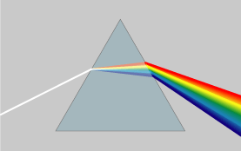
Dispersion
Dispersion is a phenomenon that causes the separation of a wave into spectral components with different wavelengths, due to a dependence of the wave's speed on its wavelength.
Disperse light
Sun light
Prism

Slide 5
Types of Dispersion
Material Dispersion
Modal Dispersion
Waveguide Dispersion

Slide 6
Types of Dispersion
Material Dispersion
For glass material n(λ), i.e, n changes with λ or frequency
Velocity of electromagnetic wave in any medium = c/n
Changing optical path length due to a changing refractive index n₁
I
f₁
n₂
n₁
f₂
t
Output wave
Input wave

Slide 7
Waveguide Dispersion
Waveguide dispersion is chromatic dispersion which arises from waveguide effects. The origin of waveguide dispersion can be understood by considering that a guided wave has a frequency-dependent distribution of k vectors
Field with shorter wavelength concentrated in the core
Wave propagating in core and cladding with different group velocities
Field with longer wavelength leaked from core to cladding

Slide 8
Definition of Modal Dispersion
Only a certain number of modes can propagate in fiber optic waveguide. Each of these modes carries the modulation signal and, as each one is incident on the boundary at a different angle, they will each have their own individual propagation times. In a digital system, the net effect is to smear out the pulses, and so there is a form of dispersion called modal dispersion

Slide 9
Modal Dispersion
I
θ_{i} =φ_{c}
θ_{i}=90⁰
n₂
φ_{c}
Ray1(axial)
θ
θ_{a}
n₁
t
L
Ray2
Input light wave

Slide 10
Effect of Dispersion on OFC
Short length fiber
1
0
1
1
1
0
1
1
n₂
n₁
t
t
Input pulse
L₁
Output pulse
1
0
1
1
Long length fiber
n₂
n₁
Input pulse
L₂
No zero level
Indistinguishable pulse
Intersymbol Interference
Output pulse
t

Slide 11
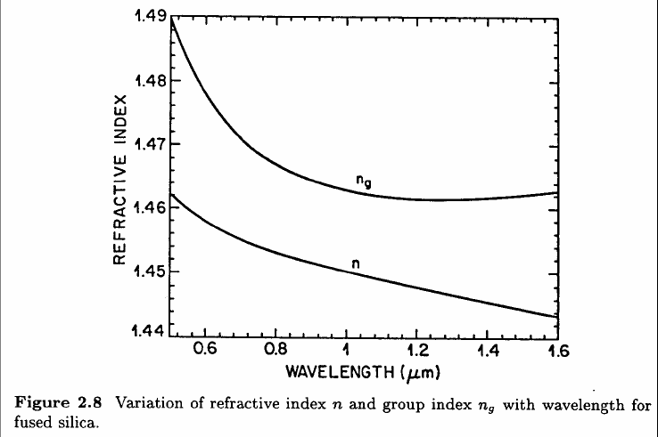
Wavelength dependence of Ng and n

