Slide 1
Development and role of selling in marketing
Chapter 1

Slide 2
Break-even analysis
A break-even analysis is a financial calculation that weighs the costs of a new business, service or product against the unit sell price to determine the point at which you will break even. In other words, it reveals the point at which you will have sold enough units to cover all of your costs.
Variable costs per unit: Rs. 400 Sale price per unit: Rs. 600 Desired profits: Rs. 4,00,000 Total fixed costs: Rs. 10,00,000 First we need to calculate the break-even point per unit, so we will divide the Rs.10,00,000 of fixed costs by the Rs. 200 which is the contribution per unit (Rs. 600 – Rs. 200). Break-Even Point = Rs. 10,00,000/ Rs. 200 = 5000 units Next, this number of units can be shown in rupees by multiplying the 5,000 units with the selling price of Rs. 600 per unit. We get Break-Even Sales at 5000 units x Rs. 600 = Rs. 30,00,000. (Break-even point in rupees)

Slide 3
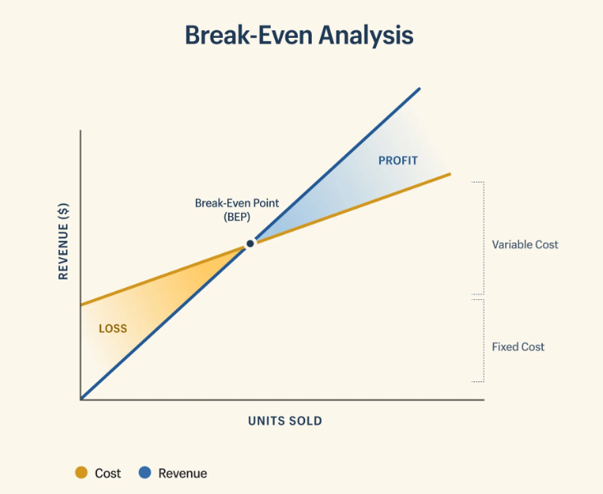

Slide 4
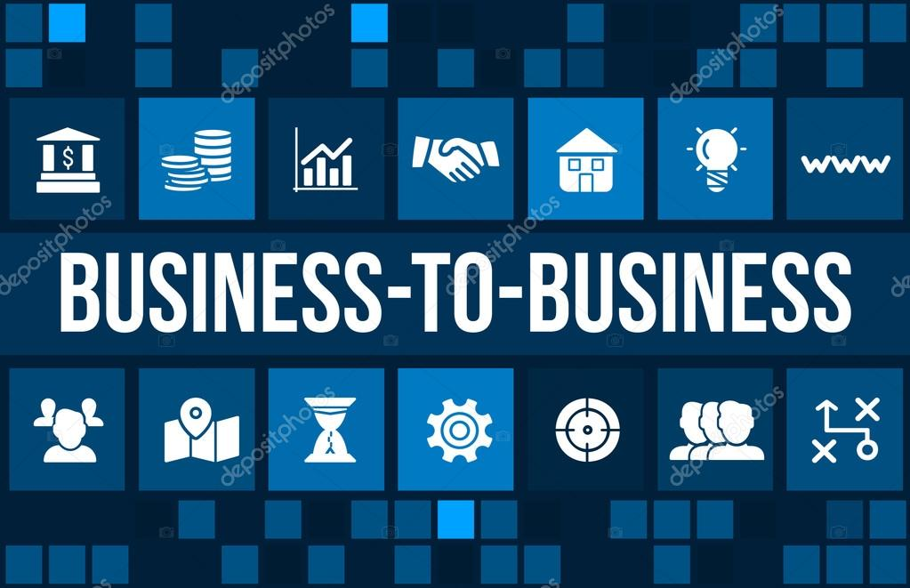
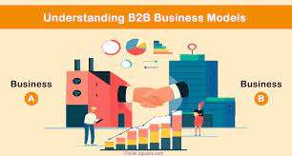
Business to business (B2B)
Business-to-business (B2B), also called B-to-B
Business-to-business refers to business that is conducted between companies, rather than between a company and individual consume
Samsung, for example, is one of Apple's largest suppliers in the production of the iPhone. Apple also holds B2B relationships with firms like Intel, Panasonic and semiconductor producer Micron Technology

Slide 5
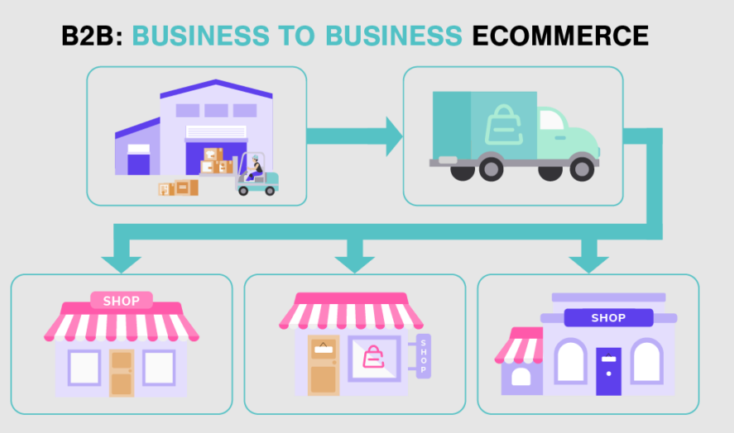

Slide 6
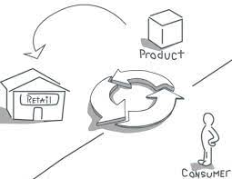
Business to consumer (B2C)
The process of selling products and services directly between a business and consumers who are the end-users of its products or services

Slide 7
The communications mix involves all the tools you use to communicate with your customers or potential customers.
Publicity
communications mix
sales promotion
Advertising
personal selling
personal selling

Slide 8
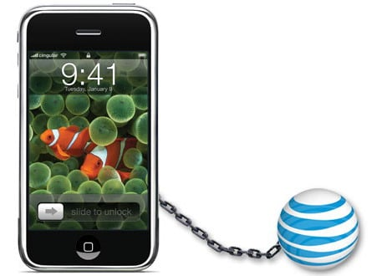
Exclusive distribution
Exclusive distribution definition is a kind of distribution a manufacturer or supplier authorizes only one distributor to carry out within a definite region. Such a distributor becomes the sole authorized seller of the manufacturer's specific product
Apple and At&T
Apple solely authorizing AT&T to be the distributor of the iPhone to end users

Slide 9
Intensive distribution
Intensive distribution is a form of marketing strategy under which a company tries to sell its product from a small vendor to a big store
Soft drinks and cigarettes are some of the examples on which intensive distribution is followed.
Market penetration
Market penetration can be understood as a strategy to enter into a new market. It’s also used as a metric to measure the percentage of market share a service or product is able to capture.
Expand into different territories: It is one of the most common ways for firms to expand. When a market gets saturated, most shops will begin to explore for new locations. Moving to a new region is one of the simplest ways to grow a retail empire, but it requires favorable market conditions.

Slide 10
Market segmentation
Market segmentation is a marketing strategy in which select groups of consumers are identified so that certain products or product lines can be presented to them in a way that appeals to their interests
Common examples of market segmentation include geographic, demographic, psychographic, and behavioral
Market skimming
A pricing approach in which the producer sets a high introductory price to attract buyers with a strong desire for the product and the resources to buy it, and then gradually reduces the price to attract the next and subsequent layers of the market
Electronic products – take the Apple iPhone, for example – often utilize a price skimming strategy during the initial launch period. Then, after competitors launch rival products, i.e., the Samsung Galaxy, the price of the product drops so that the product retains a competitive advantage

Slide 11
Market Concept
The marketing concept is the strategy that firms implement to satisfy customers’ needs, increase sales, maximize profit, and beat the competition.
Businesses that give to charities, change production methods to meet environmental standards, or improve nutrition in products.
Marketing mix
Marketing Mix is a set of marketing tool or tactics, used to promote a product or services in the market and sell it. It is about positioning a product and deciding it to sell in the right place, at the right price and right time. The product will then be sold, according to marketing and promotional strategy

Slide 12
7 P’S OF MARKETING MIX
Product
Price
Promotion
Place
People
Process
Physical Evidence

Slide 13
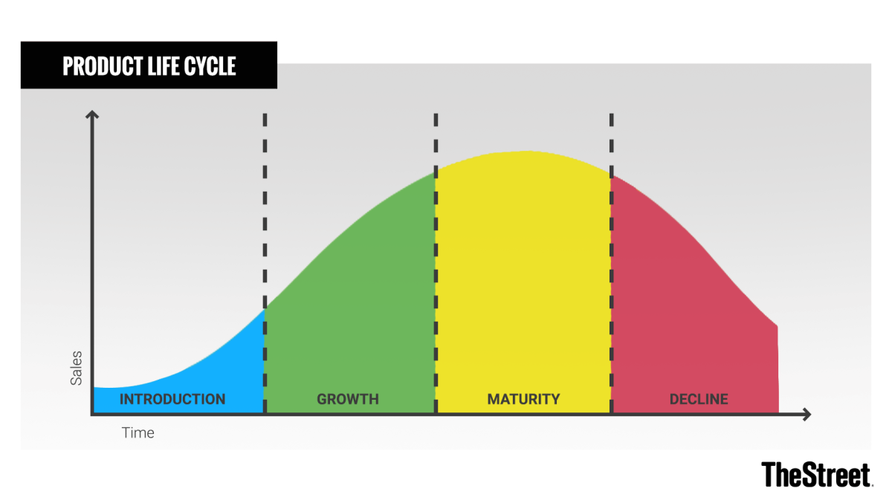
product life-cycle
The product life cycle is the course of the life of a product. It begins when the product is in development and ends after the product has been removed from the market

Slide 14
Sales management
Sales management encompasses hiring, training and motivating the sales team, forecasting sales and setting sales goals, and developing effective strategies for managing leads and increasing sales
Selling
At its essence, selling is handing over something of value in exchange for money or another item of value.

Slide 15
Target accounts
Simply put, target accounts are companies that you want to turn into customers.
When you’re doing account-based marketing (ABM), you focus the bulk of your energy and resources on best-fit accounts that have the highest revenue potential for your business.
Recently, account-based teams have been experimenting with “pizza-nars” which as the name implies, is a webinar accompanied by pizza. The idea is straightforward –– pizza is delivered to target accounts for them to enjoy while they watch your webinar.

Slide 16
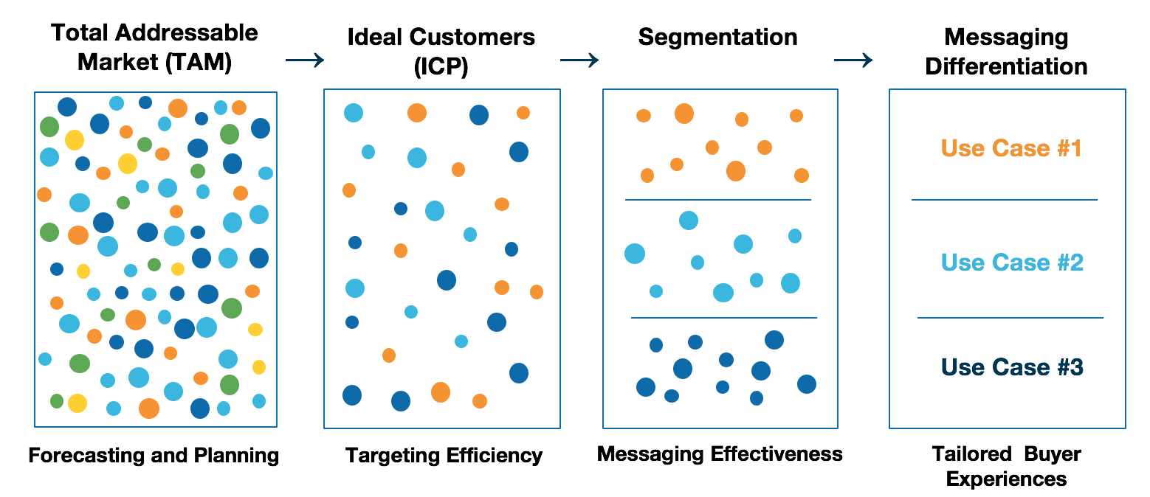
Targeting
Targeting in marketing involves breaking the target audience into segments and then designing marketing activities that will reach the segments most likely to be responsive to your efforts. Target marketing can greatly increase the success you have in reaching potential customers.

Slide 17
Characteristics of modern selling
Customer retention and detention
Database and knowledge management
Adding value/ satisfying needs
Customer
Customer relationship management
Problem solving and system selling
Marketing the product

Slide 18
SUCCESS FACTORS FOR PROFESSIONAL SALESPEOPLE
Listening skills
Follow-up skills
Ability to adapt sales style from situation to situation
Tenacity – sticking to the task
Organizational skills
Verbal communication skills
Proficiency in interacting with people at all levels within an organization
Demonstrated ability to overcome objections
Closing skills
Personal planning and time management skills

Slide 19
Types of selling
Merchandisers
Technical support salespeople
Sales support salespeople
Consumer salespeople
Order takers
Organizational salespeople
Front-line salespeople
New business salespeople
The selling function
Order Creators
Missionary salespeople
Outside order takers
Order getters
Delivery salespeople
Inside order takers

Slide 20
Business to consumer (B2C) markets
Business to business (B2B) markets
Fast moving consumer goods (FMCG)
Business to business (B2B) markets are characterised by often large and powerful buyers, purchasing predominantly for the furtherance of organisational objectives and in an organisational context using skilled/professional buyers.
Semi-durable consumer goods
Durable consumer goods:

Slide 21
Selling as a career
Empathy and an interest in people
Ability to communicate:
Determination
Self-discipline and resilience

Slide 22
IMAGE OF SELLING
There are a number of elements in the sales task that act as demotivators
Misconceptions about selling
Selling is not a worthwhile career
salespeople are constantly exposed to the possibility of rejection and often have to suffer ‘ego punishment
salespeople visit buyers in their offices, so they are effectively working in ‘foreign’ territory and might sometimes feel uneasy
The salesperson tends to work alone, often staying away from home for periods
Good products will sell themselves and thus the selling process adds unnecessarily to costs
There is something immoral about selling, and one should be suspicious about those who earn their living from this activity

Slide 23
Determining salesforce objectives and goals
Forecasting and budgeting
Salesforce organization, salesforce size, territory design and planning
Salesforce selection, recruitment and training;
Motivating the salesforce
Salesforce evaluation and control.
THE NATURE AND ROLE OF SALES MANAGEMENT

Slide 24
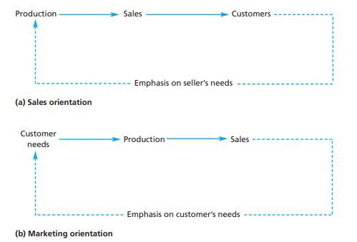
THE MARKETING CONCEPT
Production orientation.
Sales orientation.
Marketing orientation

Slide 25
Among some of the more frequently used bases for segmentation are the following:
1. Consumer products/markets
• age • sex • income • social class
• geographical location
• type of residence (A Classification of Residential Neighborhoods – ACORN)
• personality • benefits sought • usage rate, e.g. heavy users versus light users.
2. Industrial products/markets
• end-use market/type of industry/product application
• benefits sought
• company size • geographical location • usage rate.
Market segmentation and targeting
Market segmentation is the process of identifying those clusters of customers in a market that share similar needs and wants and will respond in a unique way to a given marketing effort

Slide 26
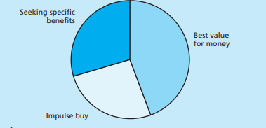
Application of segmentation
Based on demographics
Based on usage
Based on the behavior/needs of consumers

Slide 27
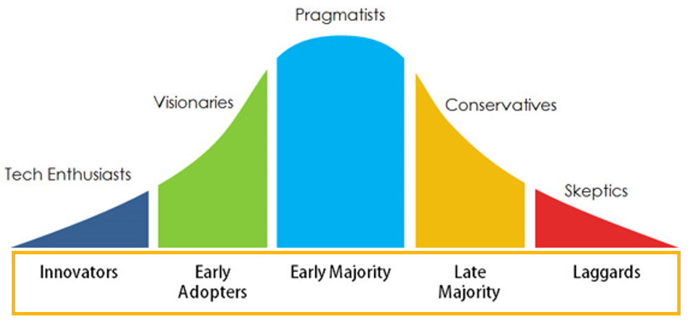
Product adoption and diffusion
Consumers are placed into one of five ‘adopter’ categories, each with different behavioral characteristics. These adopter categories contain percentages of first-time buyers (i.e. not repeat buyers) that fall into each category. What will attract first-time buyers to a product or service, and the length of time it will take for the diffusion process to be completed, will depend upon the nature of the product or service

Slide 28
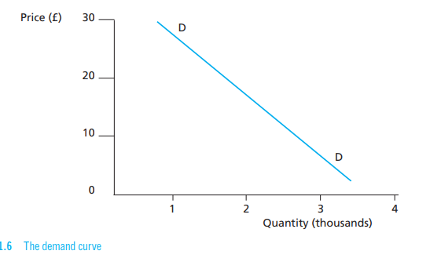
Pricing
Inputs to pricing decisions
Company objectives
Marketing objectives
Demand considerations
Cost considerations
Competitor considerations

Slide 29
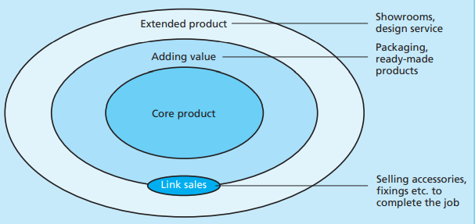
The marketing mix in B2B markets
Product
Price’
Promotion
place

Slide 30
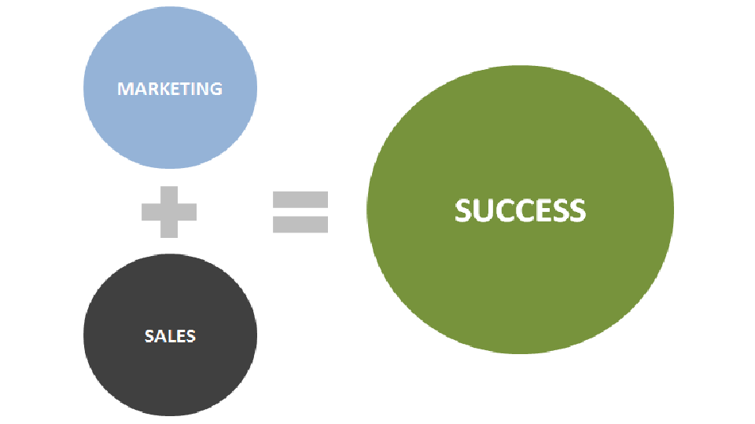
The relationship between sales and marketing
The fact of the matter is, when you look at the basic purposes of sales and marketing teams, it comes down to this: marketing is responsible for developing strategy, while salespeople are responsible for implementing strategy.
Sales efforts influence, and are influenced by, decisions taken on the ingredients of a company’s marketing mix, which in turn affect its overall marketing efforts. It is essential, therefore, that sales and marketing be fully integrated. The adoption of the marketing concept has in many companies been accompanied by changes in organizational structure, together with changes in the view of what constitutes the nature of selling

Slide 31
Target market choice
The definition of a target market has clear implications for sales management because of its relationship with target accounts. Once the target market has been defined (e.g. organizations in a particular industry over a certain size), sales management can translate that specification into individual accounts to target. Salesforce resources can then be deployed to maximum effect.

Slide 32
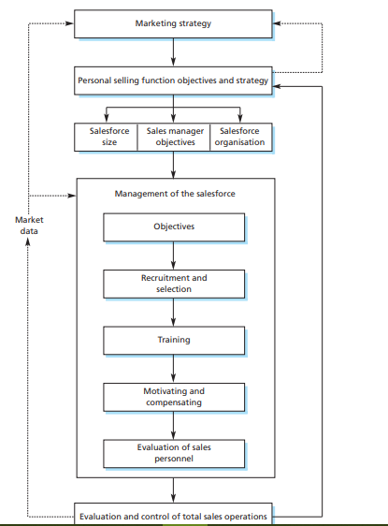
Marketing strategy and management of personal selling

Slide 33
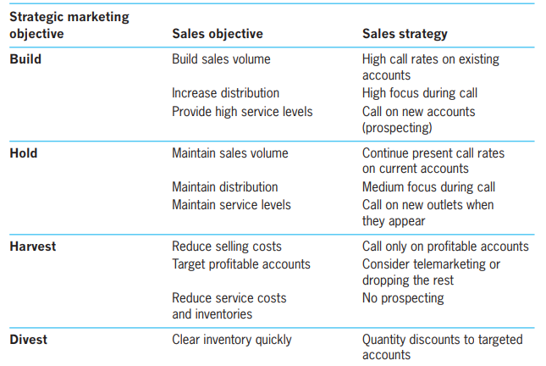
Marketing strategy and sales management

