Slide 1
Thermal Properties
Chapter 07

Slide 2
Lecture 01

Slide 3
Thermal Properties
The behaviour shown by a textile material when it is subjected to heat is known as thermal property. Followings are the thermal properties of a textile material-
Thermal conductivity
Glass transition temperature
Melting temperature
Thermal expansion
Heat of wetting or heat of absorption
Heat setting

Slide 4
Thermal conductivity
Thermal conductivity is the rate of transfer of heat in calorie along the body of a textile material by conduction. Higher conductivity of a material indicates that the heat will pass through the material very easily.
Woolen dresses are comfortable to wear during winter season due to its lower conductivity and cotton dresses are comfortable to wear in summer season because of its higher conductivity.

Slide 5
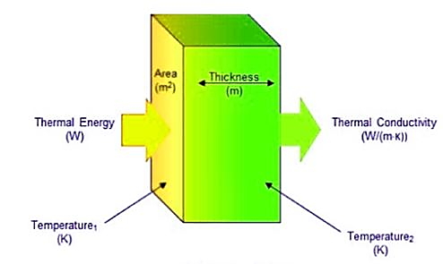
Thermal conductivity
K = $\frac{\text{QL}}{\text{AΔT}}$
Where,
K is the thermal conductivity in W/m.K
Q is the amount of heat transferred through the material in Joules/second or Watts
L is the distance between the two isothermal planes
A is the area of the surface in square meters
ΔT is the difference in temperature in Kelvin

Slide 6
Typical values of thermal conductivity for some fibres
Fibre Thermal conductivity (mWm⁻¹K⁻¹)
Cotton 71
Wool 54
Silk 50
(Above thermal conductivity of fibres with a bulk density of 0.5 gm/cm³)
PVC 160
Cellulose acetate 230
Nylon 250
Polyester 140
Polyethylene 340
Polypropylene 120

Slide 7
Glass transition temperature
The temperature up to which a textile material behaves hard as like glass and after which it behaves soft as like rubber is known as glass transition temperature and it is expressed by Tg. The range of Tg lies between -100⁰ C to 300⁰ C.

Slide 8
Factors influence the Tg value of polymers
Higher the flexibility of chain bond, lower will be the Tg value.
Composition of ring structure in molecular chain raises the value of Tg.
Bulky side groups raise the value of Tg.
Flexibility of side groups decreases the value of Tg.
Tg increases with molecular weight upto 20,000.
Polarity of side groups increases the value of Tg.
Co-polymers have lower value of Tg than homo-polymers.
Increase of orientation restrict the chain movement and increase the value of Tg. (Tg of undrawn polymer fibre is 110⁰C whereas Tg of fully drawn polymer fibre is 150⁰C)

Slide 9
Thank You

Slide 10
Lecture 02

Slide 11
Melting temperature
The temperature at which a textile material melts is known as melting temperature and it is expressed by Tm.
At melting temperature a polymer losses its identity and change into viscous liquid. It losses its strength and some molecular weight at melting temperature.
Cellulose and protein fibres decompose before melting.

Slide 12
Typical values of T_{g} and T_{m} for some MMF
Fibre Tg (⁰C) Tm (⁰C)
Nylon-6 50 215
Nylon-6.6 50 260
Polyester 69 260
PVC 81 310
PAN 97 314
Rubber -73 36
Cellulose tri-acetate - 300

Slide 13
Thermal Expansion
Thermal expansion is the increment of length of a textile material after heating. Thermal expansion is measured by co-efficient of thermal expansion.
Co-efficient of thermal expansion can be defined as the fractional increase in length of a material due to rise in temperature by 1⁰ C.
Co-efficient of thermal expansion = $\frac{\text{Increase} \text{in} \text{length}}{\text{Initial} \text{length} \text{of} \text{a} \text{textile} \text{material}}$

Slide 14
Heat of wetting or heat of absorption
When textile materials absorb water they show their ability to leave off small amount of heat which is known as heat of wetting or heat of absorption.
If 1 gm dried material is completely wetted, then heat in calorie/gm involved in that material is known as heat of wetting.

Slide 15
Heat Setting
Heat setting is the process of stabilizing the form, size and dimension of the material by drying and cooling in successive dry and wet condition.
For manmade fibre, heat setting process must be done to keep the dimension of fabric during further heat treatment. Usually, spandex or elastane is heat set at 180-200⁰C based on different brands. After heat setting material becomes able to keep its dimensions up to setting temperature. Heat setting is usually done by hot air or steam flow treatment.

Slide 16
Thank You

