Slide 1
SCREENING
Mr. Faisal Muhammad
Lecturer & IMPH Coordinator, Department of Public Health, DIU Email: faisal.ph0049.c@diu.edu.bd

Slide 2
Class outline
Definition of screening
Types of screening
Criteria for screening
Validity and reliability of screen test
Importance /risk of screen test

Slide 3
Screening is the process of using tests on a large scale to identify the presence of disease in apparently healthy people.
The presumptive identification of unrecognized disease, defect or disability among an apparently healthy population by the application of tests, examinations or procedures which can be applied rapidly.
Screening test do not usually establish a diagnosis, but rather the presence or absence of an identified risk factor.
Screening can also be used to identify high exposure to risk factors.

Slide 4
When should we screen?
Screen when:
It is an important health problem (think about how to define ‘important’?)
There is an accepted and effective treatment
Disease has a recognizable latent or early symptomatic stage.
There are adequate facilities for diagnosis and treatment.
There is an accurate screening test
There is agreement as whom to consider as cases.

Slide 5
Examples for Screening Tests
Infancy | Pregnancy | Elderly | Adults
Growth Charts | Weight | Cancers | Lipid profile
Metabolic Screening | CBC | Depression | Blood pressure
Hearing Test | Blood sugar | Vitamin deficiencies | BMI

Slide 6
Issues in screening
Disease/disorder should be an important public health problem
High prevalence
Serious outcome
-Early Detection in asymptomatic (pre-clinical) individuals is possible
-Early detection and treatment can affect the course of disease (or affect the public health problem?)

Slide 7
Types of screening
Mass screening : aims to screen the whole population( or subset)
Multiple or mutiphasic screening – uses several screening test at the same time.
Targeted screening of groups with specific exposures, e.g. workers in lead battery factories is often used in environmental and occupational health.
Case finding or opportunistic screening- is aimed at patients who consult a health practitioner for some other purpose.

Slide 8
Criteria for screening:
The criteria for instituting screening program relate to the characteristics of the disease, its treatment, and the screening test
Table: Criteria for instituting a screening program
Disease | Serious if not diagnosed early (example: inborn metabolic defects, e.g., phenylketonuria and cancer of the cervix) High prevalence of preclinical stage Natural history understood Long period between first sign and overt disease Long lead time (Screening to Diagnosis time)
Diagnostic test (Screening test) | Sensitive and specific Simple and cheap Safe & acceptable Reliable
Diagnosis & treatment | Facilities are adequate Effective , accurate and safe treatment available

Slide 9
Criteria for Evaluating a Screening Test
Validity: provide a good indication of who does and does not have disease
-Sensitivity of the test
-Specificity of the test
Reliability: (precision): gives consistent results when given to same person under the same conditions
Yield: Amount of disease detected in the population, relative to the effort
-Prevalence of disease/predictive value

Slide 10
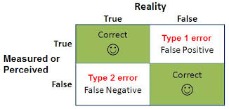
Type of Error (Random Error)

Slide 11
How Good Is the test
Disease present?
Yes
No
Positive
False positive
True positive
Test result
Negative
False negative
True negative
Sensitivity = True positive
True positive + False negatives
Specificity = True negative
True negative + False positives
Notes:
Sensitivity = the ability of the test to correctly define those who have disease
Specificity the ability of the test to correctly define those who do not have disease
When doing these squares always put Th. e positives and those with disease at the top left
When you do multiple tests, the sensitivity and specificity are multiplied., so that only the positives are retested, and then the results given out.

Slide 12
Characteristics of a good screening test
Valid (e.g., sensitive and specific)
Reliable (gives consistent results; no random errors)
Yield (number of cases identified per thousand screened)
Cost – benefit (compare costs avoided due to early detection of the disease against cost of the screening. Does the test merely uncover more disease that is expensive to treat without appreciable advantage?)
Acceptable (discomfort, hassle, cost of obtaining test)
Follow-up services (plan needed to deal with positive results)
Notes:
Valid, that a positive test indicates a problem
This is a problem with rubella screening, do the titres mean a person is immune
Reliable, does the test produce the same value if retested
Yield - how many positives do you get when you screen 100 people?
Is the cost of the test, and treatment less than the cost of the disease?
Is the test acceptable e.g.. transurethral ultrasound for prostatic ca
Chlamydia screening in males
Are there services for the individual once you have screened them
E.g.. early days of HIV, no there weren’t

Slide 13
Criteria for a suitable screening test are :
It must be relatively simple.
Cheap or inexpensive
It should be easy to apply or administer with minimum discomfort.
Must be acceptable to the public or subjects
Must be safe and in addition must be reliable and valid.

Slide 14
Considerations in screening
Severity
Prevalence
Understand natural history
Diagnosis and treatment
Cost
Efficacy
Safety

Slide 15
Sensitivity
The sensitivity of the test is defined as the ability of the test to identify correctly those who have the disease.
Sensitivity is the proportion of truly ill people in the screened population who are identified as ill by the screening test.

Slide 16
Validity
Validity is the degree to which data measure what they were intended to measure-that is , the result of a measurements correspond to the true state of the phenomenon being measured .
Another word for validity is accuracy.
It is measured by sensitivity and specificity.
Specificity- is defined as the ability of the test to identify correctly those who do not have the disease.
Specificity- is the proportion of truly healthy people who are so identified by the screening test.

Slide 17
Positive predictive value (+ PV) | The fraction of people with positive tests who actually have the condition.
Negative predictive value (-PV) | The fraction of people with negative tests who actually don't have the condition.

Slide 18
 | Patient with the disease | Patient without the disease
Test is positive | A True Positive | B False Positive
Test is negative | C False Negative | D True Negative

Slide 19
Using the 2X2 table you can calculate
Sensitivity = a / (a+c)
Specificity = d / (b+d)
+ PV = a/(a+b)
- PV = d/(c+d)
Knowing the prevalence of the disease in the population is necessary for these calculations

Slide 20
Understanding Predictive Value
Prevalence is defined as the number of patients per 100,000 population who have the disease at a given time.
A high +PV indicates a strong chance that a person with a positive test has the disease whereas a low +PV is usually found in populations with low prevalence of the condition being examined. A high -PV means that a negative test in effect rules out the disease.

Slide 22
Assume a population of 1,000 people 100 have a disease 900 do not have the disease A screening test is used to identify the 100 people with the disease
Sensitivity = 80/ 100 X 100= 80%
Specificity = 800/ 900 X 100 = 88%

Slide 23
Bias in screening
Lead time bias
Length bias
Volunteer bias
Lead time- interval between the diagnosis of disease at screening and the usual time of diagnosis (by symptoms)
Lead time bias- assumes survival is time between screen and death.
Does not take into account lead time between diagnosis at screening and usual diagnosis.

Slide 24
Lead time bias

Slide 25
Length bias
Most chronic diseases, especially cancers, do not progress at the same rate in everyone. Any group of disease people will include some in whom the disease developed slowly and some in whom it developed rapidly.

Slide 26
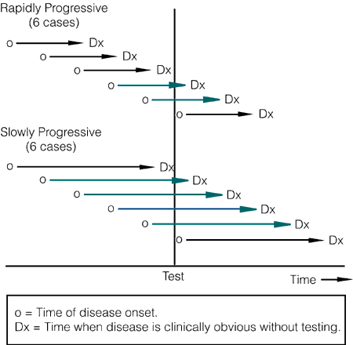
Length bias

Slide 27
Contrast between screening and diagnosis
Screening | Diagnosis
1. Done on apparently healthy people. | 1. Done with those indication of sick
2. Applied to groups. | 2. Applied to single patients.
3.Less accurate | 3. More accurate
4. Not basis of treatment. | 4. A basis of treatment.
5. Less expensive. | 5. More expensive.
6. Test results are arbitrary and final. | 6. Diagnosis is not final but modified in the light of new evidence.
7. Based on one criteria or cut off point. | 7. Based on evaluation of no of s/s and laboratory findings.

Slide 28
Risk of Screening
True
Positive
False
Positive
False
Negative
Labelling Effect
Delayed Diagnosis
Anxiety
Fear From
Future Test
Delayed
Intervention
Monetary
Expenses
Complications

Slide 29
THANK YOU

