Slide 1
Introduction to Software Architecture
Fahim Faisal
Lecturer, Dept. of CSE
Daffodil International University

Slide 2
Introduction
Software architecture is process of designing the global organization of a software system, including:
Dividing software into subsystems.
Deciding how these will interact.
Determining their interfaces.
The architecture is the core of the design, so all software engineers need to understand it.
The architecture will often constrain the overall efficiency, reusability and maintainability of the system.

Slide 3
The importance of software architecture
Why you need to develop an architectural model:
To enable everyone to better understand the system
To allow people to work on individual pieces of the system in isolation
To prepare for extension of the system
To facilitate reuse and reusability

Slide 4
Contents of a good architectural model
A system’s architecture will often be expressed in terms of several different views
The logical breakdown into subsystems
The interfaces among the subsystems
The dynamics of the interaction among components at run time
The data that will be shared among the subsystems
The components that will exist at run time, and the machines or devices on which they will be located

Slide 5
Design stable architecture
To ensure the maintainability and reliability of a system, an architectural model must be designed to be stable.
Being stable means that the new features can be easily added with only small changes to the architecture

Slide 6
Developing an architectural model
Start by sketching an outline of the architecture
Based on the principal requirements and use cases
Determine the main components that will be needed
Choose among the various architectural patterns
Discussed next
Suggestion: have several different teams independently develop a first draft of the architecture and merge together the best ideas

Slide 7
Developing an architectural model
Refine the architecture
Identify the main ways in which the components will interact and the interfaces between them
Decide how each piece of data and functionality will be distributed among the various components
Determine if you can re-use an existing framework, if you can build a framework
Consider each use case and adjust the architecture to make it realizable
Mature the architecture

Slide 8
Describing an architecture using UML
All UML diagrams can be useful to describe aspects of the architectural model
Four UML diagrams are particularly suitable for architecture modelling:
Package diagrams
Subsystem diagrams
Component diagrams
Deployment diagrams

Slide 9
Package diagrams

Slide 10
Component diagrams

Slide 11
Deployment diagrams

Slide 12
Architectural Patterns
The notion of patterns can be applied to software architecture.
These are called architectural patterns or architectural styles.
Each allows you to design flexible systems using components
The components are as independent of each other as possible.

Slide 13
The Multi-Layer architectural pattern
In a layered system, each layer communicates only with the layer immediately below it.
Each layer has a well-defined interface used by the layer immediately above.
The higher layer sees the lower layer as a set of services.
A complex system can be built by superposing layers at increasing levels of abstraction.
It is important to have a separate layer for the UI.
Layers immediately below the UI layer provide the application functions determined by the use-cases.
Bottom layers provide general services.
e.g. network communication, database access

Slide 14
Example of multi-layer systems

Slide 15
The multi-layer architecture and design principles
1. Divide and conquer: The layers can be independently designed.
2. Increase cohesion: Well-designed layers have layer cohesion.
3. Reduce coupling: Well-designed lower layers do not know about the higher layers and the only connection between layers is through the API.
4. Increase abstraction: you do not need to know the details of how the lower layers are implemented.
5. Increase reusability: The lower layers can often be designed generically.

Slide 16
The multi-layer architecture and design principles
6. Increase reuse: You can often reuse layers built by others that provide the services you need.
7. Increase flexibility: you can add new facilities built on lower-level services, or replace higher-level layers.
8. Anticipate obsolescence: By isolating components in separate layers, the system becomes more resistant to obsolescence.
9. Design for portability: All the dependent facilities can be isolated in one of the lower layers.
10. Design for testability: Layers can be tested independently.
11. Design defensively: The APIs of layers are natural places to build in rigorous assertion-checking.

Slide 17
The Client-Server and other distributed architectural patterns
There is at least one component that has the role of server, waiting for and then handling connections.
There is at least one component that has the role of client, initiating connections in order to obtain some service.
A further extension is the Peer-to-Peer pattern.
A system composed of various software components that are distributed over several hosts.

Slide 18
An example of a distributed system

Slide 19
The distributed architecture and design principles
1. Divide and conquer: Dividing the system into client and server processes is a strong way to divide the system.
Each can be separately developed.
2. Increase cohesion: The server can provide a cohesive service to clients.
3. Reduce coupling: There is usually only one communication channel exchanging simple messages.
4. Increase abstraction: Separate distributed components are often good abstractions.
6. Increase reuse: It is often possible to find suitable frameworks on which to build good distributed systems
However, client-server systems are often very application specific.

Slide 20
The distributed architecture and design principles
7. Design for flexibility: Distributed systems can often be easily reconfigured by adding extra servers or clients.
8. Design for portability: You can write clients for new platforms without having to port the server.
9. Design for testability: You can test clients and servers independently.
10. Design defensively: You can put rigorous checks in the message handling code.

Slide 21
The Broker architectural pattern
Transparently distribute aspects of the software system to different nodes
An object can call methods of another object without knowing that this object is remotely located.
CORBA is a well-known open standard that allows you to build this kind of architecture.

Slide 22
Example of a Broker system

Slide 23
The broker architecture and design principles
1. Divide and conquer: The remote objects can be independently designed.
2. Increase reusability: It is often possible to design the remote objects so that other systems can use them too.
3. Increase reuse: You may be able to reuse remote objects that others have created.
4. Design for flexibility: The brokers can be updated as required, or the proxy can communicate with a different remote object.
5. Design for portability: You can write clients for new platforms while still accessing brokers and remote objects on other platforms.
6. Design defensively: You can provide careful assertion checking in the remote objects.

Slide 24
The Transaction-Processing architectural pattern
A process reads a series of inputs one by one.
Each input describes a transaction – a command that typically some change to the data stored by the system
There is a transaction dispatcher component that decides what to do with each transaction
This dispatches a procedure call or message to one of a series of component that will handle the transaction

Slide 25
Example of a transaction-processing system

Slide 26
The transaction-processing architecture and design principles
1. Divide and conquer: The transaction handlers are suitable system divisions that you can give to separate software engineers.
2. Increase cohesion: Transaction handlers are naturally cohesive units.
3. Reduce coupling: Separating the dispatcher from the handlers tends to reduce coupling.
4. Design for flexibility: You can readily add new transaction handlers.
5. Design defensively: You can add assertion checking in each transaction handler and/or in the dispatcher.

Slide 27
The Pipe-and-Filter architectural pattern
A stream of data, in a relatively simple format, is passed through a series of processes
Each of which transforms it in some way.
Data is constantly fed into the pipeline.
The processes work concurrently.
The architecture is very flexible.
Almost all the components could be removed.
Components could be replaced.
New components could be inserted.
Certain components could be reordered.

Slide 28
Example of a pipe-and-filter system

Slide 29
The pipe-and-filter architecture and design principles
1. Divide and conquer: The separate processes can be independently designed.
2. Increase cohesion: The processes have functional cohesion.
3. Reduce coupling: The processes have only one input and one output.
4. Increase abstraction: The pipeline components are often good abstractions, hiding their internal details.
5. Increase reusability: The processes can often be used in many different contexts.
6. Increase reuse: It is often possible to find reusable components to insert into a pipeline.

Slide 30
The pipe-and-filter architecture and design principles
7. Design for flexibility: There are several ways in which the system is flexible.
8. Design for testability: It is normally easy to test the individual processes.
9. Design defensively: You rigorously check the inputs of each component, or else you can use design by contract.

Slide 31
The Model-View-Controller (MVC) architectural pattern
An architectural pattern used to help separate the user interface layer from other parts of the system
The model contains the underlying classes whose instances are to be viewed and manipulated
The view contains objects used to render the appearance of the data from the model in the user interface
The controller contains the objects that control and handle the user’s interaction with the view and the model
The Observable design pattern is normally used to separate the model from the view

Slide 32
Example of the MVC architecture for the UI

Slide 33
Example of MVC in Web architecture
The View component generates the HTML code to be displayed by the browser.
The Controller is the component that interprets ‘HTTP post’ transmissions coming back from the browser.
The Model is the underlying system that manages the information.

Slide 34
The MVC architecture and design principles
1. Divide and conquer: The three components can be somewhat independently designed.
2. Increase cohesion: The components have stronger layer cohesion than if the view and controller were together in a single UI layer.
3. Reduce coupling: The communication channels between the three components are minimal.
4. Increase reuse: The view and controller normally make extensive use of reusable components for various kinds of UI controls.
5. Design for flexibility: It is usually quite easy to change the UI by changing the view, the controller, or both.
6. Design for testability: You can test the application separately from the UI.

Slide 35
The Service-oriented architectural pattern
This architecture organizes an application as a collection of services that communicates using well-defined interfaces
In the context of the Internet, the services are called Web services
A web service is an application, accessible through the Internet, that can be integrated with other services to form a complete system
The different components generally communicate with each other using open standards such as XML.

Slide 36
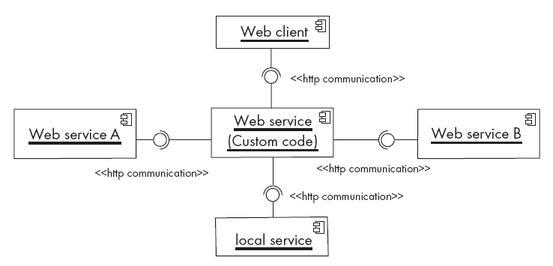
Example of a service-oriented application

Slide 37
The Service-oriented architecture and design principles
1. Divide and conquer: The application is made of independently designed services.
2. Increase cohesion: The Web services are structured as layers and generally have good functional cohesion.
3. Reduce coupling: Web-based applications are loosely coupled built by binding together distributed components.
4. Increase reusability: A Web service is a highly reusable component.
5. Increase reuse: Web-based applications are built by reusing existing Web services.
6. Anticipate obsolescence: Obsolete services can be replaced by new implementation without impacting the applications that use them.

Slide 38
The Service-oriented architecture and design principles
7. Design for portability: A service can be implemented on any platform that supports the required standards.
8. Design for testability: Each service can be tested independently.
9. Design defensively: Web services enforce defensive design since different applications can access the service.

Slide 39
The Message-oriented architectural pattern
Under this architecture, the different sub-systems communicate and collaborate to accomplish some task only by exchanging messages.
Also known as Message-oriented Middleware (MOM)
The core of this architecture is an application-to-application messaging system
Senders and receivers need only to know what are the message formats
In addition, the communicating applications do not have to be available at the same time (i.e. messages can be made persistent)
The self-contained messages are sent by one component (the publisher) through virtual channels (topics) to which other interested software components can subscribe (subscribers)

Slide 40
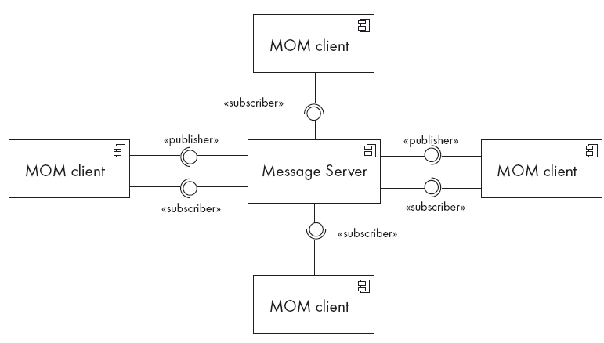
Example of a Message-oriented application

Slide 41
The Message-oriented architecture and design principles
1. Divide and conquer: The application is made of isolated software components.
3. Reduce coupling: The components are loosely coupled since they share only data format.
4. Increase abstraction: The prescribed format of the messages are generally simple to manipulate, all the application details being hidden behind the messaging system.
5. Increase reusability: A component will be resusable is the message formats are flexible enough.
6. Increase reuse: The components can be reused as long as the new system adhere to the proposed message formats.

Slide 42
The Message-oriented architecture and design principles
7. Design for flexibility: The functionality of a message-oriented system can be easily updated or enhanced by adding or replacing components in the system.
8. Design for testability: Each component can be tested independently.
9. Design defensively: Defensive design consists simply of validating all received messages before processing them.

Slide 43
Questions?

Slide 44
Thank You

