Slide 1
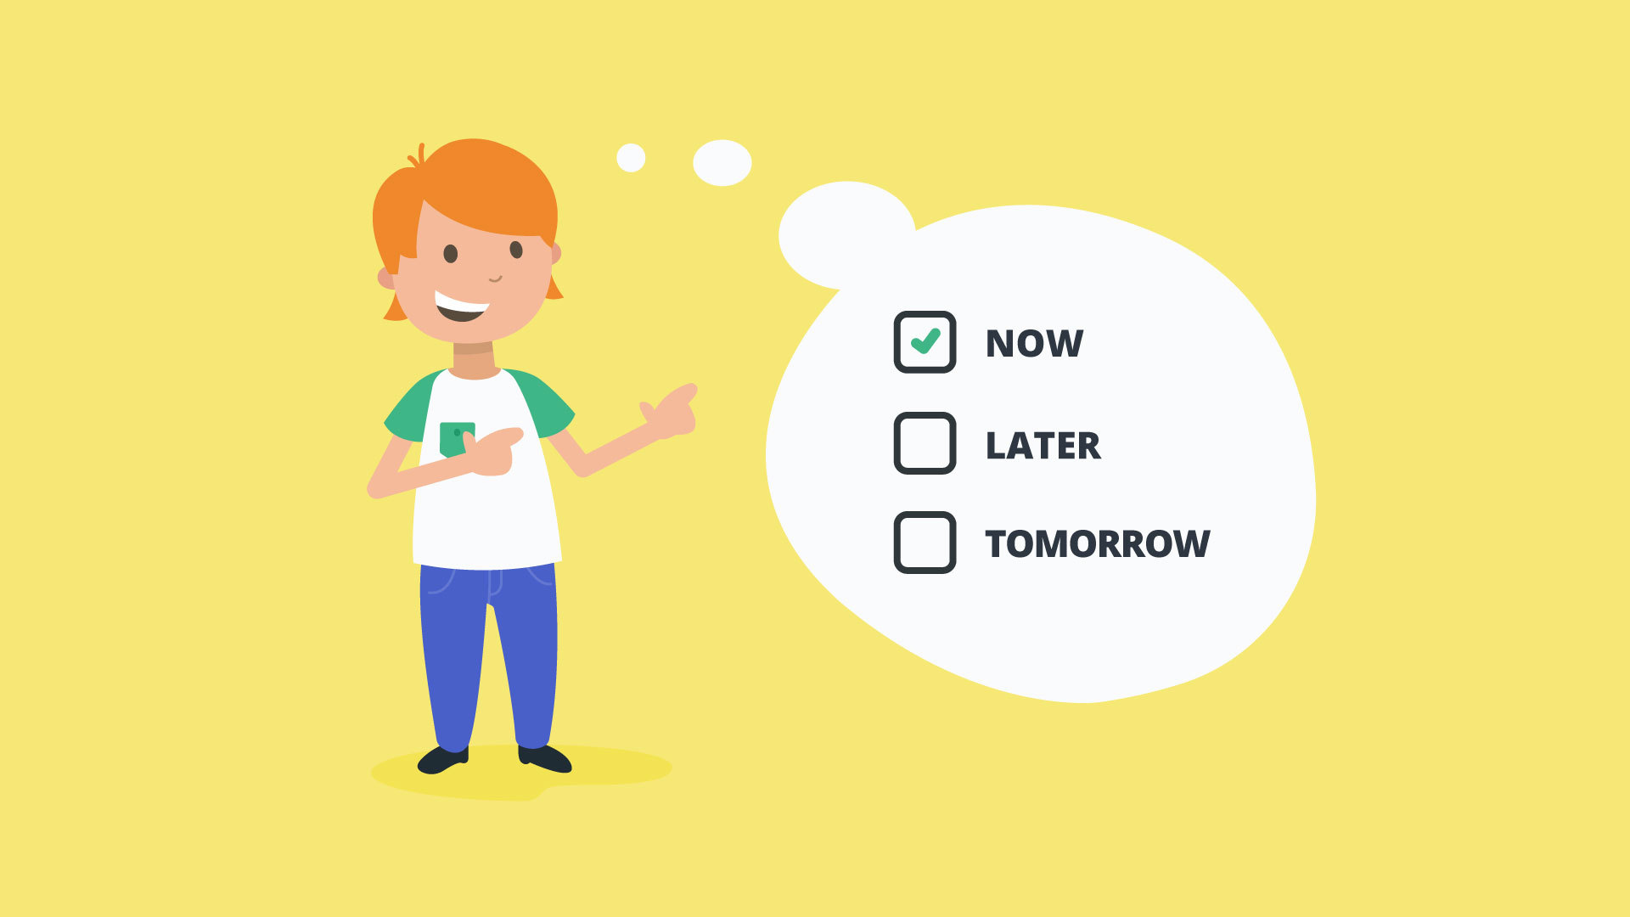
Overcoming Procrastination - Stop Delaying, Start Doing!
Conducted By:
Bilkis Khanam
Psychologist
Daffodil International University

Slide 2
Session 3: How to Overcome (Part 1)
Session content:
Procrastination cycle
Do you want to change?
Dismissing procrastination excuses by
challenging unhelpful conclusions
Testing unhelpful conclusions
Encourage rather criticize

Slide 3
The Procrastination Cycle
Task/Goal
Unhelpful Rules/Assumptions
Discomfort Driven
Procrastination Excuses
Procrastination Activities/Diversions
Consequences: Positive & negative

Slide 4
Approach Task/Goal
One or more unhelpful rules/assumptions are activated
1. Need To Be In Charge 2. Pleasure Seeking 3. Fear of Failure 4. Fear of Uncertainty 5. Low Self-Confidence 6. Depleted Energy
Discomfort Driven ( Emotions)
Procrastination Excuses
Procrastination Activities
Positive Consequences
Negative Consequences
Continue to Procrastinate

Slide 5
Do I Want To Change?
Being a procrastinator…
How does it hurt me? | How does it help me?
If I change and no longer procrastinate…
What will be good? | What will be bad?

Slide 6
Changing Your Conclusions
The Truth | Unhelpful Conclusion
I am really tired | I am better off doing it after I have rested
I don’t want to do it now | I may feel more like doing it tomorrow
I will miss out on the fun happening | I can always wait till nothing much is happening
I don’t have everything I need | I will wait till I do
I have plenty of time | So I don’t have to start it now
I don’t feel inspired | I will wait till I do
I have other things to do | I will do it once those things are finished
I don’t have enough time to get it all done | I will wait till I have a lot of time to do it
I work better under pressure | So I will leave it to the last minute

Slide 7
Challenging Your Conclusions
Disputation Questions
What is the reasons that it is better for me to put off this task or goal?
What is the reasons that it is better for me to start this task or goal now?
Is it really true that I will be better off in the long run delaying this task or goal?
Is it really true that I can’t make even a small start on the task or goal right now? Can I still get some parts of the task or goal done now, even though conditions aren’t ideal?
Is it really true that later is a better time to do it?
If I do make some start on the task or goal right now – What might happen? How might I feel?
If I don’t make a start on the task or goal right now – What might happen? How might I feel?

Slide 8
Procrastination Excuse
The Truth | Old Unhelpful Conclusion
I am really tired | I am better off doing it after I have rested
Answers to Disputation Questions It is true I am tired right now and things will be more of an effort. But, times before when I have done things even though I am tired, I have felt better for having gotten started and accomplished something, and usually I end up having more energy rather than less. If I delay this, it will just play on my mind, I will just feel worse in the long run, and things will be harder to get done. I guess I could make a small start, maybe just 30minutes on it. I don’t know that I will feel any better after resting, it may be the same story tomorrow. If I make a small start I know I will feel better, and may feel like doing more.
End Result
The Truth |  | New Helpful Conclusion
I am really tired |  | But I can still make a small start right now and then rest

Slide 9
The Truth | Helpful Conclusion
I am really tired | But I can still make a small start right now, and then rest
I don’t want to do it now | But later won’t be any better, so I may as well try to get started
I will miss out on the fun happening now | But if I get some of it done, I can reward myself with other fun later
I don’t have everything I need | But I can still try to make a start on some bits of the task
I have plenty of time | But better to get on top of it now than leave it to the last minute
I don’t feel inspired | But if I get started, the inspiration may follow, I can’t just wait around for inspiration to arrive
I have other things to do | But they are not more important and can be done after this
I don’t have enough time to get it all done | But that doesn’t mean I can’t get some of it done now
I work better under pressure | But it is still worth making a start now, because if I leave things too late it can backfire

Slide 10
Testing Your Conclusions
“I am really tired, I am better off doing it after I have rested”
“I don’t want to do it now, I may feel more like doing it tomorrow”
“I don’t feel inspired, I will wait till I do”
“I am not in the mood, I will wait till I am”
Fatigue, Motivation, Inspiration & Poor Mood
0 10
Set yourself a small amount of time and do the task (5 minutes, 10 minutes or 30 minutes

Slide 11
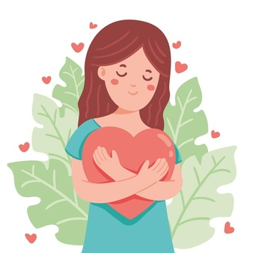
Encourage Rather Than Criticize
Self-Critical Self-Talk | Motivational Self-Talk
I should be finished by now. If I can’t even do this I must be a real idiot! | I would prefer to be finished by now. But let’s focus on what I can do to get closer to the finish line.
I can’t believe I haven’t started yet. I must be so lazy! | Just focus on getting started. Just because I haven’t started, doesn’t mean anything bad about me.
Common on! Others can get it done faster than this – I must be a complete stupid! | What others do is of no concern. Focusing on what I am doing and my task is more helpful.

