Slide 1
Targeting Customers and Gathering Information
Chapter 3

Slide 2
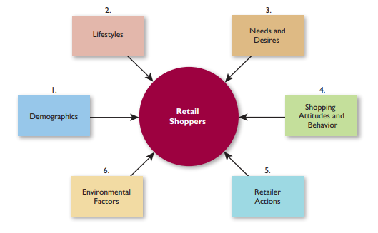
Identifying and Understanding Consumers
What Makes Retail Shoppers Tick

Slide 3
Understanding Consumer Lifestyles: Social Factors
Culture
Reference
Groups
Lifestyle
Social
Class
Time
Utilization; less
time shopping
Household Life
Cycle; life stage
for both
Family Life Cycle:
bachelorhood
to children , solitary

Slide 4
Understanding Consumer Lifestyles: Psychological Factors
Personality
Attitudes
Lifestyle
Perceived
Risk
Class Consciousness:
Desire and pursue
social status
Purchase Importance:
spend time

Slide 5
Blurring Gender Roles
Due to changing lifestyles, more men and women now shop together.

Slide 6
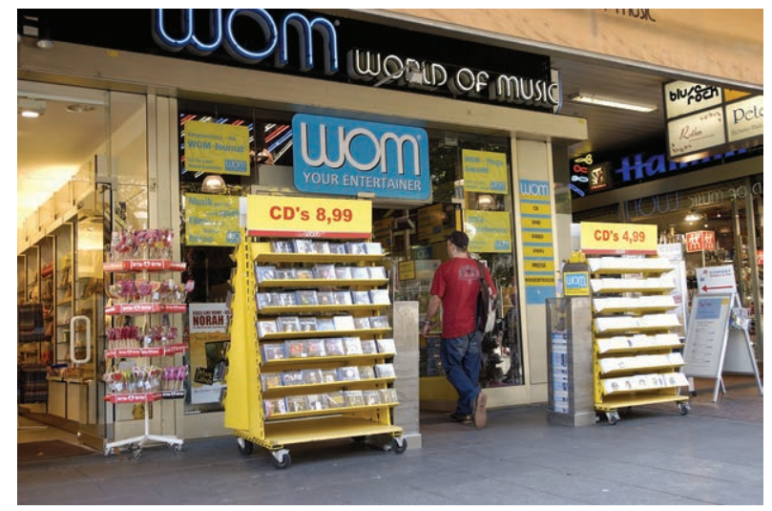
Three Special Market Segments
Channel relations tend to be smoothest with exclusive distribution
Channel relations tend to be most volatile with intensive distribution.
With selective distribution, suppliers sell through a moderate number of retailers

Slide 7
In-Home Shoppers
Shopping is discretionary, not necessary
Convenience is important
Active, affluent, well-educated
Self-confident, younger, adventuresome
Time scarcity is not a motivator

Slide 8
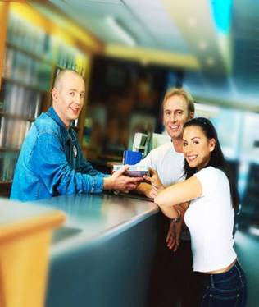
Online Shoppers
Use of Web for decision- making process as well as buying process
Convenience is important
Above average incomes, well-educated
Time scarcity is a motivator

Slide 9
Outshoppers
Out-of-hometown shopping
Young, members of a large family, and new to the community
Income and education vary
They like to travel, enjoy fine food, are active, and read out-of-town newspapers

Slide 10
Attitudes Towards Shopping
Shopping enjoyment
Shopping time
Shifting feelings about retailing (Spending ,value &shopping)
Why people buy or not on a shopping trip
Attitudes toward private brands they think that its better than manufacturer brand

Slide 11
Top Reasons for Leaving an Apparel Store Without Buying
Cannot find an appealing style
Cannot find the right size
No sales help is available
Cannot get in and out of the store easily
Prices are too high

Slide 12
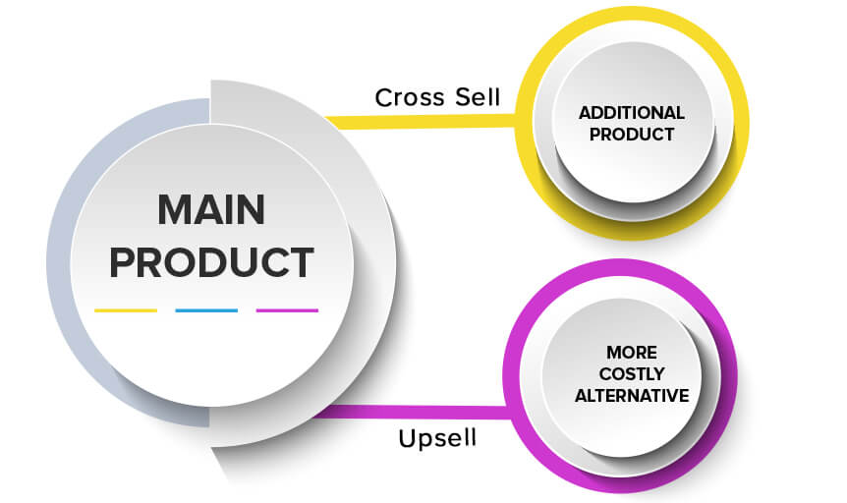
Cross-Shopping
Shopping for a product category at more than one retail format during the year
Visiting multiple retailers on one shopping trip

Slide 13
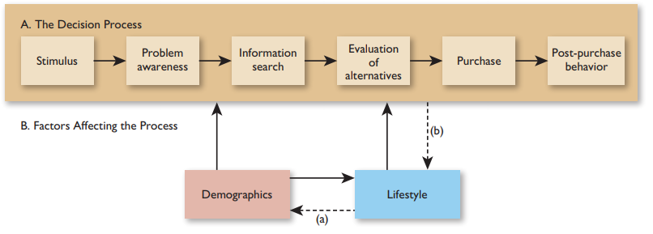
The Consumer Decision Process
Besides identifying target market traits, a retailer should know how people make decisions. This requires familiarity with consumer behavior, which is the process by which people determine whether, what, when, where, how, from whom, and how often to purchase goods and services.

Slide 14
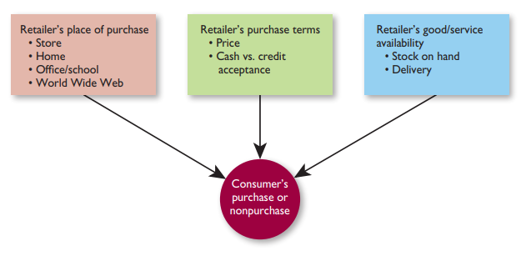
Key Factors in the Purchase Act

Slide 15
Types of Consumer Decisions
Extended
Limited
Routine
High
RISK & TIME
Low

Slide 16
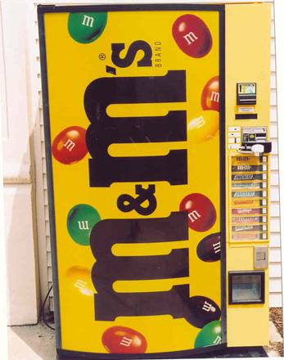
Types of Impulse Shopping
Completely unplanned
Partially unplanned
Unplanned substitution
Figure: Stimulating Impulse Purchases

Slide 17
Information Gathering and Processing in Retailing

Slide 18
How Information Flows in a Retail Distribution Channel
Information
and the
Supplier
Information
and the
Consumer
Information
and the
Retailer

Slide 19
Suppliers Need To Know
From the Retailer
Estimates of category sales
Inventory turnover rates
Feedback on competitors
Level of customer returns
From the Customer
Attitudes toward styles and models
Extent of brand loyalty
Willingness to pay a premium for superior quality

Slide 20
Retailers Need To Know
From the Supplier
Advance notice of new models and model changes
Training materials
Sales forecasts
Justifications for price changes
From the Customer
Why people shop there
What they like and dislike
Where else people shop

Slide 21
Consumers Need To Know
From the Supplier
Assembly and operating instructions
Extent of warranty coverage
Where to send a complaint
From the Retailer
Where specific merchandise is stocked in the store
Methods of payment acceptable
Rain check and other policies

Slide 22
Retail Information System (RIS)
Anticipates the information needs of retail managers
Collects, organizes, and stores relevant data on a continuous basis
Directs the flow of information to the proper decision makers

Slide 23
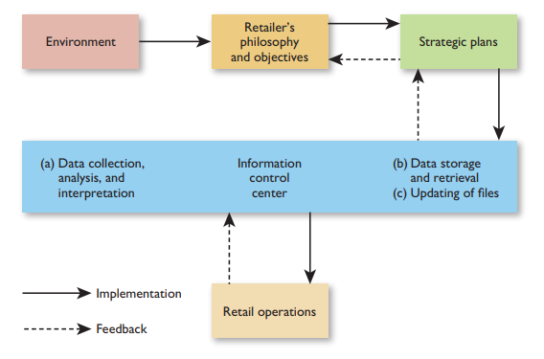
A Retail Information System

Slide 24
Data-Base Management
System gathers, integrates, applies, and stores information in related subject areas
Its a major element in an RIS
Customer, vendor, product category data base
Used for
Frequent shopper programs
Customer analysis
Promotion evaluation
Inventory planning
Trading area analysis

Slide 25
Five Steps to Approaching Data-Base Management
Plan the particular data base and its components and determine information needs
Acquire the necessary information
Retain the information in a usable and accessible format
Update the data base regularly to reflect changing demographics, recent purchases, etc.
Analyze the data base to determine strengths and weaknesses
E.g. By customer; purchase frequency, items bought, average purchase

Slide 26
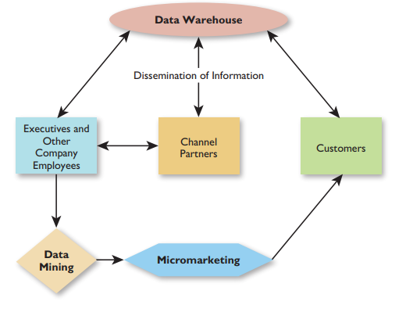
Retail Data-Base Management in Action
The data warehouse is where information is collected, sorted, and stored centrally. Information is disseminated to retailer personnel, as well as to channel partners (such as alerting them to what merchandise is hot and what is not hot) and customers (such as telling them about order status). In data mining, retail executives and other employees—and sometimes channel partners—analyze information by customer type, product category, and so forth in order to determine opportunities for tailored marketing efforts. With micromarketing, the retailer applies differentiated marketing. Focused retail strategy mixes are planned for specific customer segments—or even for individual customers.

Slide 27
Components of a Data Warehouse
Physical storage location for data – the warehouse
Software to copy original databases and transfer them to warehouse
Interactive software to allow processing of inquiries
A directory for the categories of information kept in the warehouse

Slide 28
Data Mining and Micromarketing
Data mining is the in-depth analysis of information to gain specific insights about customers, product categories, vendors, and so forth
Micromarketing is an application of data mining, whereby retailers use differentiated marketing and develop focused retail strategy mixes for specific customer segments

Slide 29
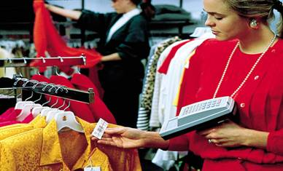
Applying UPC Technology to Gain Better Information

Slide 30
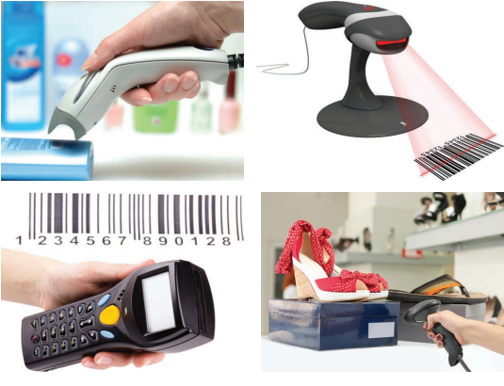

Slide 31
The Marketing Research Process

Slide 32
Marketing Research in Retailing
The collection and analysis of information relating to specific issues or problems facing a retailer
Secondary Data
Advantages
Inexpensive
Fast
Several sources and perspectives
Generally credible
Provides background information
Disadvantages
May not suit current study
May be incomplete
May be dated
May not be accurate or credible
May suffer from poor collection techniques

Slide 33
Secondary Data Sources
Internal
Sales reports
Billing reports
Inventory records
Performance reports
External
Government
Retail Trade
Statistical Abstract of the
Public records

Slide 34
Primary Data
Advantages
Collected for specific purpose
Current
Relevant
Known and controlled source
Disadvantages
May be more expensive
Tends to be more time consuming
Information may not be acquirable

Slide 35
Survey Methods
In-person
Over the telephone
By mail
Online
Mystery Shoppers
Retailers hire people to pose as customers and observe operations from sales presentations to how well displays are maintained to service calls

