Slide 1
UI Design

Slide 2
What is UI Design?
UI design refers to the visual design of a digital product’s interface. It’s the process of creating interfaces (namely apps and websites) with a focus on look, style, and interactivity. A UI designer will design the movement between different screens, and create the visual elements—and their interactive properties—that facilitate user interaction.

Slide 3
What does a UI Designer do?
While UI design is largely a visual discipline, UI designers work on a vast array of projects. In order to design accessible, user-friendly interfaces, UI designers bring empathy into every stage of the design process—from designing screens, icons, and interactions, to creating a style guide that ensures consistency and the proper implementation of a visual language across an entire product. They also take great care in making sure the product is accessible and inclusive for all users, as opposed to a select few.
Think about your favorite app. When you first downloaded it, you didn’t spend hours working out how to use it—you just started using it straight away. This is because the UI designer uses stylistic elements like patterns, spacing, and color to guide the user in a way that feels natural.

Slide 4
Difference between UI and UX
UI design and UX (user experience) design are often used interchangeably. While they both share the same end goal of providing a good experience for the user, UI designers and UX designers work different sides of the same coin.
UX designers enhance user satisfaction by improving the usability and accessibility of a product, while UI designers enhance user satisfaction by making the product’s interface look and feel enjoyable for the user. UX designers draw out the map of the product, which UI designers then flesh it out with visual and interactive touchpoints. UX and UI designers often work in tandem to maximize the responsiveness, efficiency, and accessibility of a website.

Slide 5
UI elements
There are four main categories of UI elements:
Input controls allow users to input information into the system. These include drop-down menus, forms, and buttons—just like you’ll be designing on your app screen.
Navigational components help users navigate an app or website. These include a tab bar or hamburger menu.
Informational components share information with users, such as a pop-up box or progress bar.
Containers hold related content together.

Slide 6
Evaluating User Interfaces
Heuristic evaluation
1. Pick some use cases to evaluate.
2. For each window, page or dialog that appears during the execution of the use case
Study it in detail to look for possible usability defects.
3. When you discover a usability defect write down the following information:
A short description of the defect.
Your ideas for how the defect might be fixed.

Slide 7
Evaluating User Interfaces
Evaluation by observation of users
Select users corresponding to each of the most important actors
Select the most important use cases
Write sufficient instructions about each of the scenarios
Arrange evaluation sessions with users
Explain the purpose of the evaluation
Preferably video each session
Converse with the users as they are performing the tasks
When the users finish all the tasks, de-brief them
Take note of any difficulties experienced by the users
Formulate recommended changes

Slide 8
Best Practices for Designing an Interface
Keep the interface simple
Create consistency and use common UI elements
Be purposeful in page layout.
Strategically use color and texture.
Use typography to create hierarchy and
clarity.
Make sure that the system communicates what’s happening.
Think about the defaults.

Slide 9
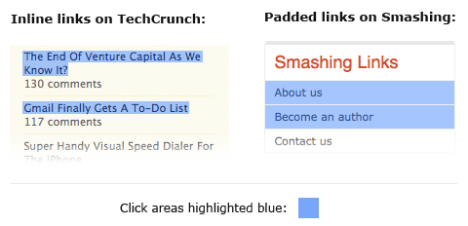
How to design a better UI
Padded Block Links

Slide 10
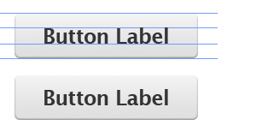
Cont.
Typesetting Buttons

Slide 11
Cont.
Using Contrast To Manage Focus

Slide 12
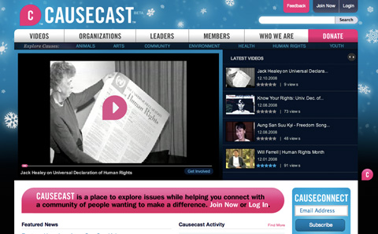
Cont.
Using Color To Manage Attention

Slide 13
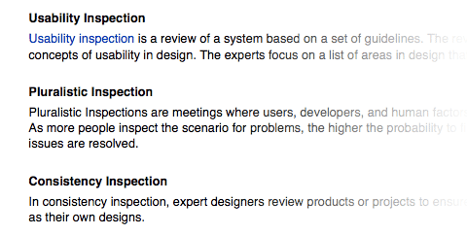
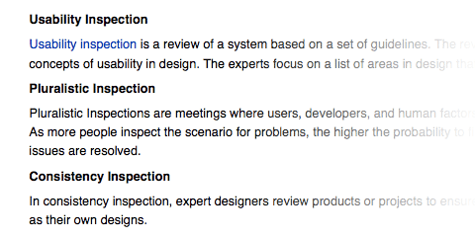
Cont.
White Space Indicates Relationships

Slide 15
Wireframe Types
Website Wireframe

Slide 16
Wireframe Types
Mobile App Wireframe

Slide 17
Prototype Vs. Wireframe
In UI design, a prototype is an interactive, high fidelity rendering of the user interface. Interactive prototypes should look and feel as good as the real thing.
Wireframes come before prototypes in the application design process. Sketch the basics in a wireframe, with a wireframe tool, then build them out in a prototype.

Slide 18
Benefits of Wireframe
The main benefits of wireframing are:
Define information architecture and content
Minimize rework and revisions
Facilitate client and stakeholder feedback
Get the user experience right from the get-go
Start defining and validating requirements

Slide 19
Benefits of Wireframe

Slide 20
Wireframing Workflow
Wireframing generally happens in two stages – ideation and validation.

Slide 21
Ideation
Obviously, this is where the ideas happen. Wireframes are an awesome way to kickstart design creativity or add new ideas to the design process. In the ideation phase, come up with as many UI design ideas as possible – doesn’t matter if some fail. In fact it’s better if some fail! That way, you know what to avoid further down the line.

Slide 22
Validation
This is where all those great web and app wireframe ideas you came up with in Ideation get put to the test. Grab your best wireframes and start showing your wireframes to anyone and everyone who can give you valid feedback. Stakeholders, potential users, colleagues, the client – all of them can weigh in on wireframes.

Slide 23
Wireframe software Tools
Pencil Project: Pencil is a free and open-source GUI prototyping tool that people can easily install and use to create mockups with a variety of templates in popular desktop.
Framebox: Framebox is a lightweight free online tool for very simple wireframing.
Moqups.
Mockingbird.
Wireframe CC.

Slide 24
Difficulties and Risks in UI Design
Users differ widely
Account for differences among users when you design the system.
Design it for internationalization.
When you perform usability studies, try the system with many different types of users.
User interface implementation technology changes rapidly
Stick to simpler UI frameworks widely used by others.
Avoid fancy and unusual UI designs involving specialized controls that will be hard to change.

Slide 25
Difficulties and Risks in UI Design
User interface design and implementation can often take the majority of work in an application:
Make UI design an integral part of the software engineering process.
Allocate time for many iterations of prototyping and evaluation.
Developers often underestimate the weaknesses of a GUI
Ensure all software engineers have training in UI development.
Always test with users.
Study the UIs of other software.

