Slide 1
Gross Domestic Product (GDP)
Definition: Gross domestic product (GDP) is the monetary value of all the finished goods and services produced within a country's borders in a specific time period. Though GDP is usually calculated on an annual basis, it can be calculated on a quarterly basis as well.
GDP includes all private and public consumption, government outlays, investments, private inventories, paid-in construction costs and the foreign balance of trade ( exports are added, imports are subtracted). Put simply, GDP is a broad measurement of a nation’s overall economic activity.
Textile sector contributes more than 12% in GDP of Bangladesh.

Slide 2
How to Determine GDP
There are three primary methods by which GDP can be determined. All, when correctly calculated, should yield the same figure.
These three approaches are often termed
A. the expenditure approach,
B. the output (or production) approach and
C. the income approach

Slide 3
How to Determine GDP
A. the expenditure approach:
The expenditure approach or spending approach, which is the most common method, calculates the monies spent by the different groups that participate in the economy. For instance, consumers spend money to buy various goods and services and businesses spend money as they invest in their business activities (buying machinery, for instance). And governments also spend money. All these activities contribute to the GDP of a country. In addition, some of the goods and services that an economy makes are exported overseas, their net export. And some of the products and services that are consumed within the country are imports from overseas. The GDP calculation also accounts for spending on exports and imports.

Slide 4
The expenditure approach
A country's gross domestic product can be calculated using the following formula: GDP = C + G + I + NX.
C is equal to all private consumption, or consumer spending, in a nation's economy,
G is the sum of government spending,
I is the sum of all the country's investment, including businesses capital expenditure and
NX is the nation's total net exports, calculated as total exports minus total imports (NX = Exports - Imports).

Slide 5
The expenditure approach

Slide 6
How to Determine GDP
B. the output (or production) approach:
The production approach is something like the reverse of the expenditure approach. Instead of exclusively measuring input costs that feed economic activity, the production approach estimates the total value of economic output and deducts costs of intermediate goods that are consumed in the process, like those of materials and services.

Slide 7
How to Determine GDP
C. the income approach:
Income earned by all the factors of production in an economy includes the wages paid to labor, the rent earned by land, the return on capital in the form of interest, as well as an entrepreneur’s profits. An entrepreneur’s profits could be invested in his own business or it could be an investment in any outside business. All this constitutes national income, which is used both as an indicator of implied productivity and of implied expenditure.
In addition, the income approach factors in some adjustments for some items that don’t show up in these payments made to factors of production. For one, there are some taxes – such as sales taxes and property taxes – that are classified as indirect business taxes. In addition, depreciation, which is a reserve that businesses set aside to account for the replacement of equipment that tends to wear down with use, is also added to the national income.

Slide 8
The income approach:

Slide 9
The income approach

Slide 10
The income approach

Slide 13
GDP of South Asian Countries

Slide 14
GDP Growth of Bangladesh

Slide 15
Top 10 Biggest GDP in the World
Rank | Country | Wealth ($ Trillions) | Change (2007-2017, %)
#1 | United States | $62.6 | 20%
#2 | China | $24.8 | 198%
#3 | Japan | $19.5 | 22%
#4 | United Kingdom | $9.9 | -2%
#5 | Germany | $9.7 | 0%
#6 | India | $8.2 | 160%
#7 | France | $6.6 | -11%
#8 | Canada | $6.4 | 25%
#9 | Australia | $6.1 | 83%
#10 | Italy | $4.3 | -19%

Slide 16
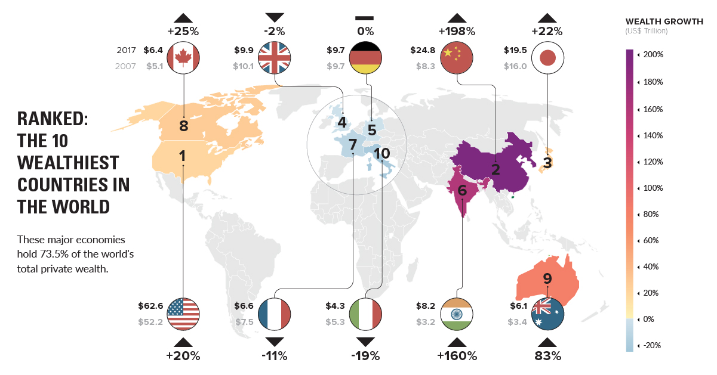
Wealthiest Countries in the World

Slide 17
Gross National Income (GNI)
The gross national income (GNI), previously known as gross national product (GNP), is the total domestic and foreign output claimed by residents of a country, consisting of gross domestic product (GDP), plus factor incomes earned by foreign residents, minus income earned in the domestic economy by nonresidents.

Slide 18
Purchasing power parity (PPP)
Concept:
Macroeconomic analysis relies on several different metrics to compare economic productivity and standards of living between countries and across time. One popular metric is purchasing power parity (PPP).
The concept is based on the law of one price, where in the absence of transaction costs and official trade barriers, identical goods will have the same price in different markets when the prices are expressed in the same currency.

Slide 19
Purchasing power parity (PPP)
Definition: Purchasing power parity (PPP) is an economic theory that compares different countries' currencies through a "basket of goods" approach. According to this concept, two currencies are in equilibrium or at par when a basket of goods (taking into account the exchange rate) is priced the same in both countries.
Measurement of PPP:
Law of one price
Big Mac Index
iPad Index
KFC Index

Slide 20
Per Capita Income
Per capita income (PCI) or average income measures the average income earned per person in a given area (city, region, country, etc.) in a specified year. It is calculated by dividing the area's total income by its total population.

Slide 21
PCI of Bangladesh

Slide 22
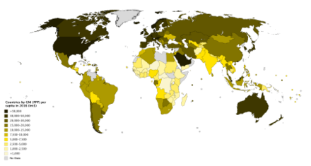
Countries by GNI (PPP) per capita in 2016

Slide 23
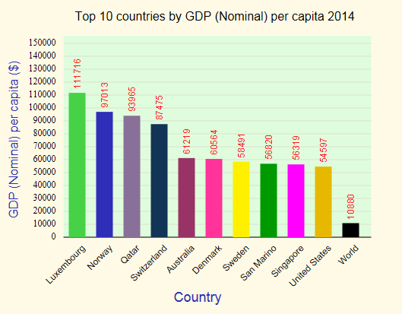
Top 10 countries in PCI

