Slide 1
Policy Adoption
Chapter 7

Slide 2
Policy Adoption: Concept
A policy decision involves action by some official person or body to adopt, modify, or reject a preferred policy alternative.
A policy decision is usually the culmination of many decisions, some routine and some not so routine, made during the operation of the policy process.
Legitimacy is an important factor in developing public support and acceptance for both government and the policies that it adopts. Legitimacy is a difficult concept to define. It is not the same as legality, although legality can contribute to belief in legitimacy
Constitutionality is not always a sine qua non for legitimacy.
Policy decisions made by the legislature are usually accepted as legitimate.
For policymaking, legitimacy is affected both by how something is done (i.e., whether proper procedures are used) and by what is being done.
When legitimacy erodes, governments and their policies diminish in effectiveness

Slide 3
Policy Decision-Making
Political and social scientists have produced a large body of theoretical and empirical literature on political decision-making.
There are many disagreements and divergences over how best to study decision-making, how decisions are actually made, and even over what constitutes a decision.
Many forces, pressures, and constraints may play upon political decision-makers.
In many instances, however, there are no easy routes to a good decision.

Slide 4
The Rational Comprehensive Theory
The rational-comprehensive theory specifies the procedures involved in making well-considered decisions that maximize the attainment of goals, whether personal or organizational.
The decision-maker is confronted with a problem that can be separated from other problems or at least considered meaningfully in comparison with them.
The goals, values, or objectives that guide the decision-maker are known and can be clarified and ranked according to their importance.
The various alternatives for dealing with the problem are examined.
The consequences (costs and benefits, advantages and disadvantages) that would follow from selecting each alternative are investigated.
Each alternative, and its attendant consequences, is then compared with the other alternatives.
The decision-maker will choose the alternative, and its consequences, that maximizes attainment of his or her goals, values, or objectives.
The result of this procedure is a rational decision-that is, one that most effectively achieves a given end. In short, it optimizes; it is the best possible decision

Slide 5
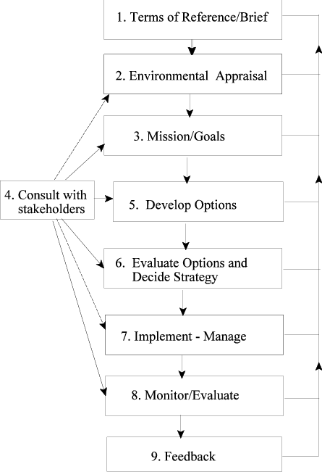
The Rational Comprehensive Theory (Veal 2002)

Slide 6
Criticisms of the Rational Comprehensive Theory
Charles Lindblom contends that decision-makers are not faced with concrete, clearly defined problems. Rather, he says that they first have to identify and formulate the problems on which they make decisions. Defining the problem is, in short, often a major problem for the decision-maker.
A second criticism holds that rational-comprehensive theory is unrealistic in the intellectual demands it makes on the decision-maker. lack of time, difficulty in collecting information and predicting the future, and complexity of calculations.
The value aspect of the rational-comprehensive theory also draws some criticism. The decision-maker might confuse personal values with those of the public. The rationalistic assumption that facts and values can be readily separated does not hold up in practice.
Yet another problem is that of "sunk costs." Previous decisions and commitments, investments in existing policies and programs, may foreclose or severely complicate the consideration of many alternatives.
The rational-comprehensive model assumes the existence of a unitary decision-maker. This condition cannot be met by legislative bodies, plural headed agencies

Slide 7
The Incremental Theory
The incremental theory of decision-making is presented as a decision theory that avoids many of the problems of the rational-comprehensive theory. It is more descriptive of the way in which public officials actually make decisions. Incremental decisions involve limited changes or additions to existing policies. Incrementalism can be summarized in the following manner:
1. The selection of goals or objectives and the empirical analysis of the action needed to attain them are closely intertwined with, rather than distinct from, one another.
2. The decision-maker considers only some of the alternatives for dealing with a problem, which will differ only incrementally (i.e., marginally) from existing policies.
3. For each alternative, only a limited number of "important" consequences are evaluated.
4. The problem confronting the decision-maker is continually redefined. Incrementalism allows for countless ends-means and means-ends adjustments that help make the problem more manageable.
5. There is no single decision or "right" solution for a problem. The test of a good decision is that various analysts find themselves directly agreeing on it, without agreeing that the decision is the most appropriate or optimum means to an agreed objective.
6. Incremental decision-making is essentially remedial and is geared more to ameliorating present, concrete social imperfections than to promoting future social goals.

Slide 8
Criticisms of the Incremental Theory
It is too conservative, too focused on the current order; hence, it is a barrier to innovation, which is often necessary for effective public policies.
In crisis situations or when major changes are made in policy, incrementalism provides no guidelines for handling the tasks of decision.
It may discourage the search for or use of other readily available alternatives.
Incrementalism does not eliminate the need for theory in decision-making, Some theory (of causation, relationships, etc.) is needed to guide the action and to indicate the likely effects of proposed changes

Slide 9
Mixed Scanning Theory
According to this theory, both the rational-comprehensive theory and incremental theory have shortcomings.
So, the theory presents mixed scanning as an approach to decision- making that draws on both fundamental and incremental decisions and provides for: “high order, fundamental policy-making processes which set basic directions and, incremental processes which prepare for fundamental decisions and work them out after they have been reached.”
Mixed scanning enables decision-makers to utilize both the rational- comprehensive and incremental theories, but in different situations.

Slide 10
Mixed Scanning Theory: Core Principles
Use focused trial and error.
Be tentative--proceed with caution.
If uncertain, procrastinate.
Stagger your decisions in stages.
If uncertain, factionalize your decisions.
Hedge your bets.
Be prepared to reverse your decisions.

Slide 11
THANK YOU

