Slide 1
Transistors

Slide 2
Common Emittor Transistor

Slide 4
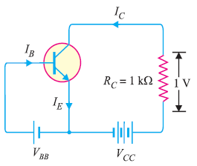
Exercise

Slide 5
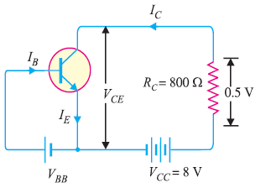

Slide 7
Common Collector Transistor

