Slide 1
Pharmaceutical Biotechnology (BPH 421) Galib Muhammad Abrar Ishtiaque Lecturer (Senior Scale) Department of Pharmacy Daffodil International University

Slide 2
Recombinant DNA Technology
CONTENTS
Basics of DNA
The Central Dogma
Replication
Transcription
Translation
Recombinant DNA Technology
Preparation of Recombinant DNA

Slide 3
Basics of DNA
Amino Acid
Polypeptide
Protein

Slide 4
Basics of DNA
Nucleoside
Nucleotide

Slide 5
Basics of DNA
Chromatin
Chromatid
Chromosome
Nucleosome

Slide 6
Basics of DNA
DNA
RNA

Slide 7
Basics of DNA
Gene
Genome

Slide 8
Basics of DNA
Codon
Start Codon
Stop Codon

Slide 9
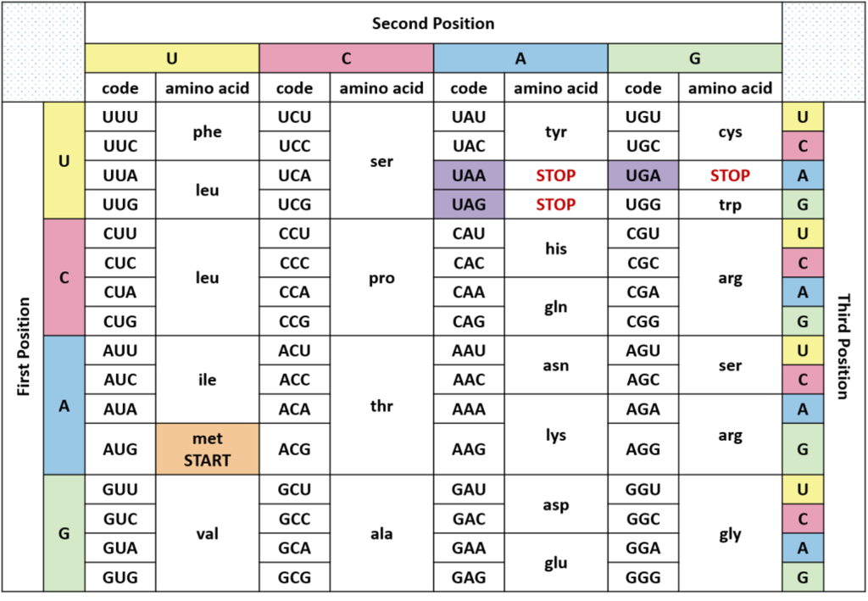
Basics of DNA

Slide 10
The Central Dogma
It is an explanation of the flow of genetic information within a biological system.
The central dogma of molecular biology states that DNA contains instructions for making a protein.
RNA then uses the instructions to make a protein.
In short:

Slide 11
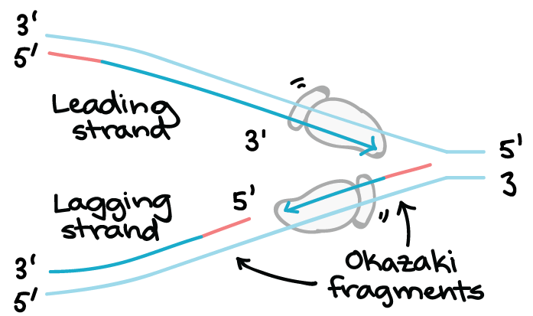
The Central Dogma (Replication)

Slide 12
The Central Dogma (Replication)

Slide 13
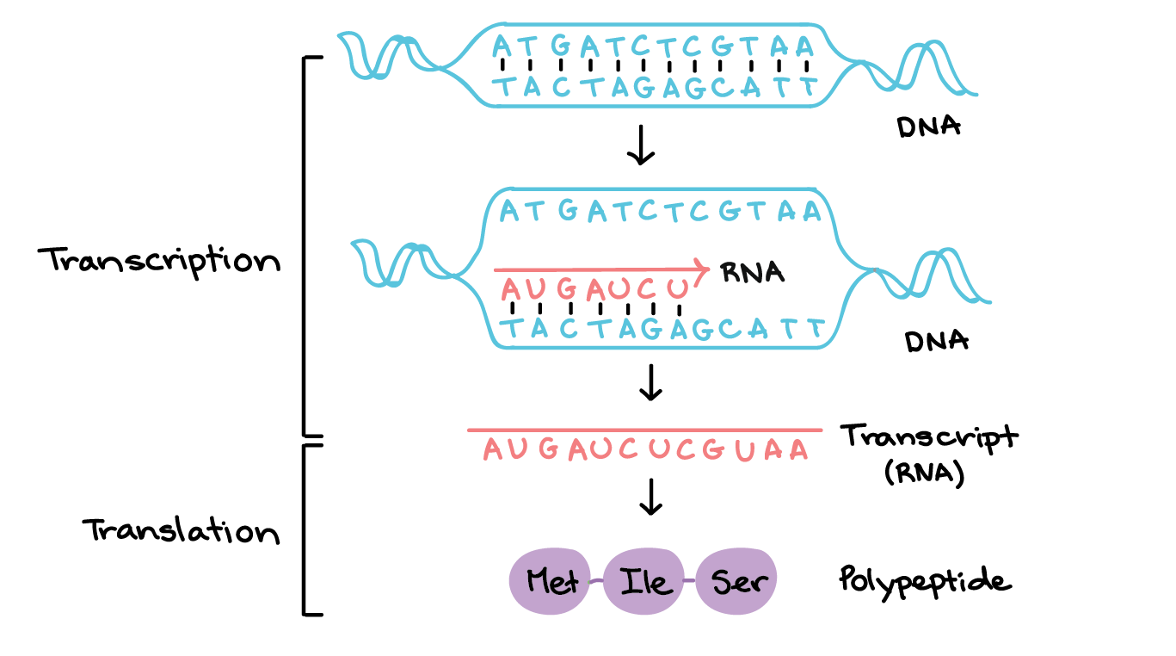
The Central Dogma (Transcription)

Slide 14
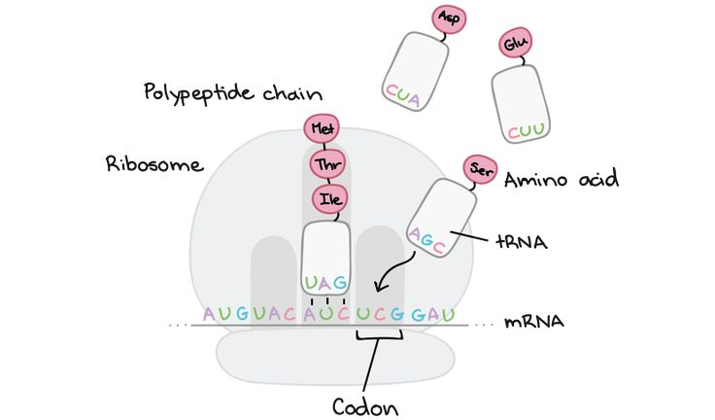
The Central Dogma (Translation)

Slide 15
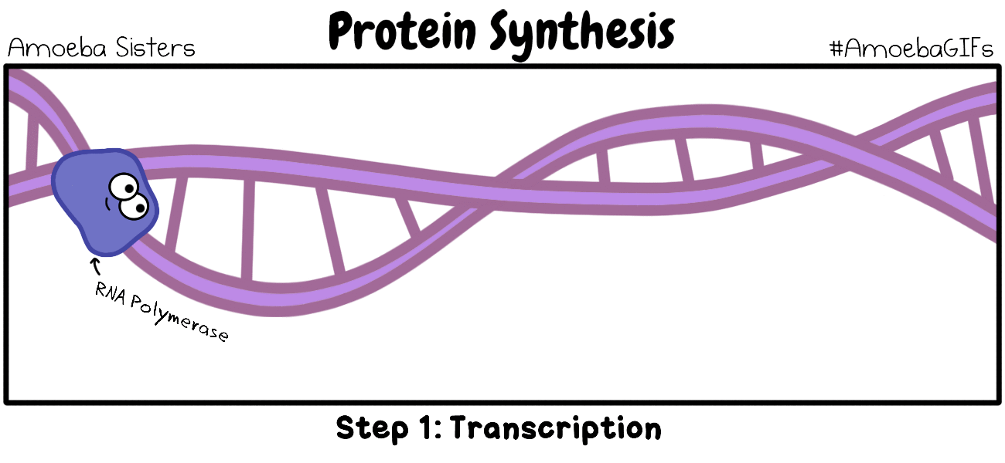
The Central Dogma (Summary)

Slide 16
Recombinant DNA Technology
The set of techniques for recombining genes from different sources in vitro and transferring this recombinant DNA into cells where it may be expressed.
DNA cloning involves:
separating a specific gene or DNA segment from a larger chromosome,
attaching it to a small molecule of carrier DNA,
then replicating this modified DNA thousands or millions of times through both an increase in host cell number and the creation of multiple copies of the cloned DNA in each cell.
The preparation of recombinant DNA entails five general steps.

Slide 17
Preparation of Recombinant DNA
Cutting DNA at precise locations. Sequence-specific endonucleases (restriction endonucleases) provide the necessary molecular scissors.
Selecting a small molecule of DNA capable of self-replication. These DNAs are called cloning vectors (a vector is a delivery agent). They are typically plasmids.
Joining two DNA fragments covalently. The enzyme DNA ligase links the cloning vector and DNA to be cloned. Composite DNA molecules comprising covalently linked segments from two or more sources are called recombinant DNAs.
Moving recombinant DNA from the test tube to a host cell that will provide the enzymatic machinery for DNA replication.
Selecting or identifying host cells that contain recombinant DNA. The methods used to accomplish these and related tasks are collectively referred to as recombinant DNA technology or, more informally, genetic engineering.

Slide 18
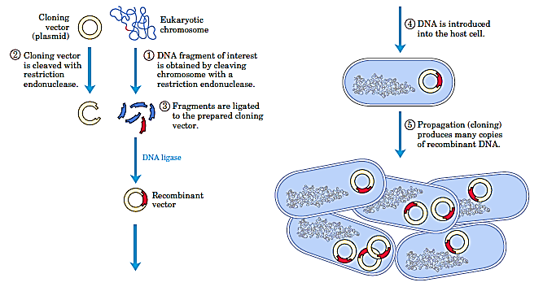
Preparation of Recombinant DNA

Slide 19
The End

