Slide 1
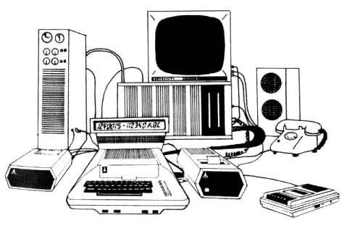
Lectute Three
IO Devices
Zannatul Mawa Koli
Lecturer
Department of CSE
Daffodil International University

Slide 2
Learning Objectives
🗌 In this lecture you will learn about:
Input/Output (I/O) devices Commonly used input devices Commonly used output devices
Other concepts related to I/O devices

Slide 3
I/O Devices
🗌 Provide means of communication between a
computer and outer world
🗌 Also known as peripheral devices because they surround the CPU and memory of a computer system
🗌 Input devices are used to enter data from the outside world into primary storage
🗌 Output devices supply results of processing from primary storage to users

Slide 4
Role of I/O Devices

Slide 5
Commonly Used Input Devices
🗌 Keyboard devices
🗌 Point-and-draw devices
🗌 Data scanning devices
🗌 Digitizer
🗌 Electronic cards based devices
🗌 Speech recognition devices
🗌 Vision based devices

Slide 6
Keyboard Devices
🗌 Allow data entry into a computer system by pressing a set of keys (labeled buttons) neatly mounted on a keyboard connected to a computer system
🗌 101-keys QWERTY keyboard is most popular

Slide 7
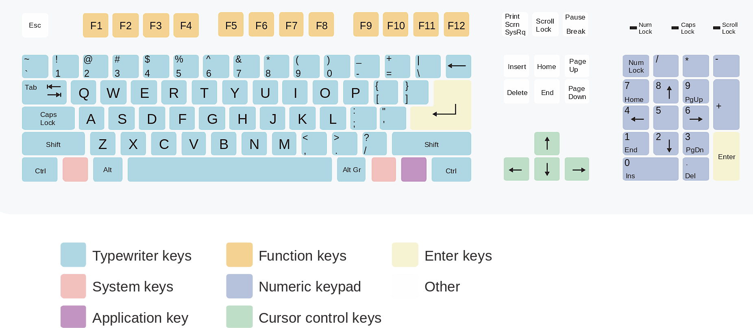
The Layout of Keys on a QWERTY Keyboard
A typical computer keyboard comprises sections with different types of keys

Slide 8
Point-and-Draw Devices
🗌 Used to rapidly point to and select a graphic icon or menu item from multiple options displayed on the Graphical User Interface (GUI) of a screen
🗌 Used to create graphic elements on the screen such as lines, curves, and freehand shapes
🗌 Some commonly used point-and-draw devices are mouse, track ball, joy stick, light pen, and touch screen

Slide 9
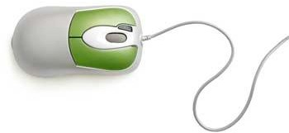
Mouse
🗌 Mouse is most popular pointing device. It is a very famous cursor- control device having a small palm size box with a round ball at its base which senses the movement of mouse and sends corresponding signals to CPU when the mouse buttons are pressed.
🗌 Generally it has two buttons called left and right button and a wheel is present between the buttons. Mouse can be used to control the position of cursor on screen, but it cannot be used to enter text into the computer.
🗌 Advantages
🗌 Easy to use
🗌 Not very expensive
🗌 Moves the cursor faster than the arrow keys of keyboard.

Slide 10
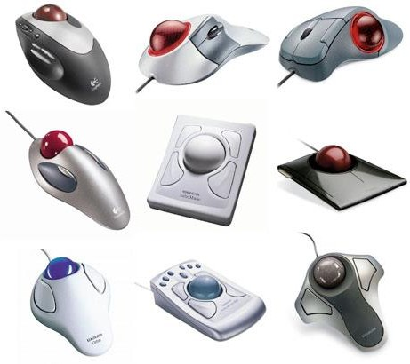
Trackball
🗌 Track ball is an input device that is mostly used in notebook or laptop computer, instead of a mouse.
🗌 This is a ball which is half inserted and by moving fingers on ball, pointer can be moved. Since the whole device is not moved, a track ball requires less space than a mouse.
🗌 A track ball comes in various shapes like a ball, a button and a square.

Slide 11
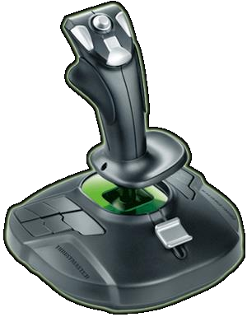
Joystick
🗌 Joystick is also a pointing device which is used to move cursor position on a monitor screen.
🗌 It is a stick having a spherical ball at its both lower and upper ends. The lower spherical ball moves in a socket. The joystick can be moved in all four directions.
🗌 Commonly used for video games, flight simulators, training simulators, and for controlling industrial robots

Slide 12
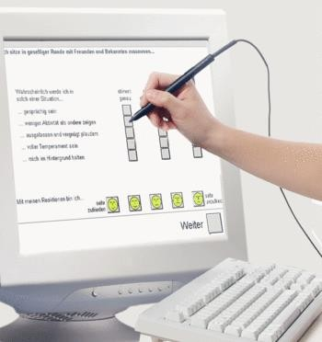
Light Pen
🗌 Pen-based point-and-draw device
🗌 Used to directly point with it on the screen to select menu items or icons or directly draw graphics on the screen
🗌 Can write with it on a special pad for direct input
of written information to a system
🗌 Pressure on tip of a side button is used to cause same action as right-button-click of a mouse
🗌 It consists of a photocell and an optical system placed in a small tube.
🗌 When the tip of a light pen is moved over the monitor screen and pen button is pressed, its photocell sensing element detects the screen location and sends the corresponding signal to the CPU.

Slide 13
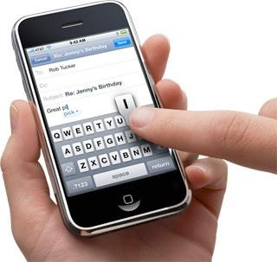
Touch Screen
🗌 Most simple, intuitive, and easiest to
learn of all input devices
🗌 Enables users to choose from available options by simply touchin with their finger the desired icon or menu item displayed on the screen
🗌 Most preferred human-computer interface used in information kiosks (unattended interactive information systems such as automatic teller machine or ATM)
g

Slide 14
Data Scanning Devices
🗌 Input devices that enable direct data entry into a computer system from source documents
🗌 Eliminate the need to key in text data into the computer
🗌 Due to reduced human effort in data entry, they improve data accuracy and also increase the timeliness of the information processed
🗌 Demand high quality of input documents
🗌 Some data scanning devices are also capable of recognizing marks or characters
🗌 Form design and ink specification usually becomes more critical
for accuracy

Slide 15
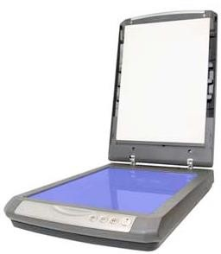
Scanner
🗌 Scanner is an input device which works more like a photocopy machine. It translates paper documents into an electronic format for storage in a computer
🗌 It is used when some information is available on a paper and it is to be transferred to the hard disc of the computer for further manipulation.
🗌 Scanner captures images from the source which are then converted into the digital form that can be stored on the disc. These images can be edited before they are printed.

Slide 16
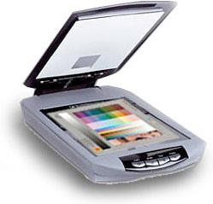
Optical Character Recognition (OCR) Device
🗌 Scanner equipped with a character recognition software (called OCR software) that converts the bit map images of characters to equivalent ASCII codes
🗌 Enables word processing of input text and also requires less storage for storing the document as text rather than an image
🗌 OCR software is extremely complex because it is difficult to make a computer recognize an unlimited number of typefaces and fonts
🗌 Two standard OCR fonts are OCR-A (American standard) and OCR-B (European standard)

Slide 17
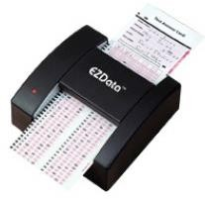
Optical Mark Reader (OMR)
🗌 Scanner capable of recognizing a pre-specified type of mark by pencil or pen
🗌 Very useful for grading tests with objective type questions, or for any input data that is of a choice or selection nature
🗌 Technique used for recognition of marks involves focusing a light on the page being scanned and detecting the reflected light pattern from the marks

Slide 18
Sample Use of OMR

Slide 19
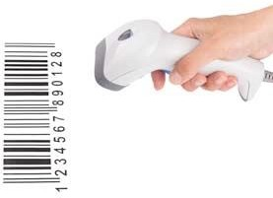
Bar-code Reader
🗌 Bar Code Reader is a device used for reading bar coded data (data in form of light and dark lines)
🗌 Scanner used for reading (decoding) bar- coded data
🗌 Bar codes represent alphanumeric data by a combination of adjacent vertical lines (bars) by varying their width and the spacing between them
🗌 Scanner uses laser-beam to stroke across pattern of bar code. Different patterns of bars reflect the beam in different ways sensed by a light-sensitive detector
🗌 Universal Product Code (UPC) is the most
widely known bar coding system

Slide 20
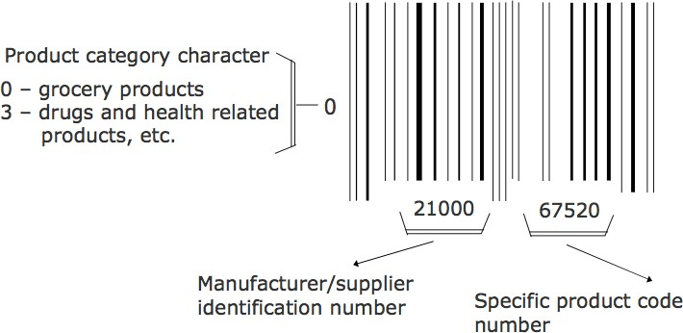
An Example of UPC Bar Code

Slide 21
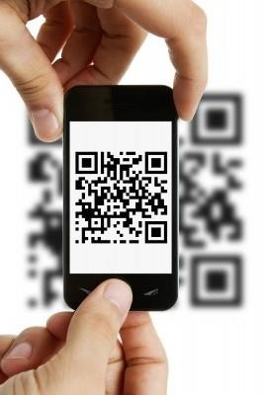
QR (Quick Response) Code
A matrix barcode (or two-dimensional code), readable by QR scanners, mobile phones with a camera, and smartphones.
Has various numbers of functions: linking to websites, send SMS functions, etc.
Certain applications on a smart phone / portable gaming device can scan QR codes (i.e ZXing on Android)

Slide 22
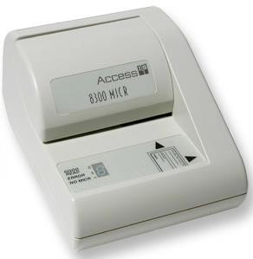
Magnetic-Ink Character Recognition (MICR)
🗌 MICR is used by banking industry for faster
processing of large volume of cheques
🗌 Bank’s identification code (name, branch, etc.), account number and cheque number are pre-printed (encoded) using characters from a special character set on all cheques
🗌 Special ink is used that contains magnetizable particles of iron oxide
🗌 This reading process is called Magnetic Ink Character Recognition (MICR). The main advantages of MICR is that it is fast and less error prone.

Slide 23
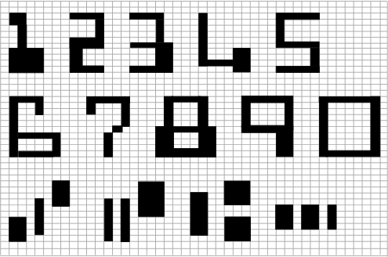
MICR Character Set (E13B Font)
🗌 It consists of numerals 0 to 9 and four special characters
🗌 MICR is not adopted by other industries because it supports only 14 symbols

Slide 24
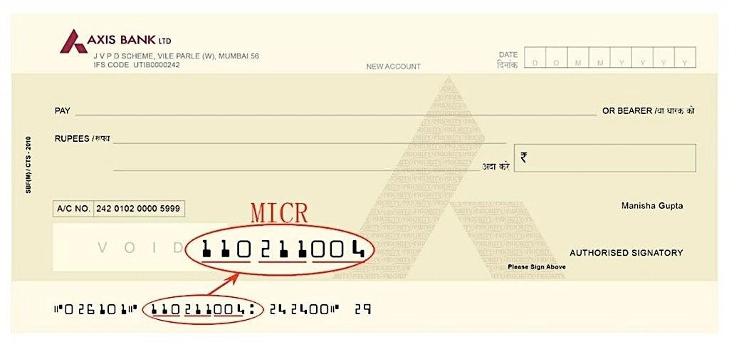
MICR Character Example

Slide 25
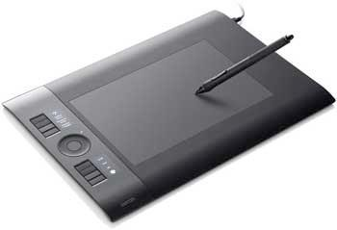
Digitizer
🗌 Input device used for converting (digitizing) pictures, maps
and drawings into digital form for storage in computers
🗌 Commonly used in the area of Computer Aided Design (CAD) by architects and engineers to design cars, buildings medical devices, robots, mechanical parts, etc.
🗌 Used in the area of Geographical Information System (GIS) for
digitizing maps available in paper form
🗌 Digitizer is also known as Tablet or Graphics Tablet because it converts graphics and pictorial data into binary inputs. A graphic tablet as digitizer is used for doing fine works of drawing and image manipulation applications.

Slide 26
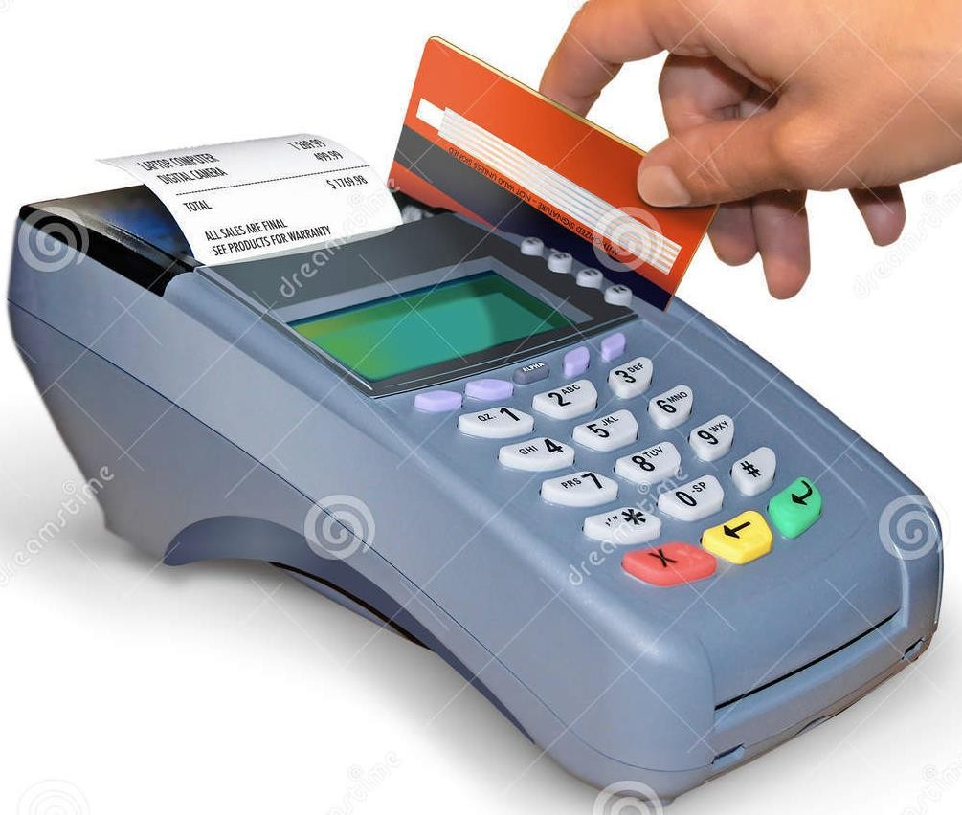
Electronic-card Reader
🗌 Electronic cards are small plastic cards having encoded data appropriate for the application for which they are used
🗌 Electronic-card reader (normally connected to a computer) is used to read data encoded on an electronic card and transfer it to the computer for further processing
🗌 Used together as a means of direct data entry into a computer system
🗌 Used by banks for use in automatic teller machines (ATMs) and by organizations for controlling access of employees to physically secured areas

Slide 27
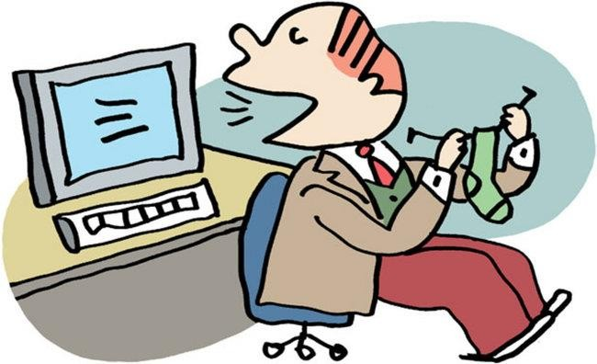
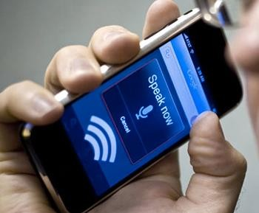
Speech Recognition Devices
🗌 Input device that allows a person to input data to a computer
system by speaking to it
🗌 Today’s speech recognition systems are limited to accepting few words within a relatively small domain and can be used to enter only limited kinds and quantities of data

Slide 28
Uses of Speech Recognition Systems
🗌 For inputting data to a computer system by a person in situations where his/her hands are busy, or his/her eyes must be fixed on a measuring instrument or some other object
🗌 For data input by dictation of long text or passage for later editing and review
🗌 For authentication of a user by a computer system based
on voice input
🗌 For limited use of computers by individuals with physical disabilities

Slide 29
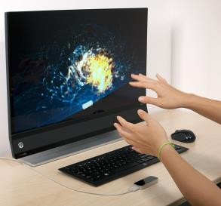
Vision-Input Systems
🗌 Allow computer to accept input just by seeing an object.
🗌 Input data is normally an
object’s shape and features
in the form of an image
🗌 Mainly used today in factories for designing industrial robots that are used for quality-control and assembly processes

Slide 30
Commonly Used Output Devices
🗌 Monitors
🗌 Printers
🗌 Plotters
🗌 Screen image projector
🗌 Voice response systems

Slide 31
Types of Output
🗌 Soft-copy output
🗌 Not produced on a paper or some material that can be touched and carried for being shown to others
🗌 Temporary in nature and vanish after use
🗌 Examples are output displayed on a terminal screen or spoken out by a voice response system
🗌 Hard-copy output
🗌 Produced on a paper or some material that can be touched and
carried for being shown to others
🗌 Permanent in nature and can be kept in paper files or can be looked at a later time when the person is not using the computer
🗌 Examples are output produced by printers or plotters on paper

Slide 32
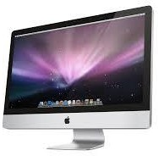
Monitors
🗌 Monitors are the most popular output devices used for producing soft-copy output
🗌 Display the output on a television like screen
🗌 Monitor associated with a keyboard is called a video display terminal (VDT).
🗌 It is the most popular I/O device

Slide 33
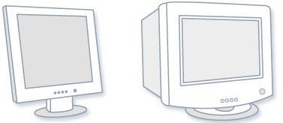
Types of Monitors
🗌 Cathode-ray-tube (CRT) monitors look like a television and
are normally used with non-portable computer systems
🗌 Flat-panel monitors are thinner and lighter and are commonly used with portable computer systems like notebook computers. Now they are also used with non- portable desktop computer systems because they occupy less table space.

Slide 34
Printers
🗌 Most common output devices for producing hard-copy output
🗌 There are two types of printers:
🗌 Impact Printers
🗌 Non-Impact Printers
🗌 Some widely used printers
🗌 Dot-Matrix Printers
🗌 Inkjet Printers
🗌 Drum Printers
🗌 Chain/Band Printers
🗌 Laser Printers

Slide 35
Impact Printers
🗌 The impact printers print the characters by striking them on the ribbon which is then pressed on the paper.
🗌 Characteristics of Impact Printers are the following:
🗌 Very low consumable costs
🗌 Very noisy
🗌 Useful for bulk printing due to low cost
🗌 There is physical contact with the paper to produce an image
🗌 These printers are of two types
🗌 Character printers : Print one character at a time.
🗌 Line printers : Print one line at a time.

Slide 36
Non-impact Printers
🗌 Non-impact printers print the characters without using ribbon.
🗌 Characteristics of Non-impact Printers
🗌 Faster than impact printers.
🗌 They are not noisy.
🗌 High quality.
🗌 Support many fonts and different character size.
🗌 These printers are of two types
🗌 Laser Printers
🗌 Inkjet Printers

Slide 37
Dot-Matrix Printers
🗌 In the market one of the most popular printers is Dot Matrix Printer.
🗌 These printers are popular because of their ease of printing and economical price.
🗌 Each character printed is in form of pattern of dots and head consists of a Matrix of Pins of size (5*7, 7*9, 9*7 or 9*9) which come out to form a character that is why it is called Dot Matrix Printer.
🗌 Advantages
🗌 Cheap in both initial cost and cost of operation
🗌 can be used for generating multiple copies by using carbon paper or its equivalent
🗌 Other language characters can be printed
🗌 Disadvantages
🗌 Slow, with speeds usually ranging between 30 to 600 characters per second
🗌 Poor Qualit

Slide 38
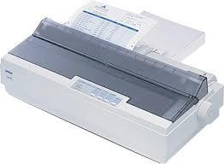
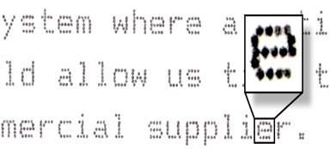
Dot-Matrix Printers

Slide 39
Inkjet Printers
🗌 Prints characters and all kinds of images by spraying
small drops of ink on to the paper
🗌 Print head contains up to 64 tiny nozzles that can be selectively heated up in a few micro seconds by an integrated circuit register
🗌 To print a character, the printer selectively heats the appropriate set of nozzles as the print head moves horizontally
🗌 Can print many special characters, different sizes of print, and graphics such as charts and graphs

Slide 40
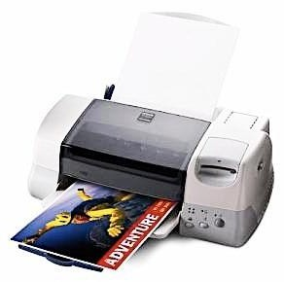
Inkjet Printers
🗌 Non-impact printers. Hence, they cannot produce multiple copies of a document in a single printing
🗌 Can be both monochrome and
color
🗌 Slower than dot-matrix printers with speeds usually ranging between 40 to 300 characters per second
🗌 More expensive than a dot-matrix printer

Slide 41
Drum Printers
🗌 Have a solid cylindrical drum with characters embossed on its surface in the form of circular bands
🗌 The surface of drum is divided into number of tracks.
🗌 Total tracks are equal to size of paper i.e. for a paper width of 132 characters, drum will have 132 tracks.
🗌 A character set is embossed on track. The different character sets available in the market are 48 character set, 64 and 96 characters set.
🗌 One rotation of drum prints one line.
🗌 Drum printers are fast in speed and can print 300 to 2000 lines per minute.
🗌 Advantages
🗌 Very high speed
🗌 Disadvantages
🗌 Very expensive
🗌 Characters fonts cannot be changed

Slide 42
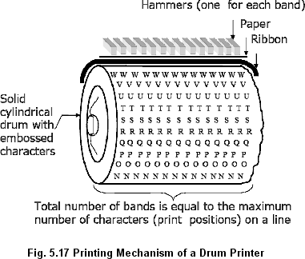
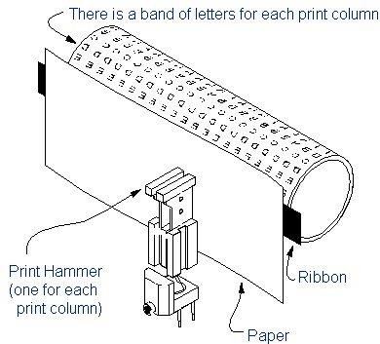
Drum Printers

Slide 43
Chain/Band Printers
🗌 Line printers that print one line at a time
🗌 In this printer, chain of character sets are used so it is called Chain Printer.
🗌 Consist of a metallic chain/band on which all characters of the
character set supported by the printer are embossed
🗌 Also have a set of hammers mounted in front of the chain/band in such a manner that an inked ribbon and paper can be placed between the hammers and the chain/band
🗌 A standard character set may have 48, 64, or 96 characters.

Slide 44
Chain/Band Printers
🗌 Can only print pre-defined sets of characters that are embossed on the chain/band used with the printer
🗌 Character fonts can easily be changed.
🗌 Cannot print any shape of characters, different sizes of print, and graphics such as charts and graphs
🗌 Are impact printers and can be used for generating multiple
copies by using carbon paper or its equivalent
🗌 Typical speeds are in the range of 400 to 3000 lines per minute

Slide 45
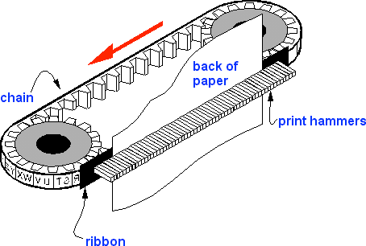
Chain/Band Printers

Slide 46
Laser Printers
🗌 Page printers that print one page at a time
🗌 Consist of a laser beam source, a multi-sided mirror, a photoconductive drum and toner (tiny particles of oppositely charged ink)
🗌 To print a page, the laser beam is focused on the electro statically charged drum by the spinning multi-sided mirror
🗌 Toner sticks to the drum in the places the laser beam has
charged the drum’s surface.
🗌 Toner is then permanently fused on the paper with heat and pressure to generate the printer output
🗌 Laser printers produce very high quality output having resolutions in the range of 600 to 1200 dpi

Slide 47
Laser Printers
🗌 Can print many special characters, different sizes of print, and
graphics such as charts and graphs
🗌 Are non-impact printers
🗌 Most laser printers are monochrome, but color laser printers are
also available
🗌 Low speed laser printers can print 4 to 12 pages per minute. Very high-speed laser printers can print 500 to 1000 pages per minute
🗌 More expensive than other printers
🗌

Slide 48
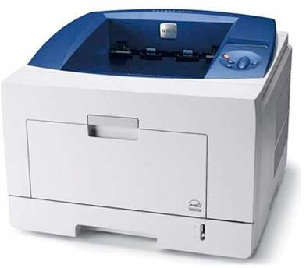
Laser Printers
🗌 Can print many special characters, different sizes of print, and graphics such as charts and graphs
🗌 Are non-impact printers
🗌 Most laser printers are monochrome, but color laser printers are also available
🗌 Low speed laser printers can print 4 to 12 pages per minute. Very high-speed laser printers can print 500 to 1000 pages per minute
🗌 More expensive than other printers

Slide 49
Plotters
🗌 Plotters are an ideal output device for architects, engineers, city planners, and others who need to routinely generate high-precision, hard-copy graphic output of widely varying sizes
🗌 Two commonly used types of plotters are:
🗌 Drum plotter, in which the paper on which the design has to be made is placed over a drum that can rotate in both clockwise and anti-clockwise directions
🗌 Flatbed plotter, in which the paper on which the design has to
be made is spread and fixed over a rectangular flatbed table

Slide 50
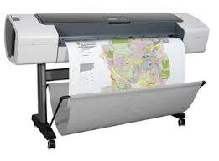
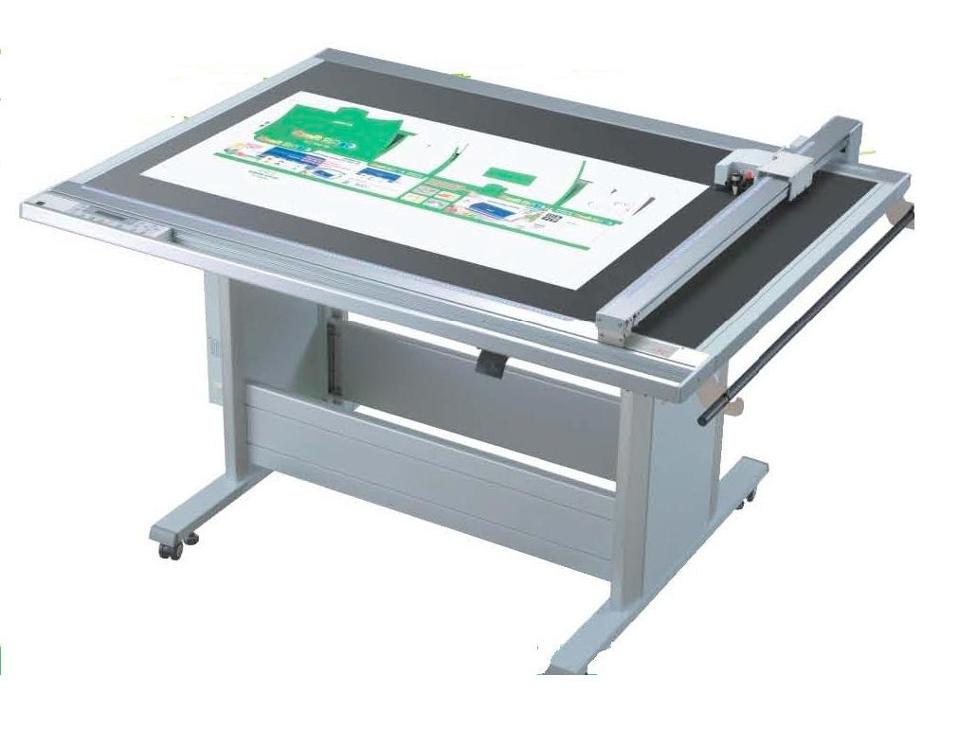
Plotters

Slide 51
Projector
🗌 An output device that can be directly plugged to a computer system for projecting information from a computer on to a large screen
🗌 Useful for making presentations to a group of people with direct use of a computer
🗌 Full-fledged multimedia presentation with audio, video, image, and animation can be prepared and made using this facility

Slide 52
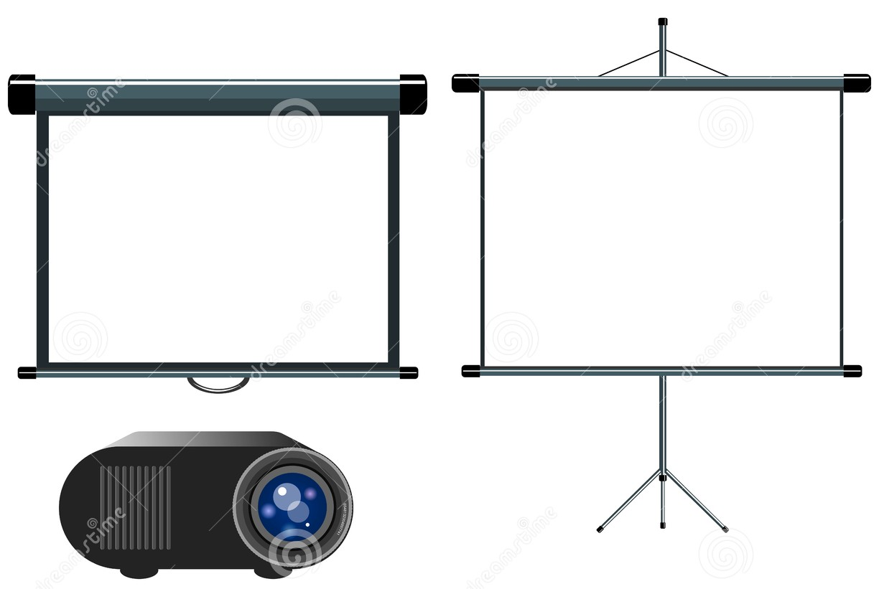
Projector

Slide 53
Voice Response Systems
🗌 Voice response system enables a computer to talk to a user with an audio- response device that produces audio output
🗌 Such systems are of two types:
🗌 Voice reproduction systems
Produce audio output by selecting an appropriate audio output from a set of pre-recorded audio responses
Applications include audio help for guiding how to operate a system, automatic answering machines, video games, etc.
🗌 Speech synthesizers
Converts text information into spoken sentences
Used for applications such as:
🗌 Reading out text information to blind persons
🗌 Allowing those persons who cannot speak to communicate effectively
🗌 Translating an entered text into spoken words in a selected language

Slide 54
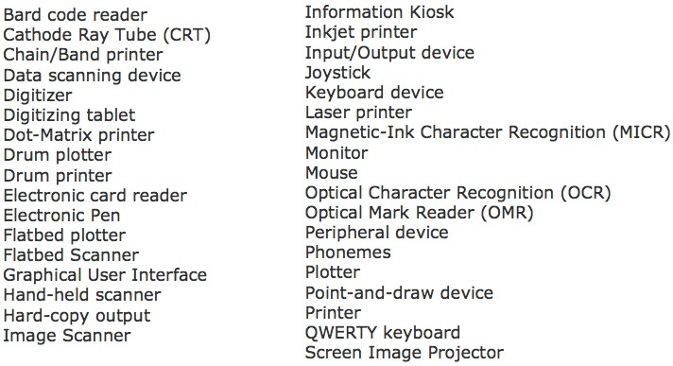
Key Words/Phrases

Slide 55
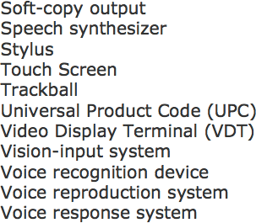
Key Words/Phrases

