Slide 1
CE 413 Structural Analysis & Design III
Introduction to Partially Encased Composite Column
Md. Abu Hasan
Senior Lecturer
Department of Civil Engineering
Daffodil International University.

Slide 2
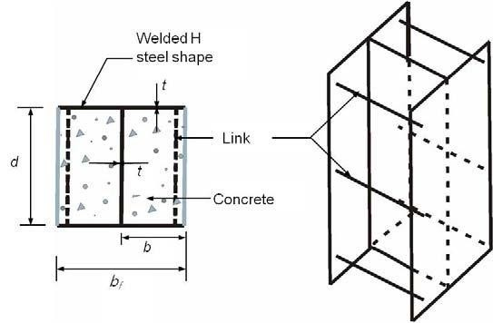
Partially Encased Composite Column
Non-compact PEC column with built-up shapes
Structural configuration of PEC column
The PEC column system is composed of :
H type steel section
Transverse links
Concrete infill

Slide 3
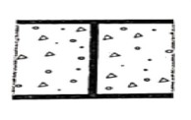
Partially Encased Composite Column
Properties
Flexible geometry
Maximize concrete/ steel ratio
Minimum reinforcement required
Easy formwork
Easy placing of concrete

Slide 4
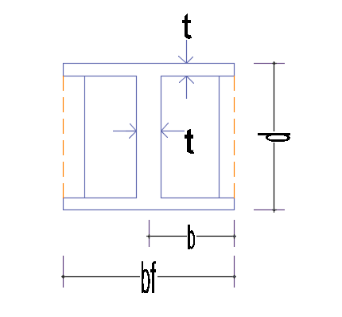
Partially Encased Composite Column (PEC)
Material limitations:
Concrete strength: 21 Mpa (3.045 ksi) ≤ f’c ≤ 70 Mpa ( 10.15 ksi)
Structural steel: Fy ≤ 350 Mpa (50 ksi)
Reinforcing bar: Fyr ≤ 400 Mpa ( 58 ksi)
As + Ar ≤ 20% of gross cross sectional area As + Ar ≤ 0.2 Ag
bf = 0.9 d to 1.1 d b/t ≤ 32 , t_{f =} t_{w =}t
Flanges & web are of equal thickness
Tie bar / link bar limitations:
500 𝑚𝑚
2 _{𝑑}
S ≤
3
smallest, S= Spacing of link bar
² 𝑏𝑓
3
Area of tie bar ≥
63 mm²
0.01 𝑏𝑓𝑡
0.5 mm^{2 X} s
Largest

Slide 5
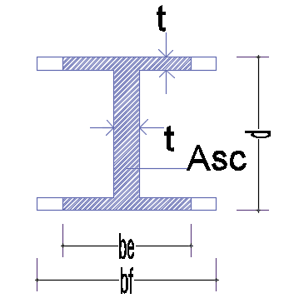
Partially Encased Composite Column (PEC)
Tie bar cover ≥ 30 𝑚𝑚
Out of straightness of the flanges < 0.005 𝑆
Clear height to width ratio of the column ≤ 14
Axial compressive strength:
Cr= Ase Fy + 0.85 Ac fcu + Asr Fyr
Ase = (d-2t+2be)t
𝑏𝑓
Ase
b_{e} = ≤ bf n = 1.5
1
𝑛
1 + 𝜆^{2𝑛}
𝑝
12 × 1− ωs² 𝐹𝑦
Π² Es k
𝜆p = ^{b}
ω = 0.3
𝑡
K =
0.9
₂ + 0.2
S
𝑏𝑓
2
+ 0.75
0.5 ≤
S
𝑏𝑓
≤1
S
𝑏𝑓
Tensile strength:
Pn = As Fy + Asr Fyr

Slide 6
Partially Encased Composite Column (PEC)
Load Moment Interaction Diagram:
𝐼 𝑀𝑦
* Section modulus = =
𝑐 σ𝑦
plastic moment M_{p} M_{y}
* Shape factor =
=
𝑦𝑖𝑒𝑙𝑑 𝑚𝑜𝑚𝑒𝑛𝑡
Classification of section of local buckling (CFT-column)
 | Width to Thickness ratio | λp compact/noncompact | λr Non compact/slender | Maximum Permitted
Rectangular | b/t | 𝐸 2 ⋅ 26 _{𝐹𝑦} | 𝐸 3 𝐹𝑦 | 𝐸 5 𝐹𝑦
Circular | d/t | 0 ⋅ 15𝐸 𝐹𝑦 | 0 ⋅ 19𝐸 𝐹𝑦 | 0 ⋅ 31𝐸 𝐹𝑦

Slide 7
Partially Encased Composite Column (PEC)
Es
For compact section , Pno = Fy As + C₂ fc’( Ac + Asr _{𝐸𝑐}) = Pp
𝑃_{𝑃} − 𝑝_{𝑦}
For noncompact section , Pno = Pp-
𝜆 − 𝜆𝑝
2
𝜆𝑟 − 𝜆_{𝑃}
2
Es
where, Py = Fy As + 0.7 fc’( Ac + Asr )
𝐸𝑐
Es
For slender Section, Pno = Fcr As + 0.7 fc’ ( Ac + Asr )
𝐸𝑐
9𝐸𝑠
For Rectangular section, Fcr =
𝑏
𝑡
2
For Round section Fcr =
0.72Fy
𝐷 Fy
0.2
( _{𝑡} ) × ( )
𝐸𝑠

