Slide 1
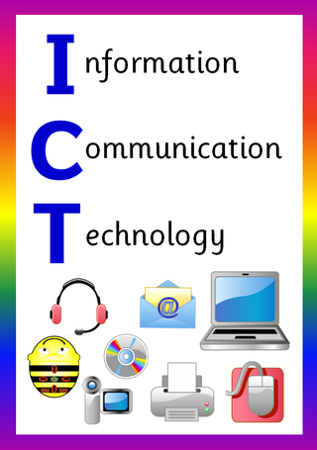
ICT in Business

Slide 2
.
.

Slide 3
Learning Objectives
In this chapter you will learn about:
Basic Concept of Storage Devices
Types of Storage Devices
Difference between RAM & ROM
Explain How Data is Stored and Organized in Magnetic Storage Devices
Different types of Magnetic Storage Devices
Different types of Optical Storage Devices
Different types of Solid State Storage Devices (SSD)

Slide 4
Storage Devices
A storage device is hardware that is used for storing, porting, or extracting data files
It can be used either internally or externally to a computer system, server or any comparable computing device to hold information.
It can also store information/data both temporarily and permanently.
Without a storage device, a computer would not be able to run or even boot up
It involves two processes:
Writing, or recording, the data so it can be found later for use.
Reading the stored data, then transferring it into the computer's memory,

Slide 5
Types of Storage Devices
Primary Storage Devices
Secondary Storage Devices:

Slide 6
Primary Storage Devices
It is also known as internal memory and main memory.
This is a section of the CPU that holds program instructions, input data, and intermediate results.
It is generally smaller in size.
RAM (Random Access Memory) and ROM (Read Only Memory) are examples of primary storage.

Slide 7
RAM
Stands for Random Access Memory.
RAM is a volatile memory which could store the data as long as the power is supplied.
With the help of RAM, computers can perform multiple tasks like loading applications, browsing the web, editing a spreadsheet, experiencing the newest game, etc.
It ranges from 1GB – 32GB/64GB depending upon the specifications

Slide 8
RAM
The most common types of RAM are;
DRAM -Dynamic RAM must be continuously refreshed, or otherwise, all contents are lost.
SRAM – Static RAM is faster, needs less power but is more expensive. However, it does need to be refreshed like DRAM.
Synchronous Dynamic RAM (SDRAM) – This type of RAM can run at very high clock speeds.

Slide 9
ROM
Stands for Read-Only Memory.
ROM is a non-volatile memory which could retain the data even when power is turned off.
ROM stores instructions that are used to start a computer.
ROM chips can only store few megabytes (MB) of data, which ranges between 4 and 8 MB per ROM chip.

Slide 10
ROM
The most common types of ROM are;
PROM: The full form of PROM is Programmable Read-Only memory. This type of ROM is written or programmed using a particular device.
EPROM: The full form of EPROM is Erasable Programmable Read-only memory. It stores instructions, but you can erase only by exposing the memory to ultraviolet light.
EEPROM stands for electrically Erasable Programmable Read-Only Memory. It stores and deletes instructions on a special circuit.
Mask ROM is a full form of MROM is a type of read-only memory (ROM) whose contents can be programmed only by an integrated circuit manufacturer.

Slide 11
Differences between RAM and ROM
RAM | ROM
RAM is a volatile memory which could store the data as long as the power is supplied. | ROM is a non-volatile memory which could retain the data even when power is turned off.
Data stored in RAM can be retrieved and altered. | Data stored in ROM can only be read.
It is a high-speed memory. | It is much slower than the RAM.
The CPU can access the data stored on it. | The CPU cannot access the data stored on it unless the data is stored in RAM.
The price of RAM is quite high. | The price of ROM is comparatively low.

Slide 12
Secondary Storage Devices
The primary storage of a computer has some limitations;
Limited capacity
Volatile
Secondary storage is used in a computer system to overcome the limitations of primary storage.
It is used to store large volumes of data on a permanent basis.
It is also known as "auxiliary memory.

Slide 13
Types of Secondary Storage Devices
Secondary storage devices are generally separated into three types:
Magnetic Storage Devices
Optical Storage Devices
Solid State Storage Devices (SSD)

Slide 14
Magnetic Storage Devices
Most common form of storage
Data is stored with using magnetized medium.
Can be performed read/write activities very easily.
Have huge capacities for storing data that it’s more attractive point
These storage devices are not more costly but their data accessing power is slow.

Slide 15
Data Storage and Retrieval in Magnetic Storage Devices
Media is covered with iron oxide
Read/write head is a magnet
Magnet writes charges on the media
Positive charge is a 1
Negative charge is a 0
Magnet reads charges
Drive converts charges into binary

Slide 16
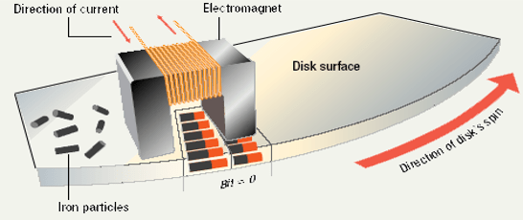

Slide 17
Storage Capacity Calculation
Formula;
Storage capacity of a disk= Total number of surfaces * Number of tracks per surface * Number of sectors per track * Number of bytes per sector
Problem
Consider a disk pack with the following specifications- 16 surfaces, 128 tracks per surface, 256 sectors per track and 512 bytes per sector. What is the capacity of disk pack?

Slide 18
Storage Capacity Calculation
Solution;
Given,
Number of surfaces = 16
Number of tracks per surface = 128
Number of sectors per track = 256
Number of bytes per sector = 512 bytes
We Know,
Capacity of disk pack
= Total number of surfaces x Number of tracks per surface x Number of sectors per track x Number of bytes per sector
= 16 x 128 x 256 x 512 bytes
= 268435456 Bytes
=268435456/ (1024*1024) MB
= 256 MB

Slide 19
Data Organization in Magnetic Storage Devices
Disks must be formatted before use
Format draws tracks on the disk
Uses magnet to access data
Tracks is divided into sectors

Slide 20
Data Organization in Magnetic Storage Devices
Data is organized on the disk in the form of tracks and sectors, where tracks are the circular divisions of the disk. Tracks are further divided into sectors that contain blocks of data. All read and write operations on the magnetic disk are performed on the sectors. The floating heads require very precise control to read/write data due to the proximity of the tracks.

Slide 21
Types of Magnetic Storage Devices
There are different types of magnetic storage device;
Hard Drive
Floppy Disk
Magnetic Tape

Slide 22
Hard Drive
Hard drive is also known as the “Hard Disk Drive”
It is capable to store data more than 200 GB.
Hard drive contains the stack of disks which are mounted internally with solid encasement, and all data is stored on that disk
In Hard Drive, all data does not discard after getting to discontinue power supply.

Slide 23
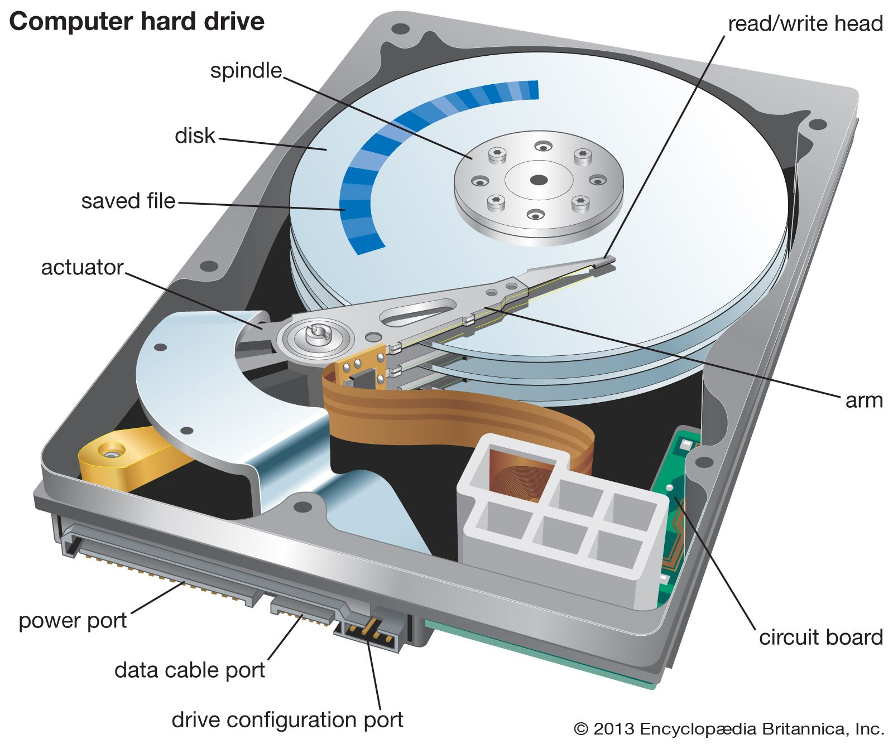

Slide 24
Floppy Disk
Floppy disk was introduced by IBM, in 1969.
Floppy disk is also called the “Floppy Diskette”.
In the floppy disk, iron oxide was used to coat internally for storing data in magnetic form, just similar to hard disk
But, now floppy disk is completely obsolete.

Slide 25
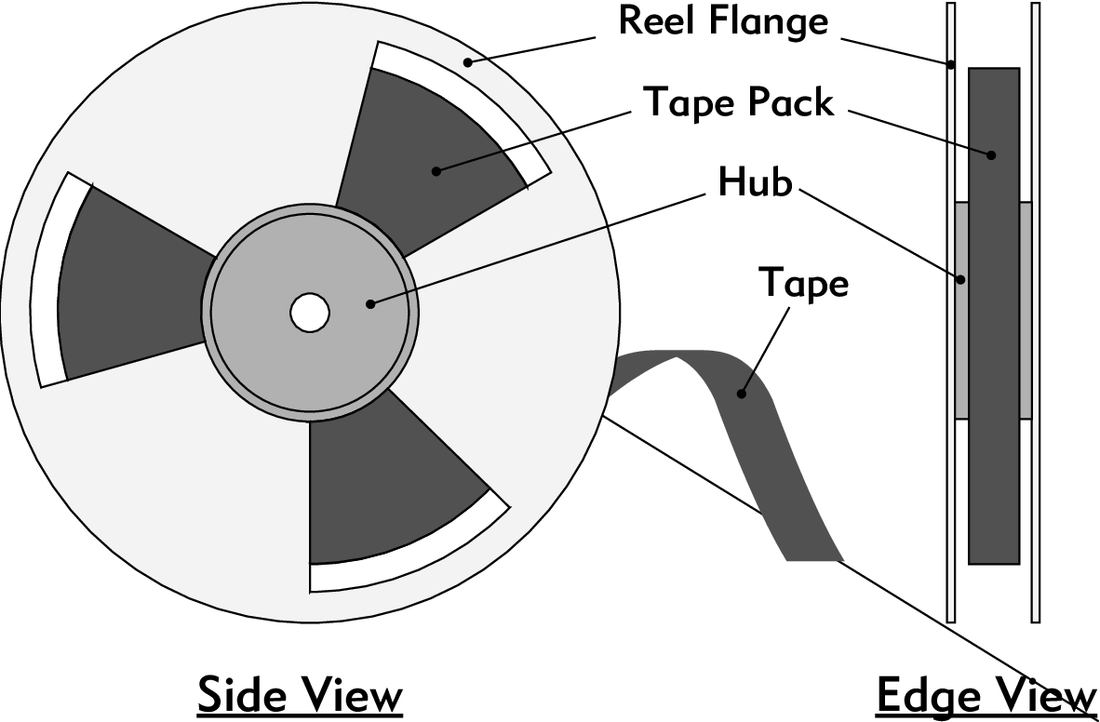
Magnetic Tape
Magnetic Tape was introduced by Fritz Pfleumer in 1928.
Primary objective of magnetic tape of using was recording voice.
It is traditional technology, but later it was replaced by CD and DVD.

Slide 26
Advantages of Magnetic Storage Devices
Low cost per gigabyte - magnetic tape is the cheapest, but hard disk is very low as well.
Huge capacity, offers up to several terabytes per device.
Magnetic tape can hold its data for up to thirty years in the correct environment.

Slide 27
Disadvantages of Magnetic Storage Devices
Slow read /write compared to new SSD drives.
Need a special piece of equipment to record and read the data on the tape
Easily broken if dropped
The data may be corrupted if the tape is placed near a strong magnetic field e.g. a large speaker or magnet
High energy uses as it uses moving parts (lower battery life on laptops)
Not as portable as other technologies. But external hard disks are commonly available, but they need to be treated carefully

Slide 28
Optical Storage Devices
Optical storage is also known as “Optical Media” or “Optical Memory” or “Optical Medium.
It allows all read and write activities which are performed by laser beam.
Following are some optical storage devices:
CD-ROM
DVD-ROM
Blu-Ray
Recordable Optical Devices (CD-R, CD-RW, DVD-R, DVD-RW, DVD-RAM)

Slide 29
CD-ROM
CD-ROM stands for “Compact Disc Read Only Memory”.
These types of disc can capable to store almost 650/700 MB of digital data.
These data can’t discard by mistaken.

Slide 30
DVD-ROM
DVD-ROM stands for “Digital Versatile Disc – Read Only Memory”.
DVD-ROM discs can store data up to 4.7 GB.
Are used to store ultra-quality video.

Slide 31
Blu-Ray
It is just like CD and DVD but the storage capacity of Blu-ray is up to 25GB.
To run a Blu-ray disc, need a separate Blu-ray reader.
It is designed to supersede the DVD format, and capable of storing several hours of high-definition video (HDTV 720p and 1080p).
The main application of Blu-ray is as a medium for video material such as feature films and for the physical distribution of video games.

Slide 32
Recordable Optical Devices
CD-R: It stands for Compact Disc read-only. In this type of CD, once the data is written cannot be erased. It is read-only.
CD-RW: It stands for Compact Disc read Write. In this type of CD, you can easily write or erase data multiple times.
DVD-R: It stands for Digital Versatile Disc read-only. In this type of DVD, once the data is written cannot be erased. It is read-only. It is generally used to write movies, etc.
DVD-RW: It stands for Digital Versatile Disc read Write. In this type of DVD, you can easily write or erase data multiple times.
DVD-RAM: DVD-RAM stands for “DVD-Random Access Memory”, and it is able to Re-Write data. DVD-RAM are available in market like as floppy-disc style case.

Slide 33
Advantages of Optical Storage Devices
It is capable to store vast amount of data.
Affordable price
RW optical storage can be Re-used.
Optical disks offer very high level of Stability.
Despite their size, optical disks are still portable.
It is not subjected to wear and no power failures can cause data losses, which makes it more durable and last for many years.

Slide 34
Disadvantages of Optical Storage Devices
Some traditional PCs are not able to read these disks.
It is getting trouble while recycling.
Optical storage are more vulnerable to loss and theft due to their size.
Optical disks are susceptible to scratching because they are not protected by any plastic casings, which makes the disk unreadable.

Slide 35
Solid-State Storage Devices (SSD)
Do not use disks or tapes and have no moving parts.
Solid-state storage is neither magnetic nor optical. Instead, it relies on integrated circuits to hold data.
Solid-state storage devices have a big advantage in terms of speed over standard storage devices.
Flash memory and Smart Cards are examples of solid state storage devices.

Slide 36
Flash Memory
Flash memory is used to store data in pen drives, SD cards, memory cards, and multimedia cards.
Pen Drive: It is also known as a USB flash drive that includes flash memory with an integrated USB interface. We can directly connect these devices to our computers and laptops and read/write data into them in a much faster and efficient way. These devices are very portable. It ranges from 1GB to 256GB generally.

Slide 37
Flash Memory
SD Card: It is known as a Secure Digital Card. It is generally used with electronic devices like phones, digital cameras, etc. to store larger data. It is portable and the size of the SD card is also small so that it can easily fit into electronic devices. It is available in different sizes like 2GB, 4GB, 8GB, etc.

Slide 38
Flash Memory
Memory Card: It is generally used in digital cameras, printers, game consoles, etc. It is also used to store large amounts of data and is available in different sizes. To run a memory card on a computer you require a separate memory card reader.
Multimedia Card: It is also known as MMC. It is an integrated circuit that is generally used in-car radios, digital cameras, etc. It is an external device to store data/information.

Slide 39
Smart Cards
Smart cards contain a small chip that stores data
Some smart cards, called intelligent smart cards, also contain their own tiny microprocessors, and they function like a computer.
It may be used to store digital cash that can be used to make purchases in stores or online.
Smart cards could store a person's entire medical history, or they could be used as a source of secure ID.
Smart cards are finding many purposes---both current and future.
For example, large hotels now issue guests a smart card instead of a key; the card not only allows guests to access their room, but it also allows them to charge other services and expenses to the card as well.

Slide 40
Advantages of Solid-State Storage Devices (SSD)
It performs fast operations because there are no mechanical parts in SSDs.
Due to no mechanical parts, it has a lower chance of damage from vibrations, drops, accidents, and other wear and tear, which makes it more durable.
HDDs have a size restriction, however SSDs don't.
When the SSDs are in operation, they produce no noise at all because there are no metal platters or read/write arms in them. The noise value of SSDs has been found to be 0 decibels.
Their lightweight components make them easier to carry.
They don’t require as much power to operate as hard drives do, which results in a longer battery life.

Slide 41
Disadvantages of Solid-State Storage Devices (SSD)
Consumer-grade SSDs are more expensive than consumer-grade hard drives.
Solid state devices are highly expensive and are sold with a hefty price tag unlike conventional HDDs.
The memory chips in an SSD have a limited number of write cycles, which can lead to unrecoverable data loss.
The data recovery process is difficult and takes so long, sometimes impossible.

Slide 42
Cloud and Virtual Storage
Nowadays, secondary memory has been upgraded to virtual or cloud storage devices.
We can store our files and other stuff in the cloud and the data is stored for as long as we pay for the cloud storage.
There are many companies that provide cloud services largely Google, Amazon, Microsoft, etc.
Though it is actually being stored in a physical device located in the data centers of the service provider, the user doesn’t interact with the physical device and its maintenance.
Google Drive, Microsoft One Drive, Mega, Dropbox, Amazon AWS etc. are the example of cloud storage.

Slide 43
End of Chapter
.

