Slide 1
Skeletal system

Slide 2
Introduction
The skeletal system consists of skeleton that is the bony framework of the body providing support and protection for some of the soft organs, acting as levers in movement and providing surfaces for the attachment of the skeletal muscle.
This system has 206 bones and associated cartilage, tendons, and ligaments.
A joint is a place of union between two or more bones that may be movable or immovable.

Slide 3
Functions of Bone and Skeletal System
Support
Protection
Assistance in Movement
Mineral Homeostasis
Blood Cell Production
Triglyceride Storage

Slide 4
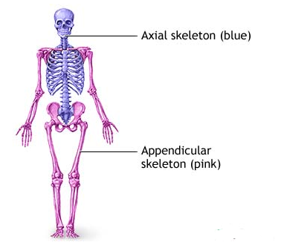
Parts of skeletal system
There are two parts of the skeletal system:
1.Axial skeleton:
consists of the bones that form the axis of the body.
The axial skeleton includes the skull, the vertebral column and the ribs.
2.Appendicular skeleton:
consists of the bones of the upper and lower extremities and the pectoral and pelvic girdles.

Slide 5
Bones of Axial skeleton(80 bones)
22 bones in skull: Cranial Bones (8) Parietal (2) Temporal (2) Frontal (1) Occipital (1) Ethmoid (1) Sphenoid (1) | 6 in middle ears (Auditory ossicles) Malleus (2) Incus (2) Stapes (2) 1 hyoid bone 26 in vertebral column: Cervical vertebrae (7) Thoracic vertebrae (12) Lumbar vertebrae (5) Sacrum (1) Coccyx (1) 25 in thoracic cage (Rib cage): Sternum (1), Ribs (24)
Facial Bones (14) vomer (1) maxilla (2), mandible (1) zygomatic (2) palatine (2), lacrimal (2) nasal (2), inferior nasal conchae (2)

Slide 6
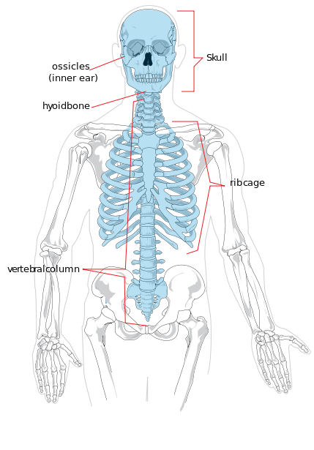
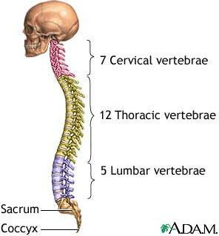
Axial skeleton

Slide 7
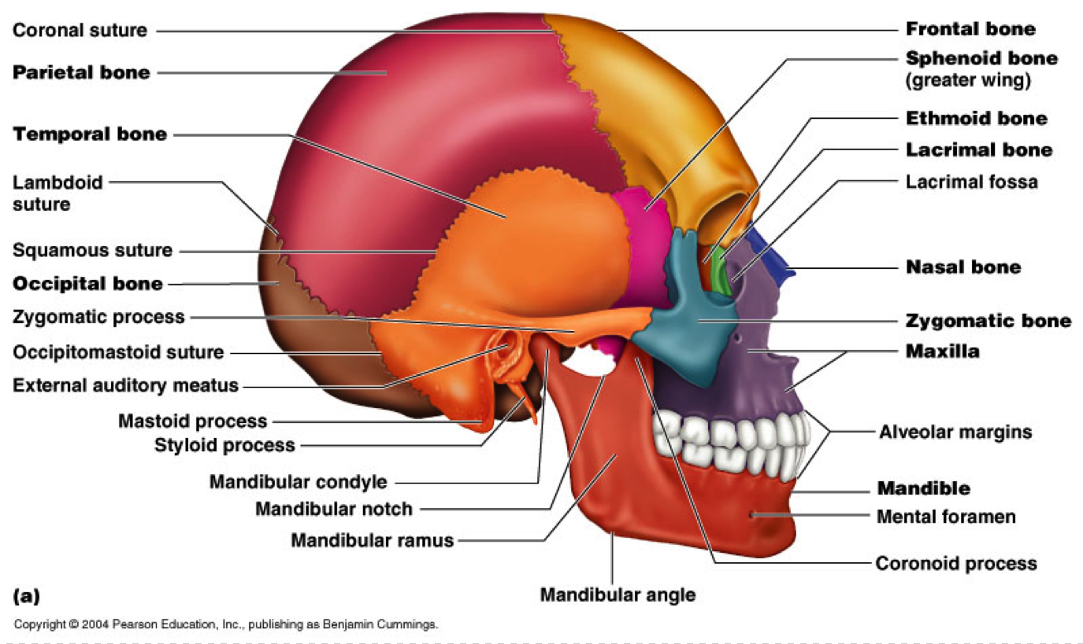
Skull

Slide 8
Appendicular skeleton (126 bones)
Upper Limb (64 bones) | Lower Limb (62 bones)
Pectoral Girdle : 4 bones Scapula (2) Clavicle (2) Arm & Forearm Humerus (2) Ulna(2) , Radius(2) Hands :54 bones Carpal (16) Metacarpal(10) Proximal phalanges (10) Middle phalanges (8), Distal phalanges (10). | Pelvic girdle : 2 bones Coxae (2) 3 fused bones: ilium, ischium, and pubis. Thigh & leg : 8 bones Femur (2) , Patella (2) (knee) Tibia (2), Fibula (2) Feet and ankles : 52 bones Tarsals (14) (ankle) Metatarsals (10) Proximal phalanges (10) middle phalanges (8) Distal phalanges (10).

Slide 9
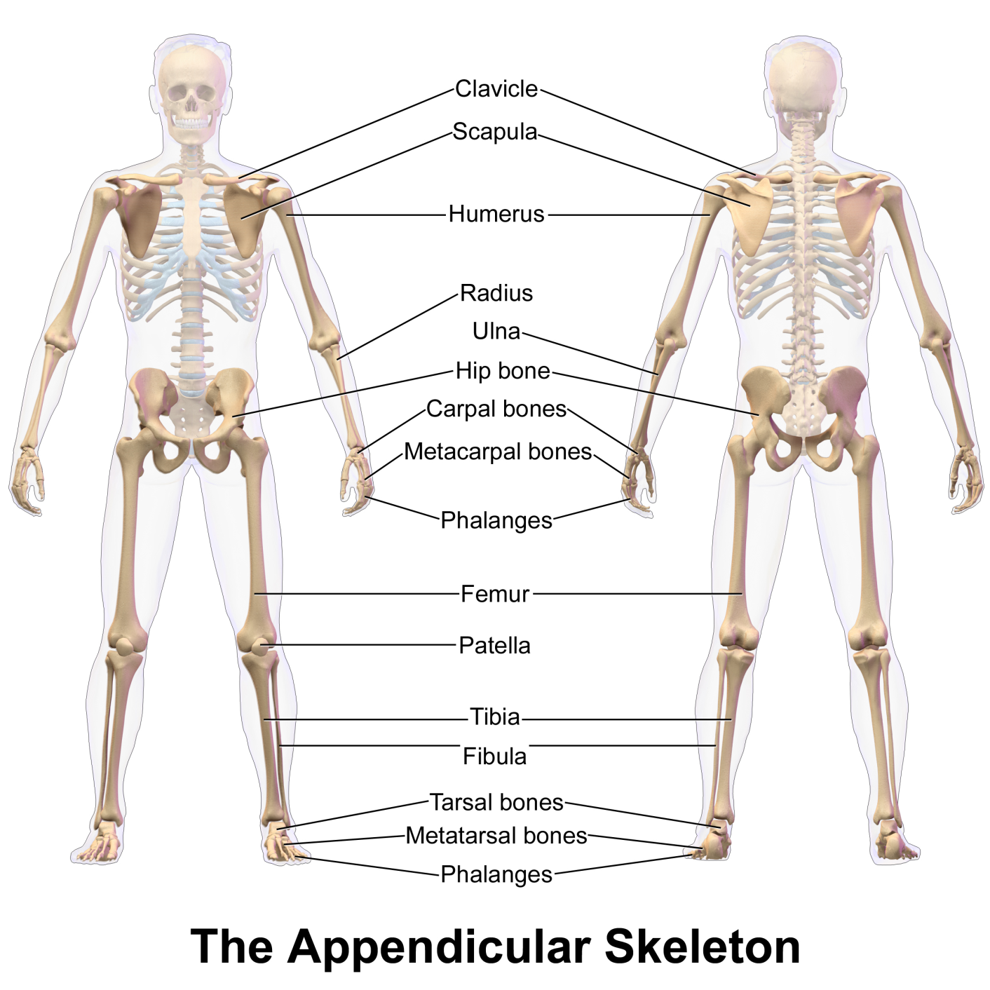
Appendicular skeleton

Slide 10
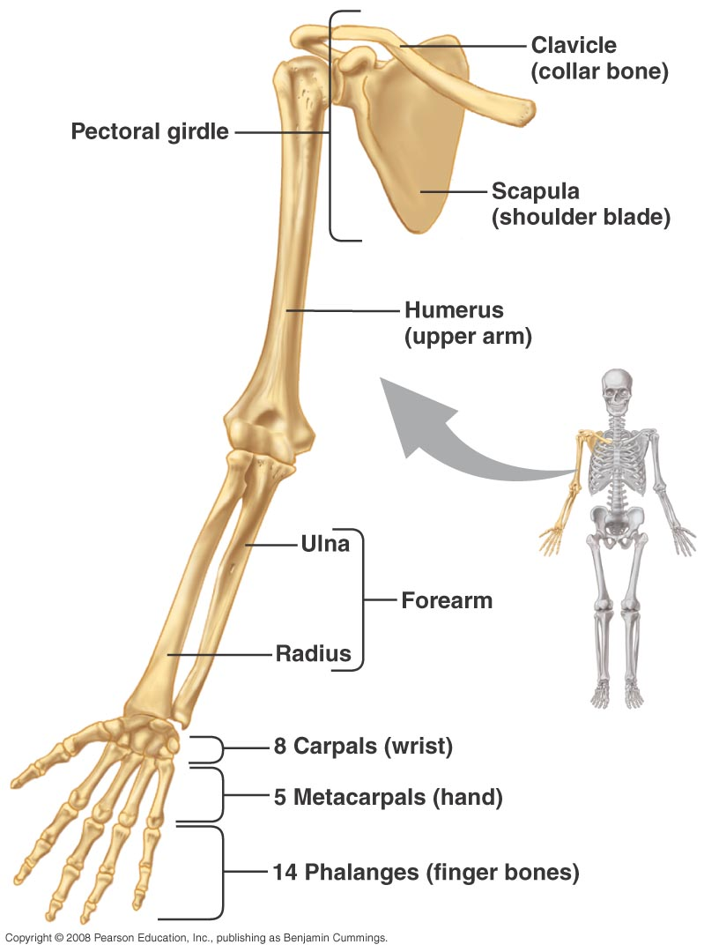
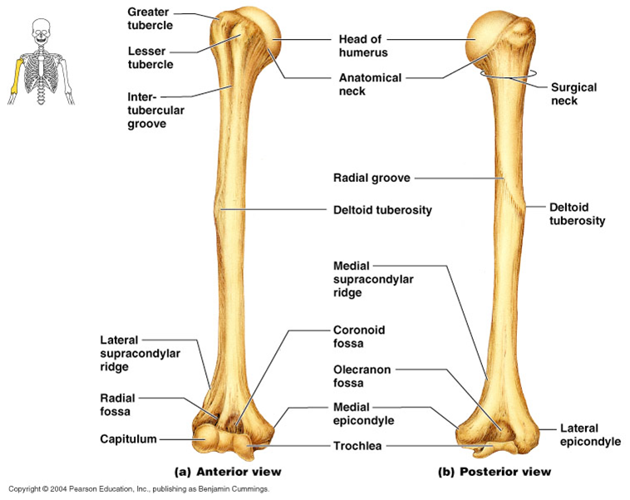
Upper Limb

Slide 11
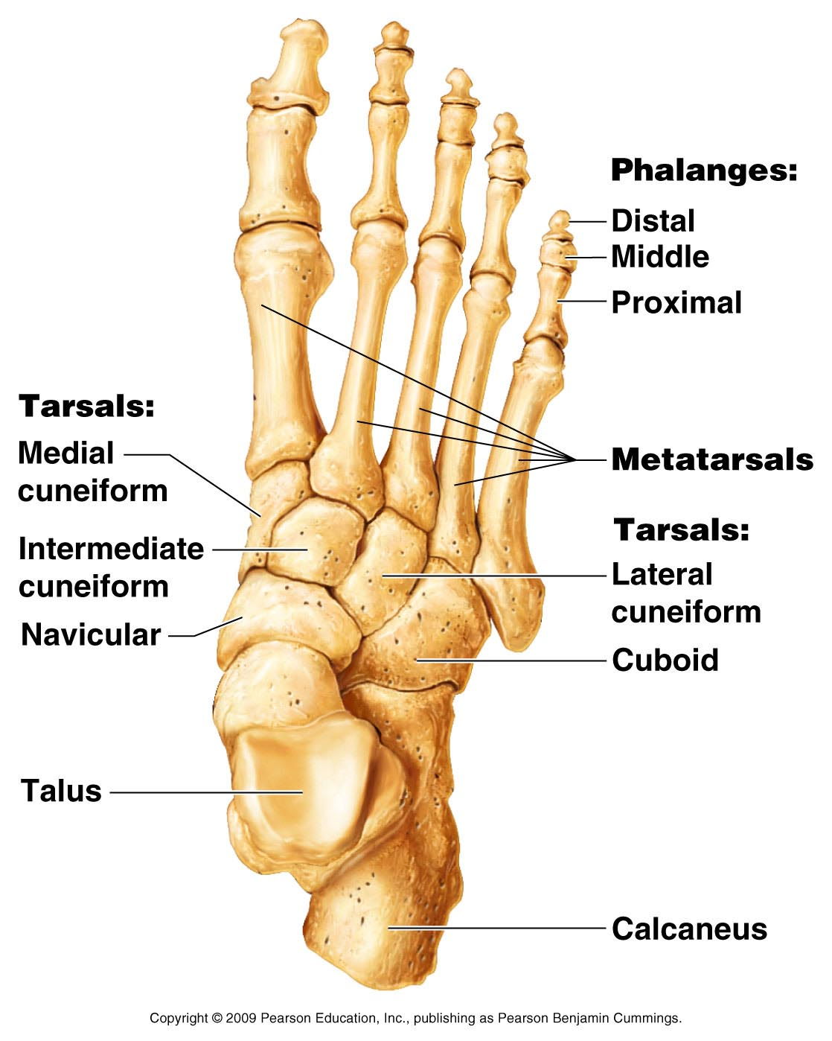
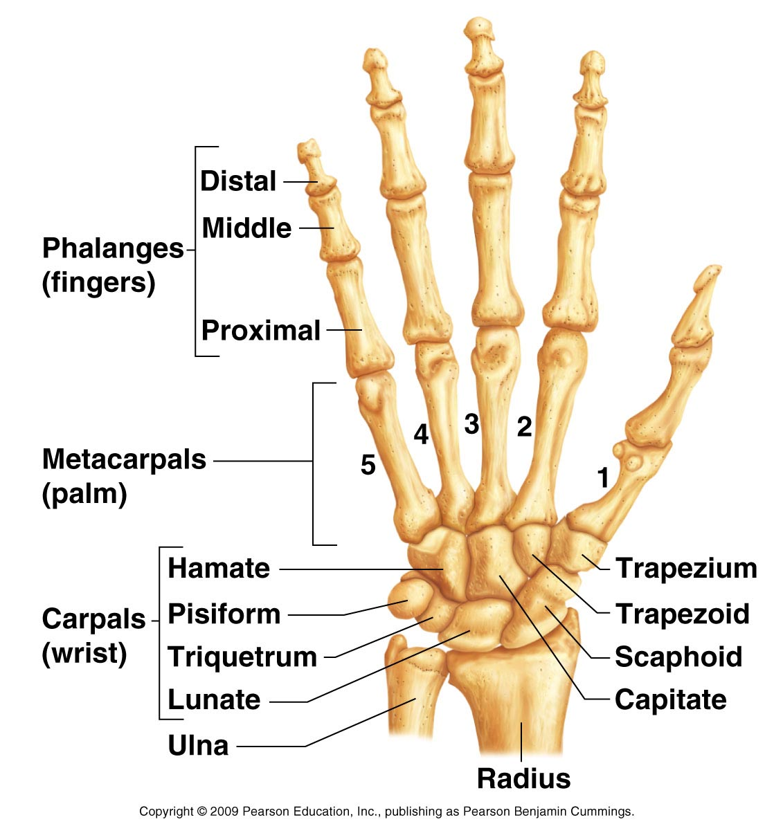
Hand & Foot

Slide 12
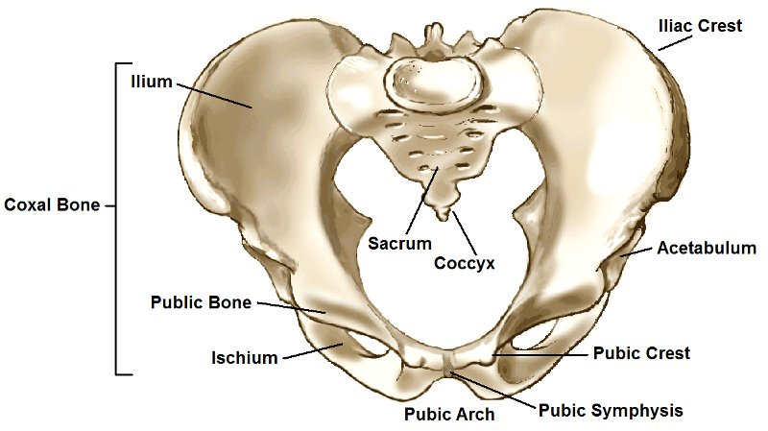
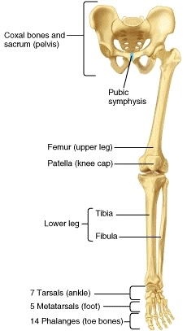
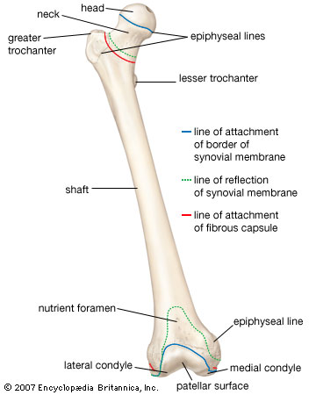
Lower Limb

Slide 13
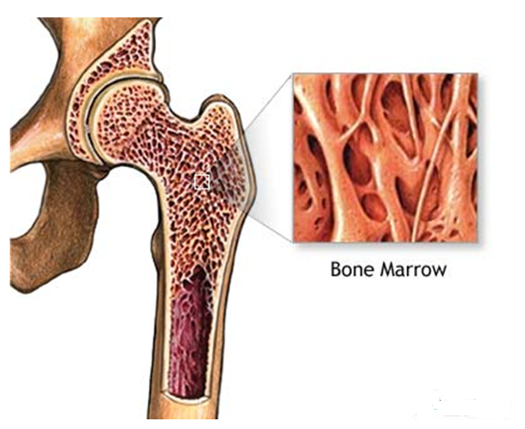
Bone marrow
Fig: Bone marrow
Within the bones there are two types of bone marrow: red marrow and yellow marrow.
The yellow marrow has fatty connective tissue and fills the marrow cavity.
The red marrow of some bones is an important site for blood cell production. Here all erythrocytes (red blood cells), platelets, and most leukocytes (white blood cells) form in adults.

Slide 14
Joints
-The sites where two skeletal elements come together
-The site where two or more bones come together , whether there is movement between them or not
Synovial joints
Shoulder, Hip joints ( Ball & Socket)
Intertarsal joints (Plane)
Interphalangeal joints (Hinge)
etc.
Solid joints
Sutures of Skull (Fibrous)
Pubic symohysis (Cartilaginous)

Slide 15
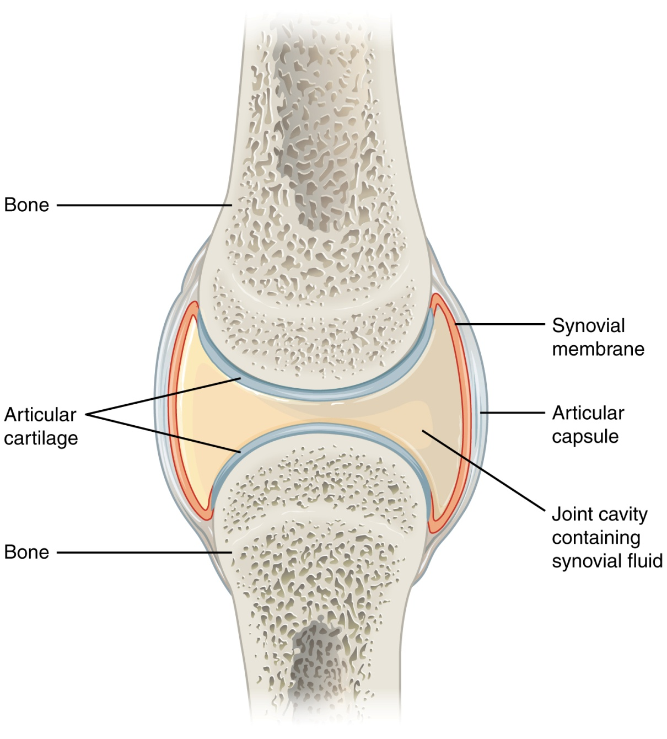
Synovial Joint

Slide 16
Summery………….
Skeletal system definition
Function of Skeletal System
Number of bones and main parts of skeletal system
Bones of Axial skeleton
Skull
Question: Write down the functions of Skull.

Slide 17
Summery………………..
Bones of appendicular skeleton
Bones of upper & lower limb
Bone marrow
Joints and its classification (Ref. Grays Anatomy)
Diagram of
Humerus
Femur
Pelvic girdle
Hand & Foot
Synovial Joint
** Characteristics & Functions of Pelvis.

