Slide 1
Daffodil International University Dept. of CSE Information Security
Lecture 1
Information Security and It’s Elements

Slide 2
History of information security
1968, Maurice Wilkes discusses password security in Time-Sharing Computer Systems.
1975, The Federal Information Processing Standards (FIPS) examines Digital Encryption Standard (DES) in the Federal Register.
1979, Dennis Ritchie publishes “On the Security of UNIX” and “Protection of Data File Contents,” discussing secure user IDs and secure group IDs, and the problems inherent in the systems.
Today, the Internet brings millions of unsecured computer networks into continuous communication with each other.

Slide 3
What is security?
In general, security is “the quality or state of being secure—to be free from danger.”
Information Security is a comprehensive study of the principles and practices of computer system security including operating system security, network security, software security and web security.
A successful organization should have the following multiple layers of security –
-Physical security
-Personnel security
-Operations security
-Communications security
-Network security
-Information security

Slide 4
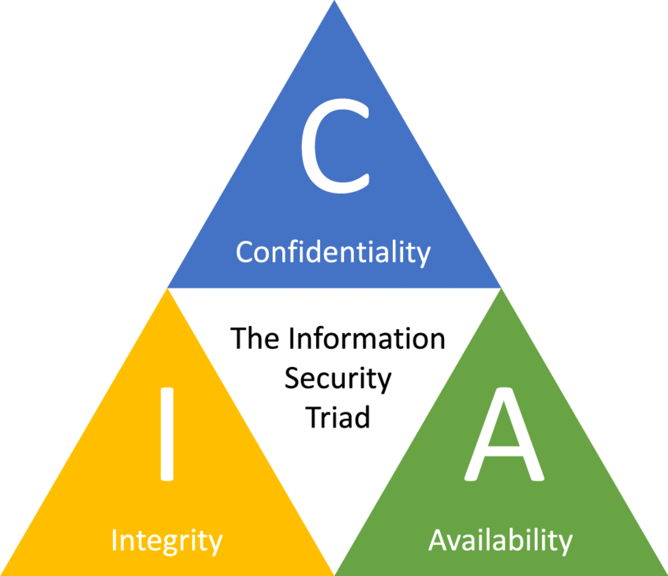
Principles of Security (CIA Triad)
1. Confidentiality
-Education of information custodians and end users
-Information classification
-Application of general security policies
-Secure document storage
2. Integrity
3. Availability

Slide 5
Five major Elements (Confidentiality, Integrity, Availability, Authenticity and Non-Repudiation)

Slide 6
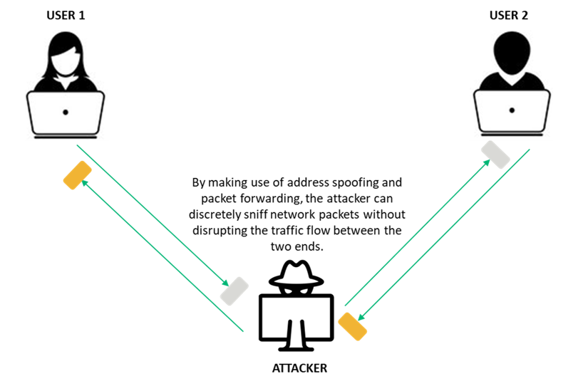
“Attack” in Information Security
Attacks = Motive (Goal) + Method + Vulnerability
An attack is an information security
threat that involves an attempt to
obtain, alter, destroy, remove,
implant or reveal information
without authorized access
or permission.

Slide 7
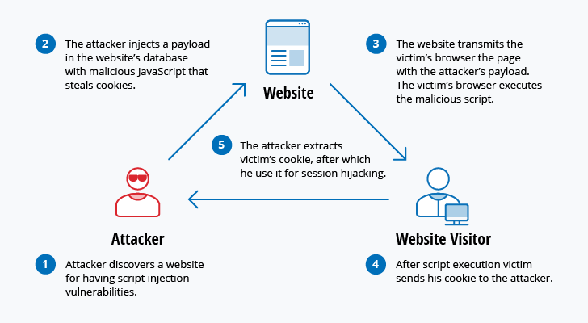

Slide 8
Classification of Attack

Slide 9
Information Warfare

Slide 10
Examples of information warfare weapons include viruses, worms, Trojan horses, logic bombs, trap doors, nanomachine and microbes, electronic jamming and penetration exploits and tools.
Martin Libicki divided information warfare or InfoWar into the following categories-
Command and control warfare (C2 warfare)
Intelligence-based warfare
Electronic warfare
Psychological warfare
Hacker warfare
Economic warfare
Cyberwarfare

Slide 11
Thank You

